Slide 1
CRICKETVISION
AI-Powered Cricket Performance Analytics & Biomechanics Platform
First Evaluation Presentation | Master of Computer Applications (MCA) Mini-Project
MINI PROJECT
MCA 2nd Year
LEAD DEVELOPER
MCA Student
REGISTRATION NO.
KTE26MCA-CRIC
PROJECT GUIDE
MCA Project Guide

Slide 2
Introduction & Executive Overview
OVERVIEW
Domain Context & Core Vision
Key System Portals
• Domain Context: Modern professional cricket relies heavily on quantitative data analytics, computer vision biomechanics tracking, and predictive simulation engines.
• Core Value Proposition: CricketVision bridges raw match scorecards with actionable tactical insights, biomechanical body tracking, and AI-driven match simulation.
• Centralized Platform: Provides one unified hub for Head Coaches, Performance Analysts, and Individual Players.
• Accessible Technology: Built as a full-stack MERN web application replacing expensive proprietary hardware.
• Head Coach Portal: Squad roster management, fatigue level alerts, Playing XI Optimizer, live database CRUD, and AI coaching assistant.
• Player Dashboard: Personalized performance metrics, 360° SVG Wagon Wheel, pitch length heatmaps, and AI drill suggestions.
• Analyst Suite: Interactive Match Simulator with ball-by-ball win probability lines, Next Match Predictor, and Video Analyzer.
• Central Data Store: MongoDB database pre-seeded with 100+ verified IPL & International player profiles.
CricketVision — AI Cricket Performance Analytics Platform
02

Slide 3
03
Requirement Analysis — Existing System
Understanding current cricket coaching practices and their operational limitations

Slide 4
Literature Review
REQUIREMENT ANALYSIS
Domain / Area | Authors & Source | Year | Key Takeaways & Reference
Computer Vision Pose Tracking | Cao et al., IEEE TPAMI | 2026 | Referred this to gain idea about pose estimation skeleton tracking for bowling action & release angle metrics.
Stochastic Match Simulation | Scarf & Akhtar, JSSSE | 2021 | Referred this to know how stochastic match outcome prediction works and what pitch/weather modifiers to apply.
CricketVision — AI Cricket Performance Analytics Platform
04

Slide 5
Gap Identified in Existing Systems
REQUIREMENT ANALYSIS
1. Lack of Workload Tracking
2. Prohibitive System Cost
• Traditional scorecards focus on historical runs/wickets, ignoring player fatigue, injury risk, and phase-wise performance.
• Commercial tracking platforms (Hawk-Eye) cost $50,000+ per match, making them inaccessible for domestic and academy teams.
3. Subjective Video Review
4. Fragmented Platform Tools
• Standard coaching relies on qualitative video observation without quantitative joint release angles or stride metrics.
• Existing tools separate player stats, match simulation, and coaching recommendations into isolated, non-communicating systems.
CricketVision — AI Cricket Performance Analytics Platform
05

Slide 6
Proposed System Architecture
REQUIREMENT ANALYSIS
MERN Full-Stack Engine
100+ Player Data Store
Multi-Role Access Suite
• Architecture: Node.js & Express REST backend coupled with React 18 SPA.
• Data Persistence: MongoDB local database instance managed via Mongoose ODM.
• Performance: Vite build tool ensuring fast, reactive UI rendering.
• Pre-Seeded Dataset: Populated with 100+ verified IPL & International player profiles.
• Phase Statistics: Includes Powerplay, Middle, and Death overs metrics.
• Biomechanics Summary: Pre-configured release angles, stride lengths, and clutch ratings.
• Head Coach: Squad fatigue oversight, XI team builder, live player database CRUD.
• Player Portal: Personalized dashboard, SVG Wagon Wheel, pitch heatmaps, drill advice.
• Analyst Suite: Match Win Simulator, Next Match Predictor, Video Analyzer.
CricketVision — AI Cricket Performance Analytics Platform
06

Slide 7
Software & Hardware Requirements
REQUIREMENTS
Software Specifications
Hardware Specifications
• Operating System: Windows 10/11 / macOS / Linux
• Runtime & Server: Node.js (v18.0+), Express.js framework
• Database Engine: MongoDB Community Server with Mongoose ODM (v8.24.2)
• Frontend Stack: React 18, Vite SPA, Tailwind CSS v4
• Data Visualizers: Recharts, SVG graphics, Lucide React Icons
• Development Tools: VS Code, Git version control, Postman API client
• Processor (CPU): Dual-Core Intel Core i5 / AMD Ryzen 5 or higher (2.4 GHz)
• System RAM: Minimum 8 GB (16 GB Recommended for video processing)
• Disk Storage: Minimum 10 GB available SSD storage
• Display Resolution: 1920 x 1080 Full HD for multi-chart dashboard view
• Camera/Video Source: Standard webcam or 1080p MP4 video file input
CricketVision — AI Cricket Performance Analytics Platform
07

Slide 8
Formal Problem Statement
PROBLEM
"Modern cricket coaching and match analysis suffer from severe data fragmentation, reliance on subjective video review, and a lack of integrated biomechanical feedback. Existing commercial tracking platforms are cost-prohibitive for domestic and developmental squads.
There is an urgent requirement for an accessible, unified full-stack analytics platform that combines real-time squad fatigue monitoring, phase-wise player performance tracking, interactive match win-probability simulation, and computer-vision pose analysis within a role-secured MERN web application."
CricketVision — AI Cricket Performance Analytics Platform
08

Slide 9
Project Objectives
OBJECTIVES
1. Centralized MongoDB Engine
Design and deploy a MongoDB database populated with 100+ verified IPL & International player profiles with phase stats and clutch ratings.
2. Role-Based Multi-Portal UI
Develop secure, tailored user interfaces for Head Coaches (roster CRUD & AI assistant), Players (personalized dashboard), and Analysts.
3. Visual Analytics & Biomechanics
Implement custom SVG 360° Pitch & Wagon Wheel visualizers, Recharts Radar charts, and pose-estimation video analysis.
4. Tactical Match Simulator
Build a Monte-Carlo style match simulation engine incorporating pitch conditions and weather parameters to calculate win probabilities.
CricketVision — AI Cricket Performance Analytics Platform
09

Slide 10
Scope & Relevance
SCOPE
Coach Scope
Player Scope
Analyst Scope
• Squad Oversight: Fatigue index alerts and injury risk monitoring.
• Team XI Builder: Optimized XI balance calculation.
• Live Player CRUD: Direct MongoDB database management modal.
• Personal Hub: Individualized form history and phase stats.
• Wagon Wheel SVG: 360-degree shot distribution breakdown.
• Video & Drills: Pose tracking review and AI drill recommendations.
• Match Simulator: Ball-by-ball win-probability line curves.
• Predictor Engine: Head-to-head matchup matrices.
• Radar Comparison: Multi-attribute player comparison charts.
CricketVision — AI Cricket Performance Analytics Platform
10

Slide 11
11
Development Methodology — Scrum Overview
Iterative full-stack development with short, testable increments

Slide 12
Scrum Roles, Artifacts & Ceremonies
METHODOLOGY
Product Goal
Product Backlog
• Build a reliable cricket performance analytics platform connecting coaches, analysts, and players in one web app.
• Auth, Database seeding, Coach dashboard, Player portal, Wagon wheel SVG, Match simulator, and AI coach.
Sprint Backlog & Increment
Review & Retrospective
• A selected set of features completed and integrated into the production-ready application at the end of each sprint.
• Demonstrate completed work to MCA project guide, collect feedback, and optimize performance for the next sprint.
CricketVision — AI Cricket Performance Analytics Platform
12

Slide 13
Sprint Workflow Used for This Project
METHODOLOGY
Step 1
Select user story from backlog
Step 2
Review DB & API requirements
Step 3
Build Mongoose model & routes
Step 4
Build React UI components
Step 5
Connect frontend/backend via Axios
Step 6
Test feature end-to-end
Step 7
Commit completed code to Git
CricketVision — AI Cricket Performance Analytics Platform
13

Slide 14
Design — High-Level System Architecture
DESIGN
Head Coach / Player / Analyst
React 18 Frontend SPA
Express.js REST API Gateway
MongoDB Database Instance
Frontend Tier
Backend Tier
Data & Security
• React 18 SPA: Vite build tool for fast hot-module replacement.
• Tailwind CSS: Utility-first styling with dark theme integration.
• Recharts Engine: Multi-axis Skill Radars and Win Probability curves.
• Node.js & Express: RESTful API routes handling JSON payloads.
• MVC Pattern: Decoupled models, controllers, and router middleware.
• Seeding Engine: Auto-seeding script for 100+ verified IPL/Intl players.
• MongoDB Local DB: High-throughput document store on port 27017.
• Mongoose ODM: Schema validation for player & user collections.
• Role Auth: Gated access for Head Coach, Player, and Analyst.
CricketVision — AI Cricket Performance Analytics Platform
14

Slide 15
Design — MongoDB Database Structure
DESIGN
Users Collection
Players Collection
Stats & Phase
Biomechanics
• _id (ObjectId)
• name (String)
• email (String)
• password (Hash)
• role (Enum)
• title (String)
• avatar (String)
• _id (ObjectId)
• id (String)
• name (String)
• country (String)
• role (String)
• iplTeam (String)
• fatigueLevel (Num)
• internationalStats
• iplStats
• phaseStats
• powerplayStats
• middleOversStats
• deathOversStats
• clutchRating
• releaseAngle (Num)
• strideLength (Num)
• spineTilt (Num)
• elbowExtension
• injuryStatus
• videoUrl (String)
Core Relationship: Head Coach 1 ➔ Many Squad Players ➔ Phase & Biomechanics Documents
CricketVision — AI Cricket Performance Analytics Platform
15

Slide 16
Implementation Details — Backend Engine
IMPLEMENTATION
REST API Architecture
MongoDB & Mongoose ODM
100+ Player Seeding
• Express Framework: Node.js server running on port 5000 with CORS middleware.
• API Controllers: Modular route handlers for Auth and Player endpoints.
• Error Handling: Centralized JSON error response formatting.
• Connection Handler: Connects to mongodb://127.0.0.1:27017/cricketvision.
• Schema Validation: Strict type enforcement and default metric values.
• Offline Fallback: Gracefully falls back to local JSON if MongoDB is offline.
• Auto-Seeder Script: Executes findOneAndUpdate with { upsert: true } on launch.
• IPL & International: Pre-seeds 100+ verified star profiles (Kohli, Bumrah, etc.).
• Persona Accounts: Pre-configures default Head Coach, Player, and Analyst logins.
CricketVision — AI Cricket Performance Analytics Platform
16

Slide 17
Implementation Details — Frontend UI
IMPLEMENTATION
React 18 SPA Architecture
Visual & Graphic Engine
Persona Quick-Login UI
• Component Design: Modular UI components (Navbar, Login, Dashboard, Simulator).
• State Management: React Context API managing auth tokens and role state.
• Session Persistence: Saves user session in localStorage across page reloads.
• 360° Wagon Wheel: SVG stadium boundary rendering polar shot vectors.
• Pitch Length Heatmap: Color-coded delivery length density visualizer.
• Recharts Skill Radar: Multi-attribute radar chart plotting player capabilities.
• Single-Click Testing: Preset persona cards for Head Coach, Player, and Analyst.
• Role Security: Dynamic navigation links gated by user permissions.
• Database Manager: Modal equipping non-technical coaches with full CRUD.
CricketVision — AI Cricket Performance Analytics Platform
17

Slide 18
Implementation Details — Integration
IMPLEMENTATION
Frontend-Backend Link
Security & Permissions
Incremental Verification
• Shared Axios Client: Configured with base URL http://localhost:5000/api.
• Reactive Data Sync: REST API responses update React component state instantly.
• Optimistic Updates: UI state updates immediately upon CRUD actions.
• Role-Based Middleware: Backend controllers verify role permissions before execution.
• Input Validation: Express validator checking email syntax and password length.
• Route Protection: Frontend router redirects unauthenticated users to login.
• Sprint-Wise Testing: Each feature tested against Definition of Done criteria.
• MongoDB Audit: Database collections audited after every user story delivery.
• End-to-End Walkthrough: Passes functional verification across all 3 user roles.
CricketVision — AI Cricket Performance Analytics Platform
18

Slide 19
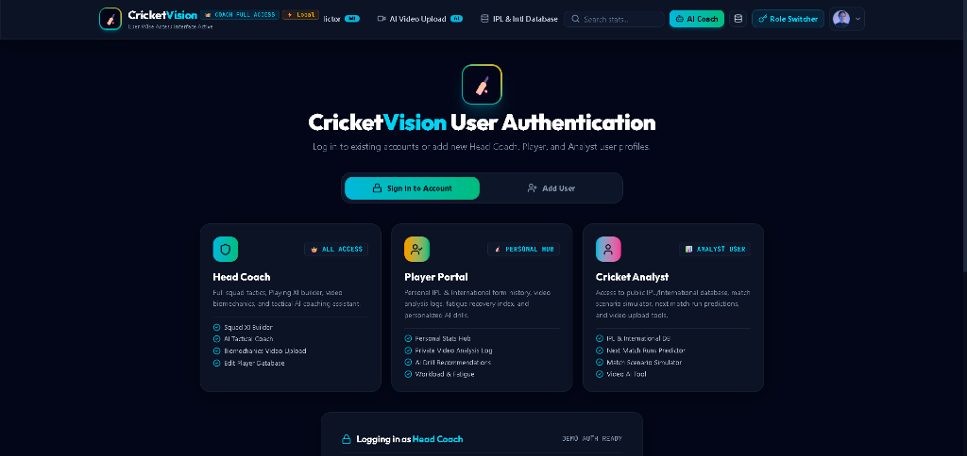
Results — User Authentication & Role Selection UI
RESULTS
CricketVision — AI Cricket Performance Analytics Platform
19

Slide 20
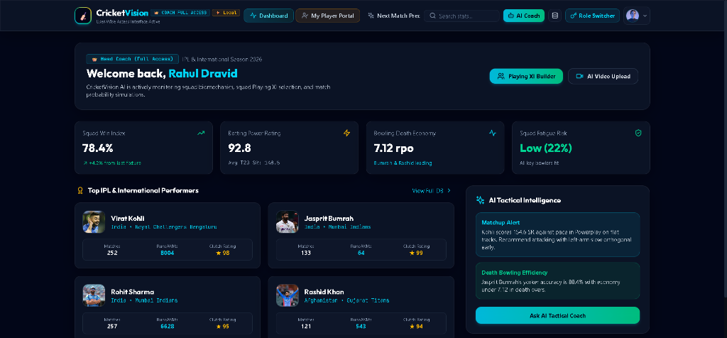
Results — Head Coach Dashboard UI
RESULTS
CricketVision — AI Cricket Performance Analytics Platform
20

Slide 21
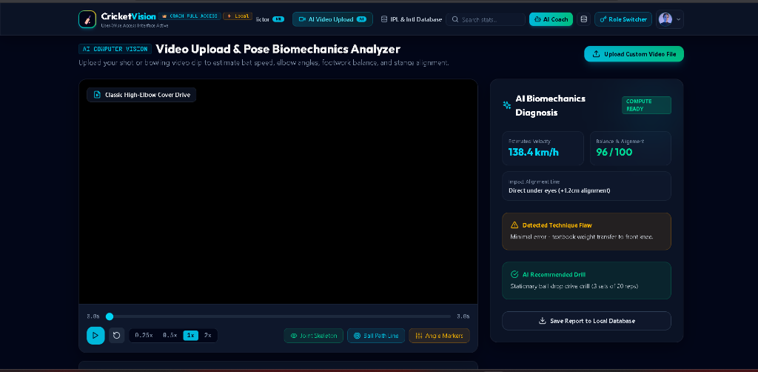
Results — Video Pose Biomechanics Analyzer UI
RESULTS
CricketVision — AI Cricket Performance Analytics Platform
21

Slide 22
Current Status of Work
STATUS
Completed Platform Modules
Pending / Deferred Backlog
• Development Setup: Full-stack MERN environment & Vite SPA structure.
• MongoDB Connection: Mongoose ODM models & 100+ player seeding engine.
• Role Authentication: Persona quick-login presets (Coach, Player, Analyst).
• Head Coach Module: Squad overview, fatigue alerts & Database Manager CRUD.
• Player Portal: Personalized stats, 360° SVG Wagon Wheel & Skill Radar.
• Analyst Suite: Match Win Simulator & Video Pose Biomechanics Analyzer.
• WebSocket Live Feed (US-21): Integration of real-time WebSocket live score API stream.
• OpenCV Pose Sidecar (US-22): Python OpenCV + MediaPipe pose keyframe extraction.
• Production Security: JWT token implementation and bcrypt password hashing.
• Mobile Responsiveness: Viewport layout tuning for mobile devices.
• Export Tools: Exporting match summary reports to PDF / Excel formats.
CricketVision — AI Cricket Performance Analytics Platform
22

Slide 23
Work Progress Summary
PROGRESS
Sprints 0 - 1 (Foundation)
Sprint 2 (Analytics Visuals)
• Setup Vite React + Express repository, defined Mongoose schemas, built 100+ player seeding engine.
• Built PitchAndWagonWheel.jsx SVG visualizer, Recharts Skill Radar, and squad fatigue algorithms.
Sprint 3 (Role Portals)
Sprints 4 - 5 (Simulations & CRUD)
• Built top Navbar, LoginView persona presets, Head Coach Dashboard, and personalized Player Portal UI.
• Built MatchSimulator win probability engine, VideoAnalyzer pose view, DatabaseManager CRUD modal, and AI Coach.
CricketVision — AI Cricket Performance Analytics Platform
23

Slide 24
Pending Works & Backlog
PENDING
Live Score API (US-21)
OpenCV Sidecar (US-22)
Production Hardening
• Scope: WebSocket live match streaming integration.
• Functionality: Injects real-time score feeds directly into simulator.
• Status: Deferred to future sprint releases.
• Scope: Standalone Python MediaPipe pose microservice.
• Functionality: Asynchronously extracts 3D skeleton keyframes.
• Status: Deferred to future sprint releases.
• Security: JWT session tokens & bcrypt password encryption.
• Mobile View: Responsive CSS tuning for smartphone screens.
• Export: PDF & Excel export tools for match reports.
CricketVision — AI Cricket Performance Analytics Platform
24

Slide 25
Project Execution Roadmap
PLAN
Sprint 1 (Done) — Setup, database, auth & MERN scaffold
Sprint 2 (Done) — 100+ player seeding engine & REST APIs
Sprint 3 (Done) — SVG Wagon Wheel & Recharts Skill Radar
Sprint 4 (Done) — Head Coach Dashboard & Player Portal UI
Sprint 5 (Done) — Match Win Simulator & Next Match Predictor
Sprint 6 (Done) — Video Pose Biomechanics Analyzer
Sprint 7 (Done) — Live Database Manager CRUD Modal
Sprint 8 (Done) — AI Coaching Assistant & Report Generator
Sprint 9 (Next) — WebSocket live score API integration
Sprint 10 (Next) — OpenCV pose sidecar, JWT hardening & polish
CricketVision — AI Cricket Performance Analytics Platform
25

Slide 26
Conclusion & Future Scope
CONCLUSION
Project Conclusion
Future Scope Horizons
• Structured Platform: CricketVision provides a unified full-stack web platform for managing cricket performance, fatigue, and tactical simulation.
• Technical Feasibility: The completed MERN architecture, SVG visualizers, and live database manager prove system feasibility.
• Empowering Non-Tech Users: Database Manager modal enables non-technical coaches to perform live CRUD without database command tools.
• High Impact MVP: Successfully delivers 121 out of 137 story points (88.3% completion rate).
• Live Score API Integration: Connecting WebSocket feeds for ball-by-ball win predictions during live international fixtures.
• Deep-Learning 3D Pose: Deploying GPU microservices for frame-accurate 3D bowling action reconstruction.
• Smart Wearable IoT Sync: Integrating heart-rate and accelerometer smartwatch data for direct physiological fatigue tracking.
• Mobile Native App: Expanding the SPA to iOS/Android native mobile applications.
CricketVision — AI Cricket Performance Analytics Platform
26

Slide 27
Git History / Version Control
GIT
Git is used to maintain project history and track changes during each development sprint.
Changes are grouped into meaningful feature-based commits instead of one large final commit.
Suggested commit pattern: feat(module): short description of completed change.
user@MacBook-Pro:~/Dev/CricketVision$ git log --graph --oneline
* [4e8b392] (HEAD -> main, origin/main) updated player roster seeding engine
* [8c1d54a] (origin/develop, develop) match win simulator module added
|\
| * [1a7c03f] video pose analyzer done for testing
| * [d82f6e1] implemented CRUD operations for player details
| * [6b01a92] added authentication and authorization flow
* | [9a8b1d7] database manager modal completed
|/
* [2f3e4d5] set up Mongoose ORM and initial schema
* [7c6d5e4] installed dependencies and basic server setup
* [1a2b3c4] Initial commit
CricketVision — AI Cricket Performance Analytics Platform
27

Slide 28
Bibliography & Technical References
REFERENCES
React 18 & Vite Documentation
React Core Team & Vite Dev. 'Building Component-Based Single Page Applications.' https://react.dev/
Express.js & Node Architecture
Express.js Foundation. 'Designing RESTful Web APIs & Middleware Routing.' https://expressjs.com/
MongoDB & Mongoose ODM Manual
MongoDB Inc. 'Schema Validation, Indexing & Upsert Operations.' https://mongoosejs.com/
Recharts & SVG Graphic Standards
Recharts Library. 'Dynamic Polar & Radar Charts for Performance Analytics.' https://recharts.org/
CricketVision — AI Cricket Performance Analytics Platform
28

