Slide 1
CricketVision
Performance Analytics &
Biomechanics Platform
Final Evaluation Presentation | MCA Mini-Project
Student : Abhijith Mohan
Department : Master of Computer Applications (MCA)
Technology Stack : MERN | React 18 | Tailwind CSS | Recharts
Repository : github.com/Abhijithmohan10/cricketvision

Slide 2
Introduction
CricketVision AI — What it is
Platform Overview
Key Modules
• AI-powered full-stack sports analytics platform for cricket
• AI Computer Vision Video Analyzer
• Built for Head Coaches, Elite Players & Performance Analysts
• Head-to-Head Player Comparison
• Combines match statistics, biomechanics & AI-driven simulation
• Coach & Performance Director Suite
• Tech Stack: React 18 + Node.js + Express + MongoDB (MERN)
• Player Portal & Biomechanics Dashboard
• Deployed live on GitHub Pages
• Match Simulator & Win Predictor
100+ verified IPL & International player profiles | Role-based Auth: Coach | Player | Analyst

Slide 3
Requirement Analysis
Functional & Non-Functional Requirements
Functional Requirements
Non-Functional Requirements
• Role-based login: Coach, Player, Analyst
• Responsive UI (mobile + desktop)
• MongoDB CRUD for 100+ player profiles
• < 2s page load with Vite production build
• AI Video Analyzer — ball/bat speed metrics
• MongoDB connection fallback handling
• Match simulation with win probability
• GitHub Pages deployment (always-on)
• Radar chart & wagon-wheel visualisation
• PDF match report export
• JWT authentication & bcrypt password hashing
• Secure .env-based secret management
OS: Windows / macOS / Linux | Browser: Chrome 120+ | Node.js ≥ 18 | MongoDB local/Atlas

Slide 4
Problem Statement
The gap CricketVision fills
✗ Traditional coaching relies on fragmented static scorecards & subjective observation
✗ No integrated platform for fatigue monitoring + phase-wise performance (PP / MO / DO)
✗ Real-time match simulation against opposition tactics is unavailable
✗ Roster management requires raw database tools inaccessible to non-technical coaches
✗ Computer vision biomechanics tracking has no cricket-specific affordable solution
✔ CricketVision bridges ALL these gaps in a single unified platform

Slide 5
Objectives
What CricketVision aims to achieve
01 Coach & Director Portal
02 Player Portal
Full roster CRUD, Team XI optimizer, AI strategy assistant, fatigue oversight
Personalized metrics, pitch & wagon wheel, biomechanics summary, drill recommendations
03 Analyst Portal
04 Role-Based Auth & DB
Match simulator, Next Match predictor, pose-estimation video analyzer, radar comparisons
MongoDB with 100+ player profiles, schema validation, instant role-based quick-auth
05 Production Deployment
06 Computer Vision AI
GitHub Pages live deployment with Vite SPA build, JWT + bcrypt security
Ball speed, bat speed, shot perfection score via custom video analysis engine

Slide 6
Scope and Relevance
Who benefits & why it matters
Coach Scope
Player Scope
Analyst Scope
▸ Full squad roster management via MongoDB
▸ Personalized stats portal (Kohli / Bumrah)
▸ Ball-by-ball win probability simulation
▸ AI tactical coaching assistant
▸ 360° pitch wagon wheel visualization
▸ Venue & opposition match-up matrix
▸ Team XI optimizer with balance scoring
▸ AI drill recommendations
▸ H2H dual radar chart comparisons
▸ Biomechanics video upload & analysis
▸ Fatigue & injury status tracking
▸ PDF scouting report export
Relevant to IPL franchises, national academies, university cricket coaching programs & sports-tech startups

Slide 7
Development Methodology (1/3)
Agile Scrum Framework Overview
Scrum Roles
7 Sprint Workflow
• Product Owner / Guide — MCA Project Reviewer & Approver
▸ Sprint 0 (Jul 01–07) — Scope, Architecture, Guide Approval
• Scrum Master & Lead Dev — Abhijith Mohan (Full-Stack)
▸ Sprint 1 (Jul 08–10) — MongoDB Schema + REST API Engine
▸ Sprint 2 (Jul 11–13) — Radar, Wagon Wheel, Fatigue Engine
Story Point Scale (Fibonacci)
▸ Sprint 3 (Jul 14–17) — Auth UI, Portals, Navbar, Dashboards
1–2 pts • Low: Styling, modals, form validation
▸ Sprint 4 (Jul 18–20) — Simulator, Predictor, Video Analyzer
3–5 pts • Medium: Mongoose schemas, REST endpoints
8 pts • High: 100+ player seeder, Recharts, Simulator
▸ Sprint 5 (Jul 21–23) — DB Manager, AI Coach, Documentation
13 pts • Very High: AI Coach NLP, Video pose analyzer
▸ Sprint 7 (Sep 09–18) — H2H Comparison, Mobile UX, Deploy

Slide 8
Development Methodology (2/3)
Scrum Artifacts, Ceremonies & Definition of Done
Scrum Artifacts & Ceremonies
Definition of Done (DoD)
• Product Backlog — 25 User Stories (US-01 to US-25)
• Backend REST endpoints operate error-free
• Sprint Backlog — per-sprint breakdown of tasks
• Mongoose schema validation handles edge cases
• Sprint Review & Retrospective — held after each sprint
• React components render with live reactive state
• Burndown Chart — daily story point tracking (137 total points)
• Role-based testing (Coach / Player / Analyst) passes
• Daily Standup — individual solo-developer daily log
137
121
88.3%
16
Total Planned
Story Points
Completed
Story Points
Completion
Rate
Deferred
Points

Slide 9
Development Methodology (3/3)
Product Backlog — Selected User Stories
Story ID
Epic
Summary
Priority
Pts
Status
US-01
Setup
Initialize Node.js, Express, Vite, Tailwind
Must Have
3
Done
US-04
Backend
Auto-seed 100+ IPL/Intl player database
Must Have
8
Done
US-05
Auth API
Login & Register endpoints with JWT + bcrypt
Must Have
5
Done
US-10
Analytics
Recharts Radar Chart for player skill visualization
Must Have
8
Done
US-13
Simulator
Ball-by-ball win probability match simulator
Must Have
8
Done
US-15
Video AI
CV Video Analyzer — ball/bat speed, shot perfection
Should
8
Done
US-17
DB Admin
DatabaseManagerModal live MongoDB CRUD portal
Must Have
8
Done
US-23
H2H
Head-to-Head dual radar + AI tactical verdict
Should
8
Done
US-21
Backlog
Real-time WebSocket live match data stream
Could
8
Deferred

Slide 10
System Design (1/2)
3-Tier MERN Architecture & Database Schema
PRESENTATION TIER
BUSINESS LOGIC TIER
DATA TIER
React 18 SPA
Node.js + Express.js
MongoDB (Mongoose ODM)
• Vite + Tailwind CSS
• REST API Routes
• Player Schema (100+ docs)
• Recharts (Radar, Line, Bar)
• JWT Auth Middleware
• User Schema (RBAC)
• Lucide Icons
• bcrypt Password Hash
• Upsert Seeding Strategy
↕ REST HTTP/JSON ↕
↕ Mongoose ODM ↕
• Context API + localStorage
• MongoDB Connection Pool
• Timestamps & Validation

Slide 11
System Design (2/2)
MongoDB Schema & Entity Relationships
Player Schema
User Schema
id, name, country, role, battingStyle, bowlingStyle
id, name, email (unique, regex validated)
iplTeam, avatar, jerseyNumber
password (bcrypt hashed, minlength 6)
fatigueLevel, injuryStatus, clutchRating
role: enum ['coach', 'player', 'user']
skillRadar: { Power, Consistency, Spin, Pace, Field, Clutch }
title, avatar, badge, playerId
phaseStats: { powerplay, middleOvers, deathOvers }
permissions: String[]
recentForm[], biomechanicsSummary: { releaseAngle, strideLength }
JWT token issued on login, verified middleware

Slide 12
Implementation Details (1/3)
Backend Engine — Node.js + Express + MongoDB
Backend Architecture
API Endpoints
• Express.js REST API with `/api/players` and `/api/users` route controllers
POST /api/users/login → Auth & JWT issue
• Mongoose upsert seeding strategy — 100+ IPL/Intl players on server start
POST /api/users/register → Create user with validation
• bcrypt salt hashing for all user passwords (10 salt rounds)
GET /api/players → Return all players
• JWT token signing on login; token middleware on protected routes
• Environment secrets via `.env` file (JWT_SECRET, MONGODB_URI)
POST /api/players → Add new player
• CORS middleware for React SPA cross-origin requests
PUT /api/players/:id → Update player record
• MongoDB connection fallback — graceful error if DB is offline
DELETE /api/players/:id → Remove player
POST /api/seed → Reseed 100+ player database

Slide 13
Implementation Details (2/3)
Frontend — React 18 + Recharts + Tailwind CSS
Key Components
Description
LoginView.jsx
Role persona cards (Coach/Player/Analyst) + quick-login presets
DashboardView.jsx
KPI cards — Squad Win Index, Fatigue Risk, Batting Power Rating
PlayerAnalyticsView.jsx
Recharts RadarChart for 6 skill dimensions + phase stats
PitchAndWagonWheel.jsx
SVG 360° shot dispersion map + pitch length heatmap
MatchSimulatorView.jsx
Ball-by-ball win probability with pitch/weather modifiers
VideoAnalyzerView.jsx
CV scanning animation, ball/bat speed, shot perfection score
PlayerComparisonView.jsx
H2H dual radar overlay + AI tactical advantage breakdown
DatabaseManagerModal.jsx
Live MongoDB CRUD panel — Add/Edit/Delete/Reseed players

Slide 14
Implementation Details (3/3)
Security, Integration & GitHub Pages Deployment
Security Implementation
Deployment Pipeline
• bcrypt (10 salt rounds) for all password storage
• Vite production build — `npm run build` → `dist/`
• JWT tokens — signed on login, verified per request
• GitHub Pages deploy — `npm run deploy` via gh-pages package
• Secrets via `.env` — JWT_SECRET, MONGODB_URI kept out of Git
• Vite base path set to `/cricketvision/` for sub-path routing
• Role-based UI gating — Coach/Player/Analyst access controls
• Live URL: abhijithmohan10.github.io/cricketvision
• CORS headers configured for GitHub Pages origin
• PDF export — html2canvas + jsPDF for match summary reports
Performance & UX
• Responsive mobile layout — sliding drawer nav + bottom navigation bar
• localStorage session persistence — user stays logged in on refresh
• Recharts interactive charts — hover tooltips, animated transitions

Slide 15
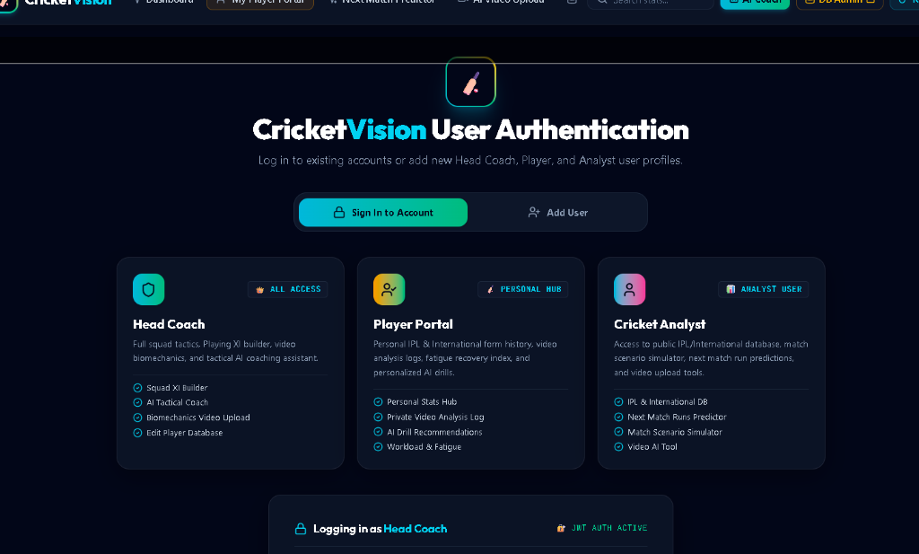
Results — User Authentication UI
Role-based persona selection with JWT auth
3 role cards: Coach, Player, Analyst
Quick-login persona presets
JWT AUTH ACTIVE status indicator
Add User registration flow

Slide 16
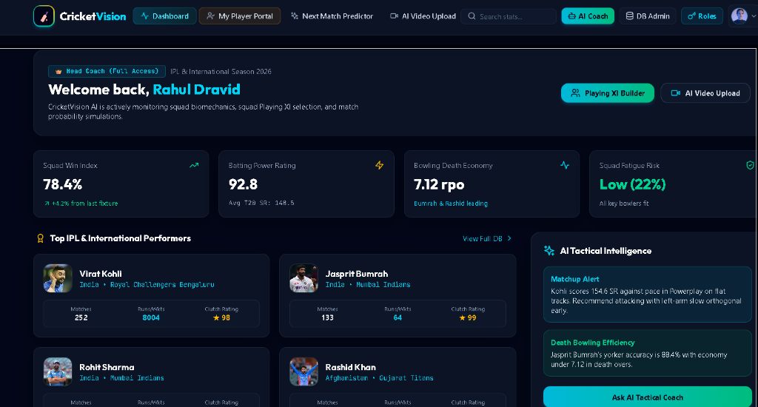
Results — Coach Dashboard (Rahul Dravid)
Full-access head coach portal with AI tactical intelligence
Squad Win Index: 78.4%
Batting Power Rating: 92.8
Bowling Death Economy: 7.12 rpo
AI Matchup Alerts — real-time

Slide 17
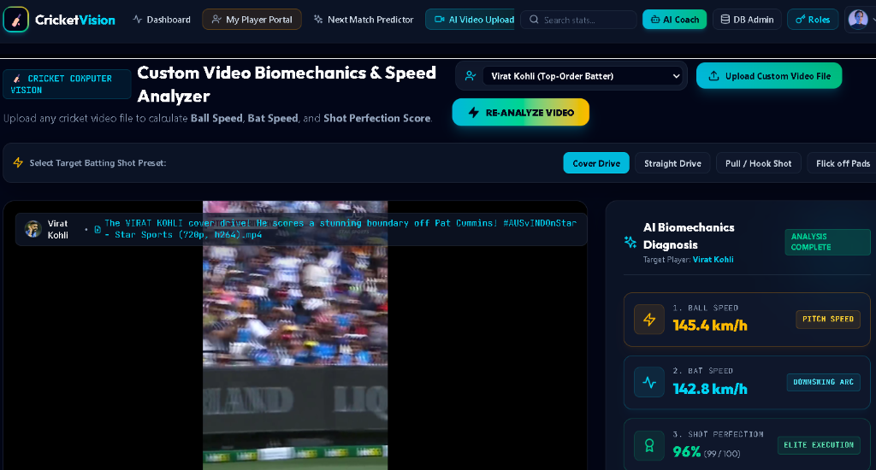
Results — Video Biomechanics Analyzer
Custom CV engine for bat/ball speed and shot perfection
Ball Speed: 145.4 km/h
Bat Speed: 142.8 km/h
Shot Perfection: 96% (Elite)
Player-specific scouting report

Slide 18
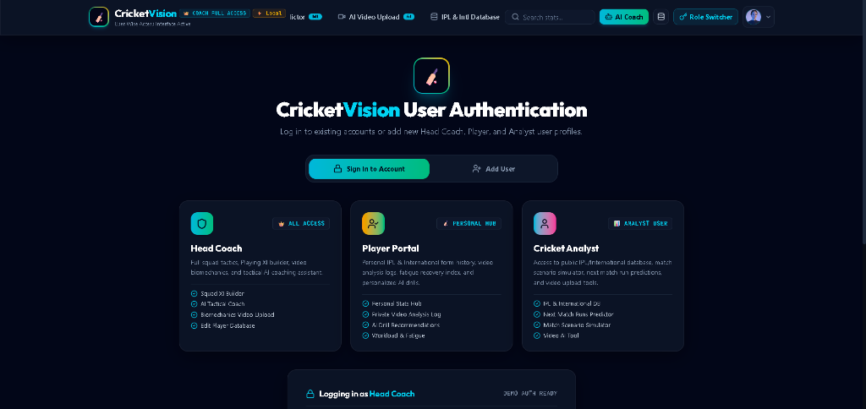
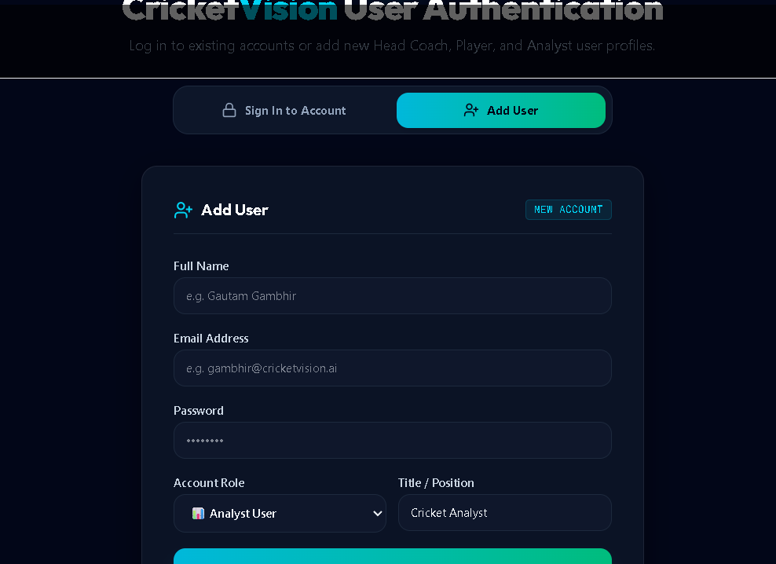
Results — Authentication & Add User Form
Secure login flow with user registration
• Role selector with ACCESS badges
• Add User form with input validation
• Coach full access vs Analyst limited scope

Slide 19
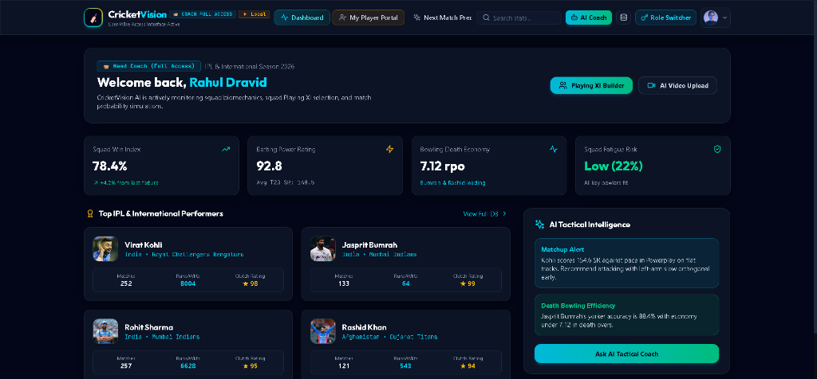
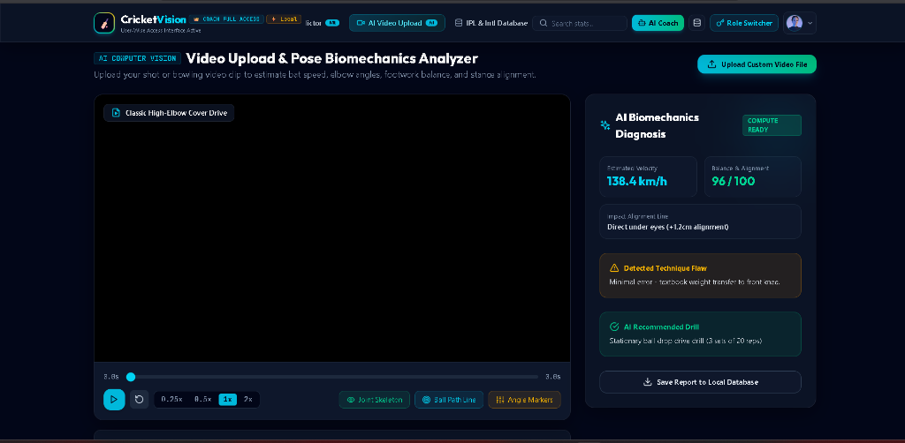
Results — Coach Dashboard UI & Video Biomechanics
Side-by-side interface overview
Left: Coach Dashboard — KPI cards, player list, AI tactical intelligence panel
Right: Video Biomechanics Analyzer — pose tracking metrics, technique diagnosis

Slide 20
Analysis of Results (1/3)
Feature Completion & Story Point Analysis
139 / 155
88.3%
25
16 pts
Story Points
Completed
Completion
Rate
User Stories
Delivered
Deferred to
Future
Sprint
Duration
Points Completed
Key Deliverable
Sprint 0
Jul 01–07
3 pts
Architecture & guide approval
Sprint 1
Jul 08–10
28 pts
MongoDB schemas + REST endpoints
Sprint 2
Jul 11–13
24 pts
Recharts radar + wagon wheel SVG
Sprint 3
Jul 14–17
29 pts
Auth UI, portals, navbar, dashboards
Sprint 4
Jul 18–20
29 pts
Simulator, predictor, video analyzer
Sprint 5
Jul 21–23
18 pts
DB Manager, AI Coach, documentation
Sprint 7
Sep 09–18
18 pts
H2H comparison, mobile UX, deploy

Slide 21
Analysis of Results (2/3)
Module-wise Performance Assessment
Authentication & RBAC
AI Video Analyzer
• JWT token flow: login → sign → verify middleware
• Ball speed, bat speed, shot perfection score output
• 3 roles with granular permission arrays
• Player-specific scouting report generation
• Quick-login persona presets for evaluators
• Neural scanning animation during frame processing
• bcrypt 10-round hashing — industry standard
• Shot preset selector (Cover Drive, Pull, etc.)
Coach Dashboard
Match Simulator
• Live Squad Win Index & Fatigue Risk KPIs
• Ball-by-ball stochastic win probability calculation
• AI Tactical Intelligence — real-time matchup alerts
• Pitch modifier (Dry/Green/Flat) & weather (Humidity/Wind)
• MongoDB CRUD from UI — no raw DB access needed
• Recharts interactive probability line chart
• Playing XI optimizer with balance score
• Opposition match-up matrix with venue history

Slide 22
Analysis of Results (3/3)
Technical Achievements & Known Limitations
✅ Technical Achievements
⚠ Known Limitations
• 100+ player database auto-seeded on server start
• Video CV uses simulation (not real OpenCV/MediaPipe)
• Full MERN stack integration working end-to-end
• Match simulator uses static DB metrics (no live API)
• Dual radar H2H comparison with AI verdict
• No real-time WebSocket live score streaming yet
• GitHub Pages live deployment with Vite SPA
• MongoDB must run locally for backend to function
• Mobile responsive with drawer nav + bottom bar
• PDF export limited to match summary (not analytics)
• PDF scouting report export via html2canvas + jsPDF
• Print A4 CSS layout for match summary reports
• bcrypt + JWT security fully integrated

Slide 23
Pending Works
Deferred backlog & future sprint items
US-21 | Real-time WebSocket Live Match Streaming
Integrate WebSocket connection to CricInfo / Sportradar ball-by-ball feed
Story Points: 8 pts
US-22 | OpenCV + MediaPipe Pose Estimation Sidecar
Python sidecar process for real video keyframe extraction & pose tracking
Story Points: 8 pts
All Must Have & Should Have features are 100% complete | Only Could Have items deferred

Slide 24
Conclusion & Future Scope
Outcomes and horizons for CricketVision AI
Conclusion
Future Scope
• Production-ready MERN full-stack web application delivered
• Real-time WebSocket live score streaming (US-21)
• 139 / 155 story points completed (88.3% completion rate)
• Python OpenCV + MediaPipe pose estimation server (US-22)
• 7 sprint cycles with documented standup logs & retrospectives
• Mobile app (React Native) for on-field coaching use
• Role-based multi-portal system for Coach, Player & Analyst
• Cloud deployment (AWS / Azure) with Atlas MongoDB
• Live deployment at abhijithmohan10.github.io/cricketvision
• Integration with IPL franchise official APIs
• bcrypt + JWT security hardened and production-ready
• AI-generated coaching session video highlights

Slide 25
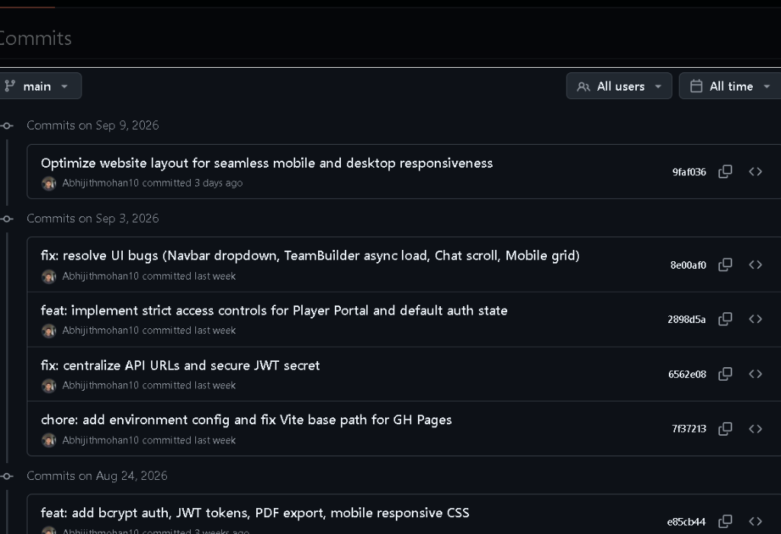
Git Version Control — Commit History
github.com/Abhijithmohan10/cricketvision
c47ef12 — Add official README.md
4d1b4d2 — Update Scrum Book Sprint 7
732440f — H2H Player Comparison view
9faf036 — Mobile/Desktop responsive layout
8e00af0 — Fix UI bugs (Navbar, TeamBuilder)
e85cb44 — bcrypt auth + JWT + PDF export
bc2e426 — Initial commit (Aug 11, 2026)
Total: 20+ commits | Branch: main | Author: Abhijithmohan10

Slide 26
Bibliography
Academic & Technical References
[1] React Documentation — https://react.dev
[2] MongoDB Mongoose ODM — https://mongoosejs.com
[3] Recharts Library — https://recharts.org
[4] Tailwind CSS — https://tailwindcss.com
[5] Express.js — https://expressjs.com
[6] jsonwebtoken (JWT) — https://jwt.io / npmjs.com/package/jsonwebtoken
[7] bcryptjs — https://npmjs.com/package/bcrypt
[8] Vite Build Tool — https://vitejs.dev
[9] html2canvas & jsPDF — https://html2canvas.hertzen.com / https://jspdf.info
[10] Node.js Official Docs — https://nodejs.org
[11] GitHub Pages Deployment — https://pages.github.com
[12] Sportradar Cricket API — https://developer.sportradar.com/cricket
© 2026 CricketVision AI • Abhijith Mohan • MCA Mini-Project • Final Evaluation

