Slide 1
EMBEDDED SYSTEM TESTING
Submitted by
Abhijith P D
Roll No 44
S6 ECE

Slide 2
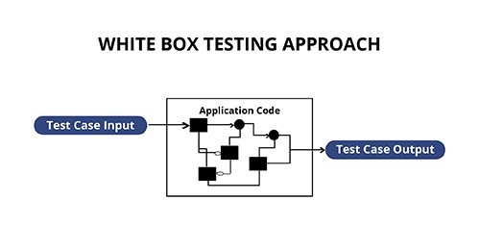
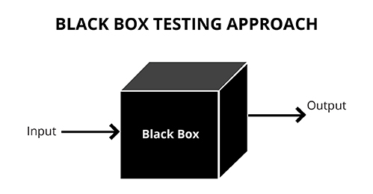
BLACK BOX vs White box

Slide 3
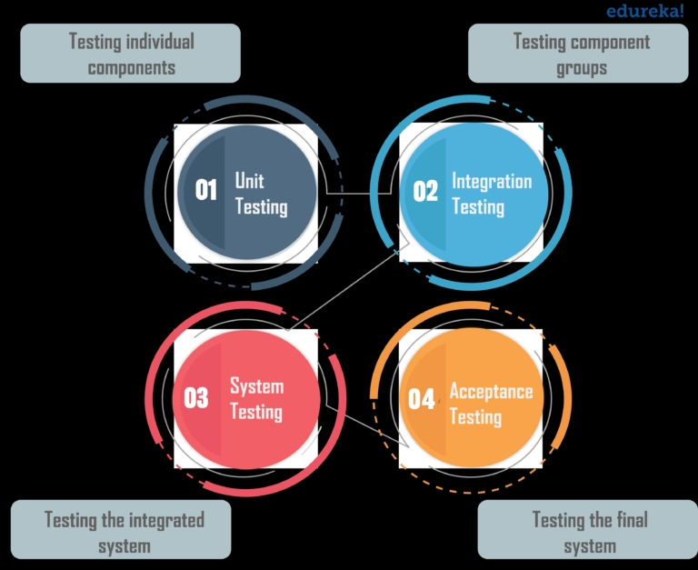
Levels of Software testing

Slide 4
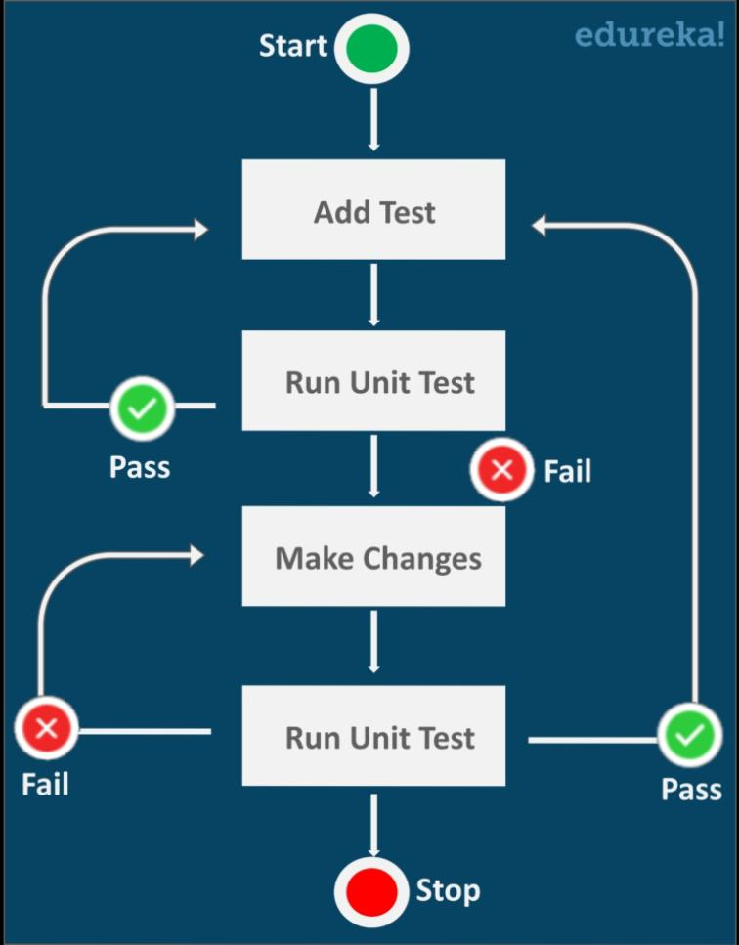
Unit test
This is a particular kind of white box testing.
Individual modules of the code are being tested.
The main aim is to isolate each unit of the system to identify, analyze and fix the defects.

Slide 5

Merits
Makes Coding Agile
Helps to Find Software Bugs Early
Provides Documentation
Debugging Easier
Reduces Testing Costs

Slide 6
Demerits
Not all errors can be detected, since every module it tested separately and later different integration bugs may appear.
A module/unit is usually designed by an individual software developer whose techniques and programming logic differs from that of other programmers.
Often at the time of module development, user requirements change and these new requirements may not be unit tested. This instigates issues.
Issues like data formatting, error trapping, hardware interfaces, and third-party service interfaces are sometimes missed during unit testing.

Slide 7
Integration test
Integration Testing is a level of software testing where individual units are combined and tested to verify if they are working as they intend to when integrated. The main aim here is to test the interface between the modules.
So, no matter how efficiently each module/unit is running, if they aren’t properly integrated, it will affect the functionality of the software program.

Slide 8
Merits
It makes sure that integrated modules work properly as intended.
The tester can start testing once the modules to be tested are available.
It detects errors related to the interface between modules.
Helps modules interact with API’s and other third-party tools.
Typically covers a large volume of the system, so more efficient.
Increases the test coverage and improves the reliability of tests.

Slide 9
Challenges
Managing integration testing is difficult sometimes because of various factors like database, platforms, environment, etc..
Integrating a new system to a legacy system or integrating two legacy system needs a lot of testing efforts and changes.
Less compatibility between the two systems developed by two different companies is a challenge for programmers.
There are way too many different paths and permutations to apply for testing the integrated systems.

Slide 10
System test
System Testing is a type of software testing that is performed on a complete integrated system to evaluate the compliance of the system with the corresponding requirements.
In System testing, the functionalities of the system are tested from an end-to-end perspective.
System Testing is usually carried out by a team that is independent of the development team in order to measure the quality of the system unbiased.

Slide 11
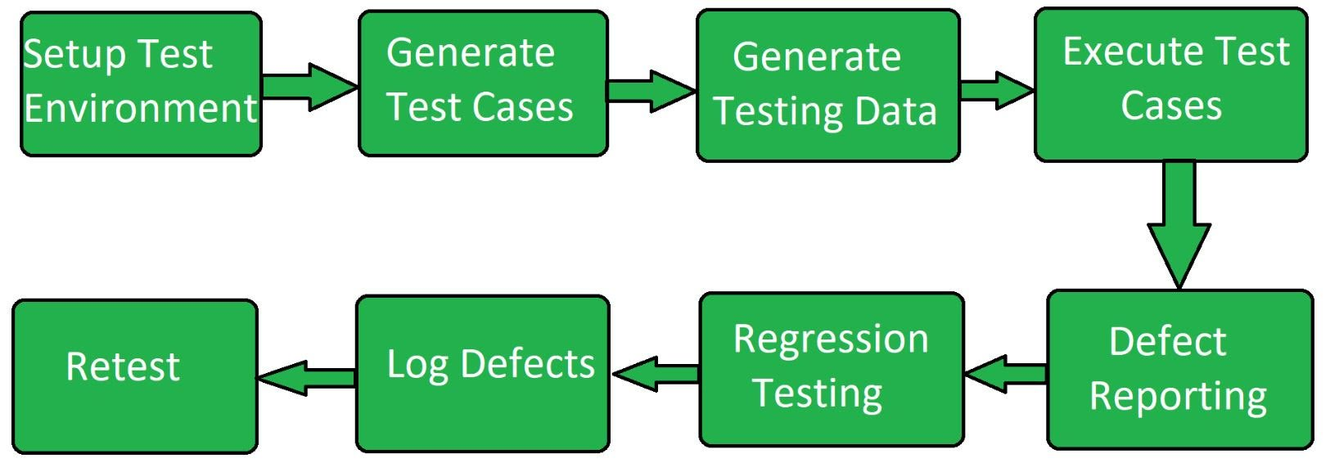
Process

Slide 12
Acceptance Test
Acceptance testing, a testing technique performed to determine whether or not the software system has met the requirement specifications.
●Data Integrity ● Usability ● Performance ● Scalability ● Documentation ● Functional Correctness and Completeness ● Confidentiality and Availability ● Data Conversion ● Timeliness

Slide 13
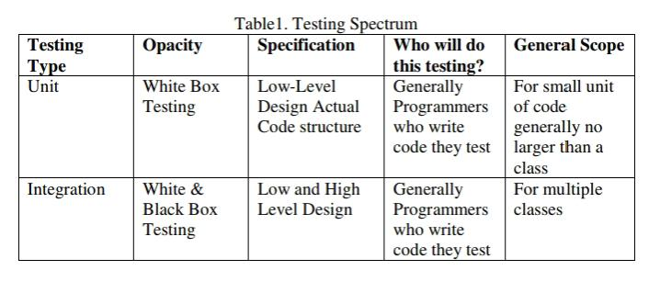
Testing SPECTRUM

Slide 14
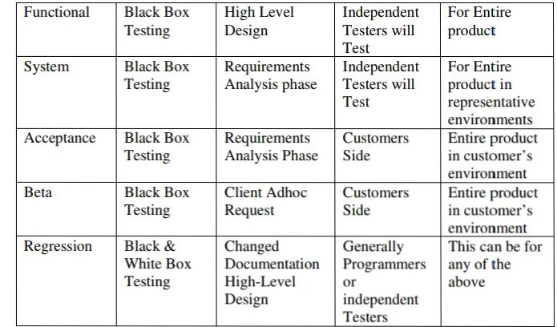

Slide 15
Hardware test
Hardware testing is to check/ensure the functionality, stability of hardware component and ensure that it should not have process fault.
Common Techniques are
1) Software-based self-testing
2) ATPG (Automatic test pattern generation)
3) BIST (Built-in self-test)

Slide 16
References
https://www.edureka.co/blog/software-testing-levels/ https://www.researchgate.net › 2761...Web results(PDF) Black Box and White BoxTesting Techniques - A Literature Review
https://nptel.ac.in › coursesWeb resultsEmbedded Software Testing – Nptel
https://blog.calsoftinc.com/2017/06/how-to-perform-hardware-and-firmware-testing-of-storage-box.html

Slide 17
Thank you

