Slide 1
Monitoring Deep Dive Project Guide
ProLUG 2024

Slide 2
Purpose
This is a lab guide to make you think as we go through the Monitoring Deep Dive.
Take screen shots of labs and answer these questions to provide a journal or notes of actions you’ve taken.
Add questions as they come up, and add any “aha” moments you have. This is not a prescriptive or exhaustive list of what you may want to write down.
You can clean this up and use it as proof to an employer that you understand monitoring of systems architecture at a deep level.

Slide 3
Initial questions
What are the 3 things we monitor?
How would you define them?
Where are they used in the systems world?

Slide 4
Initial questions
Why do we use timestream databases?
What are they optimized on?
Who is Dutch?

Slide 5
Lab on Telemetry
How is data flowing in this lab?
Where does the data start, and how is it collected?
Where is the data being aggregated?
How are we visualizing the data?

Slide 6
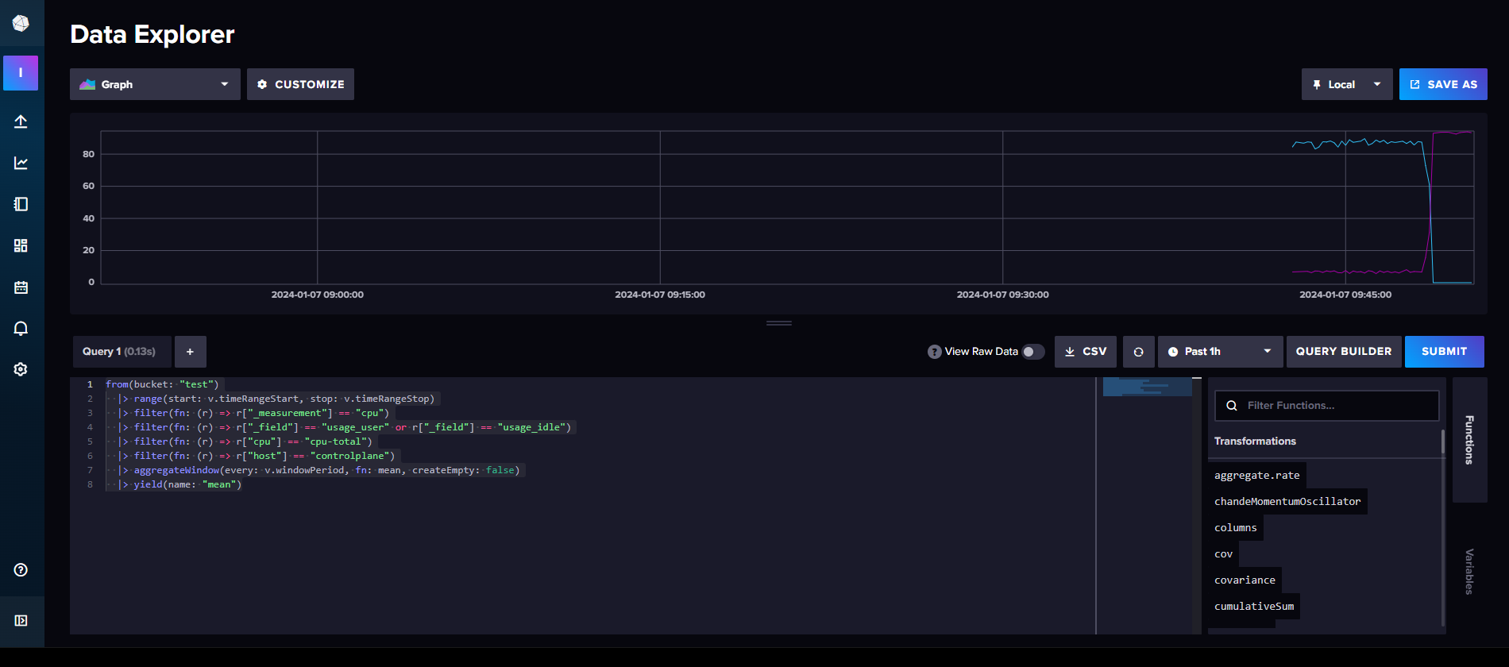

Slide 7
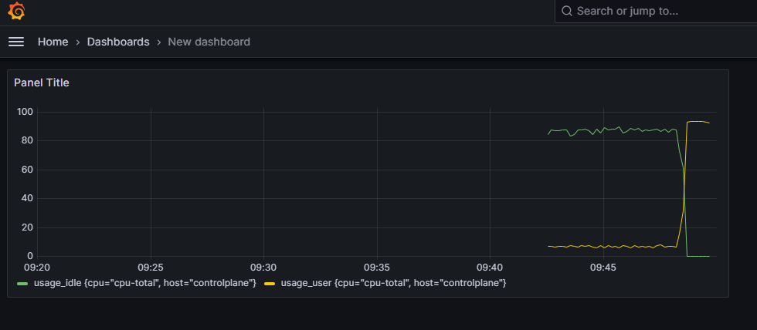

Slide 8
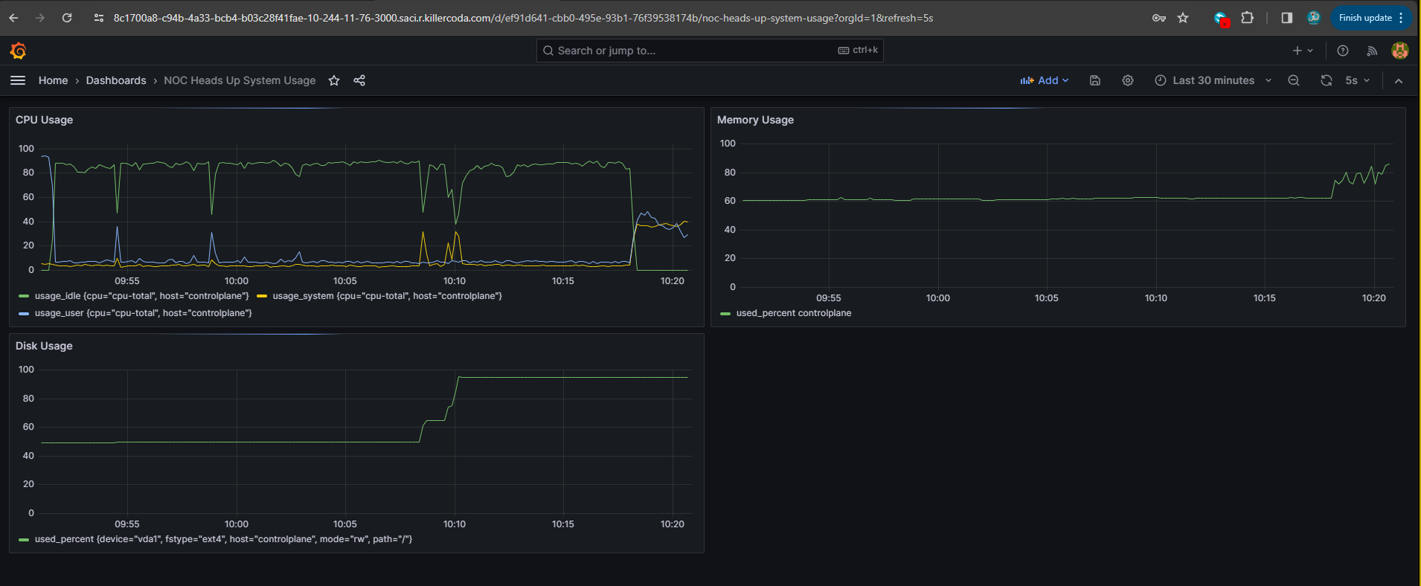

Slide 9
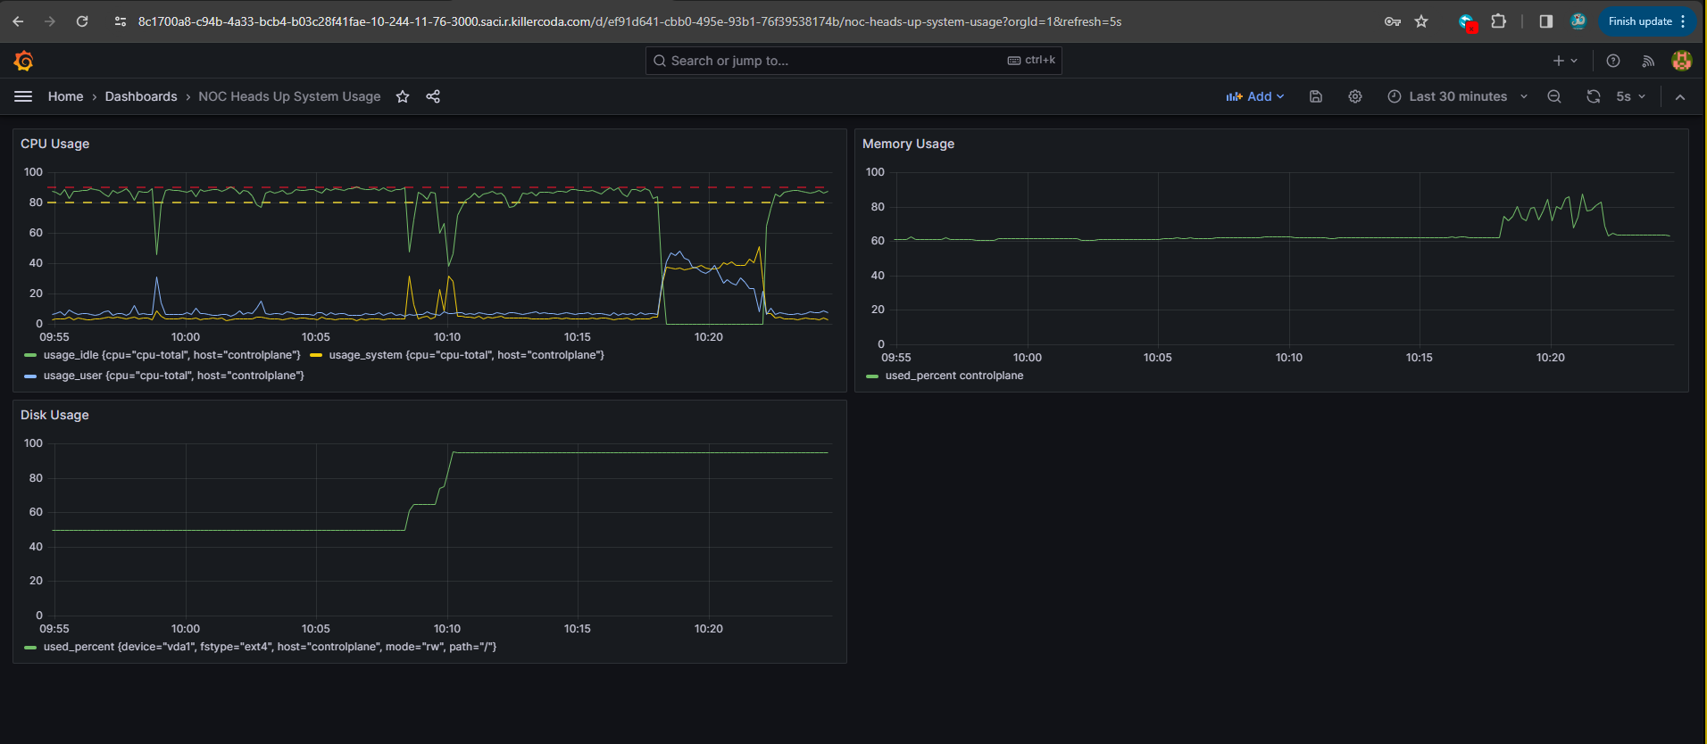

Slide 10
Lab on Telemetry
Going deeper:
How do you see yourself applying this data to what you know of the IT industry?

Slide 11
Lab on Logs
How is data flowing in this lab?
Where does the data start, and how is it collected?
Where is the data being aggregated?
How are we visualizing the data?

Slide 12
Lab on Logs
Going deeper:
How do you see yourself applying this data to what you know of the IT industry?
What is the query language used in this lab? Where would you go to practice with it more?

Slide 13
Lab on Tracing
How is data flowing in this lab?
Where does the data start, and how is it collected?
Where is the data being aggregated?
How are we visualizing the data?

Slide 14
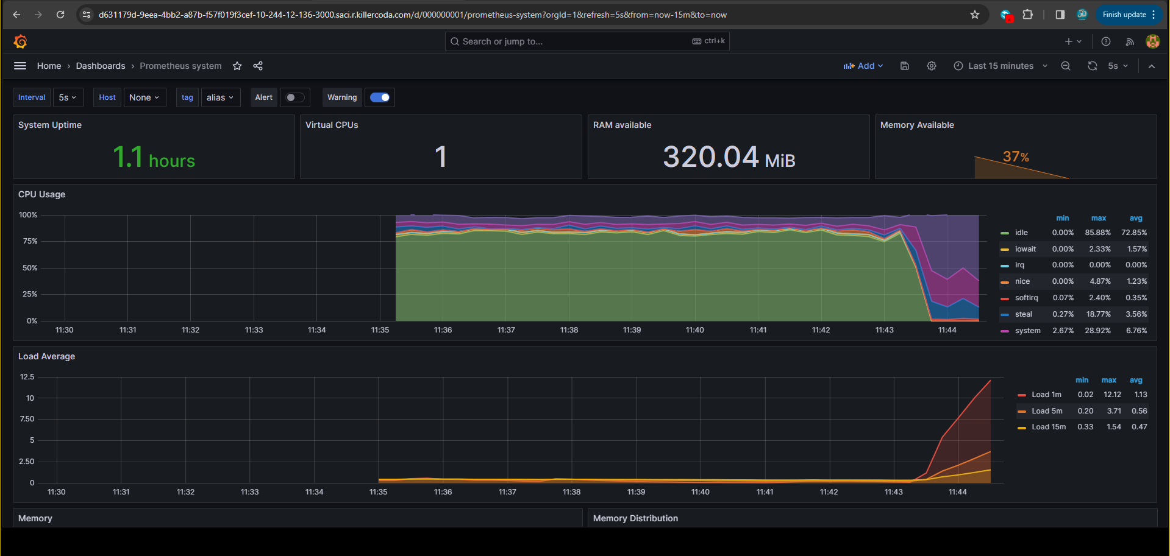
High load capture in Prometheus

Slide 15
Lab on Tracing
Going deeper:
How do you see yourself applying this data to what you know of the IT industry?

Slide 16
Where do you go from here?
What do you know now that you did not know before?
Where can you immediately utilize this knowledge and apply it?
What additional topics do you now plan on studying to help solidify this knowledge?

