Slide 1

Concept Learning Path Generation : behind and beyond
Senior Design Project : 20ECSW401
Guide : Mr. Prakash Hegade
Team Details
SI. No. | SRN | Name
1. | 01fe21bcs107 | Abhijna R Kalbhag
2. | 01fe21bcs062 | Anushika Kothari
3. | 01fe21bci034 | Nandan Date
4. | 01fe21bcs089 | Shreya M. Pai

Slide 2

Index
Motivation
Problem Statement
Implementation
Introduction
Objectives
System Design
Design Aspects

Slide 3
Introduction
The Concept Learning Path Generation represents a significant advancement in the way we understand and navigate concepts. With a multi-faceted approach, it aims to enhance learning experiences by extracting and analyzing related concepts, identifying prerequisites, and mapping out advanced topics. By moving beyond traditional linear learning models, this system seeks to offer not just a pathway through knowledge but a deeper, more personalized understanding of each concept. This initiative aligns with the vision of creating a more intuitive and connected educational environment, ultimately shaping a smarter, context-aware learning experience. The goal is to provide a structured, contextually accurate learning path that guides users through foundational, intermediate, and advanced concepts, facilitating more effective and meaningful learning journeys.

Slide 4
Problem Statement
To build a learning path of concepts for a given concept, behind and beyond using Wikipedia data

Slide 5
Objectives
Extract relevant concepts from Wikipedia data to build a comprehensive learning path.
Identify prerequisite concepts (behind) and advanced topics (beyond) for a given concept.
Generate and present the learning path in an organized, user-friendly format.

Slide 6
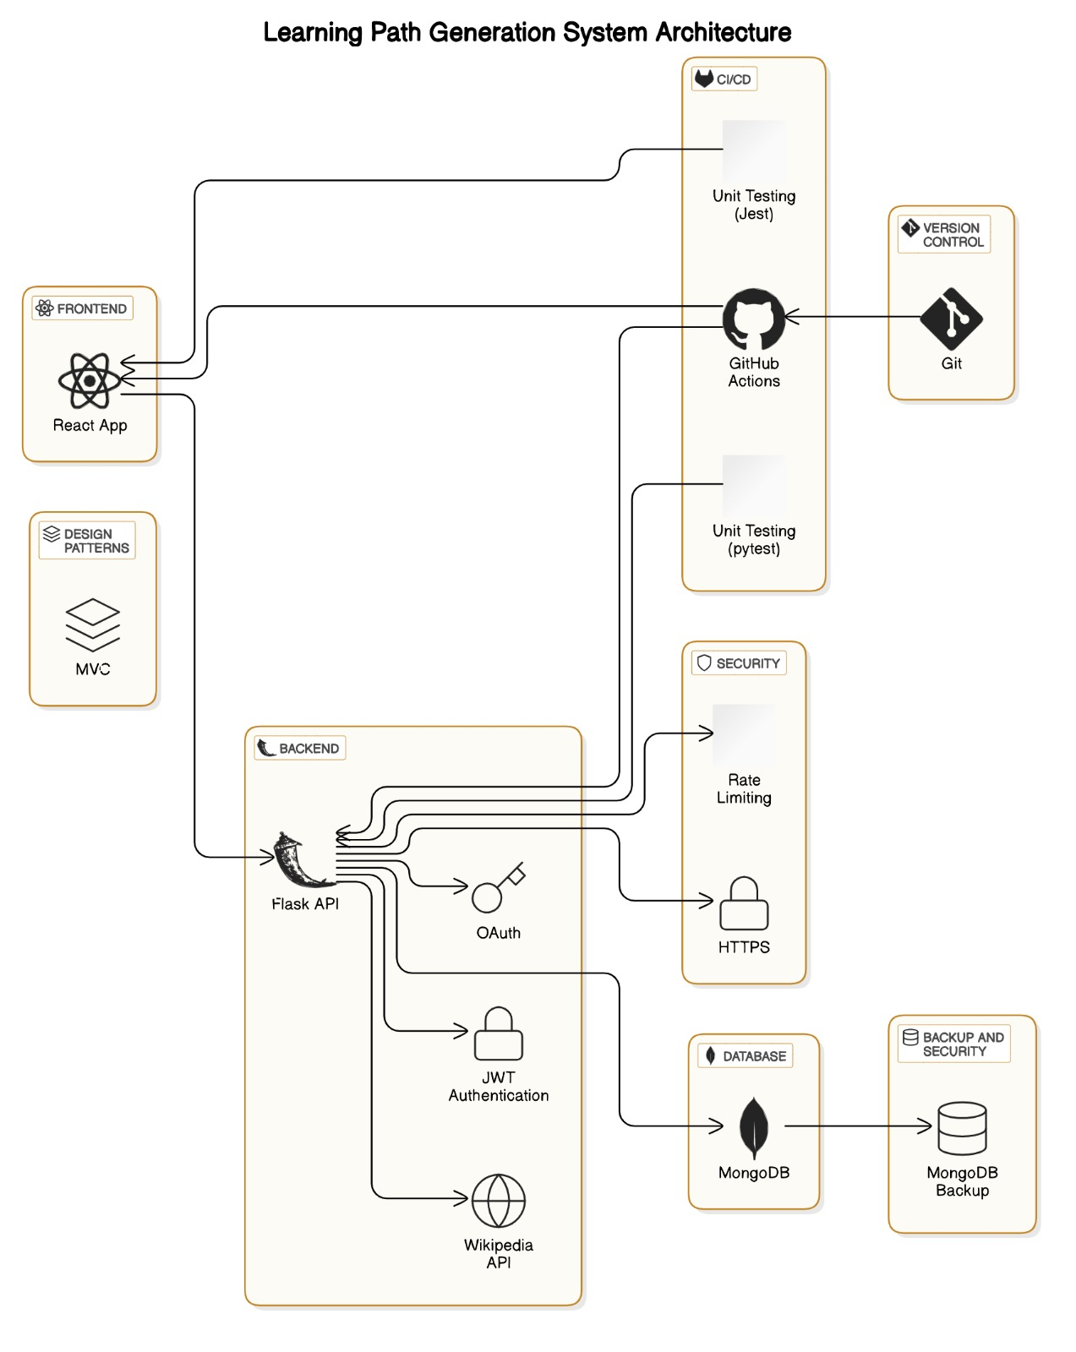
System Design

Slide 7
Design Aspects
Wireframes: These help visualize the layout of the app and organize the flow of information (e.g., input for the concept and display of the learning path). That is using React as a framework to display learning path and concepts.
Design Patterns: Patterns like Model-View-Controller (MVC) can be used for structuring the application, Creational patterns for instantiating different parts of the learning path generation modules.
REST APIs: These can be used to take a concept as input and returns the learning path. This will allow the backend to be decoupled from the frontend.

Slide 8
Design Aspects
CI/CD: continuous integration and continuous deployment (CI/CD) can be set up using Github. Every time when changes are pushed to the code repository, CI/CD pipelines can automatically run tests, build the application, and deploy it to a production or staging environment. Github is also used for version control in this project.
SOLID Principles:
Single Responsibility Principle: Each class or function should have one responsibility, such as separating the learning path generation logic from the user interface logic.
Open/Closed Principle: system can be open for adding new features but closed for modification (not changing existing code for new features.
Liskov Substitution Principle: This is useful for defining class hierarchy for different learning path generation strategies or concepts.
Interface Segregation Principle: Creation of small, specialized interfaces that will ensure compaction.
Dependency Inversion Principle: This principle helps ensure that high-level modules don’t depend on low-level modules; both should depend on abstractions (interfaces).

Slide 9
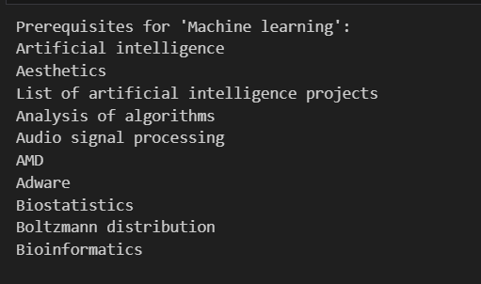
Implementation
For the concept: "Machine Learning"
Behind: For prerequisites we used the "What links here" feature on Wikipedia to see which pages link to a given page. These are considered as 'Behind' concepts

Slide 10
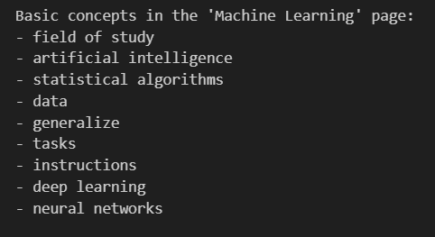
Implementation
For the concept: "Machine Learning"
Current Concept: For current concpets for the given concept. We found hyperinks int the content block of the page. These were limited to few to cover the basics.

Slide 11
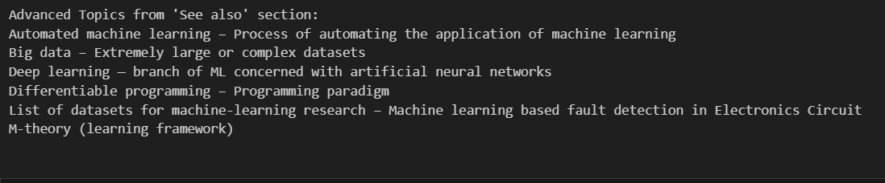
Implementation
For the concept: "Machine Learning"
Beyond: For Advanced concepts for the given concept. We made use of 'See Also' section of the page.

Slide 12
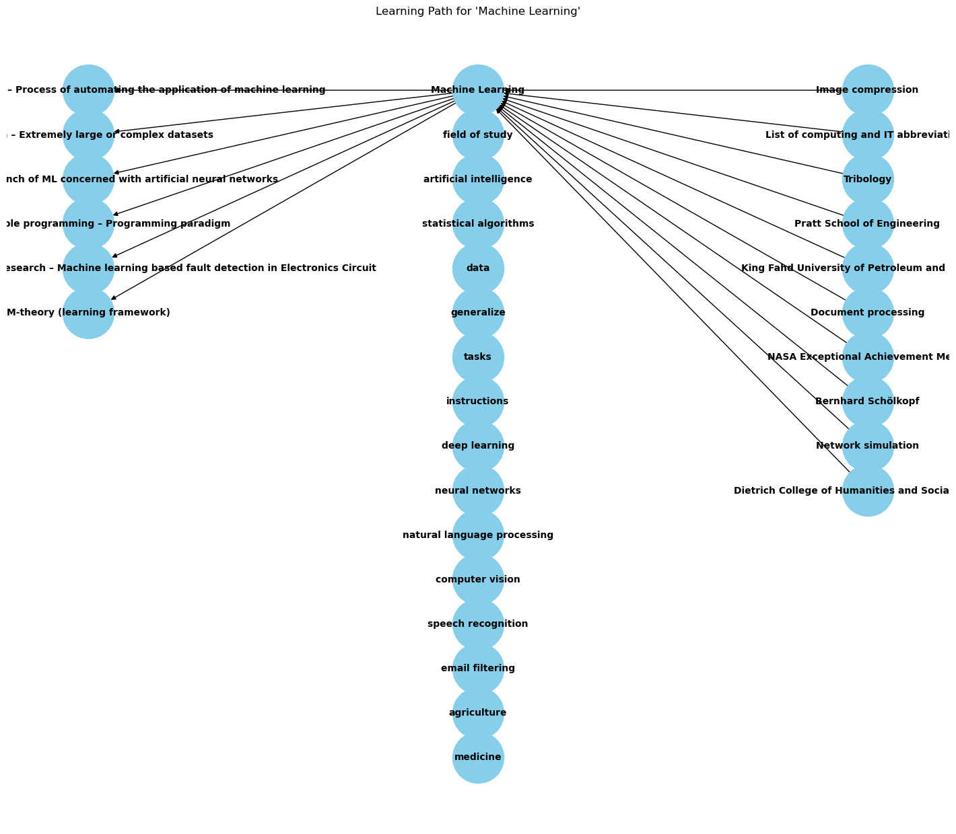
Implementation - Visualization
For the concept: "Machine Learning"
Behind -> Current -> Beyond

Slide 13
Thank You!

