Slide 1


Todo with CRUD Operation using HTML, JS, and CSS
By Abhijot

Slide 2

Introduction to CRUD Operations
Understand the fundamental concepts of CRUD operations and their significance in web development.

Slide 3

Overview of HTML, JS, and CSS
Explore the basic building blocks of web development: HTML for structure, CSS for styling, and JS for interactivity.

Slide 4

Creating a Database
Database Selection
Database Design
Database Setup
Select the most appropriate database technology for your project, considering factors like scalability and ease of use.
Design a well-structured database schema that meets your application's requirements and ensures data integrity.
Set up your chosen database technology and create the necessary tables and relationships.

Slide 5

Connecting to the Database using JS
1
Establishing a Connection
Create a connection between your web application and the database using JavaScript libraries or frameworks.
Data Retrieval
2
Use JavaScript to retrieve data from the database and display it dynamically on your web application.
3
Data Manipulation
Learn how to update, insert, and delete records in the database with JavaScript for seamless data management.

Slide 6
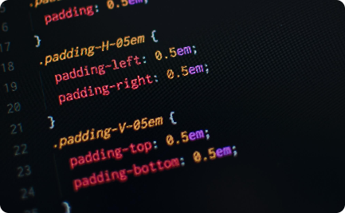
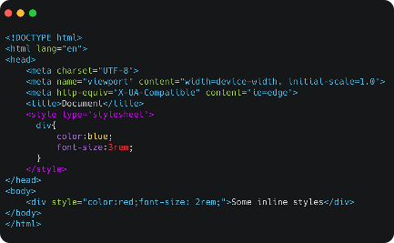

Creating User Interfaces with HTML and CSS
HTML Structure
CSS Styling
Responsive Design
Create a user-friendly and well-organized HTML structure for your Todo application.
Apply CSS styles to enhance the visual appearance of your Todo application and make it more engaging for users.
Design your Todo application to be responsive, ensuring it looks great and functions well on various devices and screen sizes.

Slide 7
Implementing CRUD Functions with JS
1
Create Task
Enable users to create new tasks by capturing input and adding them to the database using JavaScript.
Read Task
2
Fetch task data from the database and display it on the interface for users to view and interact with.
3
Update Task
Allow users to edit and update task details, such as title, due date, or status, using JavaScript.
Delete Task
4
Implement functionality to delete tasks from the database based on user actions, ensuring data consistency.

Slide 8
Conclusion and Next Steps
Summarize the key takeaways from the presentation and provide suggestions for further learning and improvement in web development.

