Slide 1
EXPLORATORY DATA ANALYSIS USING R
CHURN DATA
By Abhijoy Mukherjee

Slide 2
DESCRIPTION:
The dataset contains data of 100,000 customers of a telecom company. Per customer there are 173 variables available.
From the 173 variables there are 128 variables that are numeric and 45 that are character values.
Of the 100,000 people there are 49,562 people that have churned and 50,438 people are(still) a current customer (non-churned).
Churn status 0 indicates non-churned and 1 indicates churned.
We have performed an Exploratory Data Analysis on this churn data.

Slide 3
Data Cleaning:
There were variables(columns) with many missing values, so we took only those columns which had less than 50 percent missing values.
We finally got 163 columns on which we performed our EDA

Slide 4
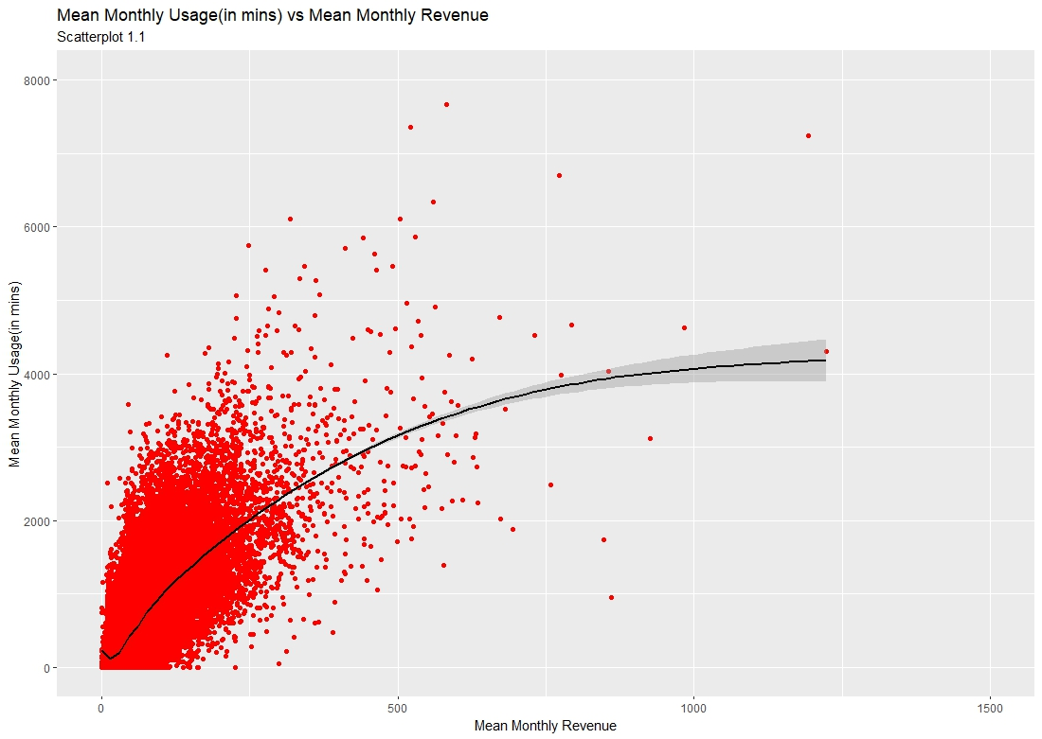
INSIGHT:
From Scatterplot 1.1,we can see a positive association between the Mean Monthly Revenue and Mean Monthly usage(in Mins).
The Product Moment Correlation between Mean Monthly Usage and Mean Monthly Revenue is 0.706. But the smoothened curve is increasing with a decreasing rate. So linear relation is not so appropriate.

Slide 5
DESCRIPTIVE STATISTICAL MEASURES:
MEASURES OF CENTRAL TENDENCY:
Mean Monthly Revenue:
Min. 1st Qu. Median Mean 3rd Qu. Max.
-6.168 33.260 48.195 58.720 70.750 3843.262
Mean Monthly Usage:
Min. 1st Qu. Median Mean 3rd Qu. Max.
0.0 150.8 355.5 513.6 703.0 12206.8

Slide 6
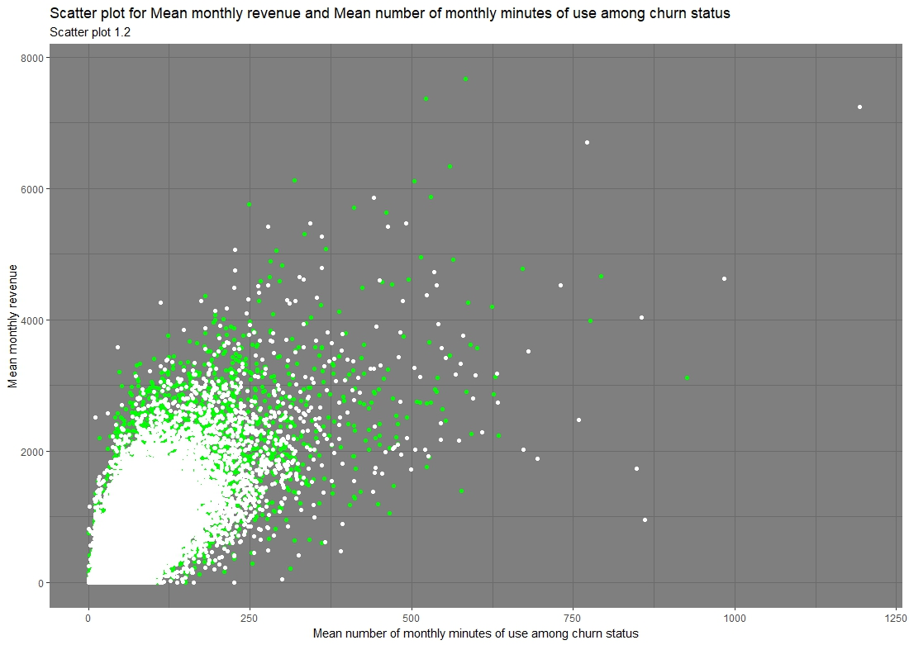
INSIGHT:
From Scatterplot 1.2, we can see white coloured scatter plot shows positive association between the Mean Monthly Revenue and Mean Monthly usage(in Mins) for non-churned. Similarly green scatter plot also shows positive association between them for churned.
The Product Moment Correlation between Mean Monthly Usage and Mean Monthly Revenue is 0.717 for non-churned and 0.700 for churned.

Slide 7
DESCRIPTIVE STATISTICAL MEASURES:
Mean Monthly Usage for non-Churn:
Min. : 0.0
1st Qu.: 169.2
Median : 380.5
Mean : 543.2
3rd Qu.: 742.5
Max. :7667.8
Mean Monthly Usage for Churn:
Min. : 0.0
1st Qu.: 133.2
Median : 329.8
Mean : 483.3
3rd Qu.: 661.8
Max. :12206.8

Slide 8
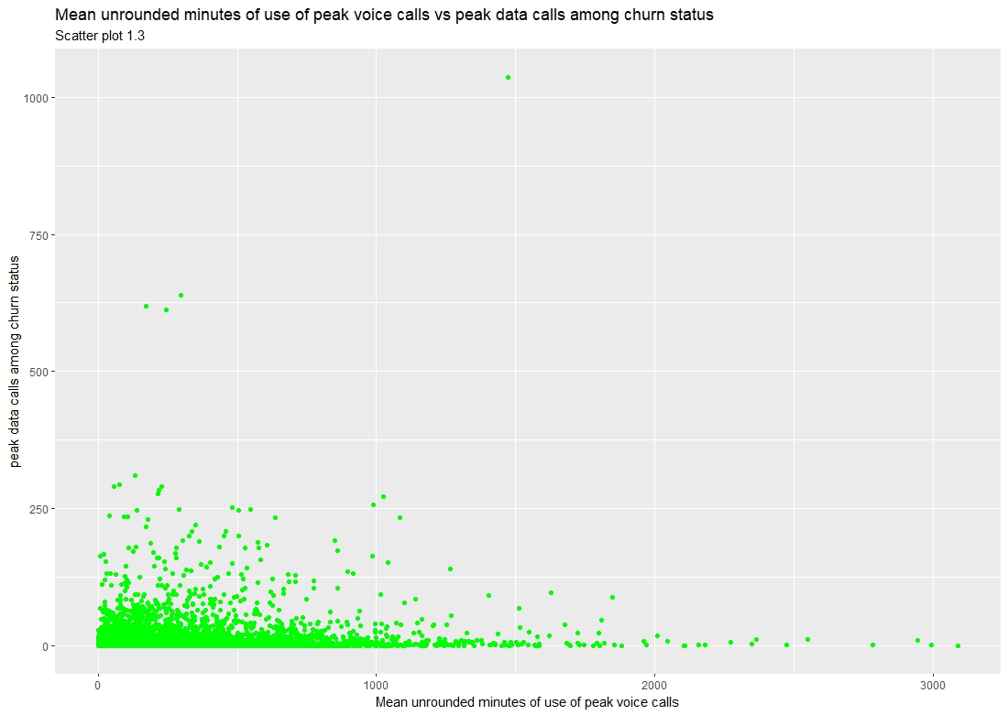
INSIGHT:
From Scatterplot 1.3,we can see less association between the Mean unrounded use of peak voice calls(in Mins) and peak data calls(in Mins). Usually we think they are inversely related but that is not seen here.
The Product Moment Correlation between Mean unrounded use of peak voice calls and peak data calls is 0.08

Slide 9
DESCRIPTIVE STATISTICAL MEASURES:
Peak data Calls:
Min. 1st Qu. Median Mean 3rd Qu. Max.
0.0067 0.1733 1.0500 7.8792 4.8067 1036.0533
Peak Voice Calls:
Min. 1st Qu. Median Mean 3rd Qu. Max.
0.0267 106.1200 200.8500 275.8605 349.8633 3089.5633

Slide 10
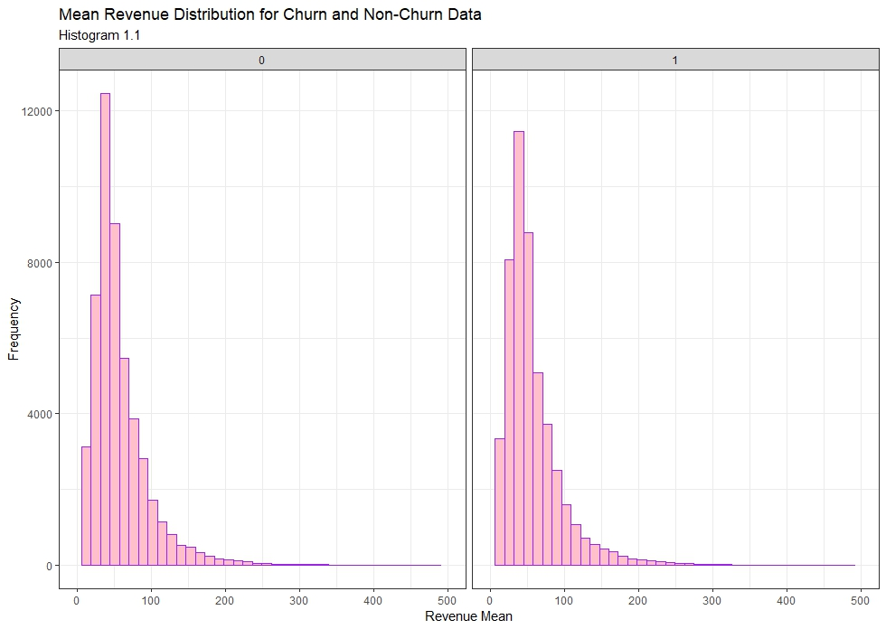
INSIGHT:
From Histogram 1.1, we notice that non-churned and churned have almost same histograms for Mean Revenue. But the odd thing is non-churned have higher frequency of Mean Revenue in third interval than churned in the same interval, whereas in the Second interval things are just opposite.

Slide 11
DESCRIPTIVE STATISTICAL MEASURES:
Mean monthly revenue for Non-Churn:
Min. : -6.168
1st Qu.: 34.087
Median : 48.876
Mean : 59.219
3rd Qu.: 71.490
Max. :1223.380
Mean monthly revenue for Churn:
Min. : 0.0
1st Qu.: 133.2
Median : 329.8
Mean : 483.3
3rd Qu.: 661.8
Max. :12206.8

Slide 12
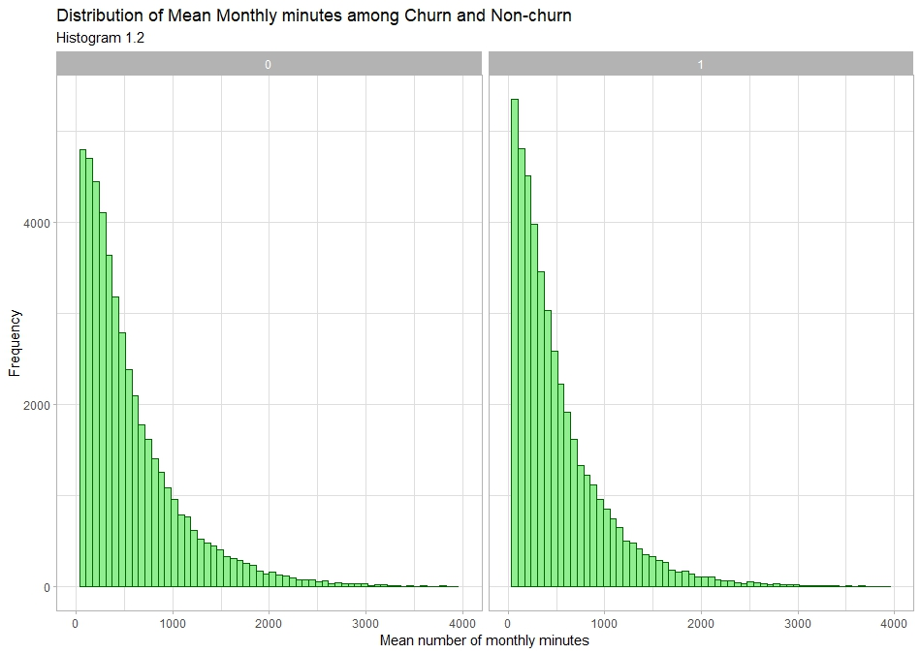
INSIGHT:
From Histogram 1.2, we notice that non-churned have lower frequency of Mean Monthly usage(in mins) in 1st interval than churned in the same interval. And also we see that frequencies decrease at a higher rate in churned than in non-churned .

Slide 13
DESCRIPTIVE STATISTICAL MEASURES:
Mean Monthly Usage for non-Churn:
Min. : 0.0
1st Qu.: 169.2
Median : 380.5
Mean : 543.2
3rd Qu.: 742.5
Max. :7667.8
Mean Monthly Usage for Churn:
Min. : 0.0
1st Qu.: 133.2
Median : 329.8
Mean : 483.3
3rd Qu.: 661.8
Max. :12206.8

Slide 14
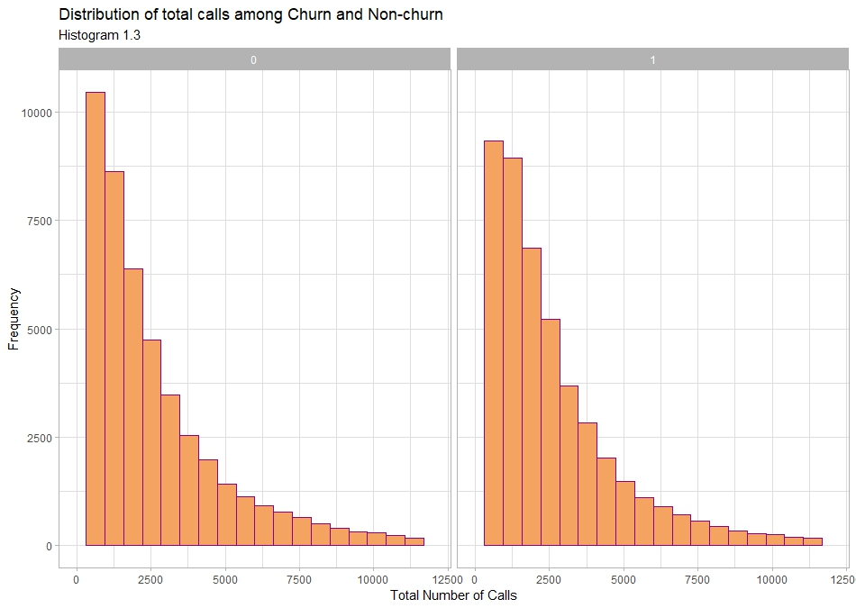
INSIGHT:
From Histogram 1.3, we notice that non-churned have higher frequency of total number of calls in 1st interval than churned in the same interval. And also we see that frequencies decrease at a higher rate in non-churned than in churned .

Slide 15
DESCRIPTIVE STATISTICAL MEASURES:
Total calls for NON-Churn:
Min. : 0
1st Qu.: 839
Median : 1775
Mean : 2936
3rd Qu.: 3519
Max. :98874
Total calls for Churn:
Min. : 0
1st Qu.: 943
Median : 1867
Mean : 2817
3rd Qu.: 3469
Max. :80295

Slide 16
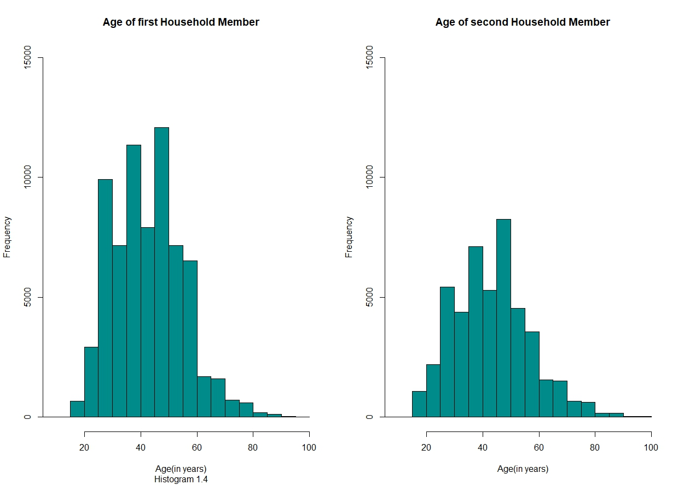
INSIGHT:
From Histogram 1.4, we notice that histogram of age of first household member and that of second are having a similar pattern. But age of first household member has higher frequency than the second in most of the intervals.

Slide 17
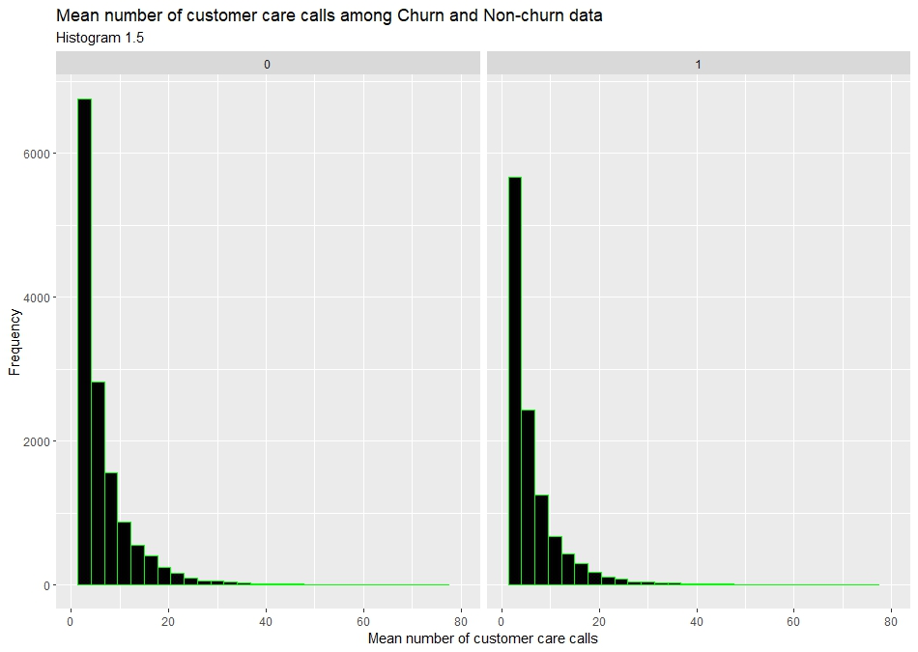
INSIGHT:
From Histogram 1.5, we notice that non-churned have higher frequency of mean number of customer care calls in 1st interval than churned in the same interval. And also we see that frequencies decrease at a higher rate in non-churned than in churned .

Slide 18
DESCRIPTIVE STATISTICAL MEASURES:
Customer care for Non-churn:
Min. : 0.000
1st Qu.: 0.000
Median : 0.000
Mean : 1.983
3rd Qu.: 2.000
Max. :365.667
Customer care for Non-churn:
Min. : 0.000
1st Qu.: 0.000
Median : 0.000
Mean : 1.596
3rd Qu.: 1.333
Max. :675.333

Slide 19
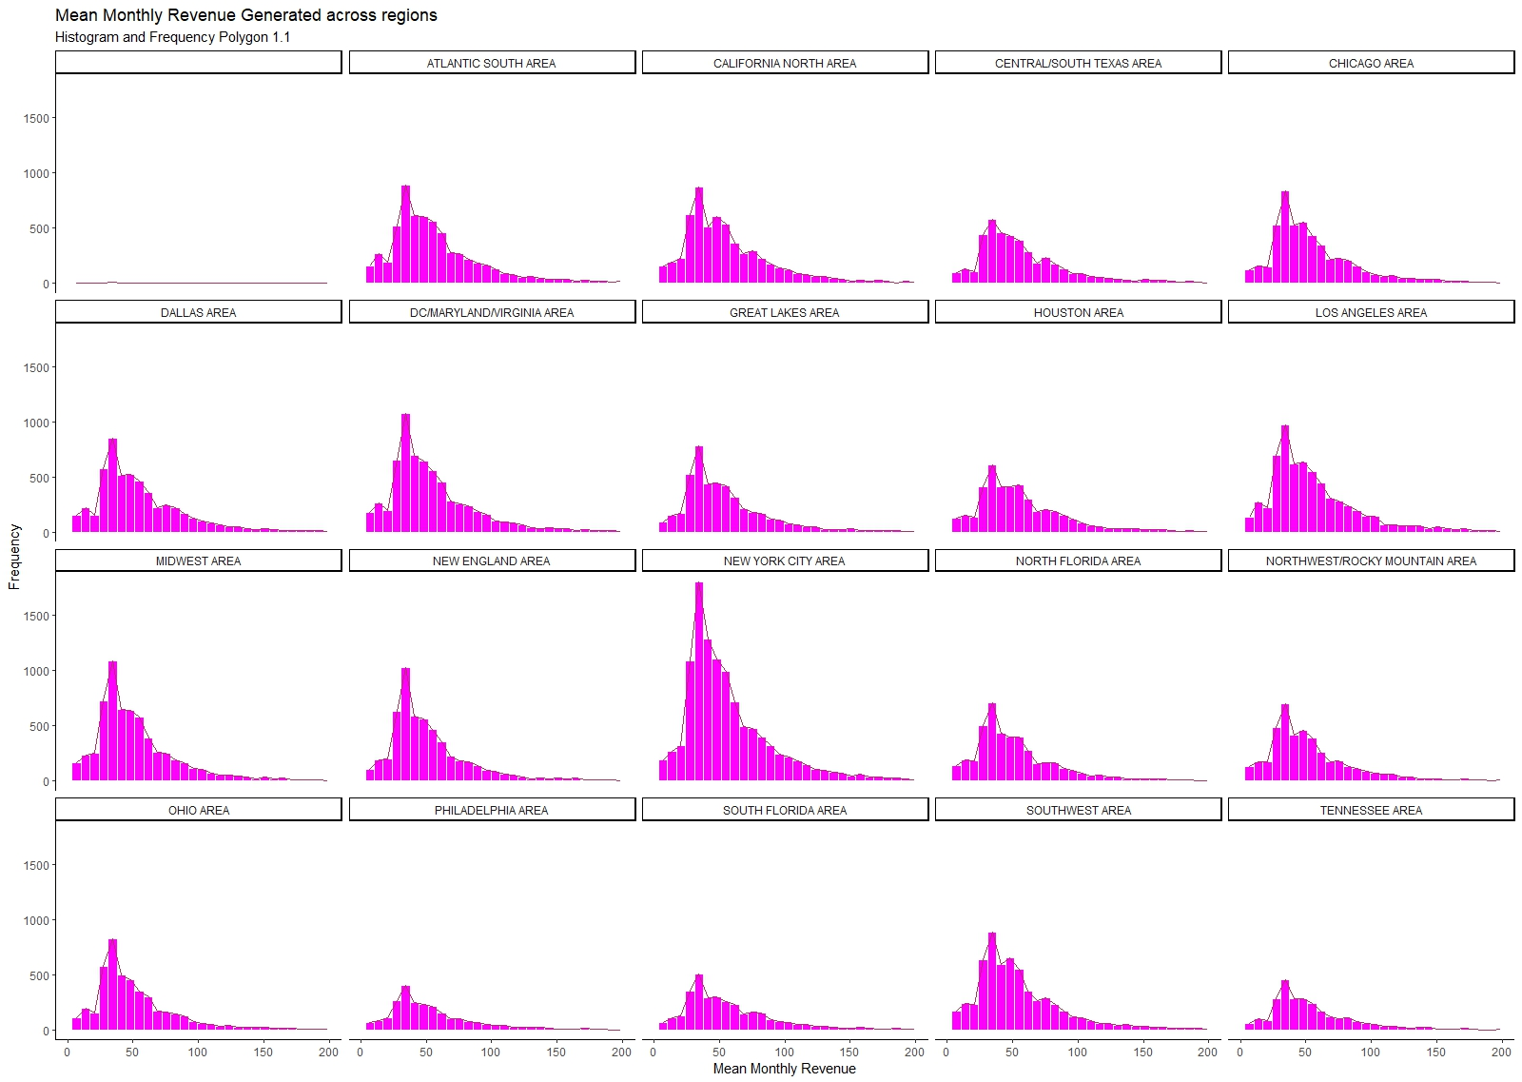

Slide 20
INSIGHT:
From Histogram and Frequency polygon 1.1, we notice that among all the regions New York City area has the highest contribution in Mean Monthly Revenue generated. We also notice accross all regions the fifth interval has the highest frequency of Mean Monthly Revenue generated.

Slide 21
DESCRIPTIVE STATISTICAL MEASURES:
Mean monthly Revenue of Midwest Area:
Min. : -3.73
1st Qu.: 32.43
Median : 45.19
Mean : 55.83
3rd Qu.: 65.79
Max. :771.78
Mean Monthly Revenue of New York City Area:
Min. : -6.168
1st Qu.: 34.990
Median : 49.733
Mean : 61.267
3rd Qu.: 72.348
Max. :3843.262

Slide 22
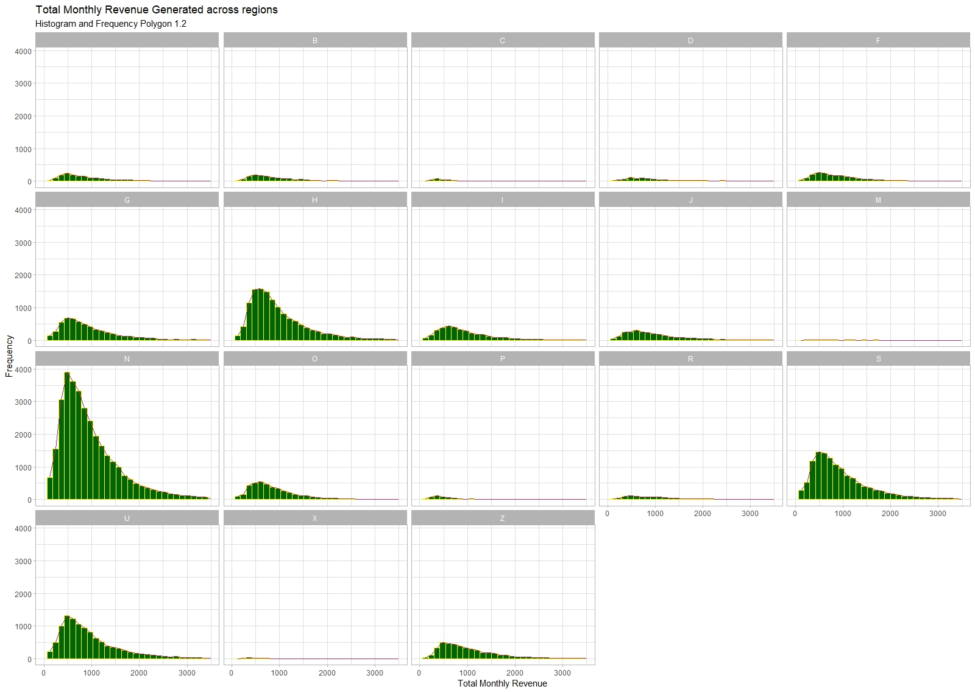

Slide 23
INSIGHT:
From Histogram and Frequency polygon 1.2, we notice that among all the regions Northern European ethnicity (here denoted as “N”) has the highest contribution in Total Monthly Revenue generated. We also notice accross all ethnicities lower intervals have higher frequency of Mean Monthly Revenue generated i.e. it is positively skewed.

Slide 24
DESCRIPTIVE STATISTICAL MEASURES:
B = Asian (non-Oriental)
D = Southern European
F = French
G = German
H = Hispanic
I = Italian
J = Jewish
M = Miscellaneous
N = Northern European
O = Asian
P = Polynesian
R = Arab
S = Scottish / Irish
U = Unknown
Z = African-American
Total Revenue of ‘N’ Ethnicity:
Min. : 3.65
1st Qu.: 515.02
Median : 802.96
Mean : 1029.68
3rd Qu.: 1269.32
Max. :16715.21

Slide 25
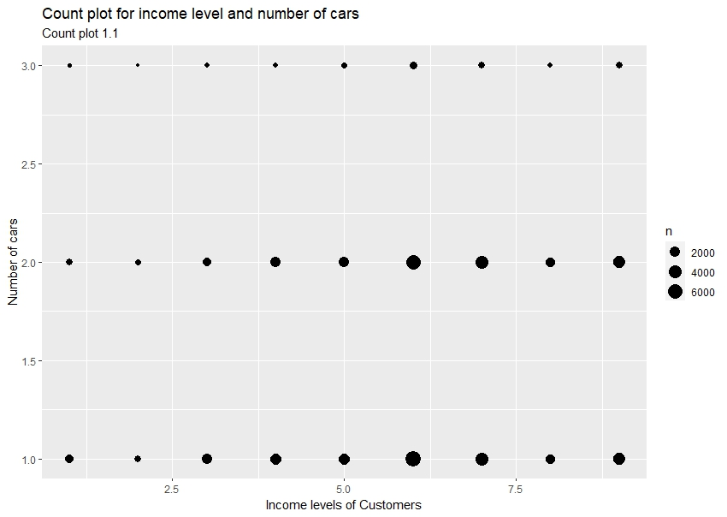
INSIGHT:
From Count plot 1.1,we can see as the income level increases the frequencies(size of dot) of having any no. of cars increases. And frequencies of having more no. car cars (in a particular income level) are lesser. We can also notice that most people who have car (of any number) are of income level 6 i.e. $50,000 to $74,999 yearly

Slide 26
DESCRIPTIVE STATISTICAL MEASURES:
Income level table:
1 2 3 4 5 6 7 8 9
4033 2260 5830 7790 8277 18802 11597 5142 10833
1 = Less than $15,000
2 = $15,000 to $19,999
3 = $20,000 to $29,999
4 = $30,000 to $39,999
5 = $40,000 to $49,999
6 = $50,000 to $74,999
7 = $75,000 to $99,999
8 = $100,000 to $124,999
9 = $125,000 +

Slide 27
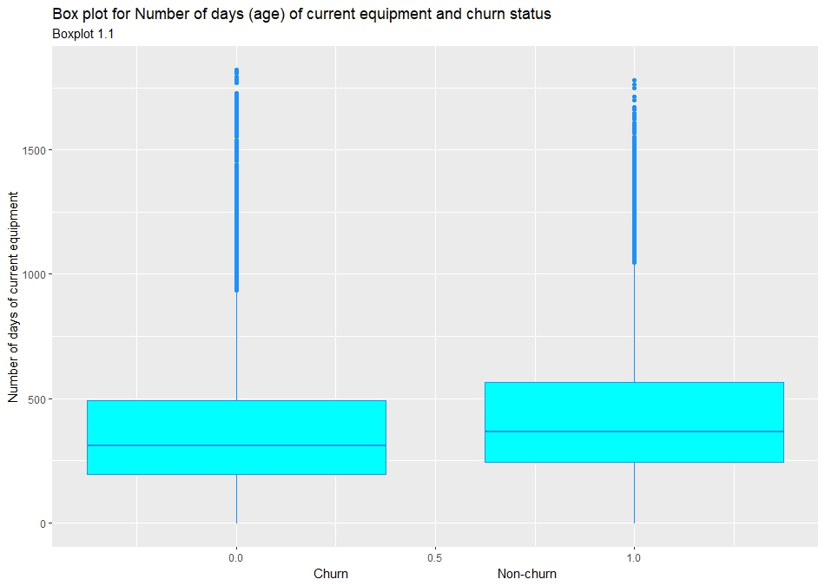
INSIGHT:
From Box plot 1.1,we can see that churned has more no. of days of current equipments (higher is the body of boxplot) than non-churned. We also observe no. of days of current equipments is positively skewed for both churned and non churned. And we also have many outliers of higher value.

Slide 28
DESCRIPTIVE STATISTICAL MEASURES:
Number of days for current equipment for Non-churn:
Min. : -5.0
1st Qu.: 196.0
Median : 310.0
Mean : 363.3
3rd Qu.: 492.0
Max. :1823.0
Number of days for current equipment for Non-churn:
Min. : -4.0
1st Qu.: 245.0
Median : 366.0
Mean : 421.1
3rd Qu.: 566.0
Max. :1779.0

Slide 29
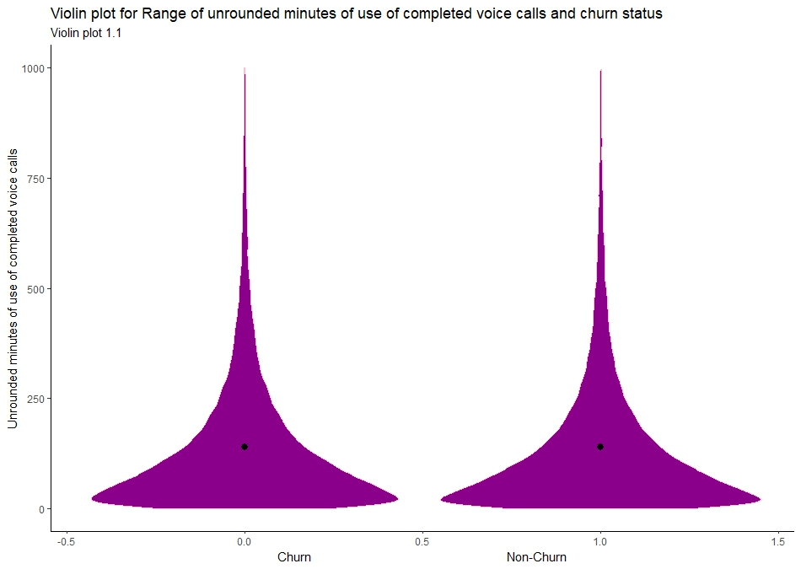
INSIGHT:
From Violin plot 1.1,we can see that for both churned and non-churned the violin plot is thicker towards the bottom i.e. most of the Range of use of completed voice calls (in unrounded mins) is of lesser values.

Slide 30
DESCRIPTIVE STATISTICAL MEASURES:
Range of Unrounded minutes of complete voice calls for non-churn:
Min. : 0.00
1st Qu.: 58.27
Median : 159.88
Mean : 241.40
3rd Qu.: 329.37
Max. :4514.45
Range of Unrounded minutes of complete voice calls for churn:
Min. : 0.00
1st Qu.: 40.58
Median : 132.71
Mean : 213.88
3rd Qu.: 289.36
Max. :3987.53

Slide 31
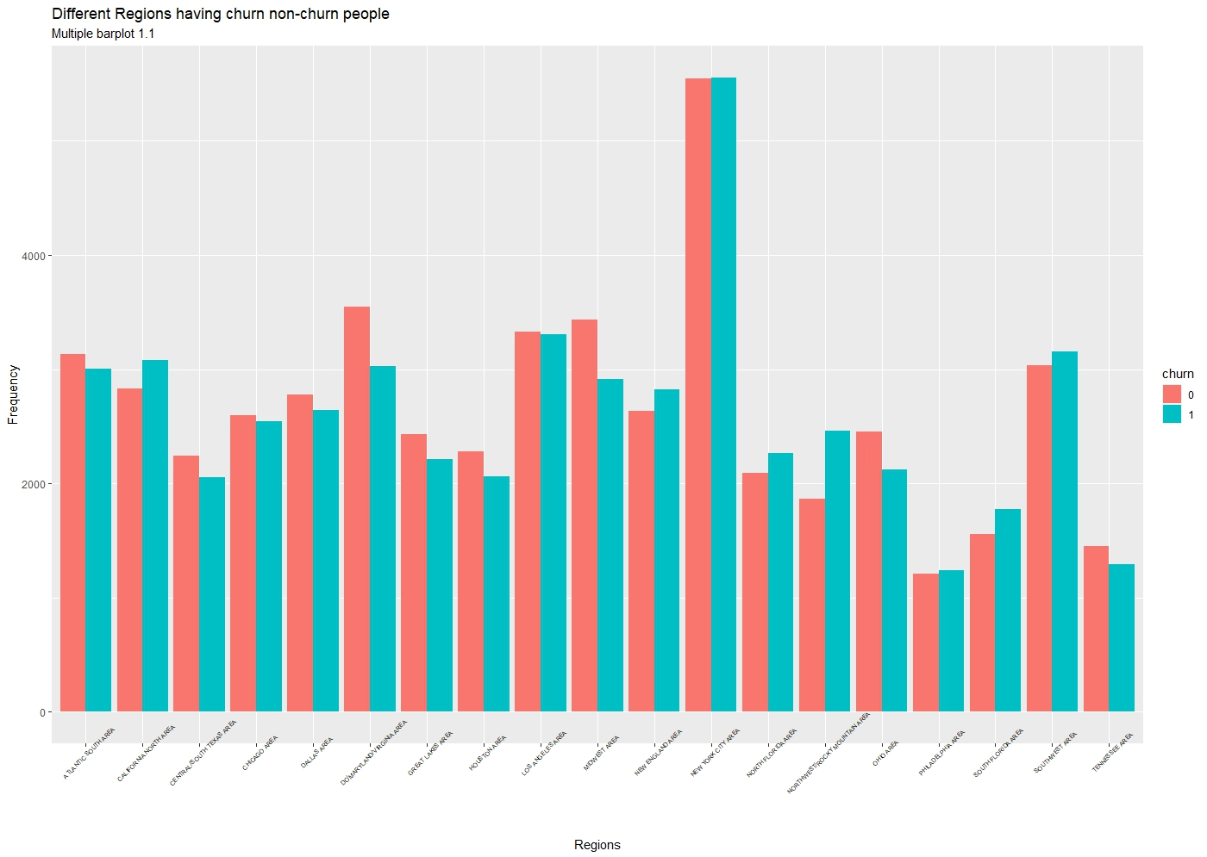

Slide 32
INSIGHT:
From Multiple Barplot 1.1,we can see that for both churned and non-churned, New York City Area dominates over other areas. Out of 19 areas, 10 have more non-churned people, 6 have more churned people and rest have more or less equally both.

Slide 33
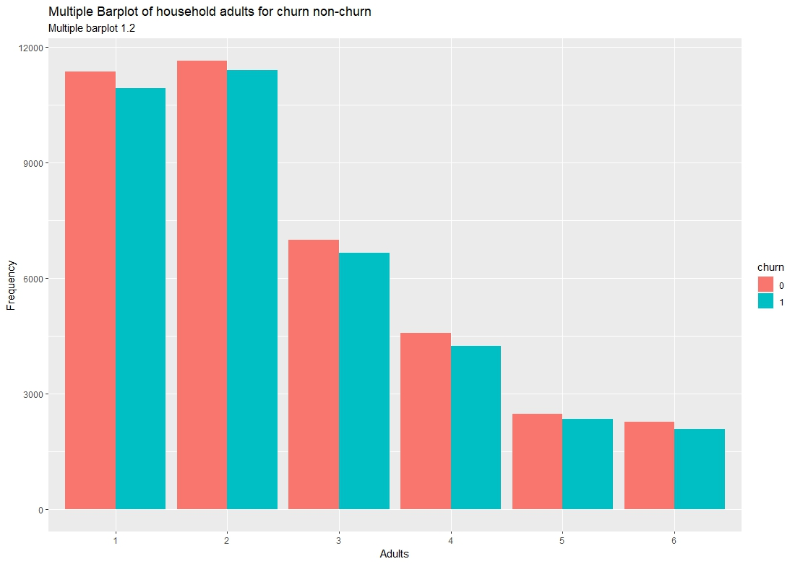
INSIGHT:
From Multiple barplot 1.2, we can see that over every household (irrespective of no of adults in it) non-churned people is more, compared to churned. And most households in the survey have 2 adults in the household. And less households have more adults in them.

Slide 34
DESCRIPTIVE STATISTICAL MEASURES:
Number of Adults for Non- Churn:
1 2 3 4 5 6
11359 11641 7003 4575 2478 2268
Number of Adults for Churn:
1 2 3 4 5 6
10940 11404 6664 4228 2339 2082

Slide 35
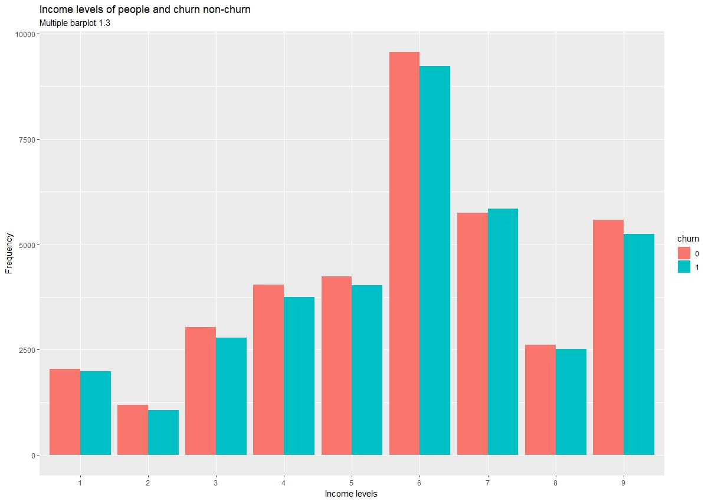
INSIGHT:
From Multiple barplot 1.3, we can see that we have highest number of customers from income level of type 6,where the customers make around $50,000 to $74,999 yearly.And among all income levels non-churned dominates over churned except level 7.

Slide 36
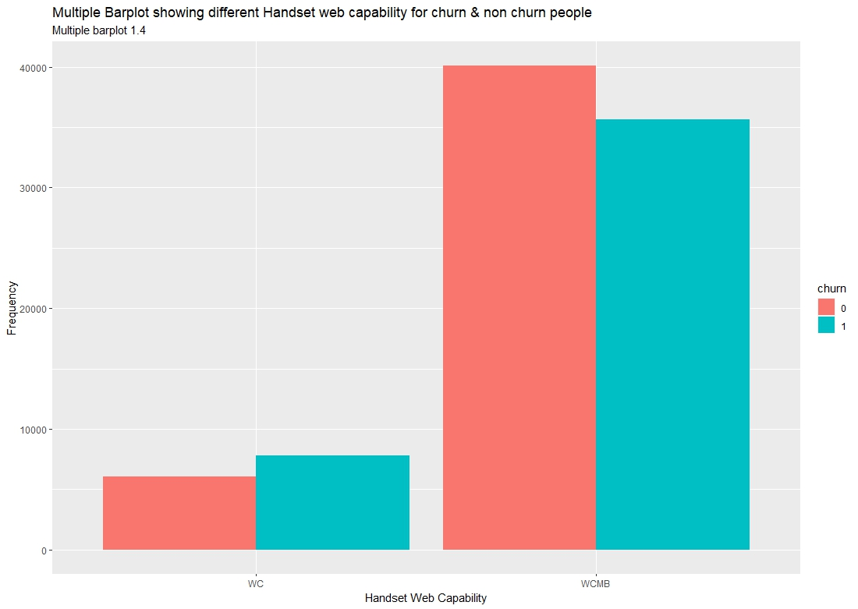
INSIGHT:
From Multiple barplot 1.4, we can see that Web capable (WC) has more churned people whereas Web capable Mini Browser (WCMB)has more non-churned people.
And more people are of WCMB than WC.

Slide 37
DESCRIPTIVE STATISTICAL MEASURES:
Handset Web capable table:
Web Capable Web capable Mini Browser
13843 75733

Slide 38
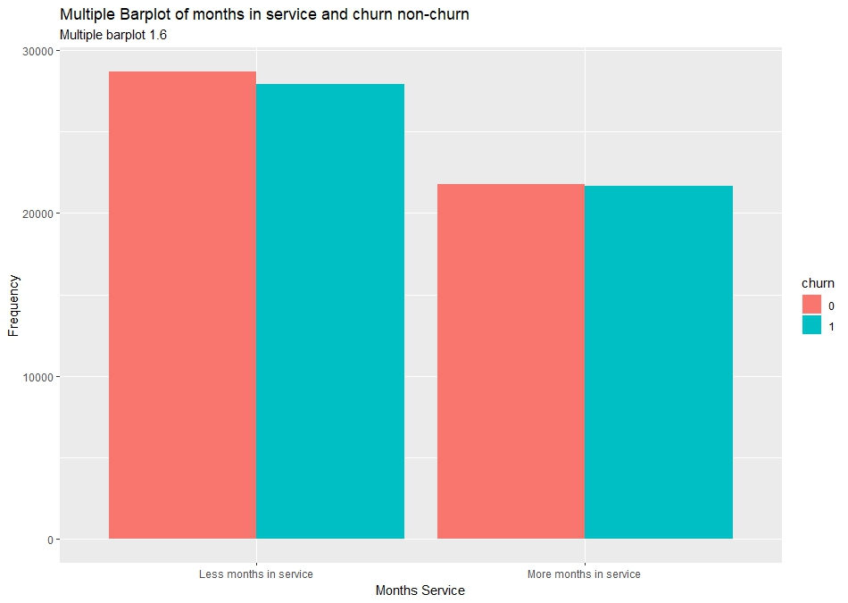
INSIGHT:
From Multiple barplot 1.6, we can see that there are more people in “Less months in service” than the other. And by very small margin non- churned dominates over churned accross the categories.

Slide 39
DESCRIPTIVE STATISTICAL MEASURES:
Months in service for Non-Churn:
Min. : 6.00
1st Qu.:11.00
Median :16.00
Mean :18.63
3rd Qu.:24.00
Max. :61.00
Months in service for Churn:
Min. : 6.00
1st Qu.:12.00
Median :17.00
Mean :19.04
3rd Qu.:24.00
Max. :61.00

Slide 40
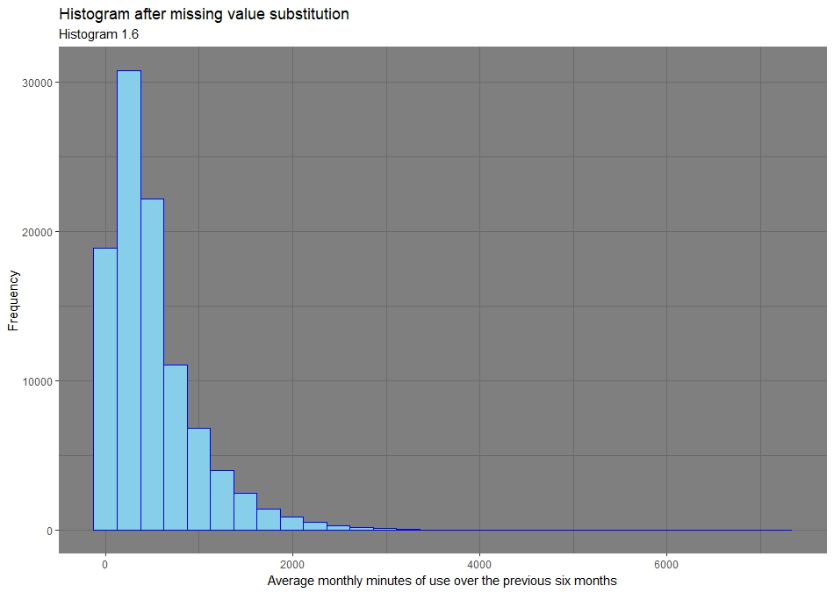
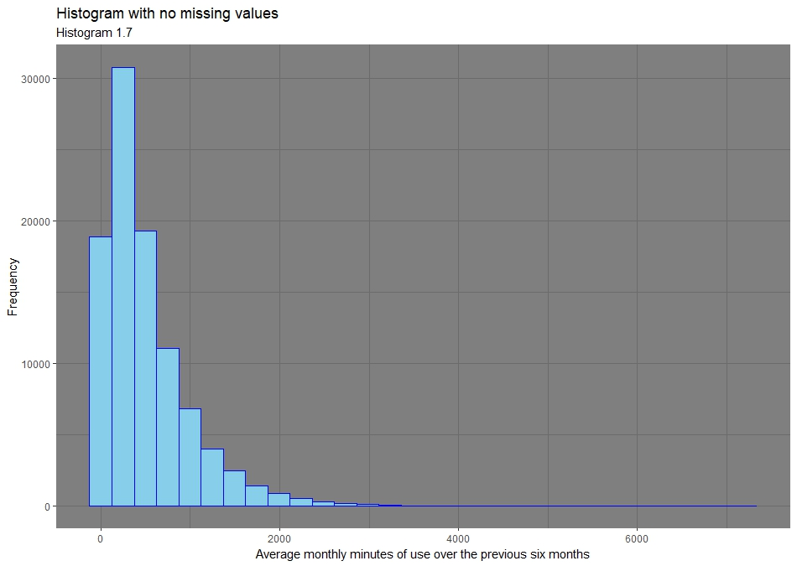
INSIGHT:
From Histogram 1.6 & 1.7, we can see that Average monthly minutes of use over the previous 6 months has highest frequency in the 2nd interval. After substituting the missing values by the mean we see frequency has increased(in 1.6) in the third interval but still modal class remains the same.

Slide 41
DESCRIPTIVE STATISTICAL MEASURES:
Average monthly mins over 6 months:
Min. 1st Qu. Median Mean 3rd Qu. Max.
0.0 163.0 363.0 509.6 698.0 7217.0
Average monthly mins over 6 months(Mean value for NAs:
Min. 1st Qu. Median Mean 3rd Qu. Max.
0.0 168.0 377.0 509.6 683.0 7217.0

Slide 42
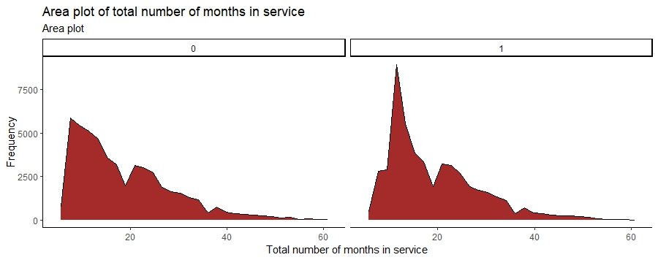
INSIGHT:
From this Area plot, we can see that for both non-churned and churned, highest peak is in the interval 0-20 of total number of months in service. But the peak of churned is much higher in that interval than non-churned. After 20 area plot is more or less same for both.

Slide 43
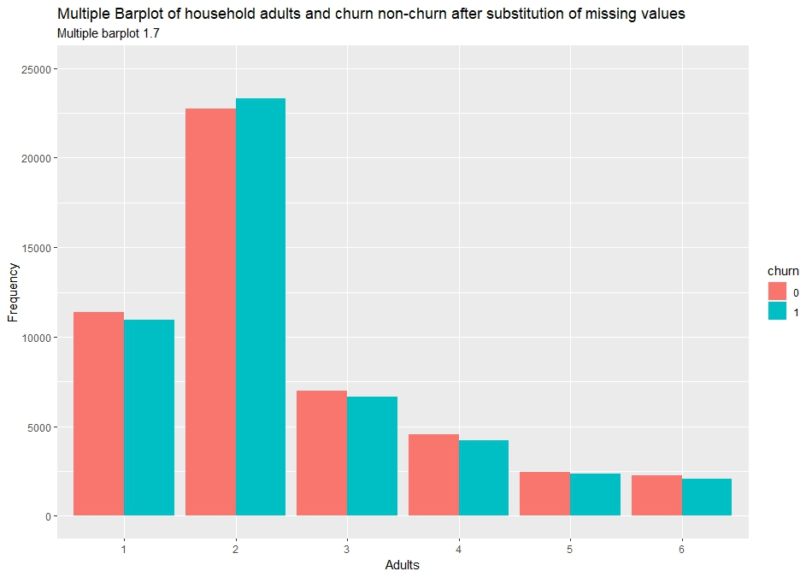
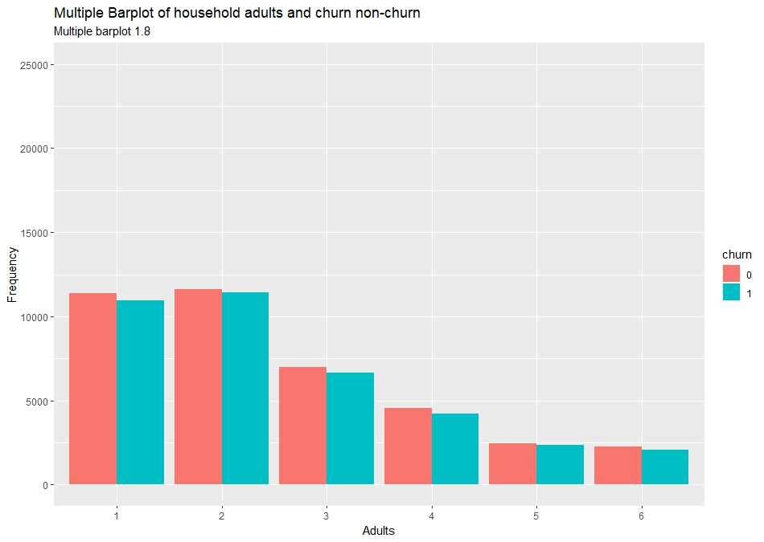
INSIGHT:
From Multiple barplot 1.8, we can see that in every household irrespective of no of adults in it, non-churned has dominated. But after substitution of missing values with modal category we see in Multiple barplot 1.7, in household having adults 2, churned has dominated.

Slide 44
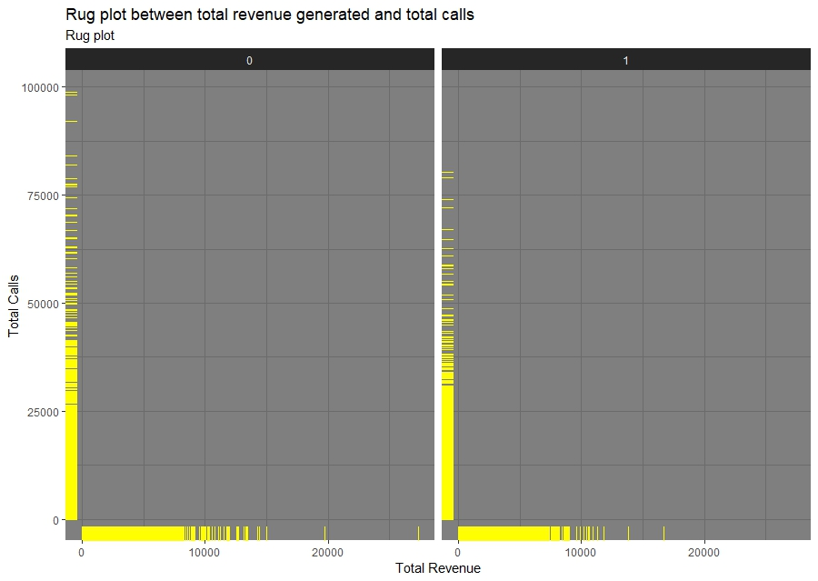
INSIGHT:
From the Rug plot, we can see that in each category of churned and non-churned, most of the values of total revenue are low and the same is for total calls.

Slide 45
CONCLUSION:
We performed our EDA and came up with many things. Non-churned people are more in number, in many plots. There were also some pecularities that were got from the plots. There we have given the insights that we got from the plots. Many variables give very less insight we haven’t taken them. EDA’s purpose is to give an outer review of the data before hardcore analysis.

Slide 46
Future Scope of Work:
We will use some methods for predictive analysis and for some hypothesis testing regarding churned and non-churned people.
And get more insights from the data.

Slide 47
THANK YOU!

