Slide 1
PowerBI DAX and Data Models
By Abhishek Karande

Slide 2
What is DAX in PowerBI?
DAX stands for Data Analysis Expressions, and is a formula language used to create custom calculations in Power BI.
DAX functions can be used to create complex calculations, such as aggregating data over time periods or across different tables
DAX can be used in measures, calculated columns, and calculated tables, providing flexibility in how data is analyzed and presented.
DAX formulas can reference other DAX formulas, as well as data from other tables, making it easy to create complex calculations based on multiple data sources.
By using DAX, users can create dynamic, interactive reports and dashboards that provide deeper insights into their data, improving decision-making and driving better business outcomes.

Slide 3
What is Data Model?
A data model is a conceptual representation of data that defines the relationships between data elements and provides a framework for organizing data.
Data models can be used to represent a wide range of data types, including text, numbers, dates, and images.
A data model typically consists of tables, which represent entities, and relationships, which define how these entities are related to one another.
Data models can be used to support a wide range of applications, including business intelligence, data analytics, and database design.
By using a data model, organizations can better understand and manage their data, improving the accuracy and completeness of their data, and making it easier to analyze and use for decision-making.

Slide 4
Use of DAX and Data Models in Zomato Analysis:
Custom calculations: By using DAX, Zomato could create custom calculations to analyze metrics such as restaurant revenue, order volumes, and customer feedback. These custom calculations could provide deeper insights into key performance indicators and help to identify areas for improvement.
Integration with multiple data sources: Zomato could use DAX to integrate data from multiple sources, including Zomato's own database and external data sources such as social media and customer reviews.
Flexibility: DAX formulas can be used in measures, calculated columns, and calculated tables, providing Zomato with a high degree of flexibility in how they analyze and present their data. This would allow Zomato to create customized reports and dashboards that are tailored to their specific needs.
Improved decision-making: By enabling deeper analysis of data and the creation of more advanced visualizations, DAX could help Zomato to make better, data-driven decisions about restaurant operations, customer engagement, and other critical business areas.
Dynamic, interactive reporting: DAX formulas can be used to create dynamic, interactive reports and dashboards that respond to user input. This would provide Zomato with a more engaging and intuitive user experience, enabling them to better understand their data and make faster, more informed decisions.

Slide 5
1- Rating bin = IF(Main[Rating]<=1,"1",IF(Main[Rating]>1.1 && Main[Rating]<=2,"2",IF(Main[Rating]>2.1 && Main[Rating]<=3,"3",IF(Main[Rating]>3.1 && Main[Rating]<=4,"4",IF(Main[Rating]>4.1 && Main[Rating]<=5,"5")))))
Rating bin DAX is a calculation that is used to group ratings into different categories or bins based on a set of predefined criteria.
- Categorizing data:
- Simplifying analysis:
2- Buckets = IF(Main[Average_Cost_for_two]<=200,"0-200",IF(Main[Average_Cost_for_two]<=400,"201-400",IF(Main[Average_Cost_for_two]<=600,"401-600",IF(Main[Average_Cost_for_two]<=800,"601-800",IF(Main[Average_Cost_for_two]<=1000,"801-1000","1000+")))))
Bucket DAX is a calculation that is used to group numeric data into different categories or "buckets" based on a set of criteria.

Slide 6
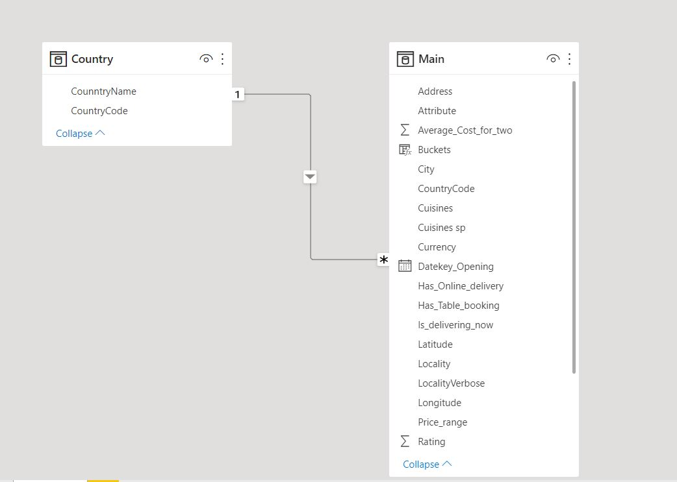
Data Model
Cardinality refers to the number of instances of one entity that can be related to the instances of another entity. It is a property of a relationship between two entities in a data model.
Cardinality is expressed using symbols such as "1", "0", "N", and "M".
For example, a "1:N" cardinality indicates that each instance of one entity is related to many instances of another entity.
A Relationship in a data model defines the way two or more entities are related to each other. It describes how data from one entity is associated with data from another entity.

Slide 7


