Slide 1

Online Video KYC
Shaheer Hasan Khan(RA2111042010035)
Astha Jaiswal (RA2111042010025)
Saad Abdul Hai (RA2111005010040)
Abhishek Kale (RA2111028010148)
Parakh Tyagi (RA2111028010146)
Yashvardhan (RA2111028010155)

Slide 2
Contents
Home Page | An overview of website’s main page to start KYC
Online Video KYC | Steps for verification
FAQ’s | Few examples of questions with their answers
Contact Support | You can reach out to us through our contact support
About Us | Our Vision, Mission, Team, Contact Us
Validation | Confirmation status of your online video KYC

Slide 3
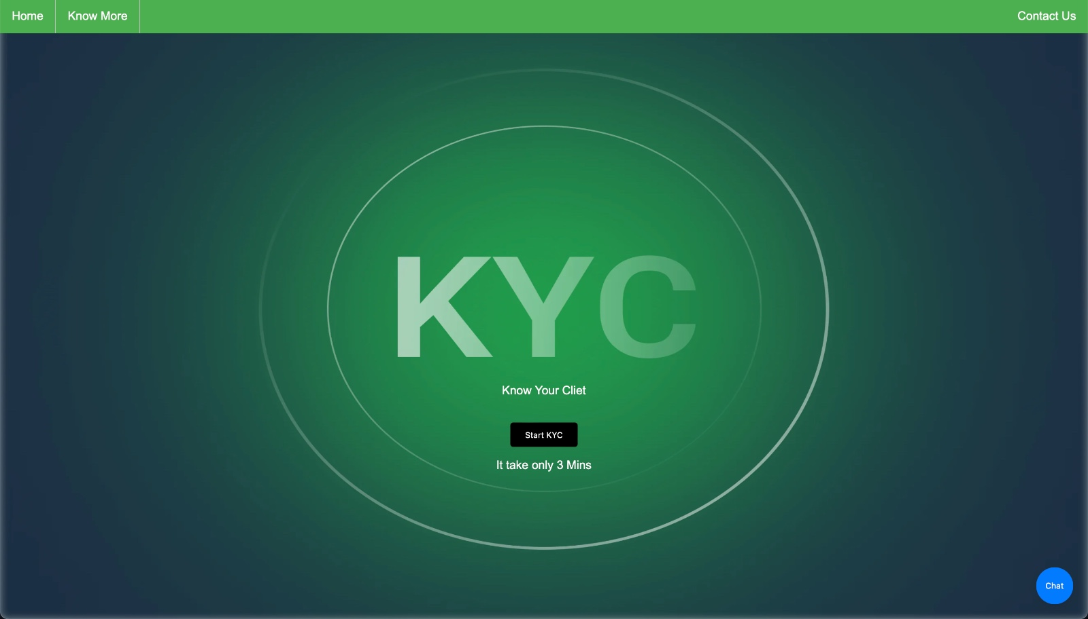

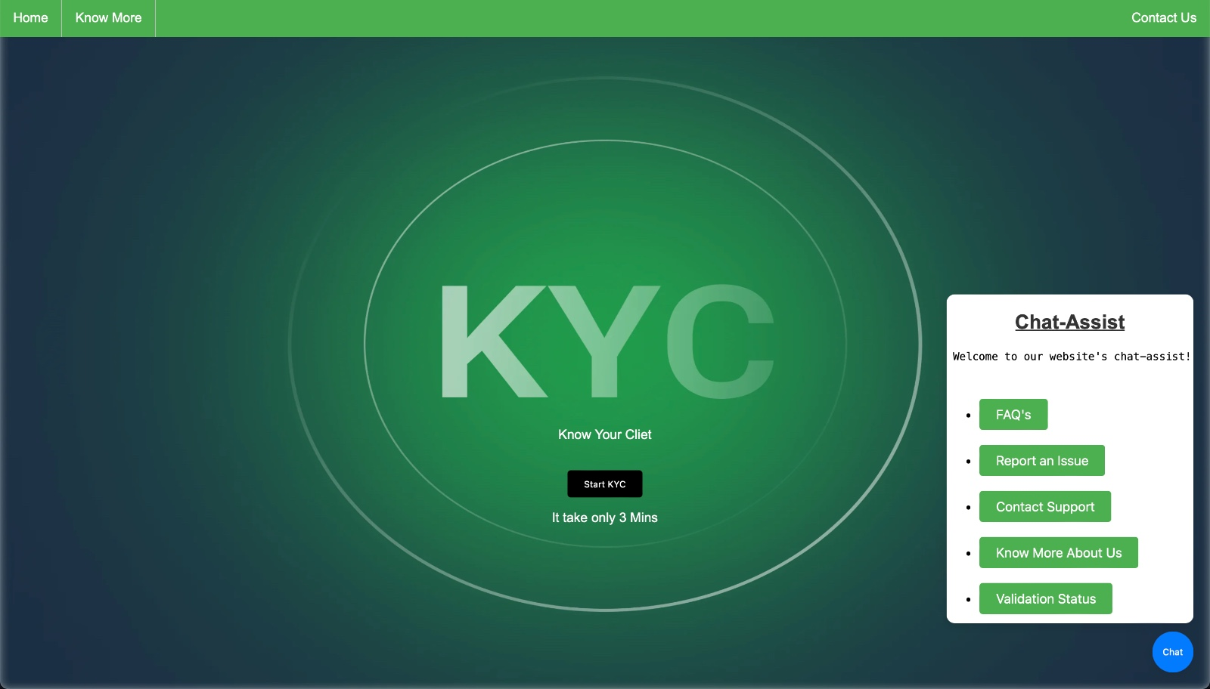
01
Home Page

Slide 4

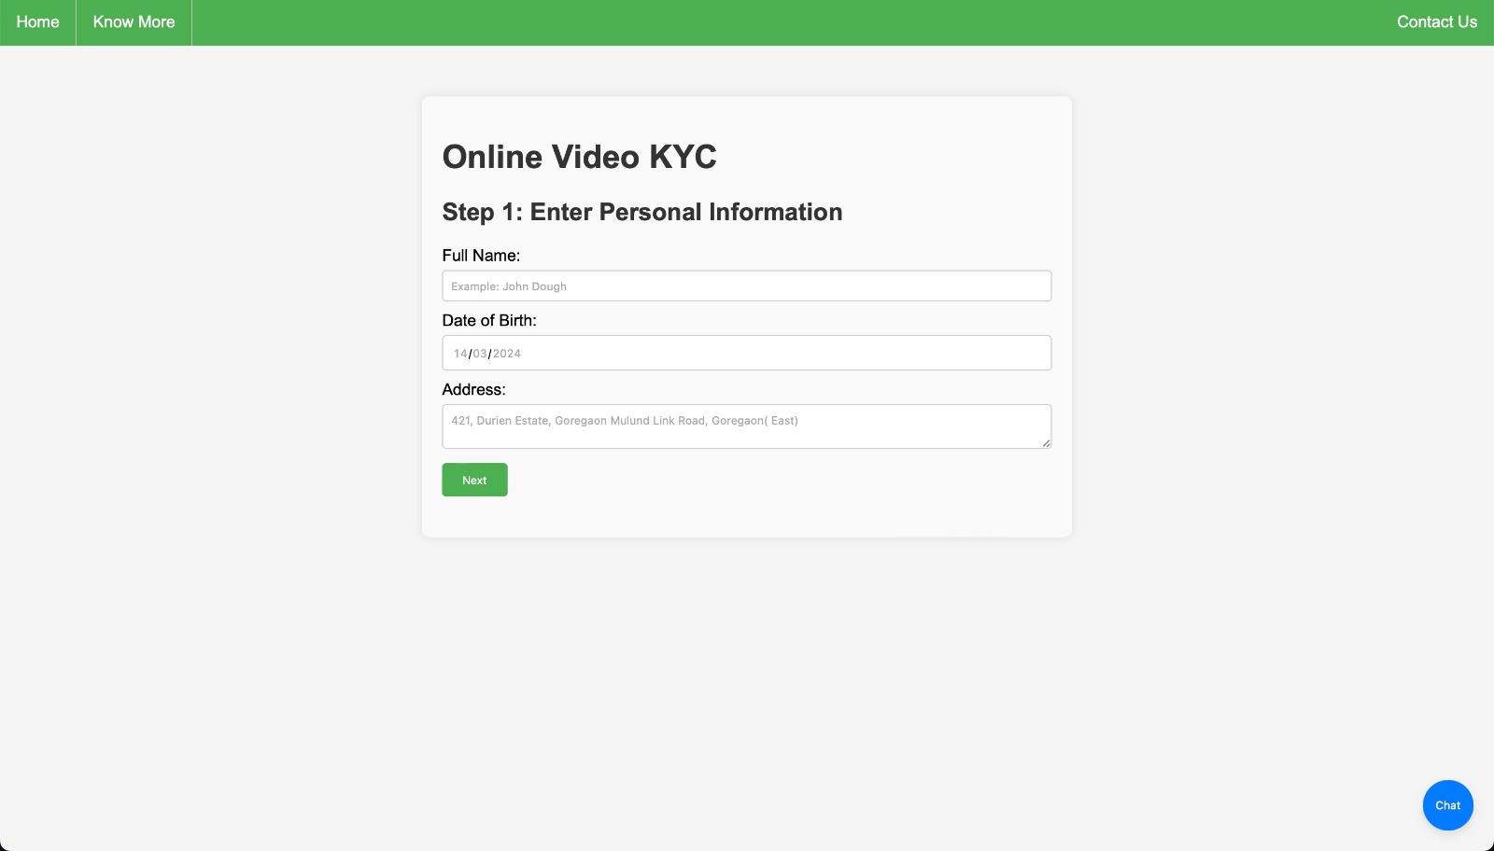
02
Online Video KYC

Slide 5

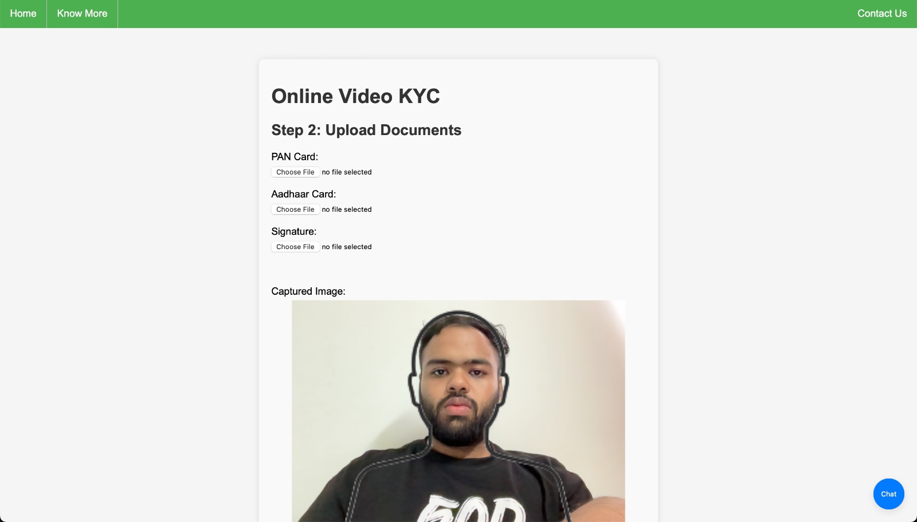
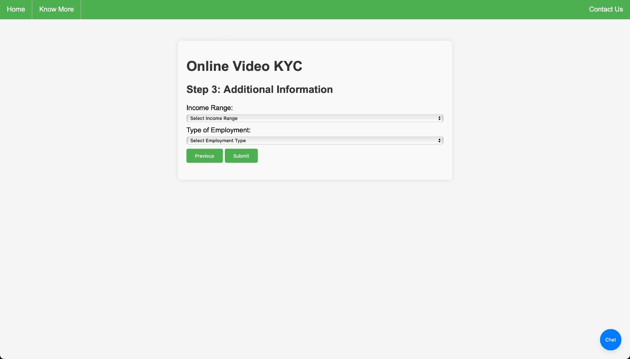
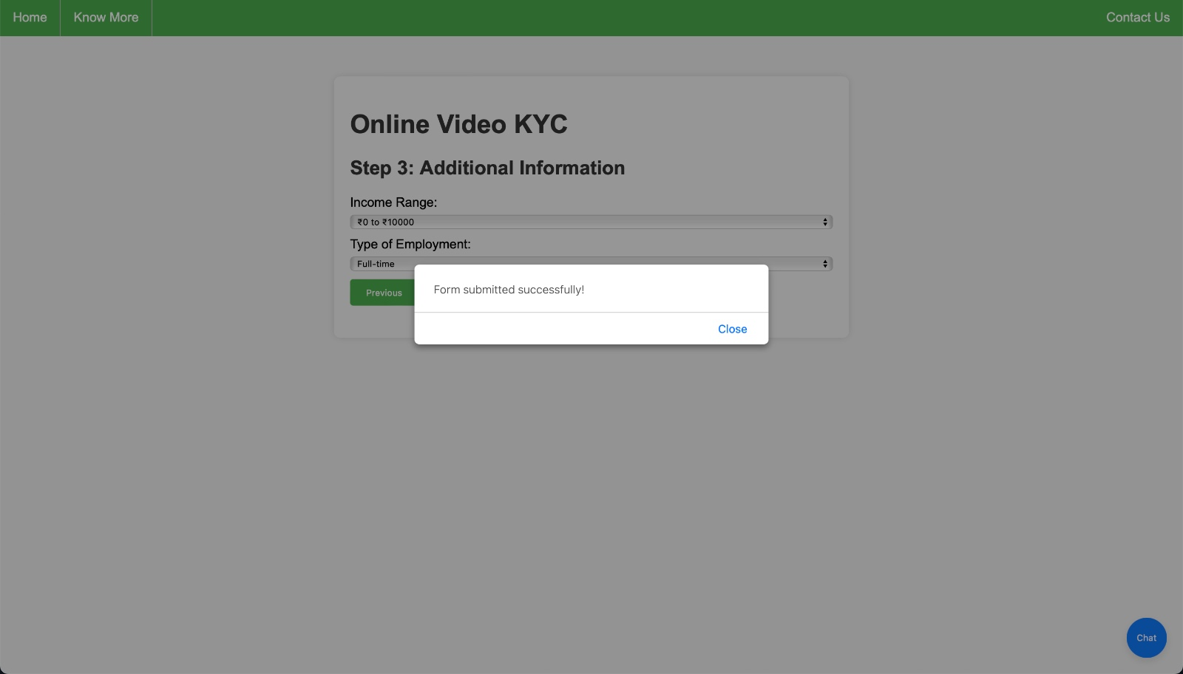
In depth
Mercury

Slide 6

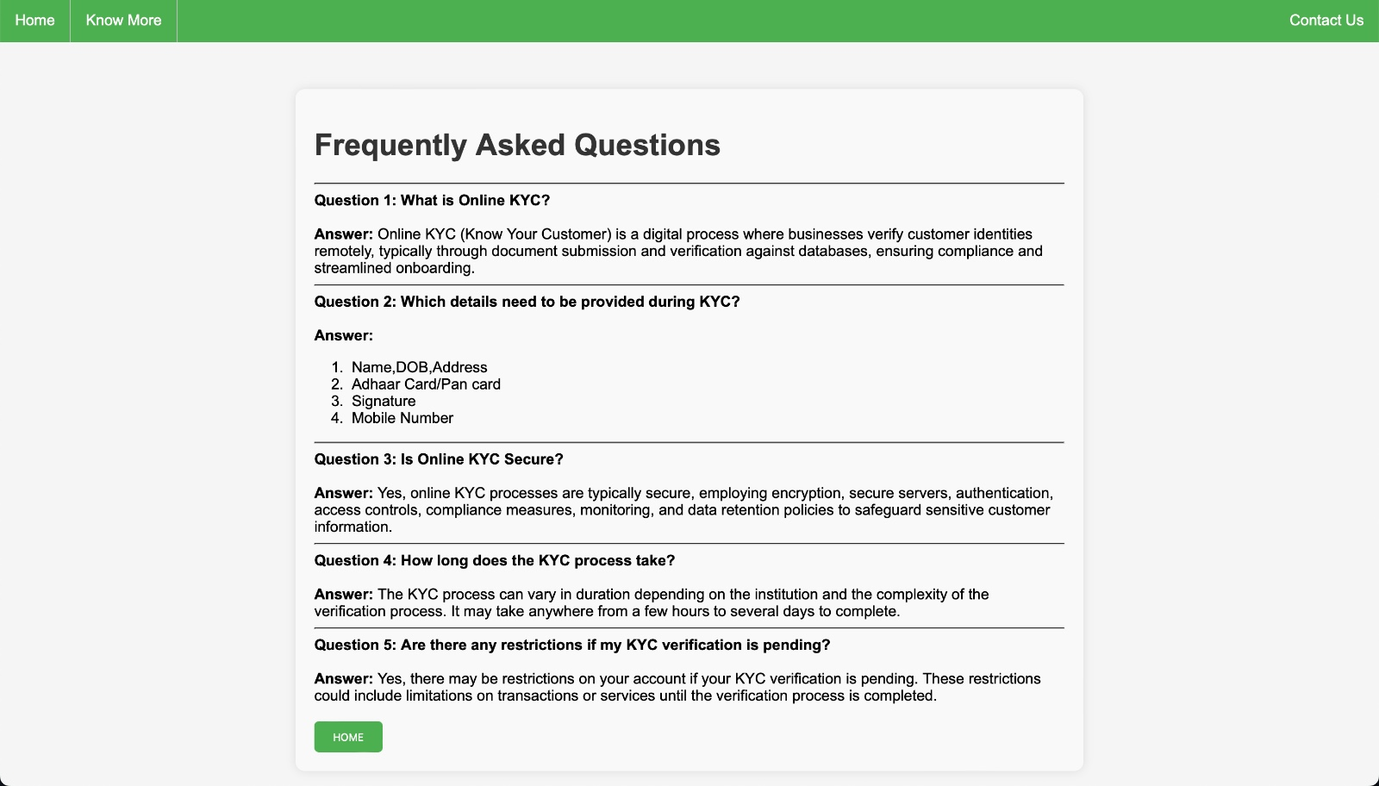
03
FAQ’s

Slide 7

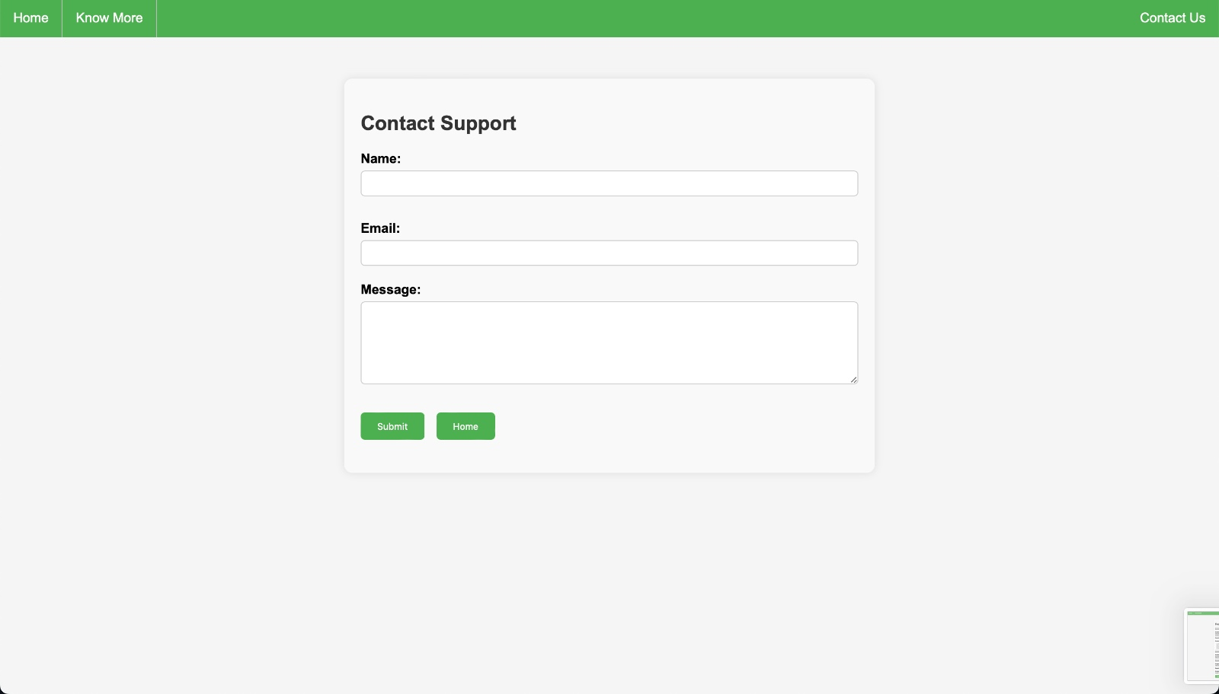
04
Contact Support

Slide 8

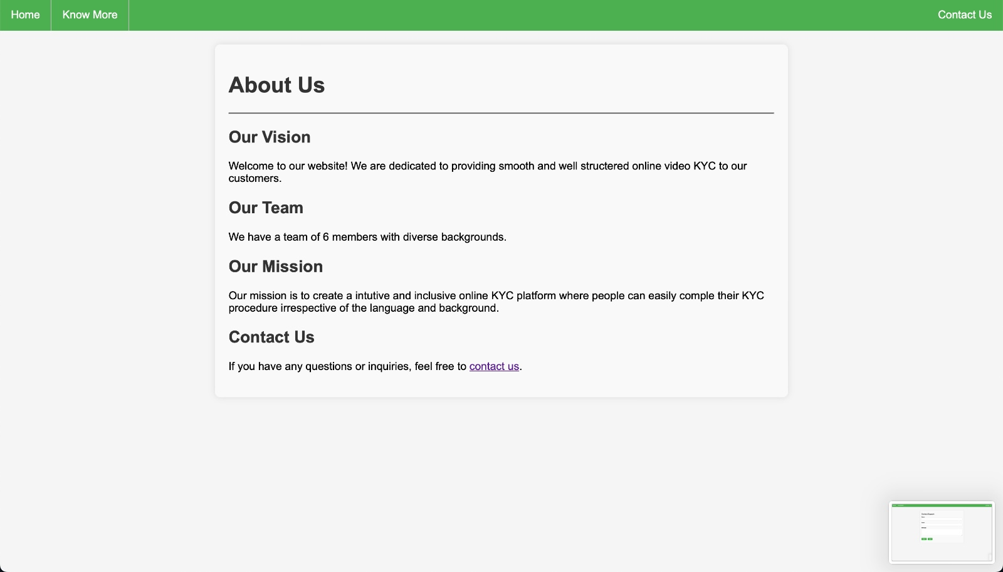
05
About Us

Slide 9
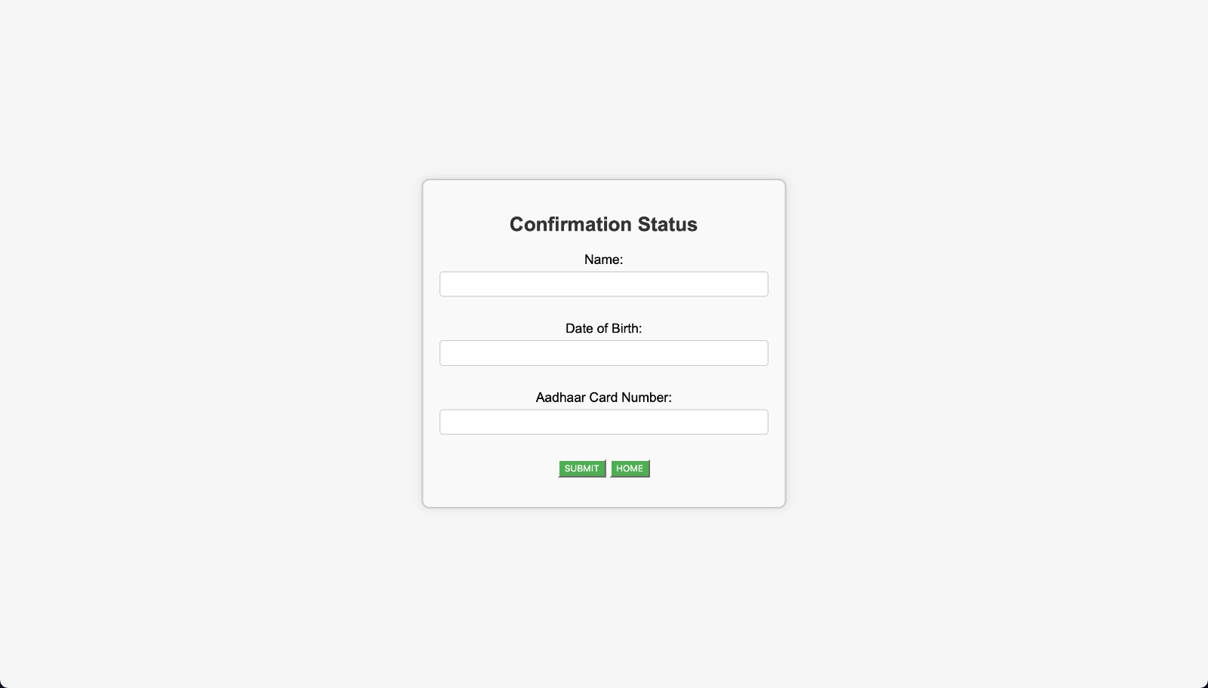
06
Validation

