Slide 1
Automation of Dean(P&D) Purchase process
Aman Namdev (205121013)
Arvind Mali (205121027)
Avish Mehta (205121031)

Slide 2
Introduction
The current project aims to develop an automated Purchase Request Approval System to enhance the efficiency of this process. This system will facilitate the approval of purchase requests created by department teachers by routing them through the Head of Department (HOD) and ultimately to the Dean/Director of the college.

Slide 3
Problem statement
The current purchase process within our academic department relies on a manual, paper-based system. Professors and staff members who require equipment or supplies for their work must initiate a request by submitting a physical form.

Slide 4
Problem statement
The primary objective of our project, "Automation of Dean (P&D) Purchase Process," is to address these challenges and provide a comprehensive solution to streamline and automate the purchase process.
By doing so, we aim to significantly reduce processing time, enhance the efficiency of the entire process, eliminate errors, and improve transparency.

Slide 5
Existing Solutions and Our Contribution
Paper Forms: The most common method involves professors and staff filling out physical forms for equipment requisitions. These forms then circulate for approvals through traditional channels.
Email Communication: In some cases, email has been used to facilitate communication and approvals. However, this method often leads to scattered and unorganized records.

Slide 6
Existing Solutions and Our Contribution
The manual process still results in delays, primarily due to physical document circulation.
We have developed an automated system that eliminates the need for physical forms and manual document circulation. The entire process, from request initiation to approval, will be electronic.

Slide 7
Methodology and Technology Stack
Methodology:
We adopted a systematic and modern approach to address the challenges in automating the Dean (P&D) Purchase Process. This methodology involved both front-end and back-end components that seamlessly work together to streamline the entire workflow.

Slide 8
Methodology and Technology Stack
Technology Stack:
Front-end Technologies:
React: Our front-end framework of choice, React, offers a dynamic and responsive user interface for requesters and approvers.
Back-end Technologies:
Node.js: The backbone of our project, Node.js, powers the server and enables non-blocking, efficient server-side code execution.
MongoDB: As our database system, MongoDB allows us to store, retrieve,and manage data with ease.

Slide 9
Methodology and Technology Stack
Authentication and Communication:
Nodemailer: To facilitate email-based authentication and communication, we integrated Nodemailer for sending verification and notification emails.
JWT Token: JSON Web Tokens (JWT) were employed to securely manage user authentication and ensure data integrity.

Slide 10
Project Implementation Steps
Requirement Analysis: Gather requirements from department teachers, HODs, and college management to ensure the system aligns with their needs.
System Design: Create a system design that outlines the database structure, user interfaces, workflow, and notification mechanisms.
Development: Develop the Purchase Request Approval System according to the design, ensuring a user-friendly and responsive interface.
Deployment: Deploy the system on a secure server within the college network, ensuring data security and accessibility.

Slide 11
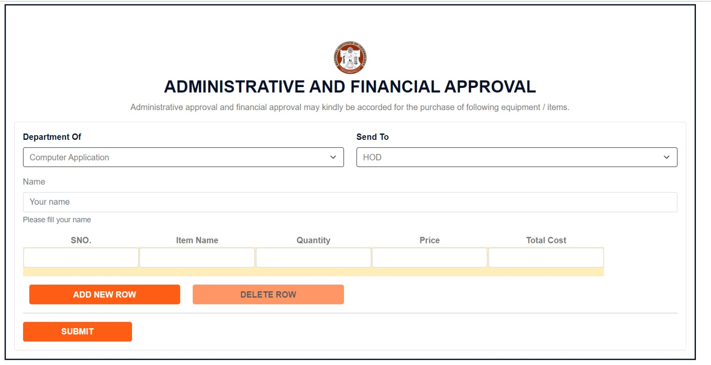

Slide 12
