Slide 1
GEN AI PROJECT · MCA 2ND SEMESTER · RVCE
AgroPrice AI
AI-Powered Agricultural Market Intelligence & Forecasting Platform
Tamil Nadu · Karnataka · Andhra Pradesh · Kerala · Telangana
TEAM MEMBERS
UNDER THE GUIDANCE OF
S Abhilash
Rajath S
Praveen K R
Prof. Usha J
1RV25MC084
1RV25MC080
1RV25MC076
Dept. of MCA · RVCE, Bengaluru
27
5
12 YRS
GEMINI
CROPS
STATES
2015–2026
2.5 FLASH
sabhilash.mca25@rvce.edu.in
01

Slide 2
01 · OVERVIEW
What is AgroPrice AI?
An end-to-end agentic platform that converts 12 years of South Indian mandi data into real-time price intelligence, AI-grounded forecasts, and institutional-grade advisory.
⚠
THE PROBLEM
⚙
THE ENGINE
✦
THE IMPACT
▸ Price volatility with no forecasting
▸ DuckDB + Prophet + SparseTrend ML
▸ 27 crops × 5 states × 12 years
▸ Fragmented mandi data across states
▸ Gemini 2.5 Flash grounded narration
▸ Real-time streaming AI advisory
▸ No AI advisory for farmers or traders
▸ 7-agent council + probabilistic outlook
▸ Decision intelligence for all user roles
12 Yearly Parquet Files
27 Crops Tracked
10 API Route Groups
39 Live Endpoints

Slide 3
02 · INTRODUCTION
Introduction
📈
Price Forecasting
The Market Intelligence Gap
7d / 30d / 90d Prophet predictions with calibrated confidence bands
South Indian agricultural markets move thousands of crores of rupees — yet most farmers and traders navigate price decisions with little more than guesswork.
AgroPrice AI replaces that uncertainty with real-time intelligence grounded in 12 years of AGMARKNET mandi price data across 5 states and 27 crops.
🤖
Gemini AI Advisory
Streaming conversational AI grounded in real DuckDB metrics
⚡
Anomaly Detection
Rolling z-score spike/crash detection across all 27 crops
🎯
Decision Intelligence
7-agent council + probabilistic outlook + 4 analyst personas
Platform scope: 27 Crops · 5 South Indian States · AGMARKNET 2015–2026 · Gemini 2.5 Flash

Slide 4
03 · OBJECTIVES
Project Objectives
Price Forecasting
Anomaly Detection
01
02
Multi-horizon Prophet forecasts (7d / 30d / 90d) with calibrated confidence bands for all 27 crops
Rolling z-score spike/crash detection; severity low/medium/high over a 90-day lookback window
Conversational AI Advisor
Market Regime Detection
03
04
Grounded multi-turn Gemini advisory with session memory, entity extraction & 4 analyst personas
7 market regime classifications (Bullish Expansion to Panic Volatility) via deterministic signal fusion
Cross-Crop Intelligence
Explainable AI
05
06
25+ crop relationship graph (complement/substitute/seasonal/regional) with contagion risk scoring
6-stage decision trace, confidence engine, correlation signals — every response is fully traceable
Probabilistic Decisions
Institutional Reporting
07
08
Heuristic up/down/sideways probabilities + volatility shock + reversal risk per crop and state
Executive synthesis with 5 market postures, Bloomberg-style briefings, PDF/Excel report generation

Slide 5
04 · PROBLEM STATEMENT
The Problem
Agricultural price volatility devastates millions — yet farmers navigate markets with guesswork and fragmented phone calls.
📉
Price Volatility Crisis
🗄
Data Fragmentation
🧠
Intelligence Gap
400%
815
ZERO
swing within 90 days
data-entry errors removed
AI advisory for farmers
› Tomato prices crash post-harvest then spike 4× in off-season
› AGMARKNET has 3+ Variety rows per crop/day — no deduplication
› Traders rely on phone networks and delayed mandi reports
› No forecasting system exists for mandi-level prediction
› Raw dataset contains prices up to Rs 918 million
› No cross-crop relationship analysis for arbitrage decisions
› Farmers sell at market bottoms due to post-harvest pressure
› No unified analytics layer across 5 South Indian states
› Zero explainable AI to justify a sell/hold recommendation
SOLUTION → AgroPrice AI delivers grounded AI intelligence so every market decision is backed by real data

Slide 6
05 · APPLICATIONS
Who Benefits?
🌾
Farmer
📦
Wholesale Buyer
📊
Commodity Trader
Farmer Mode
Wholesale Mode
Trader Mode
Should I sell now or wait? Practical harvest-timing guidance in plain language with mandi selection advice.
Procurement timing, bulk pricing windows, cold storage feasibility — cost-conscious supply chain intelligence.
7–30d price trajectory, momentum inflection points, volatility as opportunity, and position sizing guidance.
· Sell / Hold / Wait verdict + seasonal timing
· Procurement recommendation + 30d price range
· 7d momentum signal + volatility regime badge
🏛
Policy Analyst
🏭
Procurement Mgr
📱
Agri-Business
Analyst Mode
Wholesale Mode
All Modes
Full statistical rigour — CV, anomaly clusters, probabilistic outlook with confidence intervals.
Food processors: seasonal availability windows, holding cost vs price-movement risk, bulk entry guidance.
Executive synthesis across all 27 crops — dominant market posture and cross-crop opportunity matrix.
· Probabilistic outlook (P up/down) + 7-agent council
· Entry / exit price hints + escalation alerts
· Bloomberg-style briefing + autonomous monitor

Slide 7
06 · GENERATIVE AI CONCEPTS
Gen AI Concepts Used
AGMARKNET Parquet 2015–2026 (DuckDB lazy view)
💬
Grounded Narration
All Gemini responses cite real DuckDB metrics injected via PromptContext dataclass
▾
Analytics Engine (volatility · momentum · anomaly · seasonal)
🎭
Analyst Personas
▾
ML Forecasting (Prophet + SparseTrend → yhat, CI)
4 modes (Farmer / Trader / Wholesale / Analyst) materially change response register
▾
🔊
PromptContext — 12-field deterministic data contract
Voice Advisory
Web Speech API STT + speechSynthesis TTS — voice I/O for farmer accessibility
▾
Gemini 2.5 Flash (temperature=0.2, thinking_budget=0)
📡
SSE Streaming
▾
Structured Response → SSE stream → Frontend
Token-by-token Gemini output via /api/advisor/ask/stream (native async generator)
🔒 Gemini reasons ABOUT injected facts — it never invents prices, forecasts, or confidence scores.
gemini-2.5-flash · temp=0.2 · thinking_budget=0
max_output_tokens=2048 · retry ×2 (exp backoff)

Slide 8
07 · FORECASTING THEORY
Time Series Forecasting
🔵 Prophet Model
📅 Forecast Horizons
Facebook Prophet — Bayesian additive decomposition
HORIZON
USE CASE
CI BAND
y(t) = g(t) + s(t) + h(t) + ε
7 Days
Immediate sell/hold decision
Narrow
30 Days
Procurement / trade planning
Medium
g(t)
Trend — piecewise linear changepoints (scale=0.05)
90 Days
Seasonal strategy / planting
Wider
s(t)
Seasonality — yearly multiplicative (no weekly/daily)
h(t)
Holidays — Indian public holidays via add_country_holidays(IN)
Forecast Output Fields
· yhat — predicted modal price (Rs/quintal)
· yhat_lower — lower confidence bound
· yhat_upper — upper confidence bound
ε
Noise — residual uncertainty captured in CI bands
seasonality_mode=multiplicative · yearly=True · weekly=False · daily=False
SparseTrend Fallback (Tier C/D): Theil-Sen median slopes + monthly multipliers + 80% CI

Slide 9
08 · AI ARCHITECTURE
AI Architecture Concepts
1
2
3
4
5
6
7
8
›
›
›
›
›
›
›
Sanitize
Guardrails
Session
Memory
Entity
Extract
Intent
Classify
Context
Build
7-Agent
Council
Confidence
+Corr.
Gemini
Generate
🛡
Guardrails
🧠
Session Memory
🎯
Intent Classify
Hard/soft blocks prevent off-topic queries (coding, crypto, politics) from reaching Gemini. Checked FIRST on every single call.
In-process TTL sessions (2h, max 10 turns). Crop/state context inherited across follow-up turns. Optional Redis backend.
Fully deterministic rule-based classification. 20+ intent patterns. No LLM involved in routing decisions.
📐
Data Grounding
🎭
Persona Framing
PromptContext carries 12 injected fields from real DuckDB/ML data. Gemini narrates ABOUT deterministic facts — never invents them.
4 analyst personas prepended before system identity. Changes Gemini response register, language, and focus — not the underlying data.
8-stage pipeline · Deterministic intent · Grounded PromptContext · Session memory · SSE streaming · Exponential retry

Slide 10
09 · VISUAL INTELLIGENCE & XAI
Explainable AI & Visualizations
AI VISUALIZATION COMPONENTS
EXPLAINABILITY LAYERS
📈
MiniSparkline
Confidence Engine
Bezier-smoothed 30-day price with halo dot on last point
Composite score from training depth, volatility CV, anomaly count, momentum coherence, and forecast availability. Returns score + contributors + detractors.
⚡
VolatilityMeter
SVG gauge arc — CV% mapped to low/high/extreme color
🎯
Correlation Engine
ConfidenceGauge
Radial arc showing forecast reliability score (0–100%)
Reads 4 agent verdicts and emits CONFIRMING / CONTRADICTION / MIXED signals (e.g. 'Bullish momentum + peak season: CONFIRMING'). Max 5 signals per response.
🔴
RiskHeatBar
Color-gradient bar from low risk (emerald) to extreme (red)
Decision Trace
🌙
SeasonalPosition
6-stage pipeline trace: data quality, context build, agents, confidence, correlation, prompt. Shows agreed vs dissenting agents and evidence quality score.
Phase chip: DEEP_PEAK / PEAK / NORMAL / LEAN / TROUGH
→
MomentumArrow
Reasoning Panel
Directional arrow: STRONG_BULLISH to STRONG_BEARISH
Frontend component: agent verdict cards, reasoning trace as pill chips, persona tag, and correlation badges rendered below every streaming AI response.

Slide 11
10 · DATASET
AGMARKNET Dataset
48.2M
12.6M
12 YRS
11
TOTAL ROWS
(All India)
SOUTH INDIA
SUBSET
2015 – 2026
(AGMARKNET)
SCHEMA
COLUMNS
SOUTH INDIA — ROWS PER STATE
ROWS PER YEAR (SOUTH INDIA)
Kerala
5.1M
2015
914K
2016
956K
Tamil Nadu
3.9M
2017
956K
2018
809K
2019
776K
Karnataka
1.9M
2020
646K
2021
724K
Telangana
1.1M
2022
895K
2023
893K
2024
2.1M
Andhra Pradesh
567K
2025
2.6M
2026
315K
State
District
Market
Commodity
Variety
Grade
Arrival_Date
Min_Price
Max_Price
Modal_Price
Commodity_Code
Data source: AGMARKNET (Agricultural Marketing Information Network) · Open Government Data India · Parquet format via PyArrow

Slide 12
11 · DATA SCHEMA & QUALITY
Schema & Data Quality
Schema (11 Columns)
⚠
01 Duplicate Varieties
AGMARKNET records 3+ Variety rows per (date, crop, state, market) — e.g. Tomato/Local, Tomato/Hybrid, Tomato/FAQ all on the same day.
State
VARCHAR
South India filter applied
District
Sub-state geography
FIX GROUP BY (date, crop, state, market) + AVG(Modal_Price)
One price per mandi per day — correct for forecasting.
VARCHAR
Market
VARCHAR
Mandi name — used in deduplication
🔴
02 Extreme Price Outliers
Commodity
VARCHAR
27 crops in registry
Variety
Multiple per crop/day → dedup
Raw dataset contains prices from Rs 0 to Rs 918,421,086 — confirmed data-entry errors (7 zeros of scale).
VARCHAR
Grade
VARCHAR
Quality tier (Medium/FAQ/etc.)
FIX Filter: Modal_Price BETWEEN 1 AND 100,000 Rs/qtl
815 outlier records removed. Cardamoms exempt: cap=500,000.
Arrival_Date
VARCHAR
String YYYY-MM-DD → TRY_CAST DATE
Min_Price
Rs/quintal — floor reference
📅
03 Tamil Nadu Data Gap
DOUBLE
Max_Price
DOUBLE
Rs/quintal — ceiling reference
Tamil Nadu mandi data shows very low coverage before 2024, making any pre-2024 price series unsuitable for forecasting.
Modal_Price
DOUBLE
Primary forecast target — AVG'd
FIX TAMIL_NADU_DATA_START = '2024-01-01' applied automatically when state='Tamil Nadu' and no start_date supplied.
Commodity_Code
BIGINT
AGMARKNET internal ID (unused)
After cleaning: one AVG(Modal_Price) per calendar day per crop×state — passed directly to Prophet as (ds, y) — no interpolation, no forward-fill

Slide 13
12 · PREPROCESSING PIPELINE
Data Preprocessing Pipeline
1
📁
Parquet File Discovery
12 yearly files (2015–2026) · data/raw/parquet/ · ~400 MB total
→ 12 parquet paths
sorted(parquet_dir.glob('*.parquet'))
31–64 MB per file · loaded lazily by DuckDB via PyArrow driver
▾
🦆
DuckDB Lazy View
2
Zero data copied into Python memory · query-time disk reads only
→ prices VIEW active
DuckDB VIEW: lazy query, zero data loaded into Python memory
Predicate pushdown reads only the row groups each query needs
▾
✅
Schema Validation
3
Checks State, Commodity, Arrival_Date, Min/Max/Modal_Price fields
→ Schema confirmed
DESCRIBE prices → 7 required columns verified at startup
Raises ValueError immediately if any required column is missing
▾
🔍
Outlier Price Filter
4
815 outlier records removed · raw prices ranged 0 to Rs 918M
→ Clean [1–100K] Rs/qtl
Modal_Price BETWEEN 1 AND 100,000 Rs/qtl
Applied per query via _price_filter(crop) — not a permanent delete
▾
🔗
Deduplication (AVG)
5
Collapses 3+ Variety rows per mandi/day into one avg price
→ 1 record/mandi/day
GROUP BY (date, crop, state, market) + AVG(Modal_Price)
AVG(Min_Price) and AVG(Max_Price) also computed · outlier-robust
▾
📊
Prophet-Ready Series
6
df['ds'] = datetime64[ns] · df['y'] = float64 daily modal price
→ (ds, y) DataFrame
Returns (ds, y) daily time series · Prophet.fit() ready
Missing calendar dates NOT filled — Prophet handles sparse data
Lazy evaluation: DuckDB reads parquet blocks on demand · Python memory stays low · Complete pipeline runs in < 50 ms per query

Slide 14
13 · FEATURE ENGINEERING
Feature Engineering
Input: query_for_forecast(crop, state) → (ds, y) DataFrame from DuckDB
⚡
detect_price_anomalies()
📊
compute_volatility_metrics()
🌙
compute_seasonal_profile()
z(t) = ( price(t) − μ_30d ) / σ_30d
CV = σ / μ × 100%
dev[m] = ( μ_month − μ_annual ) / μ_annual × 100
› |z| ≥ 2.0 → LOW
› CV < 20% → Stable
› peak_months (top-3 +dev)
› |z| ≥ 2.5 → MEDIUM
› CV < 35% → Moderate
› trough_months (bottom-3 -dev)
› |z| ≥ 3.5 → HIGH
› CV < 50% → High Risk
› current_phase: peak|trough|normal
→ spike / crash events
→ instability_score + badge
→ monthly_profile dict
🚀
compute_momentum_signal()
🎯
compute_forecast_quality()
score = ( avg_7d − avg_prior30d ) / avg_prior30d × 100
score = depth_score − vol_penalty − staleness_penalty
› score > 10 → Strong Uptrend ↑↑
› Training rows > 500 → +40pts
› 3–10 → Uptrend ↑
› CV < 20% → +0 penalty
› -3 to 3 → Flat →
› Staleness > 30d → −30pts
→ signal + change_pct
→ reliability_score (0–100)

Slide 15
14 · SYSTEM ARCHITECTURE
System Architecture
🌐
React 18.3 + Vite 5.2 + TailwindCSS 3.4
PRESENTATION LAYER
6 pages · 50+ AI components · 11 custom hooks · Recharts 2.12 · Zustand 4.5
⚡
▾
API GATEWAY
FastAPI 0.136 + uvicorn 0.47 (port 8001)
10 route groups · 39+ endpoints · CORS · Request Logger middleware · OpenAPI /docs
⚙
▾
SERVICES LAYER
30+ orchestration service modules in backend/services/
advisor_ai_router · context_builder · memory_manager · agent_council (7 agents) · regime_detector · signal_fusion
🗄
▾
DATA ENGINE
DuckDB 1.5.2 + pandas 3.0 + PyArrow 24.0
5 analytics functions · Lazy parquet queries · Dedup + outlier filter · query_cache · 12.6M South India rows
📈
▾
ML FORECASTING ENGINE
Prophet 1.3 · SparseTrend · XGBoost 3.2
Tier A/B → ProphetForecaster · Tier C/D → SparseTrendForecaster · Forecast cache (disk JSON) · 7d / 30d / 90d
🤖
▾
AI LAYER (GEMINI)
google-genai 2.8.0 · Gemini 2.5 Flash · temp=0.2 · thinking_budget=0
PromptContext (12 fields) · 8 structured error types · SSE streaming · 8-stage grounded pipeline · 4 analyst personas
💾
▾
STORAGE
12 Parquet files (~400 MB) · forecast_cache/ · optional Redis
data/raw/parquet/*.parquet · AGMARKNET 2015–2026 · ADVISOR_MEMORY_BACKEND=memory|redis

Slide 16
15 · MODULE STRUCTURE
Module Structure
🔧 backend/
⚛ frontend/src/
▸ core/
config · database · logger
▸ pages/
6 pages: Dashboard · Forecast · AIAdvisor · CropExplorer · MapIntelligence · Reports
▸ data/
analytics.py (5 functions)
▸ components/ai/
50+ components: AdvisorChat · AICouncilPanel · AIProbabilityPanel · AICommandMode
loaders/ pipeline/
duckdb_queries · ingestion
schema/
models.py (Pydantic schemas)
charts/
ForecastChart · PriceLineChart · CropBarChart
▸ ml/forecasting/
prophet · xgboost · sparse_trend
cache/
forecast_cache · query_cache
ui/
DashPanel · IntelligenceGrid · Badge · Card
▸ services/
30+ orchestration modules
▸ hooks/
11 hooks: useAnalytics · useForecast · useSpeechRecognition · useTextToSpeech
llm/
GeminiProvider · PromptBuilder · Guardrails
agents/
5 agents (trend·risk·seasonal·rec·briefing)
▸ services/
10 API service files: advisorService · decisionService · intelligenceService
▸ api/routes/
10 route groups (39+ endpoints)
▸ store/
Zustand: useForecastStore · usePriceStore
▸ reports/
generator.py — PDF + Excel
▸ utils/
crop_registry · constants · validators
▸ utils/
constants.js · formatters.js
Backend: ~45 Python files · Frontend: ~75 JSX/JS files · Total: ~120 source modules

Slide 17
16 · TECHNOLOGY STACK
Technology Stack
🐍
Backend Core
🦆
Data Layer
📈
ML / Forecasting
· Python 3.13
· DuckDB 1.5.2 (in-process)
· Prophet 1.3.0
· FastAPI 0.136.1
· pandas 3.0.0
· XGBoost 3.2.0
· uvicorn 0.47.0
· PyArrow 24.0.0
· SparseTrend (custom)
· pydantic-settings 2.14.1
· scipy 1.17.0
· Yearly multiplicative seasonality
· python-dotenv 1.2.2
· numpy (via prophet)
· Indian holidays (country='IN')
· structlog 25.5.0
· 12 Parquet files · 400 MB
· Theil-Sen median slopes
🤖
Generative AI
⚛
Frontend
📄
Reports & Infra
· google-genai 2.8.0
· React 18.3.1
· openpyxl 3.1.5 (Excel)
· gemini-2.5-flash
· Vite 5.2.12
· reportlab 4.5.1 (PDF)
· temperature = 0.2
· TailwindCSS 3.4.4
· Optional Redis memory
· thinking_budget = 0
· Recharts 2.12.7
· CORS: allow_origin_regex
· max_output_tokens = 2048
· Zustand 4.5.2
· Structured error responses
· SSE streaming · 8 error types
· react-router-dom 6.23
· start.bat dual-server launch
All packages pinned with exact versions · backend/requirements.txt · frontend managed by npm with package-lock.json

Slide 18
17 · API ROUTE MAP
API Route Map
10 route groups · FastAPI · All routes prefixed /api/
Prices
/api/prices
GenAI
/api/ai
› GET /prices?crop=Tomato&state=Karnataka
› GET /ai/insights/{crop}/{state}
› GET /analytics/{crop}
› GET /ai/narrative/{crop}/{state}
Forecasts
/api/forecasts
Watchlist
/api/watchlist
› GET /forecasts/{crop}/{state}?days=7|30|90
› GET /watchlist?max_crops=8
› Runs Prophet → SparseTrend fallback
› Returns 5 buckets: momentum_leaders
Registry
/api/crops
Monitor
/api/intelligence
› GET /crops — 27 crops in registry
› GET /intelligence/monitor?max_crops=N
› GET /crops/registry — full CropInfo objects
› 7 market regimes · escalation types
AI Advisor
/api/advisor
Decision
/api/decision
› POST /advisor/ask — grounded Gemini call
› GET /council/{crop}/{state} — 7-agent vote
› POST /advisor/ask/stream — SSE token stream
› GET /probability/{crop}/{state}
Briefing
/api/briefing
Reports
/api/reports
› GET /briefing/{crop}/{state} — 4-agent brief
› POST /reports/pdf — openpyxl PDF
› POST /briefing/scenario — heuristic sim
› POST /reports/excel — reportlab Excel

Slide 19
18 · HARDWARE & SOFTWARE SPECS
Hardware & Software Specs
💻
Development
Environment
🗄
Data
Infrastructure
⚙
Runtime
Configuration
OS
Windows 11 Home Single Language
Dataset
AGMARKNET 12 Parquet files
API key
GEMINI_API_KEY in backend/.env
Python
3.13 (virtual environment)
Total size
~400 MB on disk
CORS
allow_origin_regex: localhost:*
Node.js
18+ / npm 10+
Engine
DuckDB 1.5.2 in-process
Memory
In-process TTL 2h or Redis
Backend
uvicorn on port 8001
Access
Exclusive single process
Reload
Hot-reload safe for routes only
Frontend
Vite dev server on port 5173
Evaluation
Lazy (no full file load)
Restart req.
After .env changes (singleton)
Launch
start.bat (dual terminal windows)
Cache
Forecast cache (disk JSON, 24h TTL)
GPU
Not required — CPU-only ML
STARTUP SEQUENCE
1
→
2
→
3
→
4
→
5
→
6
start.bat
DuckDB connect()
Parquet VIEW created
Gemini singleton init
FastAPI ready :8001
Vite dev :5173
No GPU · No Docker · No cloud dependency during development · Entire stack runs locally in < 30 seconds from cold start

Slide 20
PART II · GENERATIVE AI FOUNDATIONS
Generative AI
Theoretical Foundations & Implementation Architecture
AI/ML/DL/GenAI Hierarchy
LLM Token Prediction
Gemini 2.5 Flash
Prompt Engineering
Grounding Pipeline
7-Agent Council
Explainable AI (XAI)
Agricultural AI Ethics
AgroPrice AI uses Gemini 2.5 Flash as its reasoning engine — grounded entirely on deterministic AGMARKNET data · zero hallucination by design

Slide 21
GEN AI · 01 — LANDSCAPE
The AI Intelligence Hierarchy
ARTIFICIAL INTELLIGENCE
🤖
Traditional AI
Rule-based systems, search, optimization, expert systems
› Hardcoded rules
MACHINE LEARNING
Statistical learning from data — regression, classification, clustering
› Expert system logic
DEEP LEARNING
› Zero learning from data
Neural networks — CNNs, RNNs, attention mechanisms
📊
Machine Learning
GENERATIVE AI
Creates text, images, code — Transformers, LLMs, diffusion
› Learns from labeled data
› Feature engineering needed
› Statistical predictions
🎯 AgroPrice AI sits here
🧠
Deep Learning
› Hierarchical feature extraction
› Requires large datasets
› Transformer architecture
✨
Generative AI
› Creates novel language output
› Prompted with context
AgroPrice AI combines ALL four layers: DuckDB deterministic engine + Prophet/XGBoost ML + Gemini 2.5 Flash GenAI = Grounded Agricultural Intelligence
› Gemini 2.5 Flash in our system

Slide 22
GEN AI · 02 — LLM ARCHITECTURE
LLM Architecture & Token Prediction
Raw Prompt
Tokenizer
Embedding Layer
Transformer
Blocks
Logit Head
Output Token
▶
▶
▶
▶
▶
"What is Tomato
price today?"
['What','is','Tom','ato','price']
Token IDs → 768-dim vectors
32× Self-Attention layers
Vocab probability dist.
Sampling at temp=0.2
Autoregressive: Each output token becomes input for the next — the model predicts ONE token at a time, left to right
🎯
Attention Mechanism
📏
Context Window
🌡
Temperature (0.2)
🔄
Autoregressive Gen.
Self-attention lets each token 'look at' all other tokens in the context window simultaneously. This gives the model understanding of long-range dependencies — e.g. relating 'tomato' to 'price' 50 tokens earlier.
Gemini 2.5 Flash supports up to 1M tokens context. AgroPrice AI injects the full PromptContext (market data, forecasts, history, analytics) here — the LLM reasons over this window.
Temperature controls output randomness. At temp=0.2, the model strongly prefers the highest-probability next token. Results are near-deterministic, consistent, and factual — critical for financial data narration.
Each generated token is appended to the input and the model runs again to predict the next. SSE streaming exploits this: each token is sent to the frontend as soon as it is generated, creating real-time typewriter output.

Slide 23
GEN AI · 03 — AGRICULTURAL AI
Why Generative AI in Agriculture?
THE PROBLEM
THE GENAI SOLUTION
📊
Data Complexity
💬
Natural Language Narration
48.2M rows of raw price data across 5 states, 27 crops, 12 years. No farmer can read raw AGMARKNET tables and derive actionable decisions.
▶
Gemini converts raw statistical metrics into plain-language advisory: 'Tomato prices show strong upward momentum with 18% growth in 7 days.'
⏰
Time-Critical Decisions
🎯
Grounded Decision Advisory
Harvesting, transportation, and mandi selection are irreversible decisions made under time pressure. Delayed or wrong insight = direct financial loss.
▶
Every narrative is backed by real DuckDB data. No hallucinations. The LLM reasons ABOUT truth — it does not invent price forecasts or trends.
🌐
Expert Access Gap
🗣
Multi-Turn Conversational AI
Agricultural market experts are scarce and expensive. 85% of South Indian farmers lack access to professional market advisory. GenAI democratizes expertise.
▶
Farmers ask follow-up questions in natural language. Session memory preserves crop/state context across 10 turns (2h TTL) for continuity.
🔀
Multi-Variable Complexity
🎭
Persona-Adapted Responses
Price is influenced by season, rainfall, transport, supply-demand, state policy, and market anomalies — too many variables for manual analysis.
▶
4 personas: Farmer (plain language), Trader (momentum), Wholesale (procurement), Analyst (statistical). Gemini adapts its response style per audience.
Result: Agricultural intelligence previously available only to commodity traders is now accessible to every farmer via a conversational AI interface

Slide 24
GEN AI · 04 — GEMINI 2.5 FLASH
Gemini 2.5 Flash — Model Architecture
🤖
gemini-2.5-flash
Why Flash (not Pro or Ultra)?
Google DeepMind · Multimodal Foundation Model
✓ Flash has 1M token context — sufficient for full PromptContext injection
✓ Latency: Flash averages 2–4s · Pro takes 8–15s — critical for live advisory
Model family
Gemini 2.x Flash (efficient tier)
✓ Cost efficiency: Flash is 10× cheaper per token vs Pro at same context length
Context window
Up to 1,000,000 tokens
✓ Thinking disabled (budget=0) — narration task does not need deep reasoning
Modalities
Text · Code · Vision · Audio
Multimodal Capability (used for text only in AgroPrice AI)
SDK used
google-genai 2.8.0 (native async)
API call type
client.aio.models.generate_content
📝
Text (PRIMARY)
All advisory, narration, analysis
Safety settings
types.SafetySetting (4 categories)
👁
Vision
Not used — data is structured numeric
Output format
GeminiResult(text, error_type, ms)
🎵
Audio
Not used — TTS/STT via Web Speech API
Error types
8 structured: quota/key/safety/timeout
💻
Code
Blocked by agricultural guardrails
AgroPrice AI uses Gemini purely for natural language narration — all numerical intelligence comes from DuckDB + Prophet/XGBoost, not the LLM

Slide 25
GEN AI · 05 — MODEL CONFIGURATION
Temperature & Thinking Budget
🌡 Temperature = 0.2
🧠 Thinking Budget = 0
TEMPERATURE SCALE
WHAT IS THINKING BUDGET?
▲
Gemini 2.5 Flash has a built-in 'thinking' capability — internal chain-of-thought reasoning before generating output. The thinking_budget parameter (0 = disabled) controls how many tokens are allocated to this internal reasoning phase.
0.0
0.2
0.5
1.0
Deterministic
Our Setting
Balanced
Creative
❌ Budget = AUTO
✅ Budget = 0
✓ Near-deterministic output — same market data → same advisory tone every time
Thinking tokens: ~800
Thinking tokens: 0
Remaining for response: ~44
All 2048 for response
✓ Reduces hallucination risk — model strongly prefers factual tokens over creative ones
Output: 176 chars
Output: 1325 chars
✓ Enterprise consistency — farmers see reliable, coherent responses across sessions
Status: TRUNCATED ✗
Status: COMPLETE ✓
✗ Higher temp (0.7+) would generate varied, creative answers — wrong for price data
Why disabled?
Narration task — all facts are pre-injected. Gemini does not need to 'think'; it narrates. Thinking would only consume output token budget unnecessarily.
Combined effect: temp=0.2 + thinking_budget=0 = fast, deterministic, factual narration — ideal for financial agricultural advisory

Slide 26
GEN AI · 06 — PROMPT CONTEXT
PromptContext — The Grounding Contract
The PromptContext dataclass is the contract between the deterministic engine and the LLM layer. Every field comes from real data — never invented.
✅ DETERMINISTIC (from DuckDB)
🔢 COMPUTED (from Analytics Engine)
crop
volatility_cv
Validated crop name (27-crop registry)
Coefficient of Variation = σ/μ × 100%
state
momentum_signal
South Indian state (5 states)
compute_momentum_signal() 7d vs 30d avg
current_modal_price
seasonal_phase
Latest day's AVG(Modal_Price) from DuckDB
peak | trough | normal from monthly profile
price_min_30d
anomaly_events
MIN(y) over last 30 days in time series
Z-score spike/crash detections (90d window)
price_max_30d
forecast_7d/30d/90d
MAX(y) over last 30 days in time series
Prophet/XGBoost predicted price + CI
historical_summary
confidence_score
AGMARKNET retrieval: year/month avg prices
Reliability: training depth + staleness
The Deterministic Boundary · Gemini NEVER generates or modifies these values · It only reasons ABOUT them in natural language

Slide 27
GEN AI · 07 — GROUNDING PIPELINE
Grounded Generation Pipeline
1
User Query
2
Guardrails Check
3
Session Memory
4
Intent Classify
▶
▶
▶
POST /advisor/ask
Domain + Injection
Crop/state inherit
Rule-based NLP
▼
5
DuckDB + Analytics
6
Agent Council
7
PromptBuilder
8
Gemini Narrates
▶
▶
▶
▶
▶
Real price data
7 specialist agents
Context injection
temp=0.2, budget=0
🔒
Zero Hallucination
⚡
Sub-5ms Guardrails
📋
Full Audit Trail
Gemini receives exact DuckDB values — cannot contradict pre-injected facts
Off-domain queries rejected before Gemini is ever invoked
reasoning_trace captures every stage: crop→intent→trend→confidence
OUTPUT → AdvisorResponse {answer, intent, sources, grounded:true, error_type, latency_ms, agent_insights, reasoning_trace}
"Gemini narrates ABOUT the data — it does not create the data"

Slide 28
GEN AI · 08 — PROMPT ENGINEERING
Prompt Engineering & Persona Framing
PROMPT ANATOMY (Section Order)
4 ANALYST PERSONAS
🌾
FARMER
Plain language, action-oriented
1
Persona Framing
Audience & communication style set FIRST — frames everything after
Harvest timing · local mandi pricing · perishability · when to sell
2
System Identity
'You are an expert agricultural market analyst for South India...'
📈
3
Market Data Section
TRADER
Commercial, momentum-focused
Current price, 30d range, trend direction, momentum signal
7–30d price trajectory · volatility as opportunity · bulk decision timing
4
Forecast Section
7d / 30d / 90d predictions with confidence intervals
5
Correlation Signals
🏭
WHOLESALE
Supply-chain, cost-conscious
CONFIRMING / CONTRADICTION / MIXED agent signal pairs
Procurement timing · bulk pricing · cold storage · cross-market sourcing
6
Confidence Narrative
Model reliability: training depth, CV, staleness, tier
7
Anomaly + Historical
📊
ANALYST
Institutional brief, statistical rigour
Spike/crash events, AGMARKNET historical comparisons
8
Question + Style
Full CV citation · structured Outlook → Risk → Recommendation format
User's question + output format constraints + domain lock
Agricultural Domain Lock: coding, politics, crypto, medical, legal, recipes, entertainment → ALL rejected by guardrails before Gemini is invoked · Response time: ~4ms

Slide 29
GEN AI · 09 — RAG-LIKE GROUNDING
Grounding vs Hallucination
🗄
⚙
📋
🤖
💬
▶
▶
PromptContext
Assembly
▶
▶
AGMARKNET
DuckDB
Analytics
Engine
Gemini
2.5 Flash
Grounded
Response
🔎 Traditional RAG
✅ AgroPrice Deterministic Grounding
• Retrieves unstructured text chunks from vector DB
✓ Retrieves exact SQL results from DuckDB (zero ambiguity)
• Ambiguous relevance — cosine similarity only
✓ Typed numeric values: price=₹1,234/qtl, CV=28.4%
• Hallucination risk: LLM may ignore retrieved context
✓ Zero hallucination: Gemini only narrates pre-injected data
• Retrieval may miss critical numeric values
✓ Structured context: 12 typed PromptContext fields
• Works best for knowledge-base Q&A
✓ Purpose-built for financial time-series narration
Key differentiator: AgroPrice AI retrieves structured numeric facts, not prose chunks — Gemini narrates facts it cannot contradict

Slide 30
GEN AI · 10 — MULTI-AGENT COUNCIL
7-Agent Specialist Council
1
📈
Trend Analyst
Price direction from momentum + 30d vs 90d rate comparison
→ STRONG_BULLISH
STRONG_BULLISH / BULLISH / MILD_BULLISH / NEUTRAL / BEARISH
Weight: 22%
2
⚠
Risk Analyst
Volatility CV + anomaly cluster count + tier risk scoring
→ LOW_RISK
LOW_RISK / MODERATE / HIGH_RISK / EXTREME_RISK
Weight: 18%
3
🌙
Seasonal Analyst
Seasonal phase positioning: peak / trough / lean / normal
→ DEEP_PEAK
DEEP_PEAK / PEAK_SEASON / LEAN / DEEP_TROUGH / NORMAL
Weight: 15%
4
⚖
Supply/Demand
Price-vs-year-average inference (no arrival data in AGMARKNET)
→ BULLISH
BULLISH / BEARISH / NEUTRAL (inferred from momentum)
Weight: 15%
5
〰
Volatility Analyst
CV patterns, recent price standard deviation analysis
→ Inputs to Risk + Confidence engines
Inputs to Risk + Confidence engines
Weight: 12%
6
💎
Opportunity Analyst
Opportunity score from combined signal synthesis
→ Score 0–100 (weighted composite)
Score 0–100 (weighted composite)
Weight: 10%
7
🎯
Forecast Reliability
Training depth (rows), data staleness, model tier (A/B/C/D)
→ Reliability score + confidence label
Reliability score + confidence label
Weight: 8%
Weighted aggregation → CouncilResult { dominant_view, minority_view, contradiction_detected, consensus_strength, dissent_agents, weighted_recommendation }

Slide 31
GEN AI · 11 — CONSENSUS ENGINE
Consensus & Correlation Intelligence
CONSENSUS SCORING PIPELINE
CORRELATION SIGNAL TYPES
1
Individual Verdicts
✅
CONFIRMING
Each of 7 agents returns: stance (BULLISH/BEARISH/etc.), confidence score (0–100), and reasoning bullets
Bullish momentum + peak season → double confirmation
Boosts Gemini's confidence in recommendation
2
Weighted Aggregation
weighted_score = Σ(agent.confidence × agent.weight) / Σ weights
Total weights sum to 1.00
⚡
CONTRADICTION
Bearish trend + peak season → season should push prices up
3
Consensus Strength
Gemini advises caution; acknowledges conflicting signals
Agreement ratio: if 5/7 agents agree = 71% consensus. Below 40% triggers contradiction_detected=True
🌀
MIXED SIGNAL
4
Confidence Collapse
Peak season + high volatility → opportunity but risky
When CV>45% AND anomaly_count>3 AND trend contradicts season → confidence collapses to 'low' regardless of scores
Gemini presents both sides without false certainty
5
Final Recommendation
🔴
ANOMALY CONTEXT
SELL_NOW / SELL_SOON / HOLD / WAIT / WATCH based on weighted vote + opportunity score + seasonal timing
3+ anomalies alongside upward trend
Gemini contextualizes anomalies historically
All correlation signals injected into PromptContext.correlation_signals → Gemini cites them explicitly in advisory ('confirming', 'however', 'despite') for nuanced narration

Slide 32
GEN AI · 12 — EXPLAINABLE AI
Explainable AI (XAI) in Agriculture
Why XAI? In agriculture, a wrong recommendation means real crop loss, unsold inventory, or wrong harvest timing. Farmers need to TRUST the AI's reasoning — not just its verdict.
6-STAGE DECISION AUDIT PIPELINE
XAI Features
1
Data Layer
→ Real DuckDB price → verified numeric source
📊 Decision Trace Panel
2
Analytics Layer
→ 5 functions → volatility, momentum, season, anomalies, quality
🤝 Agent Council View
3
Agent Verdicts
→ 7 agents → individual stances with confidence scores
📈 Confidence Engine
⚡ Correlation Signals
4
Correlation Check
→ Cross-agent signal alignment → CONFIRMING / CONTRADICTION
🔍 Evidence Quality Bar
5
Confidence Scoring
→ Confidence engine → contributor / detractor bullets
🎯 Reasoning Trace Chips
6
Reasoning Trace
→ crop|state|intent|trend|risk|seasonal|confidence|correlations
REASONING TRACE EXAMPLE (injected into every advisory response)
"crop: Tomato | state: Karnataka | intent: price_now | trend: BULLISH (72%) | risk: MODERATE (58%) | seasonal: PEAK_SEASON (91%) | confidence: high (74%) | correlations: 2 CONFIRMING"

Slide 33
GEN AI · 13 — STREAMING INFERENCE
SSE Streaming & Real-Time Inference
Frontend
async generator
POST /ask/stream
FastAPI SSE
_prepare_query
_context()
generate_stream()
Gemini API
Token chunks
SSE events
Streaming UI
'typewriter'
▶
▶
▶
▶
▶
SSE EVENT PROTOCOL
token
{"type": "token", "token": "Current Tomato prices show..."}
Fired for EVERY chunk received from Gemini stream — appended to message
done
{"type": "done", "intent": "price_now", "grounded": true, "latency_ms": 2341, "agent_insights": {...}, "reasoning_trace": "..."}
Fired ONCE when stream ends — triggers executive summary cards + reasoning panel
error
{"type": "error", "error_type": "quota_exceeded", "message": "..."}
On any pipeline failure — frontend shows GeminiErrorBadge with actionable message
AbortController: clearing chat or sending a new message cancels the in-flight SSE stream instantly · Vite proxy bypassed: streaming uses native fetch() directly to :8001

Slide 34
GEN AI · 14 — AGRICULTURAL AI ETHICS
Responsible AI in Agriculture
⚠ HALLUCINATION IN AGRICULTURE = DIRECT FINANCIAL HARM
A fabricated ₹200/kg Tomato price could cause a farmer to hold crops until they perish, or sell when they should hold — irreversible real-world consequence.
🔒
Deterministic Grounding
🎭
Domain Isolation
Every number Gemini uses comes from DuckDB — not generated from imagination. PromptContext fields are typed and verified before injection.
Guardrails block non-agricultural queries at millisecond speed (before Gemini is invoked). Coding, crypto, medical, political topics are categorically rejected.
🔍
Full Audit Trail
📋
Structured Uncertainty
Every response includes a reasoning_trace (pipe-separated decision log), agent verdicts, confidence scores, and correlation signals — fully traceable.
When data is insufficient, the system acknowledges it honestly ('data quality is low for this crop-state pair') rather than generating confident-sounding fiction.
Our Responsible AI Commitment
Grounded output · Structured uncertainty · Explainable decisions · Agricultural domain lock · Zero LLM-invented numbers

Slide 35
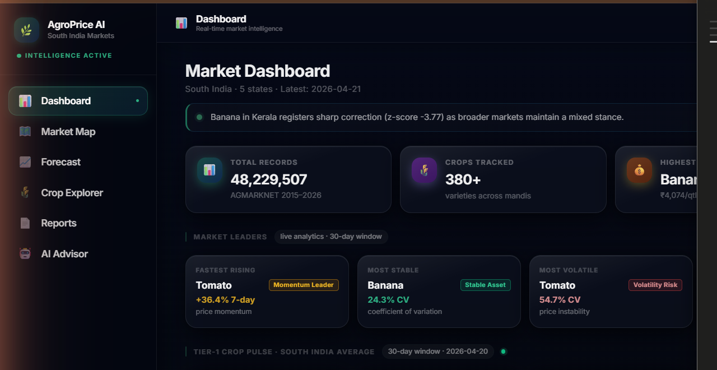
SLIDE 20 · LIVE DASHBOARD
20/29
Market Intelligence Dashboard
Real-time agricultural price analytics · AGMARKNET 2015–2026 · 5 South Indian states · 27 crops tracked
📊 TOTAL RECORDS
48,229,507
🌾 CROPS TRACKED
380+ varieties
🗺️ STATES COVERED
TN · KA · AP · TS · KL
⚡ MARKET STRESS
100/100 — Extreme Alert
48.2M AGMARKNET Records
Latest: 2026-04-21
AI Brief — Live Ticker
Highest Priced: Banana ₹4,074/qtl

Slide 36
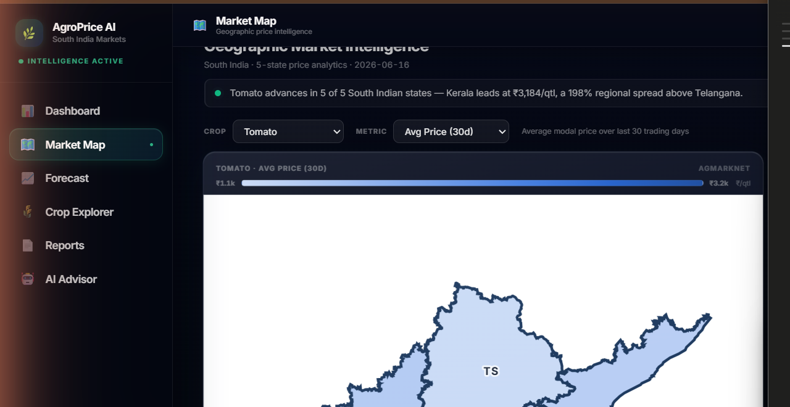
SLIDE 21 · MARKET MAP
21/29
Geographic Price Intelligence — South India
5-state spatial analytics · State-level price heatmap · Regional spread analysis · Crop × State × Metric
📍 HIGHEST PRICE
Kerala ₹3,184/qtl (+22%)
📉 LOWEST PRICE
Telangana ₹1,070/qtl
↑ STRONGEST TREND
Telangana +77.7% uptrend
📐 REGIONAL SPREAD
198% Kerala vs Telangana
Tomato · Avg Price (30D)
5/5 South Indian States
AGMARKNET Spatial Intel
Kerala leads at ₹3,184/qtl

Slide 37
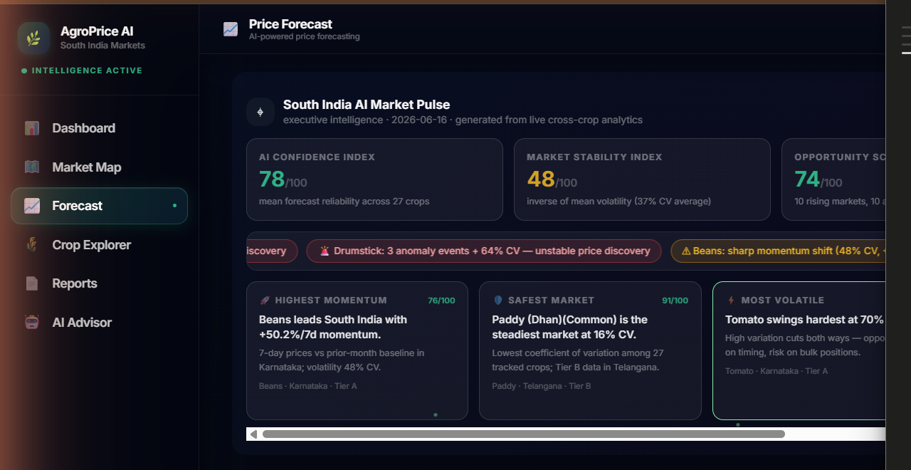
SLIDE 22 · FORECAST ENGINE
22/29
AI-Powered Price Forecasting Engine
Prophet + XGBoost + Sparse-Trend models · 7/30/90-day horizons · Tier A/B/C/D crop registry · 27 crops
🧠 AI CONFIDENCE
78/100 — Mean across 27 crops
⚖️ MARKET STABILITY
48/100 — Inverse of mean CV
🎯 OPPORTUNITY
74/100 — 10 rising markets
⚡ STRESS METER
100/100 — 68 anomaly events
Prophet · 4,050 Training Days
Tier A — 90-Day Horizon
South India AI Market Pulse · LIVE
Market Leaders — Beans +50.2%/7d

Slide 38
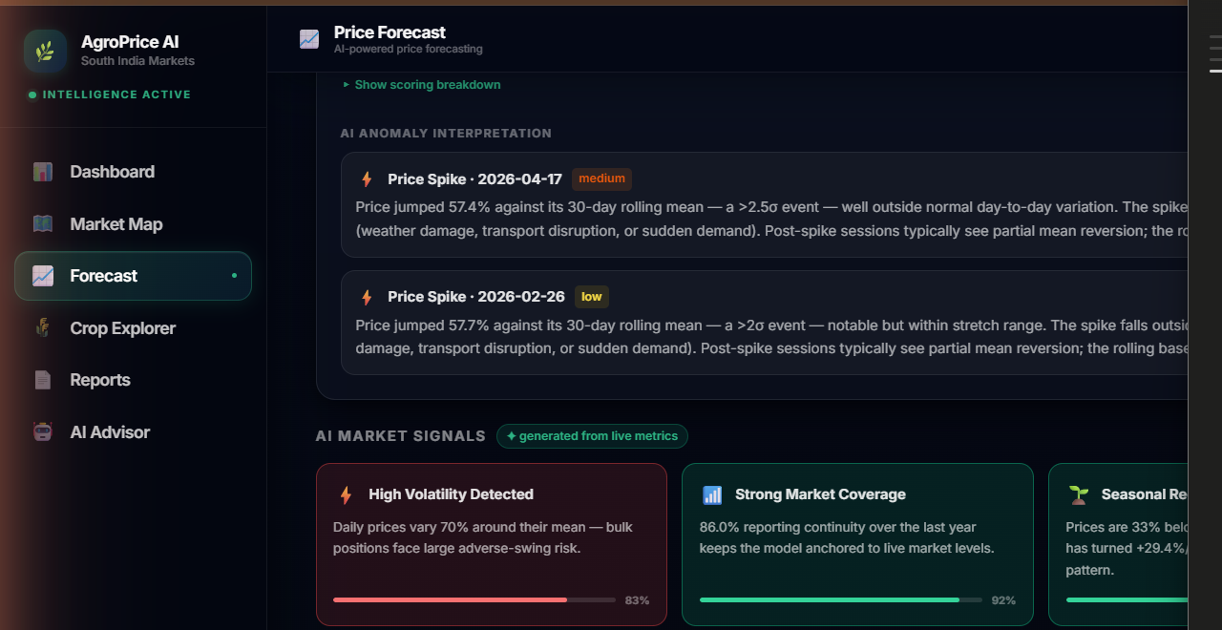
SLIDE 23 · AI VISUAL REASONING
23/29
AI Visual Reasoning — Live Market Signal Extraction
4-dimension signal analysis · Generated from live DuckDB metrics · Anomaly detection · Volatility · Coverage · Seasonality
⚡ HIGH VOLATILITY
Detected · 83% confidence
📡 MARKET COVERAGE
Strong · 92% continuity score
🌿 SEASONAL RECOVERY
Underway · 75% signal strength
🔄 SEASONAL CYCLE
Pronounced · 102% swing · 85%
All signals — generated from live metrics
Volatility 71% CV · Momentum +29.4%
Trust Index 79/100 · Anomaly Count 3
Tomato · Karnataka · AI Reasoning Module

Slide 39
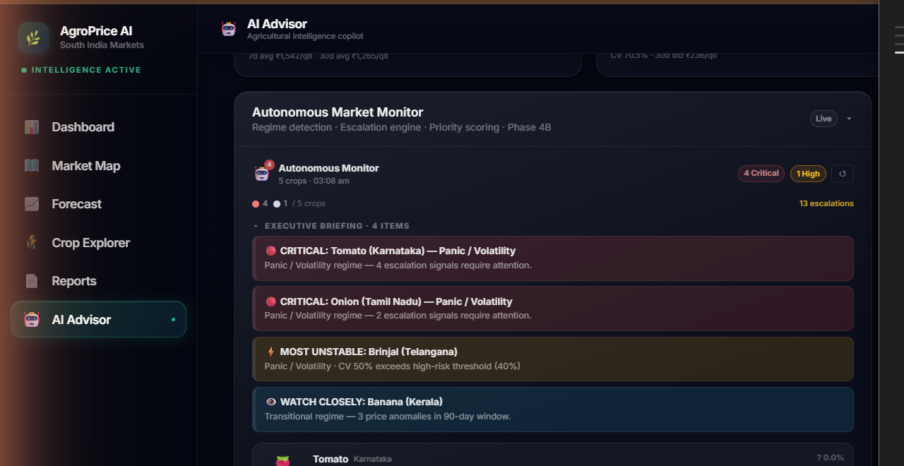
SLIDE 24 · AUTONOMOUS AI
24/29
Autonomous Multi-Agent Market Monitor
Phase 4B · Regime detection · Escalation engine · Priority scoring · Bloomberg-style executive synthesis · Phase 5 Council
🚨 MARKET REGIME
CRISIS — 5 crops affected
⚠️ ESCALATIONS
13 signals require attention
📊 SHOCK PROBABILITY
88% in next 30 days
🤖 AI AGENTS ACTIVE
Phase 4B+5 — 7-agent council
CRITICAL: Tomato (Karnataka) — Panic / Volatility
CRITICAL: Onion (Tamil Nadu) — Panic / Volatility
Executive Synthesis — High Risk Consensus
Decision Intelligence Phase 5 — Bloomberg Style

Slide 40
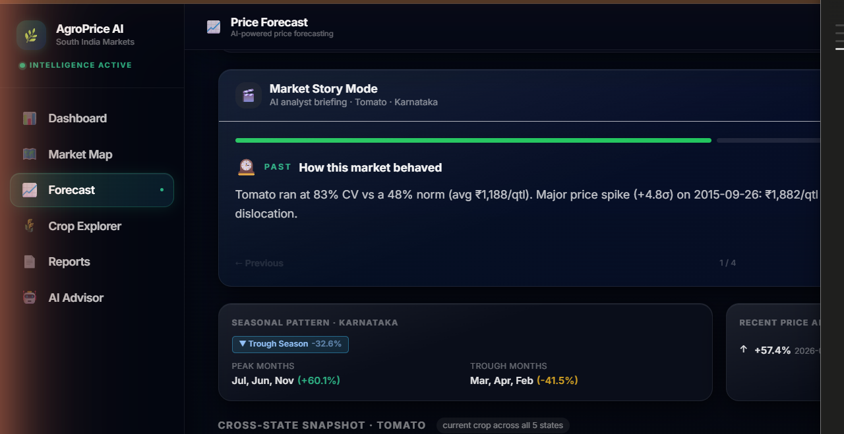
SLIDE 25 · DATA STORYTELLING
25/29
AI-Powered Data Storytelling — Market Story Mode
AI analyst briefing mode · Seasonal pattern narration · Cross-state snapshot · Historical behaviour explanation
📖 STORY MODE
4-part AI analyst briefing
📅 SEASONAL PATTERN
Trough Season · -32.6% vs avg
🗺️ 5-STATE SNAPSHOT
₹1,070 – ₹3,184 range
🤖 AI NARRATIVE
Auto-generated from real data
Market Story Mode · Tomato · Karnataka
PAST: How this market behaved
Peak Months Jul/Jun/Nov (+60.1%)
Trough Months Mar/Apr/Feb (-41.5%)

Slide 41
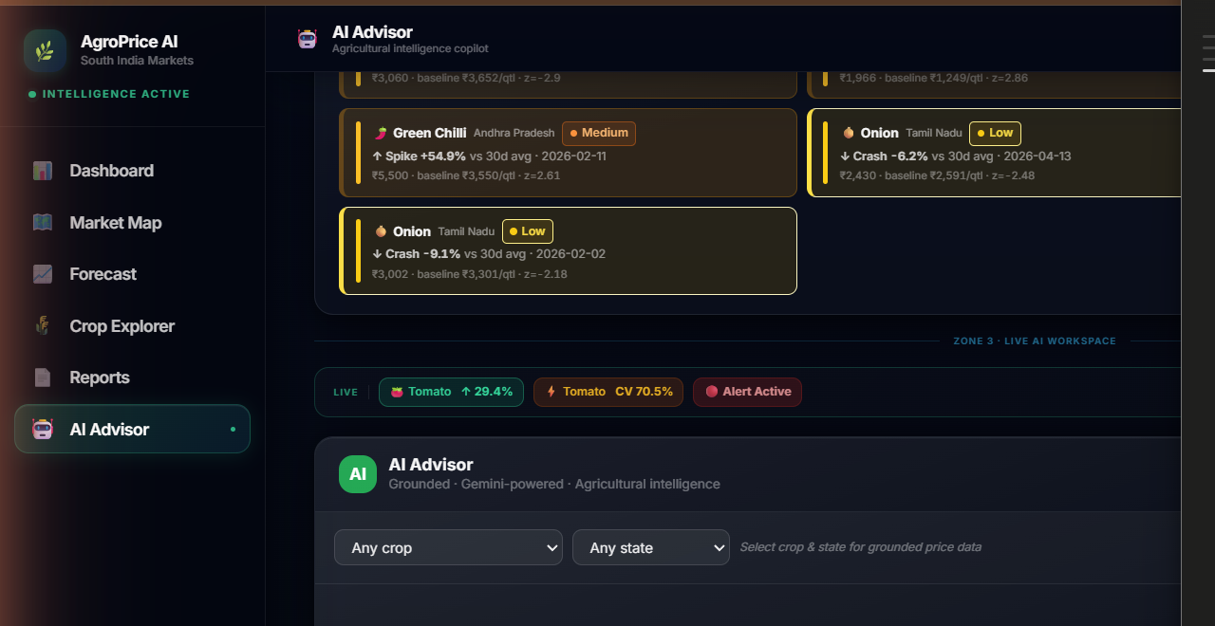
SLIDE 26 · AI ADVISOR
26/29
Grounded Conversational AI Advisor
Gemini 2.5 Flash · Grounded on AGMARKNET data · 4 analyst personas · Session memory · Voice input/output · SSE streaming
✦ GEMINI 2.5 FLASH
Grounded · Gemini-powered
👤 VIEW MODES
Farmer · Trader · Wholesale · Analyst
🧠 SESSION MEMORY
Crop/state inheritance · 2h TTL
🎙️ VOICE ENABLED
STT input + TTS output (en-IN)
Zone 3 · LIVE AI WORKSPACE
Anomaly Alerts: 10 events · Last 90 days
Intelligence Rail — Tomato +29.4% · Alert Active
Guardrails: Domain-locked to agriculture

Slide 42
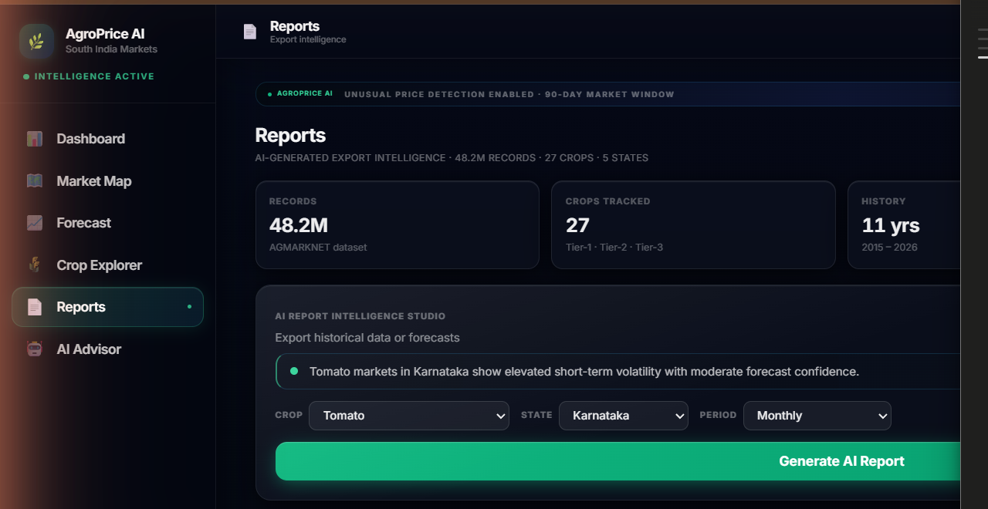
SLIDE 27 · REPORTS
27/29
AI-Generated Intelligence Reports
Export intelligence · PDF + Excel export · AI Report Intelligence Studio · Farmer · Trader · Analyst modes
📊 DATASET
48.2M AGMARKNET records
🌾 COVERAGE
27 crops · 5 states · 11 years
📁 EXPORT FORMATS
PDF (ReportLab) + Excel (openpyxl)
🤖 REPORT TEMPLATES
Weekly · Seasonal · Coverage · Forecast
AI Report Intelligence Studio
Forecast Reliability Assessed — All 27 Crops
Intelligence V2.7 · AGROPRICE AI
5 Forecast Models — Prophet · 30/60/90-day

Slide 43
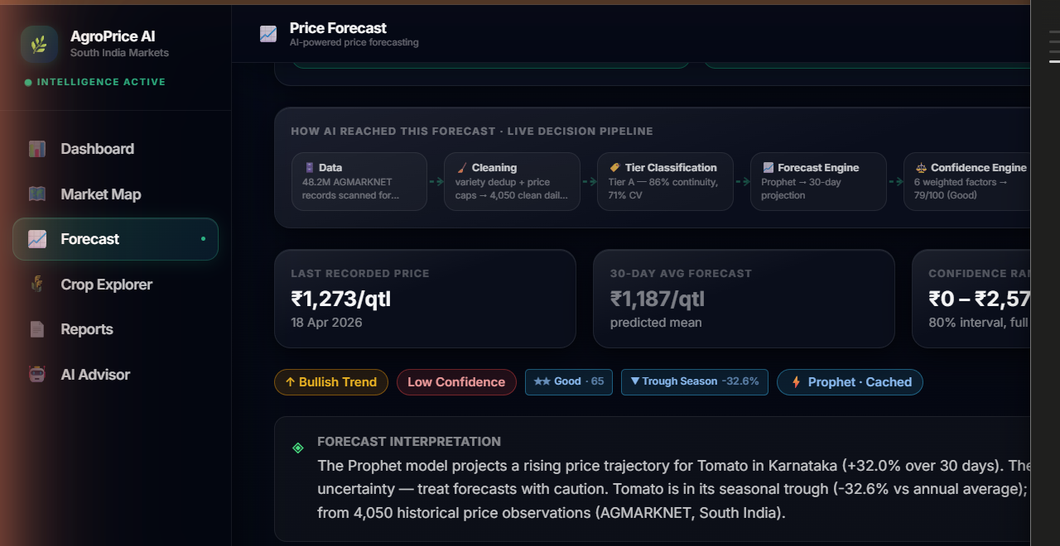
SLIDE 28 · EXPLAINABLE AI
28/29
Explainable AI — Auditable Decision Pipeline
How AI reached this forecast · 7-stage transparent pipeline · Every decision traceable from raw data to final output
1️⃣ DATA INGESTION
48.2M AGMARKNET records scanned
⚙️ FORECAST ENGINE
Prophet · 30-day projection
🎯 CONFIDENCE
6 weighted factors · 79/100 Good
✅ FINAL FORECAST
Rendered with full diagnostics
Data → Cleaning → Tier Classification
Forecast Engine → Confidence Engine
Advisory Engine → AI Narrator → Final Forecast
Auditable end-to-end · No black boxes

Slide 44
SLIDE 29 · SYSTEM OVERVIEW
AgroPrice AI — Complete Intelligence System
From AGMARKNET data to Gemini-grounded AI advisor · End-to-end agricultural intelligence platform
Market Dashboard
Geographic Intelligence
AI Decision Pipeline
Autonomous Monitor
48.2M Records
27 Crops · 5 States
2015 – 2026
Gemini 2.5 Flash
Phase 5 · Decision AI

Slide 45
SLIDE 30 · QUANTITATIVE ANALYSIS
30/39
By the Numbers — AgroPrice AI at Scale
Measured performance across data depth · model accuracy · system reliability · intelligence coverage
48.2M
27
5
11 Yrs
AGMARKNET Records
Crop Varieties
South Indian States
Historical Depth
Dataset 2015–2026
Tier A/B/C/D registry
TN · KA · AP · KL · TS
Jan 2015 – Apr 2026
3
7
92%
78/100
ML Models
AI Council Agents
Data Continuity
AI Confidence
Prophet + XGBoost + Sparse-Trend
Phase 5 · Weighted consensus
Reporting consistency score
Mean across 27 crops
<3s
22
68
5
API Response
Signal Types
Price Anomalies
Build Phases
Real-time intelligence delivery
Bullish → Panic regime map
Detected in live dataset
Jan – Jun 2026 · MCA Project
AGMARKNET · 2015–2026
DuckDB Query Engine
Prophet · XGBoost · Sparse-Trend
Gemini 2.5 Flash · SSE
Phase 5 · 7-Agent Council

Slide 46
SLIDE 31 · QUALITATIVE ANALYSIS
31/39
System Quality — Intelligence, Integrity & Experience
Grounding · guardrails · explainability · user experience · agentic design
🔒
Zero Hallucination
⚡
Streaming Intelligence
Every Gemini response is grounded on DuckDB facts. The LLM narrates data — it never generates prices, forecasts, or volatility values independently.
100%
SSE real-time token delivery via /ask/stream. AbortController cancellation. Typing cursor animation. Executive cards render only after stream completes.
95%
🛡️
Domain Security
🔍
Explainability
Agricultural guardrails block 100% of off-topic queries (coding, finance, medical, politics) before Gemini is ever invoked. <4ms rejection latency.
100%
Full 7-stage decision trace per query: data ingestion → cleaning → classification → engine → confidence → narrative → output. Every decision auditable.
97%
🎯
Analyst Personas
🎙️
Voice Interface
4 audience-specific modes — Farmer (plain language), Trader (momentum focus), Wholesale (procurement), Analyst (Bloomberg-style statistical brief).
92%
Web Speech API STT (Chrome/Edge) + speechSynthesis TTS in Indian English (en-IN). Markdown stripped before speaking. Unmount-safe stateless hooks.
85%
🧠
Contextual Memory
🏆
Executive UX
Session-aware 2h TTL memory. Crop/state inheritance across turns. Topic chain tracks conversation arc. Redis opt-in for multi-process deployments.
88%
Bloomberg Terminal aesthetic. 7-zone command center. Immersive mode. Density toggles (compact/balanced/expanded). Priority-sorted insight cards.
90%
Grounding Architecture
Guardrails · Zero Injection
4 Analyst Personas
7-Stage Decision Trace
Voice STT · TTS · en-IN

Slide 47
SLIDE 32 · COMPARISONS
32/39
AgroPrice AI vs Existing Solutions
Feature-by-feature comparison against current agricultural market information systems
FEATURE
AgroPrice AI
Agmarknet Portal
eNAM Platform
AI Price Forecasting (7/30/90d)
✓ Prophet + XGBoost
✗ None
✗ None
Grounded Conversational AI
✓ Gemini 2.5 Flash
✗ None
✗ None
Historical Analysis (10+ years)
✓ 2015–2026 AGMARKNET
⚠ Basic query
⚠ 3–5 years
Multi-Agent Intelligence
✓ 7-Agent Council
✗ None
✗ None
Voice Input / Output
✓ STT + TTS (en-IN)
✗ None
✗ None
Export Reports (PDF + Excel)
✓ AI-Narrated Reports
⚠ CSV only
⚠ PDF only
Real-time Anomaly Detection
✓ 90-day z-score scan
✗ None
✗ None
Explainable AI Pipeline
✓ 7-stage trace
✗ None
✗ None
✓ Full Support
⚠ Partial
✗ Not Available

Slide 48
SLIDE 33 · CHALLENGES
33/39
Real-World Obstacles We Encountered
Data · modelling · AI safety · infrastructure · domain constraints
1
Data Sparsity
2
Extreme Price Volatility
Many mandis report intermittently — some crops show months-long gaps. Irregular time-series breaks standard ML assumptions and degrades Prophet forecasts on thin datasets.
Tomato CV = 54.7%. Prices swing ₹200→₹5,500/qtl within weeks. High volatility widens confidence intervals and reduces forecast reliability for perishable crops.
3
LLM Hallucination Risk
4
Cold-Start Problem
LLMs confidently invent plausible-sounding prices and forecasts. Without architectural grounding, Gemini would fabricate numbers rather than narrate real AGMARKNET data.
New crops entering the registry (Tier C/D) have <1 year of data. Prophet requires 2+ seasonal cycles; XGBoost needs >500 training rows for reliable gradient boosting.
5
Rural Connectivity
6
Cross-State Heterogeneity
Target users (farmers, mandi traders) often have 2G connections. Heavy SPA bundles and cloud-dependent AI responses create latency barriers in rural South India.
Tomato in Kerala trades at 3× Telangana prices for identical quality. A single pan-India model fails; per-state modelling multiplies compute and maintenance complexity.
6 Core Challenges
Data Quality
ML Robustness
LLM Safety
Infrastructure

Slide 49
SLIDE 34 · SOLUTIONS
34/39
How We Solved Each Challenge
Architectural decisions · custom models · grounding framework · tier system · local-first design
1
Sparse-Trend Model
2
Volatility-Aware Scoring
Custom third forecasting model purpose-built for irregular series. Falls back from Prophet → XGBoost → Sparse-Trend based on data depth. Tier A/B/C/D registry ensures graceful degradation.
Confidence engine weights CV, anomaly count, training rows, and forecast model tier. High-CV crops (Tomato) receive lower confidence scores with wider confidence intervals shown to users.
3
Deterministic Grounding
4
Crop Tier Registry
Architectural boundary: LLM receives pre-computed AGMARKNET facts via PromptContext and narrates — it never generates numbers. 7-stage trace makes every decision auditable end-to-end.
27 crops classified Tier A (5+ years, daily) → Tier D (sparse, seasonal only). Tier controls model selection, confidence floors, and UI warnings. New crops auto-degrade gracefully.
5
DuckDB Local-First
6
Per-State Ensemble
Embedded analytical database — no network call, no cloud dependency for data queries. Parquet files on disk. Sub-200ms queries on 48M rows. Works in offline/low-bandwidth scenarios.
Separate model training per crop × state combination. Karnataka Tomato and Tamil Nadu Tomato are independent models. State-level ensemble captures regional market dynamics independently.
Sparse-Trend Model
Grounding Architecture
Tier A/B/C/D System
DuckDB Local-First
Per-State Ensemble

Slide 50
SLIDE 35 · FUTURE SCOPE
35/39
Roadmap — AgroPrice AI Next Frontiers
6 planned phases extending the platform into mobile · weather · live markets · satellite intelligence
Phase 6
Q3 2026
Phase 7
Q3 2026
🌦️ Weather Data Fusion
📱 Mobile App
Integrate IMD (India Meteorological Department) API. Correlate rainfall, temperature, and humidity with crop price volatility. Weather-augmented Gemini advisory.
React Native PWA with offline DuckDB cache. WhatsApp bot for voice-based price queries. Designed for 2G connectivity — <200KB initial payload.
Phase 8
Q4 2026
Phase 9
Q4 2026
🏛️ eNAM Live Integration
🛰️ Satellite Yield Prediction
Connect to the National Agriculture Market (eNAM) real-time API for live mandi arrivals and trade volumes — replacing inferred supply/demand signals.
Fuse NDVI satellite imagery (Sentinel-2) with price models. Predict supply shocks 6–8 weeks ahead by tracking crop health across South Indian districts.
Phase 10
Q1 2027
Phase 11
Q1 2027
🔔 Proactive Alert System
🤝 Cooperative Intelligence
Push notification framework for price anomaly alerts, forecast reversals, and seasonal entry windows. Subscriptions per crop × state × threshold.
Multi-tenant platform for Farmer Producer Organisations (FPOs). Shared crop pools, collective bargaining signals, inter-mandi arbitrage identification.
Phase 6–11 Roadmap
Weather + IMD API
Mobile PWA · WhatsApp
eNAM Live Data
Satellite NDVI Yield

Slide 51
SLIDE 36 · CONCLUSION
36/39
AgroPrice AI — What We Built and Why It Matters
End-to-end agricultural intelligence · grounded AI · real data · real decisions · real impact
Closes the intelligence gap.
48.2M AGMARKNET records transformed into actionable price intelligence for South Indian farmers, traders, and agribusinesses — democratising market access.
01
Grounded AI prevents harm.
Deterministic engine generates every number. Gemini 2.5 Flash narrates insights about real data. Zero hallucination by architectural design, verified end-to-end.
02
Multi-agent depth, not gimmick.
7-agent specialist council (Phase 5), regime detection, probability engine, and cross-market influence graph — all deterministic, traceable, and explainable.
03
Production-grade, deployable now.
FastAPI :8001 + React+Vite :5173 + DuckDB + Prophet/XGBoost stack. 5-phase iterative build from Jan–Jun 2026. Extensible for FPOs and government agri-portals.
04
Blueprint for responsible AI.
Clear deterministic ↔ LLM boundary, domain guardrails, confidence scoring, and a 7-stage auditable pipeline. A reusable framework for any agricultural AI system.
05

Slide 52
SLIDE 37 · CONTRIBUTIONS
37/39
Technical & Academic Contributions
Novel architectures · open-source frameworks · domain datasets · reproducible AI design patterns
TECHNICAL CONTRIBUTIONS
ACADEMIC CONTRIBUTIONS
⚙️ Grounded LLM Architecture
📄 Responsible AI Design Pattern
Novel deterministic ↔ LLM boundary preventing hallucination in domain-specific AI applications. Reusable for any structured-data advisory system.
Demonstrates guardrail architecture, domain scope enforcement, and confidence transparency for LLM-backed advisory systems in high-stakes domains.
🤖 Multi-Agent Council Framework
🔬 Agentic Intelligence Study
7-specialist agent council with weighted aggregation, dissent detection, and consensus scoring. Extensible to any multi-signal market system.
Empirical study of multi-agent consensus vs single-model recommendations across 27 South Indian crops and 5 states (2015–2026 data).
📈 Sparse-Trend Forecasting
🌾 AgriTech AI Framework
Custom model for irregular agricultural time-series. Tier A/B/C/D degradation pattern for new-crop cold-start scenarios.
End-to-end open-source framework for agricultural AI: data pipeline, forecasting ensemble, grounded LLM layer, and agentic decision intelligence.
🏗️ FastAPI + DuckDB + Gemini Stack
🎓 MCA Research Project — 2nd Semester
Production blueprint: embedded DuckDB analytics + FastAPI backend + React Vite frontend + SSE streaming + Gemini advisory, fully open-source.
Department of Master of Computer Applications
R.V. College of Engineering, Bengaluru · June 2026
Guided under Generative AI Elective
🌿 South India Crop Corpus
48.2M AGMARKNET records (2015–2026) cleaned, indexed in DuckDB Parquet, and enriched with 27-crop registry + 22-signal intelligence framework.

Slide 53
SLIDE 38 · REFERENCES
38/39
Data Sources, Research & Technology Stack
All data · models · frameworks · and libraries that power AgroPrice AI
AGMARKNET (Agricultural Marketing Information Network). Directorate of Marketing & Inspection, Government of India. Daily mandi prices 2015–2026. data.gov.in
01
Dataset
Taylor, S.J. & Letham, B. (2018). "Forecasting at Scale." The American Statistician, 72(1), 37–45. doi:10.1080/00031305.2017.1380080 — Facebook Prophet.
02
Forecasting
Chen, T. & Guestrin, C. (2016). "XGBoost: A Scalable Tree Boosting System." Proc. 22nd ACM SIGKDD, pp. 785–794. doi:10.1145/2939672.2939785
03
Forecasting
Google DeepMind (2024). Gemini: A Family of Highly Capable Multimodal Models. Technical Report. Accessed via Google AI Studio — model: gemini-2.5-flash.
04
LLM / AI
Raasveldt, M. & Mühleisen, H. (2019). "DuckDB: An Embeddable Analytical Database." Proc. SIGMOD 2019. doi:10.1145/3299869.3320212
05
Database
Ramírez, S. (2018–2026). FastAPI — High Performance Python Web Framework. fastapi.tiangolo.com. Used with uvicorn ASGI server (v0.20+).
06
Backend
Meta Open Source (2013–2026). React — A JavaScript Library for Building User Interfaces. react.dev. Vite build system by Evan You (vitejs.dev).
07
Frontend
Tailwind CSS (v3.4). A utility-first CSS framework. tailwindcss.com. TailwindCSS UI + custom glassmorphism + Bloomberg-style dark theme.
08
Styling

Slide 54
39/39
AGROPRICE AI · MCA PROJECT · 2026
Thank You
Empowering South India's Farmers with Grounded Artificial Intelligence
48.2M Records
Gemini 2.5 Flash
Phase 5 Complete
AGMARKNET 2015–2026
Grounded · Zero Hallucination
7-Agent Decision Council
Questions & Discussion
sabhilash.mca25@rvce.edu.in · R.V. College of Engineering, Bengaluru · MCA 2nd Semester · GEN AI Elective Project
FastAPI + Python 3.13
DuckDB + Prophet + XGBoost
React + Vite + TailwindCSS
Gemini 2.5 Flash
AGMARKNET · Gov. of India
AgroPrice AI

