Slide 1
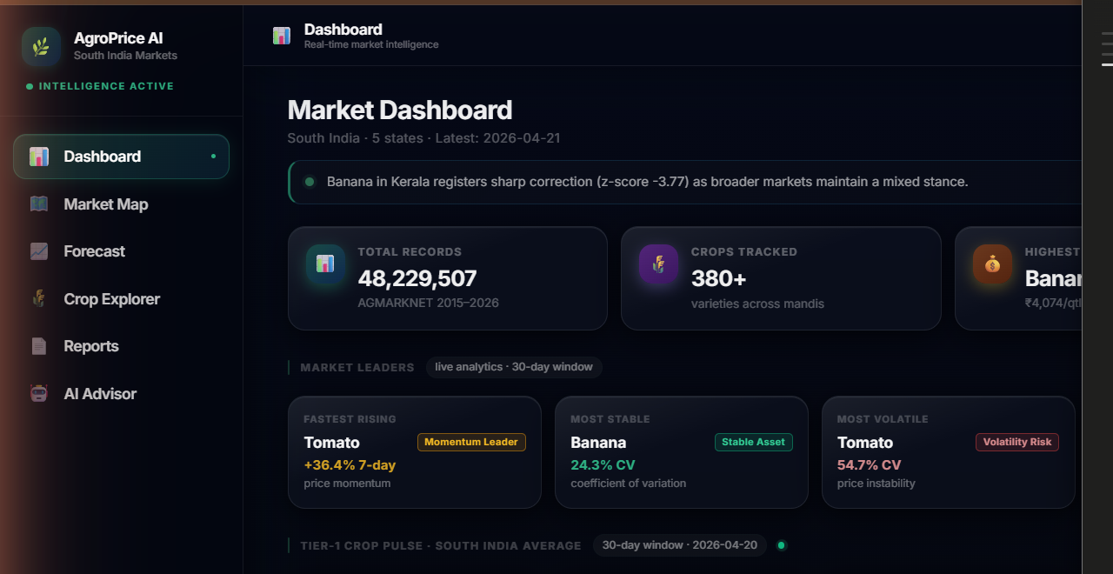
SLIDE 20 · LIVE DASHBOARD
20/29
Market Intelligence Dashboard
Real-time agricultural price analytics · AGMARKNET 2015–2026 · 5 South Indian states · 27 crops tracked
📊 TOTAL RECORDS
48,229,507
🌾 CROPS TRACKED
380+ varieties
🗺️ STATES COVERED
TN · KA · AP · TS · KL
⚡ MARKET STRESS
100/100 — Extreme Alert
48.2M AGMARKNET Records
Latest: 2026-04-21
AI Brief — Live Ticker
Highest Priced: Banana ₹4,074/qtl

Slide 2
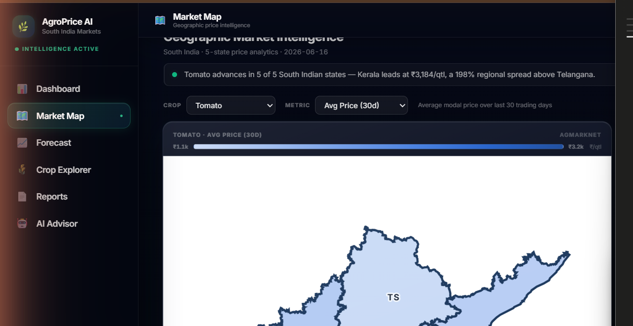
SLIDE 21 · MARKET MAP
21/29
Geographic Price Intelligence — South India
5-state spatial analytics · State-level price heatmap · Regional spread analysis · Crop × State × Metric
📍 HIGHEST PRICE
Kerala ₹3,184/qtl (+22%)
📉 LOWEST PRICE
Telangana ₹1,070/qtl
↑ STRONGEST TREND
Telangana +77.7% uptrend
📐 REGIONAL SPREAD
198% Kerala vs Telangana
Tomato · Avg Price (30D)
5/5 South Indian States
AGMARKNET Spatial Intel
Kerala leads at ₹3,184/qtl

Slide 3
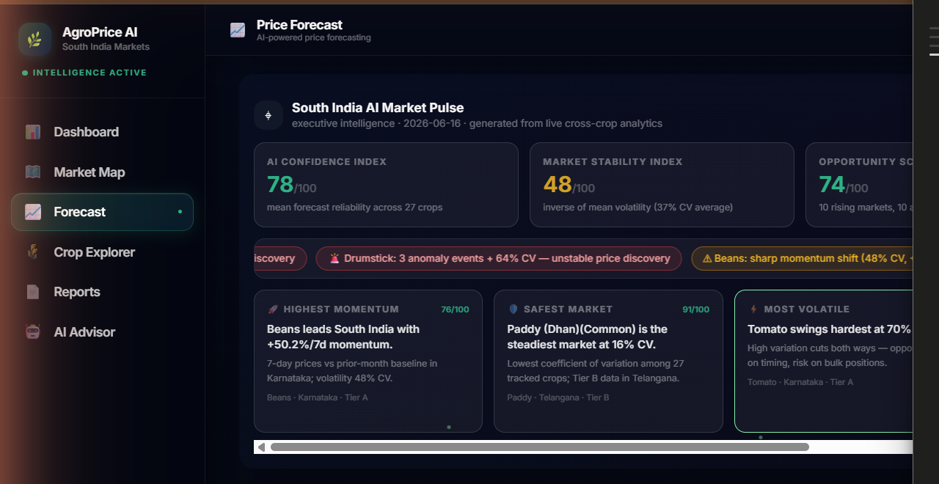
SLIDE 22 · FORECAST ENGINE
22/29
AI-Powered Price Forecasting Engine
Prophet + XGBoost + Sparse-Trend models · 7/30/90-day horizons · Tier A/B/C/D crop registry · 27 crops
🧠 AI CONFIDENCE
78/100 — Mean across 27 crops
⚖️ MARKET STABILITY
48/100 — Inverse of mean CV
🎯 OPPORTUNITY
74/100 — 10 rising markets
⚡ STRESS METER
100/100 — 68 anomaly events
Prophet · 4,050 Training Days
Tier A — 90-Day Horizon
South India AI Market Pulse · LIVE
Market Leaders — Beans +50.2%/7d

Slide 4
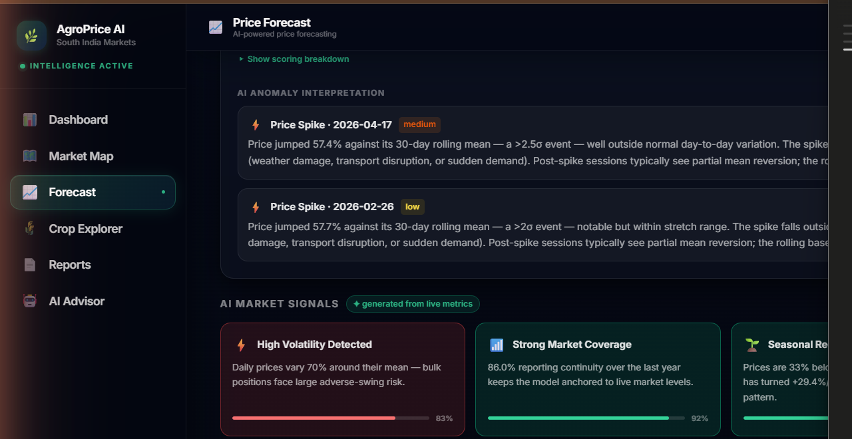
SLIDE 23 · AI VISUAL REASONING
23/29
AI Visual Reasoning — Live Market Signal Extraction
4-dimension signal analysis · Generated from live DuckDB metrics · Anomaly detection · Volatility · Coverage · Seasonality
⚡ HIGH VOLATILITY
Detected · 83% confidence
📡 MARKET COVERAGE
Strong · 92% continuity score
🌿 SEASONAL RECOVERY
Underway · 75% signal strength
🔄 SEASONAL CYCLE
Pronounced · 102% swing · 85%
All signals — generated from live metrics
Volatility 71% CV · Momentum +29.4%
Trust Index 79/100 · Anomaly Count 3
Tomato · Karnataka · AI Reasoning Module

Slide 5
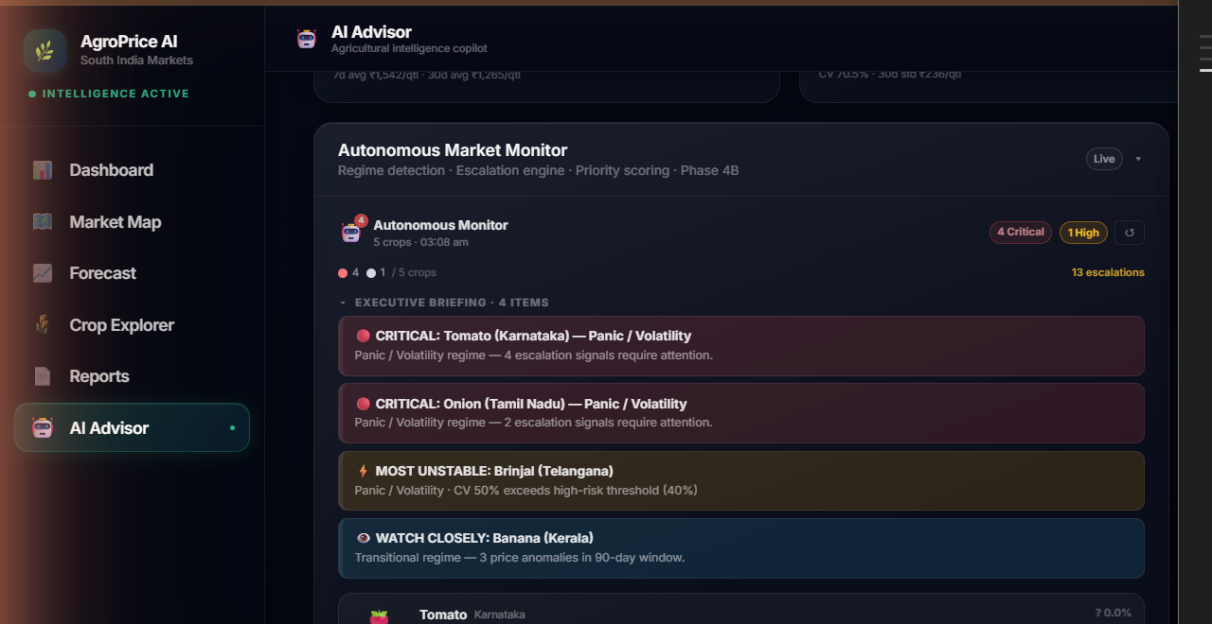
SLIDE 24 · AUTONOMOUS AI
24/29
Autonomous Multi-Agent Market Monitor
Phase 4B · Regime detection · Escalation engine · Priority scoring · Bloomberg-style executive synthesis · Phase 5 Council
🚨 MARKET REGIME
CRISIS — 5 crops affected
⚠️ ESCALATIONS
13 signals require attention
📊 SHOCK PROBABILITY
88% in next 30 days
🤖 AI AGENTS ACTIVE
Phase 4B+5 — 7-agent council
CRITICAL: Tomato (Karnataka) — Panic / Volatility
CRITICAL: Onion (Tamil Nadu) — Panic / Volatility
Executive Synthesis — High Risk Consensus
Decision Intelligence Phase 5 — Bloomberg Style

Slide 6
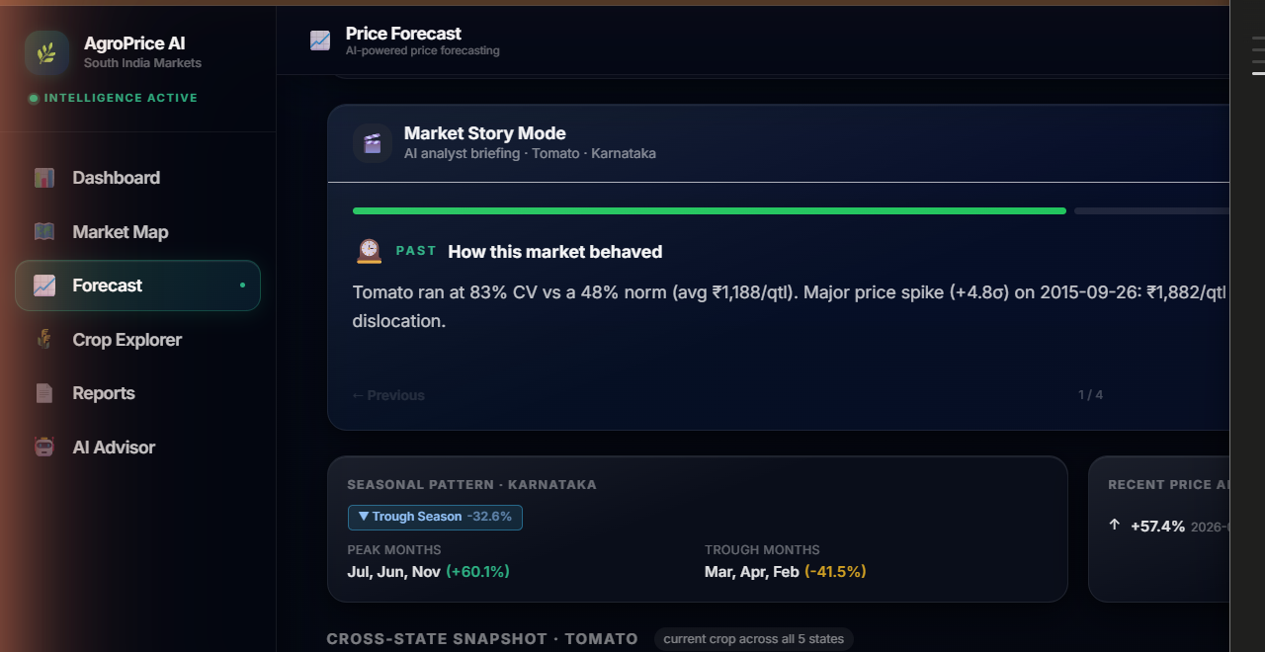
SLIDE 25 · DATA STORYTELLING
25/29
AI-Powered Data Storytelling — Market Story Mode
AI analyst briefing mode · Seasonal pattern narration · Cross-state snapshot · Historical behaviour explanation
📖 STORY MODE
4-part AI analyst briefing
📅 SEASONAL PATTERN
Trough Season · -32.6% vs avg
🗺️ 5-STATE SNAPSHOT
₹1,070 – ₹3,184 range
🤖 AI NARRATIVE
Auto-generated from real data
Market Story Mode · Tomato · Karnataka
PAST: How this market behaved
Peak Months Jul/Jun/Nov (+60.1%)
Trough Months Mar/Apr/Feb (-41.5%)

Slide 7
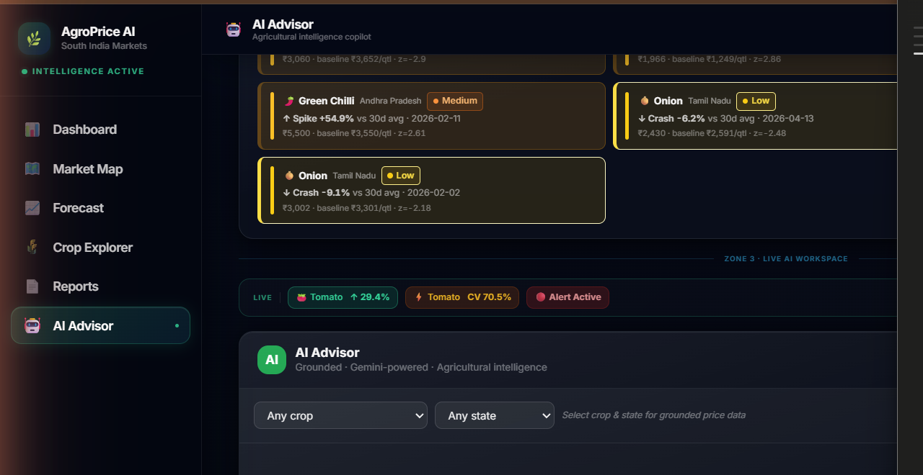
SLIDE 26 · AI ADVISOR
26/29
Grounded Conversational AI Advisor
Gemini 2.5 Flash · Grounded on AGMARKNET data · 4 analyst personas · Session memory · Voice input/output · SSE streaming
✦ GEMINI 2.5 FLASH
Grounded · Gemini-powered
👤 VIEW MODES
Farmer · Trader · Wholesale · Analyst
🧠 SESSION MEMORY
Crop/state inheritance · 2h TTL
🎙️ VOICE ENABLED
STT input + TTS output (en-IN)
Zone 3 · LIVE AI WORKSPACE
Anomaly Alerts: 10 events · Last 90 days
Intelligence Rail — Tomato +29.4% · Alert Active
Guardrails: Domain-locked to agriculture

Slide 8
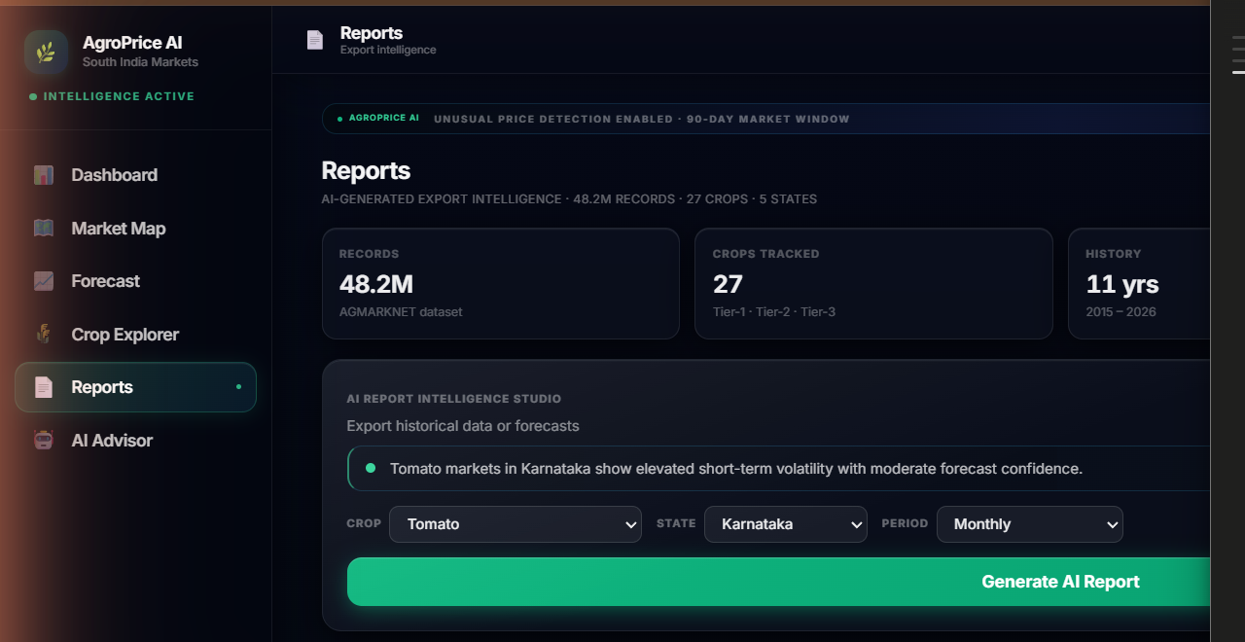
SLIDE 27 · REPORTS
27/29
AI-Generated Intelligence Reports
Export intelligence · PDF + Excel export · AI Report Intelligence Studio · Farmer · Trader · Analyst modes
📊 DATASET
48.2M AGMARKNET records
🌾 COVERAGE
27 crops · 5 states · 11 years
📁 EXPORT FORMATS
PDF (ReportLab) + Excel (openpyxl)
🤖 REPORT TEMPLATES
Weekly · Seasonal · Coverage · Forecast
AI Report Intelligence Studio
Forecast Reliability Assessed — All 27 Crops
Intelligence V2.7 · AGROPRICE AI
5 Forecast Models — Prophet · 30/60/90-day

Slide 9
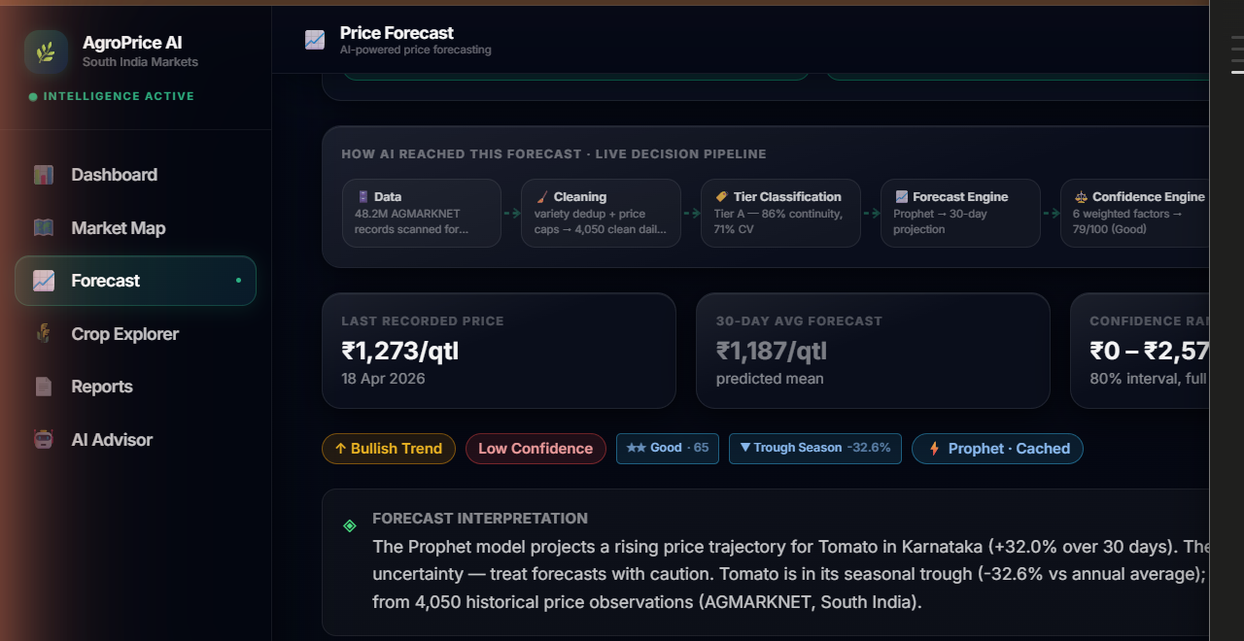
SLIDE 28 · EXPLAINABLE AI
28/29
Explainable AI — Auditable Decision Pipeline
How AI reached this forecast · 7-stage transparent pipeline · Every decision traceable from raw data to final output
1️⃣ DATA INGESTION
48.2M AGMARKNET records scanned
⚙️ FORECAST ENGINE
Prophet · 30-day projection
🎯 CONFIDENCE
6 weighted factors · 79/100 Good
✅ FINAL FORECAST
Rendered with full diagnostics
Data → Cleaning → Tier Classification
Forecast Engine → Confidence Engine
Advisory Engine → AI Narrator → Final Forecast
Auditable end-to-end · No black boxes

Slide 10
SLIDE 29 · SYSTEM OVERVIEW
AgroPrice AI — Complete Intelligence System
From AGMARKNET data to Gemini-grounded AI advisor · End-to-end agricultural intelligence platform
Market Dashboard
Geographic Intelligence
AI Decision Pipeline
Autonomous Monitor
48.2M Records
27 Crops · 5 States
2015 – 2026
Gemini 2.5 Flash
Phase 5 · Decision AI

