Slide 1
RiskWaiver360
360
GRC Process Exception &
Policy Waiver Management Platform
GRC
TEAM:
S Abhilash · Rajath S
INSTITUTION:
RVCE (RV College of Engineering), Bengaluru
TRACK:
Policy Governance & Risk Management
YEAR:
2026 · Societe Generale Hackathon
Notes:
Welcome everyone. This is RiskWaiver360 — our GRC Exception and Policy Waiver Management Platform, built for the Societe Generale Hackathon 2026. I'm [S Abhilash / Rajath S] from RVCE Bengaluru. Our team built this to solve a real problem: organizations have no single place to manage, score, track, and audit policy exceptions.

Slide 2
The Problem — Exception Blindspot in GRC
2/12
Where Do Policy Exceptions Live Today?
⚠ Audit Risk
Scattered across email threads and Slack messages
Tracked informally in spreadsheets with no lifecycle control
Expired exceptions left active — never revoked
No central visibility for security teams or auditors
Access granted "temporarily" becomes permanent without review
Hidden attack paths grow where exceptions are forgotten
No evidence trail for expired exceptions
🔓 Security Gaps
Expired firewall & access exceptions still active
📋 Compliance Drift
Policies waived without proper justification
RiskWaiver360 · GRC Exception & Policy Waiver Management · RVCE 2026
Notes:
Today, policy exceptions are managed in silos — emails, Excel files, and informal Slack approvals. The result: expired exceptions remain active, access is never revoked, and auditors cannot verify whether exceptions were justified or ever reviewed. This creates invisible compliance risk and security exposure.

Slide 3
Risk Scenarios — What Goes Wrong Without GRC Control
3/12
01
02
03
Orphaned Access
Overlapping Waivers
Conflicting Approvals
User left the org — access exception never revoked. Account remains open.
Two exceptions approved for the same asset and policy. No one noticed.
One approver approved; another rejected. System shows both records.
04
05
06
Long-Running Temp Access
Risk Accumulation
Audit Failure
"Temporary" admin access from 18 months ago — still active, never reviewed.
15 exceptions on one critical asset. Combined exposure is extremely high.
Auditor requests evidence. No justification, no review record, no expiry trail.
RiskWaiver360 · GRC Exception & Policy Waiver Management · RVCE 2026
Notes:
These are real scenarios that occur in organizations without proper exception management. Each one represents an audit finding, a security vulnerability, or a compliance gap. RiskWaiver360 is designed to detect and prevent all six of these situations.

Slide 4
Proposed Solution — RiskWaiver360
4/12
CENTRALIZED
RISK-SCORED
LIFECYCLE-TRACKED
AUDIT-READY
Single source of truth for all exceptions
Quantitative scoring, not guesswork
From intake to expiry, every step recorded
Evidence-backed, exportable reports
Exception Lifecycle Flow
1
2
3
4
5
Structured
Intake
Security
Review
Approver
Decision
Continuous
Monitoring
Audit
Evidence
"Turn scattered exceptions into governed, scored, lifecycle-tracked decisions."
RiskWaiver360 · GRC Exception & Policy Waiver Management · RVCE 2026
Notes:
RiskWaiver360 is a centralized platform where every exception goes through a defined lifecycle: structured intake, security review, approver decision, continuous monitoring, and audit evidence generation. No exception falls through the cracks.

Slide 5
System Architecture
5/12
PRESENTATION LAYER
› React 18 + Vite · Role-Based Workspaces
› 4 Role Views: Requester / Reviewer / Approver / Auditor
API LAYER
› Node.js + Express REST API · Port 4000
› Routes: Exceptions · Approvals · Alerts · Conflicts · Audit
DATA & SERVICES LAYER
› JSON Flat-File Storage (Demo) · 600 Exception Records
› Services: Risk Scoring · Alert Engine · GRC Intelligence · Audit
Engines:
Risk Scoring
Alert Engine
GRC Intelligence
Audit Report
RiskWaiver360 · GRC Exception & Policy Waiver Management · RVCE 2026
Notes:
The stack is React 18 on Vite for the frontend, Node.js + Express for the API, and JSON flat-file storage for the demo. In production, this would be replaced with PostgreSQL or MongoDB. The core backend services handle risk scoring, alert generation, GRC intelligence detection, and audit report generation.

Slide 6
Role-Based Workflow — Four Workspaces
6/12
Requester
Security
Reviewer
Approver
Auditor /
Admin
▶
▶
▶
› Submit policy exception requests
› Review submitted exceptions
› Approve, reject, or revoke exceptions
› Full read-only audit access
› Track exception status & history
› Assess risk and controls
› Add governance comments
› GRC intelligence & risk portfolio
› View own risk scores
› Request clarification or escalate
› Focus on critical / high risk items
› Audit reports & system settings
Exception Status Flow:
Submit
›
Under Review
›
Pending Approval
›
Active / Rejected
›
Monitored
›
Audited
Every action is timestamped and stored in the exception history for audit evidence.
RiskWaiver360 · GRC Exception & Policy Waiver Management · RVCE 2026
Notes:
RiskWaiver360 has four distinct role workspaces. Requesters submit exceptions and track status. Security Reviewers perform technical risk assessment. Approvers make the final governance decision. Auditors get full read-only access to all evidence, reports, and GRC intelligence. Each role sees only what is relevant to their function.

Slide 7
Core Platform Features
7/12
01
Exception Risk Register
02
Structured GRC Intake
03
Security Review Queue
Filterable registry of all 600 exceptions. Search, filter by dept, status, risk, type.
Validated intake form: exception type, asset, policy, CIA, owner, justification.
Prioritized queue for reviewers. Checklist, risk bands, action buttons.
04
Exception Evidence File
05
Risk Scoring Engine
06
Continuous Monitoring
Full exception detail: lifecycle, approvals, history, GRC conflicts, risk score.
Rule-based score (0-100). Type + Asset + Duration + Expiry + Review - Controls.
682 alerts: overdue, expiring soon, orphaned owner, missing controls, review due.
07
GRC Intelligence Center
08
Audit-Ready Reports
09
Settings & Roadmap
Detects overlaps (90), duplicates (59), conflicts, and risk accumulation hotspots (37).
Department & risk breakdown, lifecycle analysis, printable evidence packs.
Dataset stats, scoring config, role matrix, limitations, and production roadmap.
RiskWaiver360 · GRC Exception & Policy Waiver Management · RVCE 2026
Notes:
Nine core features make up RiskWaiver360. Each feature is live and functional in the demo. The exception registry, intake form, review queue, risk scoring engine, alert monitoring, and GRC intelligence are all interconnected and driven by the same 600-record exception dataset.

Slide 8
Risk Scoring Engine — Rule-Based & Explainable
8/12
Risk Score = Type Weight + Asset Criticality + Duration Penalty + Expiry Status + Review Penalty + Owner Status − Control Bonus
Scoring Factors
Exception Type
20 – 35 pts
Admin Access 30, Firewall 25, Encryption 35...
Review State
0 – 10 pts
Never reviewed: +10, Overdue: +5
Asset Criticality
10 – 30 pts
Critical asset adds 30 pts
Owner Status
0 – 10 pts
Inactive / unassigned owner: +10
Duration Penalty
0 – 15 pts
>90 days: +10, >180 days: +15
Control Bonus
0 – 15 pts
Strong compensating control: −15
Expiry Status
0 – 20 pts
Overdue: +20, Expiring soon: +10
Low 0–30
Medium 31–59
High 60–79
Critical 80–100
Score Range 0–100 · Rule-based · Explainable · Audit-friendly
RiskWaiver360 · GRC Exception & Policy Waiver Management · RVCE 2026
Notes:
The risk scoring engine is completely rule-based and explainable. Every score is derived from a transparent formula. Auditors and reviewers can see exactly why a score is what it is. There is no machine learning — scoring is deterministic and reproducible. This makes it audit-friendly and trustworthy in a regulated environment.

Slide 9
Continuous Monitoring & GRC Intelligence
9/12
Continuous Monitoring Alerts
GRC Intelligence Center
682
Total Active Alerts
186
Total GRC Findings
Across all monitored exceptions
Detected across 600 exceptions
333
Critical Risk
27
Critical Accumulation
Risk score ≥ 80 — immediate attention
Assets with stacked risk ≥ 1500
156
Overdue Exceptions
Past expiry date, still active
90
Overlapping Exceptions
127
Review Overdue
Same asset + policy, concurrent dates
Not reviewed in 90+ days
59
Duplicate Waivers
24
Missing Controls
Same dept + asset + type, similar justification
No compensating control documented
0
23
Conflicting Approvals
Expiring Soon
No governance conflicts detected
Expiry within 14 days
19
Orphaned Owner
37
Risk Hotspots
Owner is inactive or unassigned
Assets accumulating high combined risk
RiskWaiver360 · GRC Exception & Policy Waiver Management · RVCE 2026
Notes:
The monitoring layer has two components. The Alert Engine continuously evaluates 600 exceptions and currently surfaces 682 active alerts across 7 categories. The GRC Intelligence Center uses rule-based detection to find overlapping waivers, duplicate requests, conflicting approvals, and risk accumulation hotspots — patterns that no alert alone would catch.

Slide 10
Compliance Alignment & CIA Impact Mapping
10/12
Compliance Frameworks
CIA Impact Classification
NIST AC-2
Account Management — exception lifecycle & access control tracking
C
Confidentiality
Data disclosure risk if exception is misused
NIST PL-4
Rules of Behavior — policy waiver governance and documentation
I
Integrity
Data accuracy at risk from unauthorized changes
GDPR Article 25
Data Protection by Design — privacy risk captured in exception intake
A
Availability
Service disruption risk if exception expires
CIS Control 1.1
Inventory of Assets — asset-mapped exception registry
M
Multiple
Exceptions impacting more than one CIA dimension
ISO 27001 A.9
Access Control — enforces review, expiry, and approval workflows
RiskWaiver360 · GRC Exception & Policy Waiver Management · RVCE 2026
Notes:
RiskWaiver360 maps every exception to a CIA impact dimension — Confidentiality, Integrity, Availability, or Multiple. This structured mapping, combined with compliance framework alignment to NIST, GDPR, CIS, and ISO 27001, makes the platform suitable for regulatory audit environments.

Slide 11
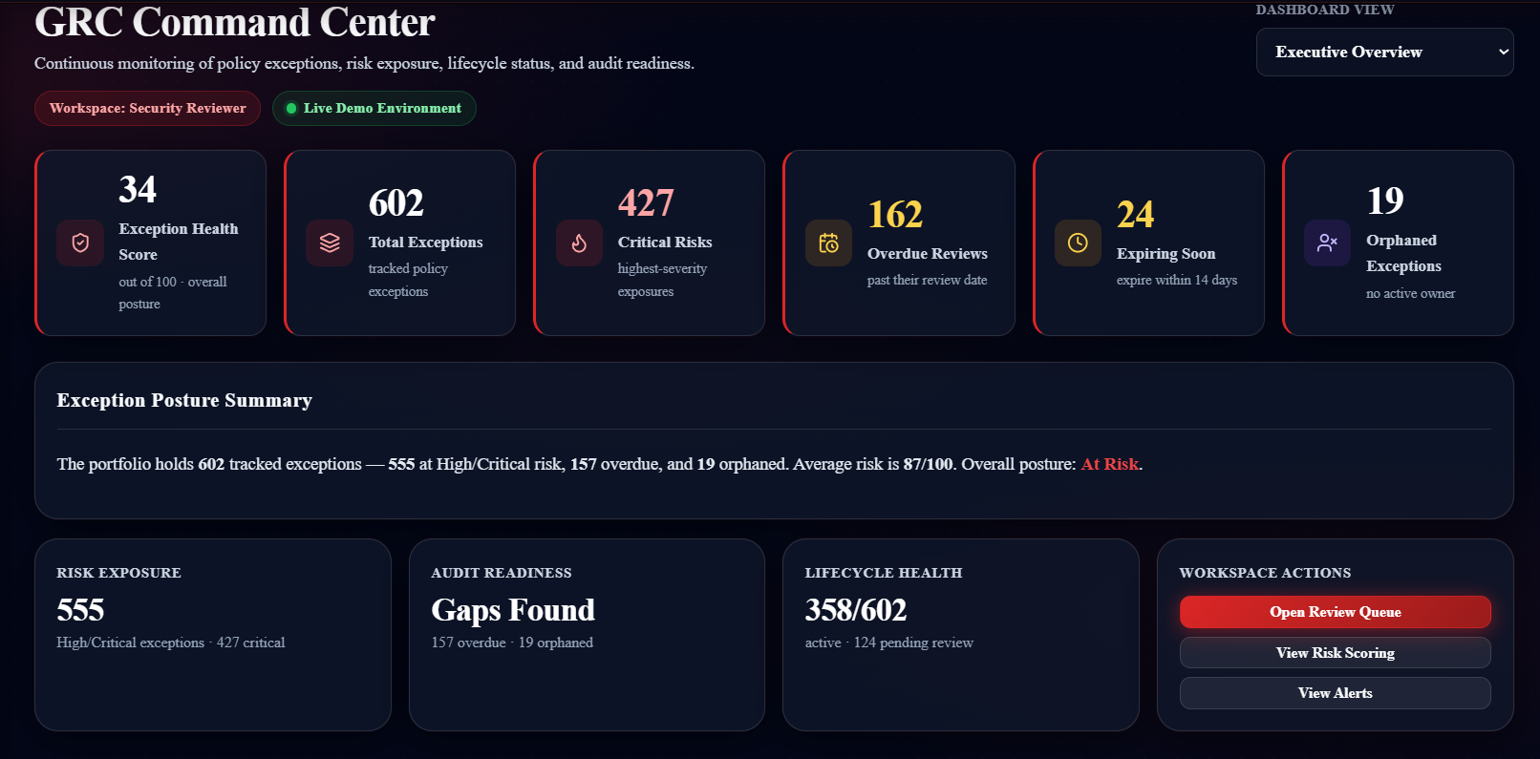
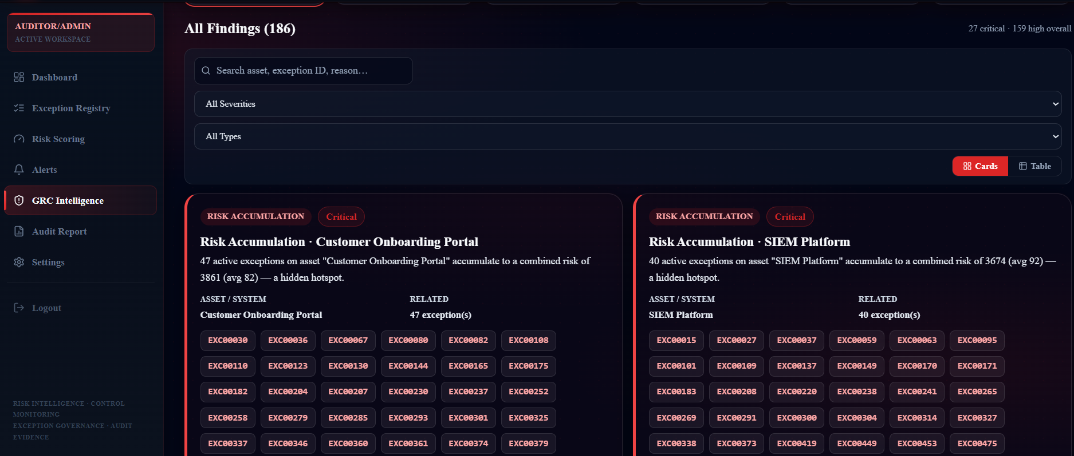
Live Demo Walkthrough
11/12
1
Home Page
2
Login
3
Dashboard
4
Risk Register
5
Intake Form
6
Review Queue
›
›
›
›
›
Marketing + role cards
Demo role selection
GRC Command Center
600 exceptions, filter & search
Structured exception request
Security reviewer workflow
7
Evidence File
8
Risk Scoring
9
Alerts
10
GRC Intelligence
11
Audit Report
12
Settings
›
›
›
›
›
Exception detail & history
Score explainer & bands
682 active alerts dashboard
186 findings, hotspots
Department & lifecycle breakdown
Config, roadmap, dataset stats
[ Insert Screenshot ]
[ Insert Screenshot ]
Dashboard — GRC Command Center
GRC Intelligence Center — Findings
RiskWaiver360 · GRC Exception & Policy Waiver Management · RVCE 2026
Notes:
The demo runs at localhost:5173. Login with any of the four demo accounts. Start as a Requester to submit an exception, then switch to Security Reviewer to assess it, then Approver to make a decision, and finally Auditor/Admin to see the full risk picture. The demo dataset has 600 pre-loaded exceptions.

Slide 12
Prototype Limitations & Production Roadmap
12/12
Current Prototype
Production Roadmap
localStorage-based demo authentication (no session security)
JSON flat-file storage (not production-grade)
No backend RBAC — roles enforced frontend only
Email notifications are simulated (not sent)
PDF export via browser print (not server-generated)
Captcha is frontend-only, no CSRF protection
30 demo system users only (not a real user directory)
SSO / OIDC integration (Okta, Azure AD)
Backend RBAC with JWT-secured routes
PostgreSQL or MongoDB for data persistence
ServiceNow / Jira / CMDB integration
IAM / Active Directory owner resolution
Real PDF audit report generation
AI-assisted risk scoring (future scope only)
"RiskWaiver360 turns scattered exceptions into centralized, risk-scored, lifecycle-tracked, audit-ready governance decisions."
RiskWaiver360 · GRC Exception & Policy Waiver Management · RVCE 2026
Notes:
The prototype is honest about its current state. This is a functional demo, not a production deployment. Authentication, storage, and email are all simulated. In production, these would be replaced with enterprise-grade SSO, a real database, and backend-enforced access control. AI is called out as future scope only — the current platform is entirely rule-based.

