Slide 1
HPCM MONITORING PIPELINE VISUALIZATION
Vidyavardhaka College Of Engineering
CTY Members – Akshay G , Chandana L, Chinmai H K , Abhilash T R , Srivarshini S
June 26 2024

Slide 2
AGENDA
Problem Statement
CDU and Schema design of Solution
Data collection / scrapping – components involved in pipeline
CLI for the monitoring system
Data persistence
Grafana NodeGraph dashboard for multiple topics
Data Logging
Demo
Project learnings and challenges
QnA

Slide 3
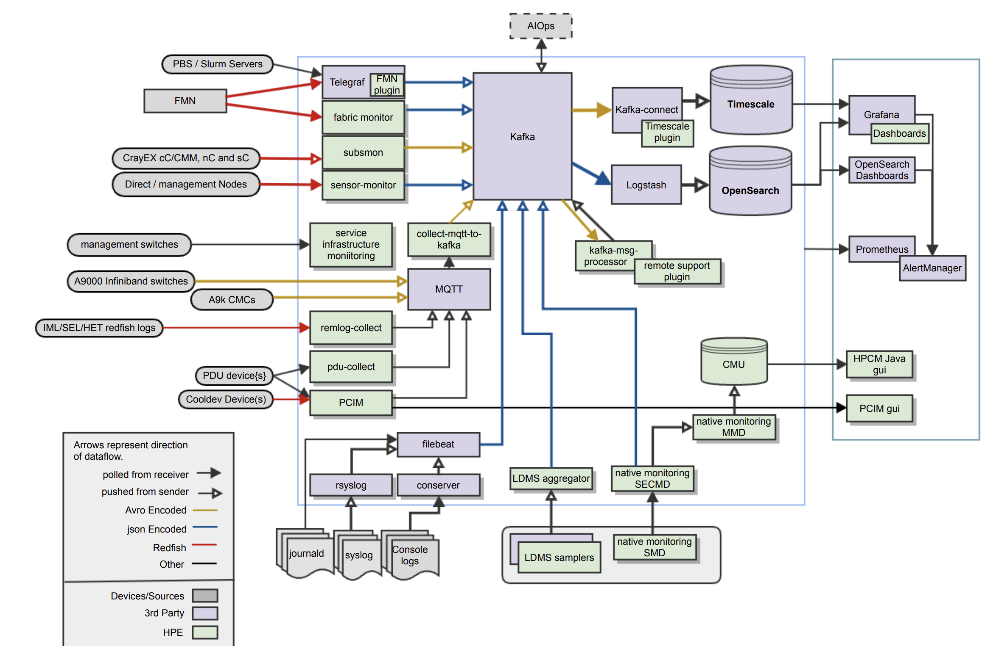
PROBLEM STATEMENT
Currently, the user must run different set of commands or mon service status check to debug the respective monitoring pipeline to find the issues.
The end user/customer finds difficulty in understanding the HPCM monitoring stack and pipelines. (including Support and on-site folks).
The purpose of this project is to reduce the difficulty in debugging the monitoring stack/components/services and pipelines for the customer and support team.

Slide 4
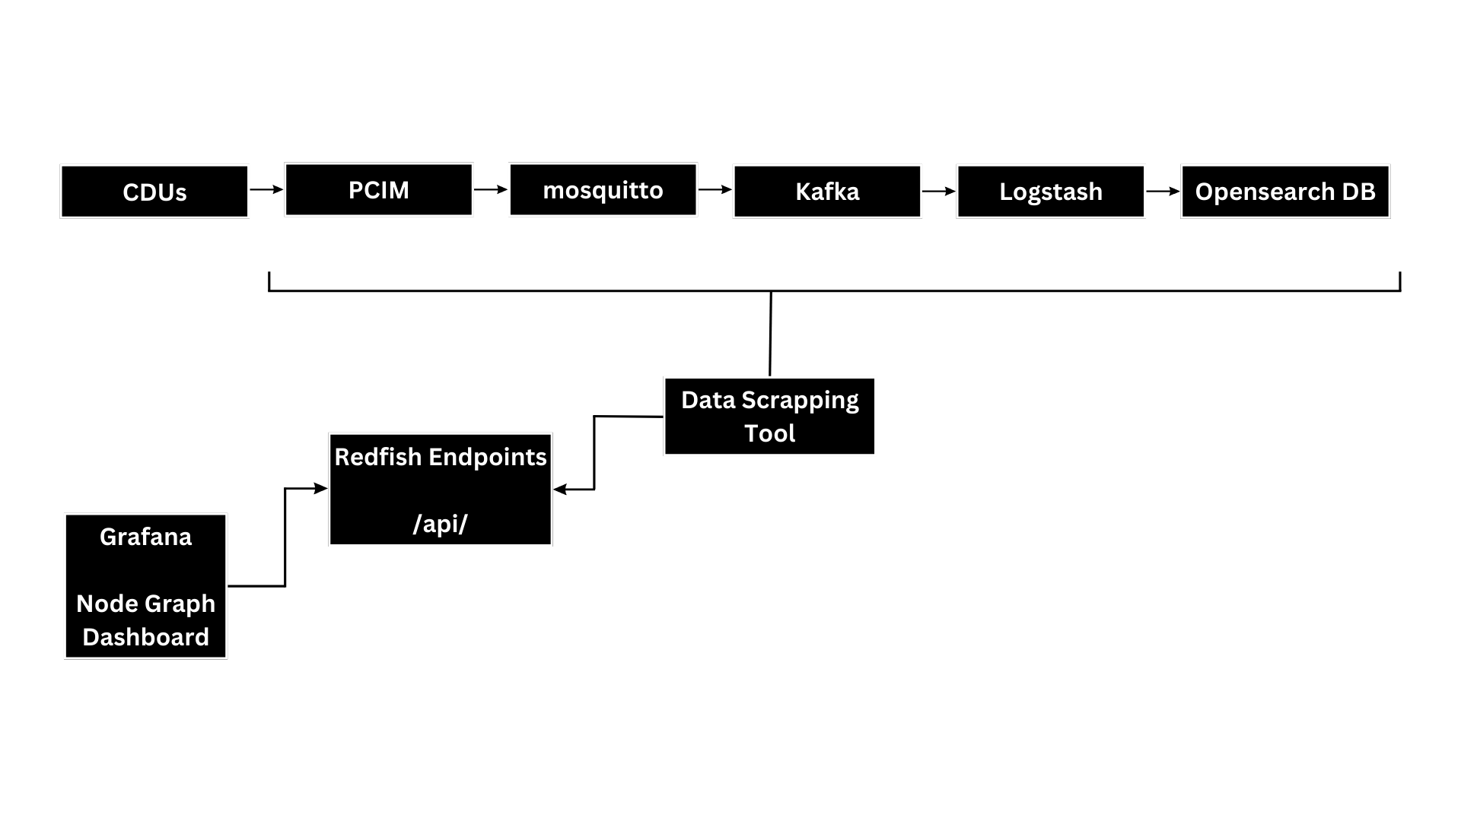

SOLUTION ARCHITECTURE, OBJECTIVES AND SKILL
Objectives
Data scraping from components of the pipeline.
Real-time monitoring of dataflow
Visualization of status of the components in the data pipeline.
Skill Set
Programming language - Python
Grafana : Nodegraph API Plugin
RHEL Operating Environment
RedFish End-Point
Kafka, Mosquitto, Logstash, Opensearch

Slide 5
SOFTWARE SPECIFICATION
Red Hat Linux 9.4
Python 3.12.4/3.11
Kafka 3.7.0
Logstash 8.13.0
Opensearch 2.11.0
Grafana 11.1.0

Slide 6
SCHEMA DESIGN – CDU MONITORING PIPELINE
SERVICES | STATUS | UPTIME | DATA FLOW
PCIM | Active | Since 2 days | 1
Mosquitto | Active/Inactive | 24hrs | 0/1
Kafka | Active/Inactive | Since 10 days, 23hrs | 0/1
Logstash | Active/Inactive | Since 12 days, 10hrs | 0/1
Opensearch | Active/Inactive | Since 25 days, 5hrs | 0/1
Service,Status and Uptime metrics has been added in the data collection tool for POC.

Slide 7
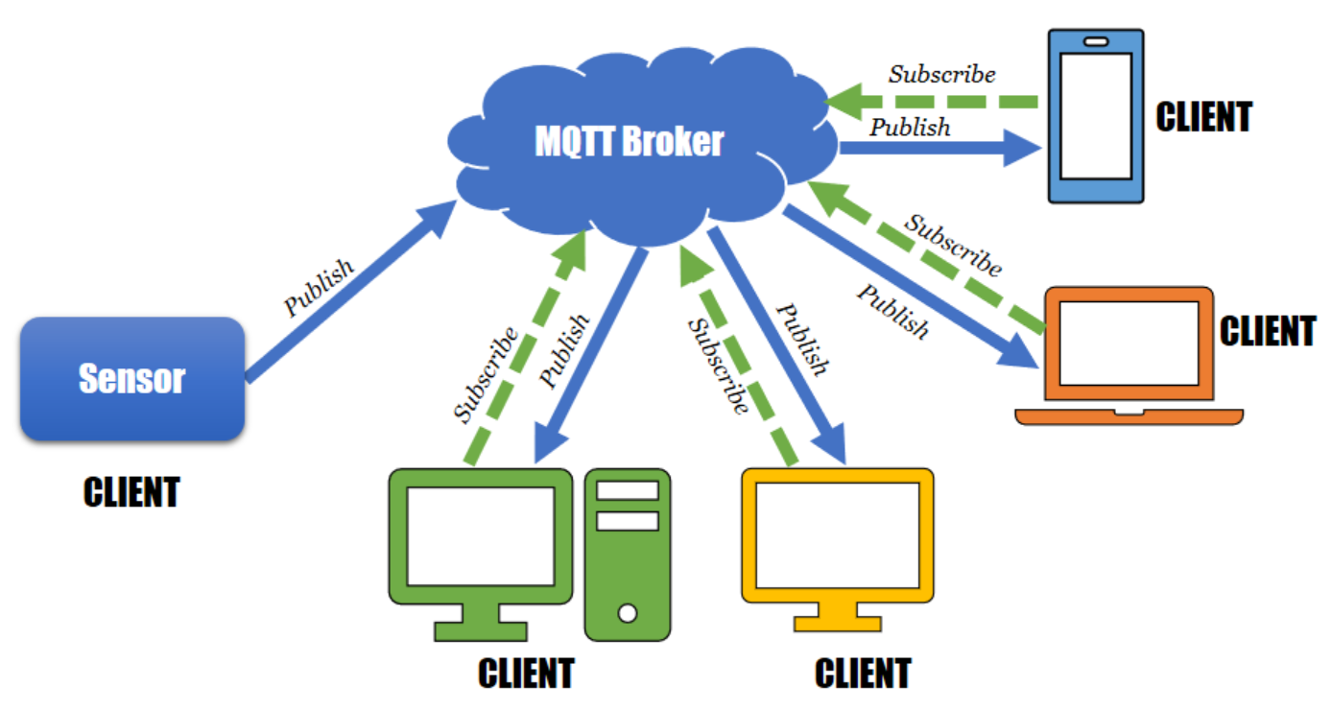
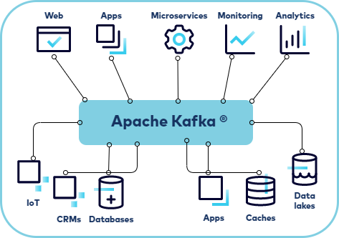
ABOUT COMPONENTS
Mosquitto
Apache Kafka

Slide 8
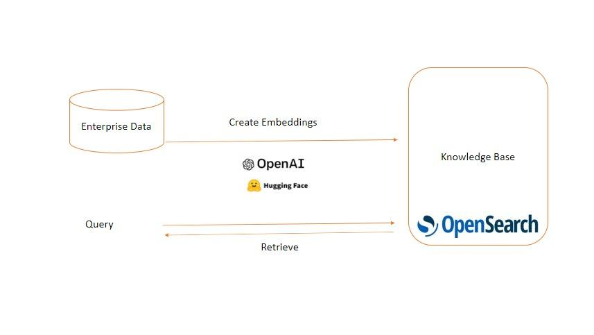
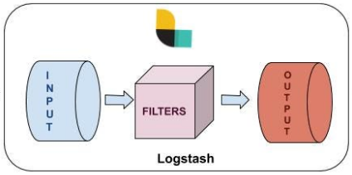
DATA COLLECTION/ SCRAPPING
Logstash
OpenSearch

Slide 9
DATA COLLECTION/ SCRAPPING
Mosquitto
Apache Kafka
Logstash
OpenSearch
Installed the above services and configured to run it as a service
Extracted the status and uptime using the subprocess module of python
The extracted status is inserted into a redfish endpoint
This process is done every 5 seconds to fetch us a time series data structure.
datacollect
Logger
kafkacomp
mosquittocomp
logstashcomp
opensearchcomp
........

Slide 10
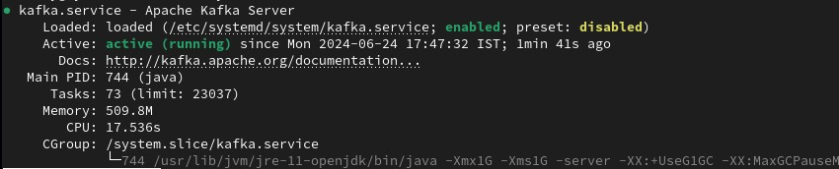
STATUS AND UPTIME IDENTIFICATION
The status and uptime has been extracted using ‘subprocess’ module to interact with system services via ‘systemctl’
Uptime is calculated by comparing the current date and time with the date and time the service was activated.

Slide 11
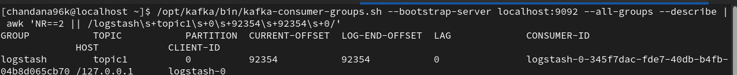
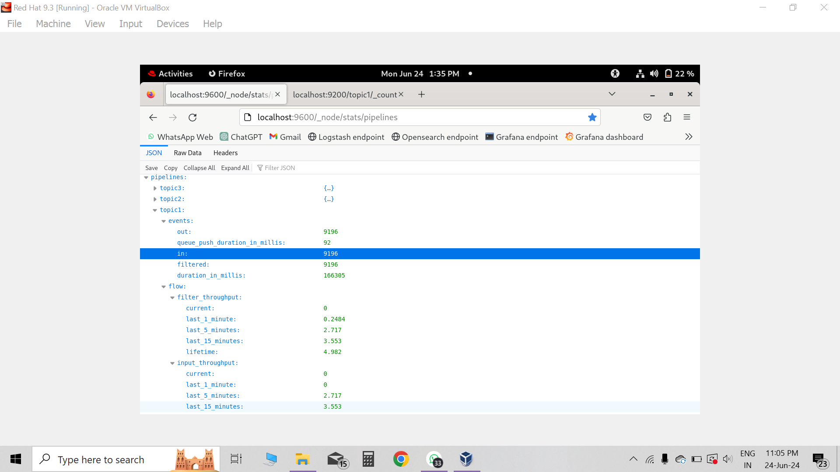
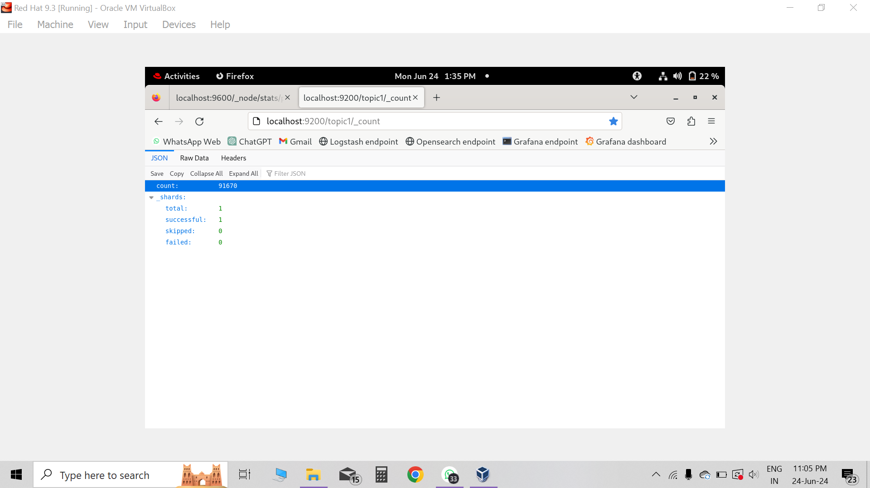
DATAFLOW IDENTIFICATION
Dataflow from Mosquitto to Kafka is identified by comparing the last known total_offset(i.e number of message parsed by kafka) with the current total_offset.
Data flow from Kafka to Logstash is identified by the growth in events_in in Logstash endpoint.
Data flow from Logstash to Opensearch is identified by the growth in document_count.

Slide 12
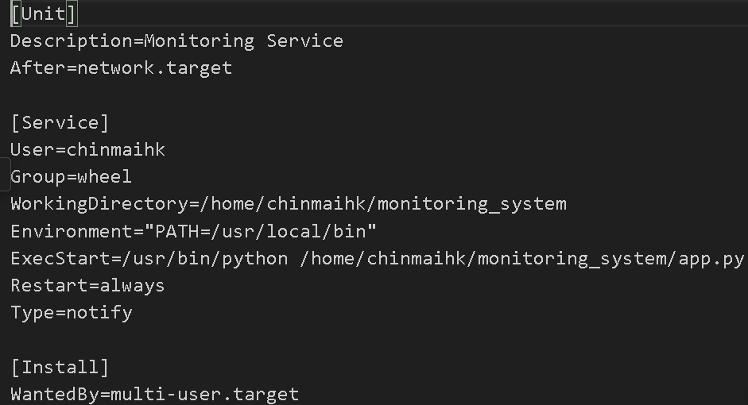
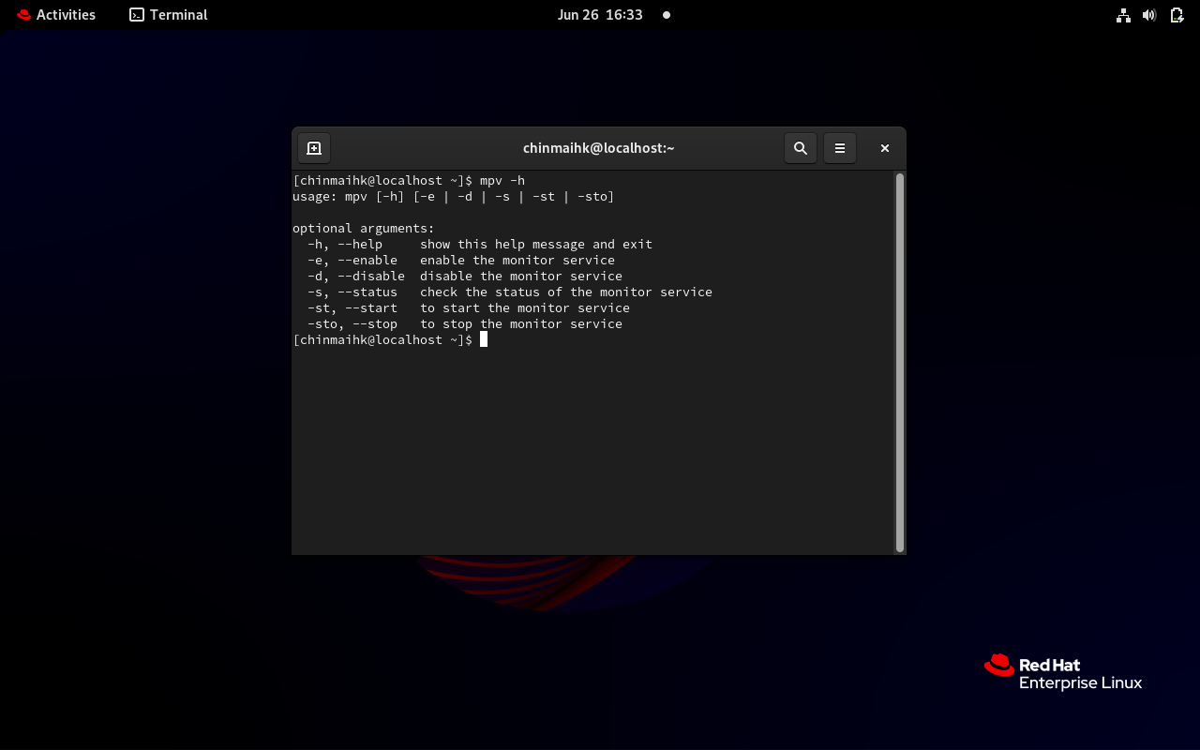
SERVICE FILE AND CLI
We have deployed our application as a service
The service is named as monitor.service
This service executes the app.py file using the /usr/bin/python file
The service will start the application when the command systemctl start monitor is run

Slide 13
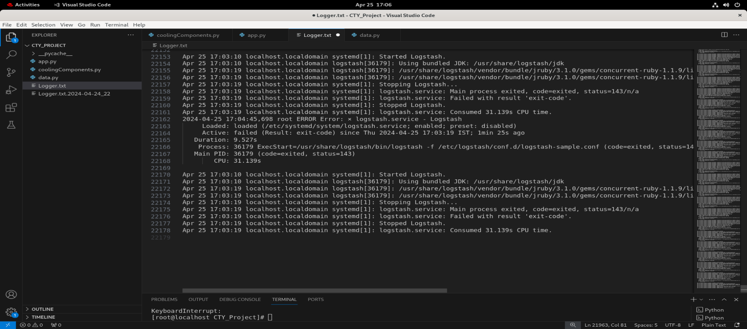
LOGGER CLASS
The logger class is built using the logging module of python
All the configurations for the logging module have been done in the constructor
The methods of the class can be used for various types of logging
There are three different logs identified in the logger class. They are: warning, info, and error
It is also configured with time rotation handler, so that it creates a backup and keeps rotating the log files so that it will not overload the file.

Slide 14
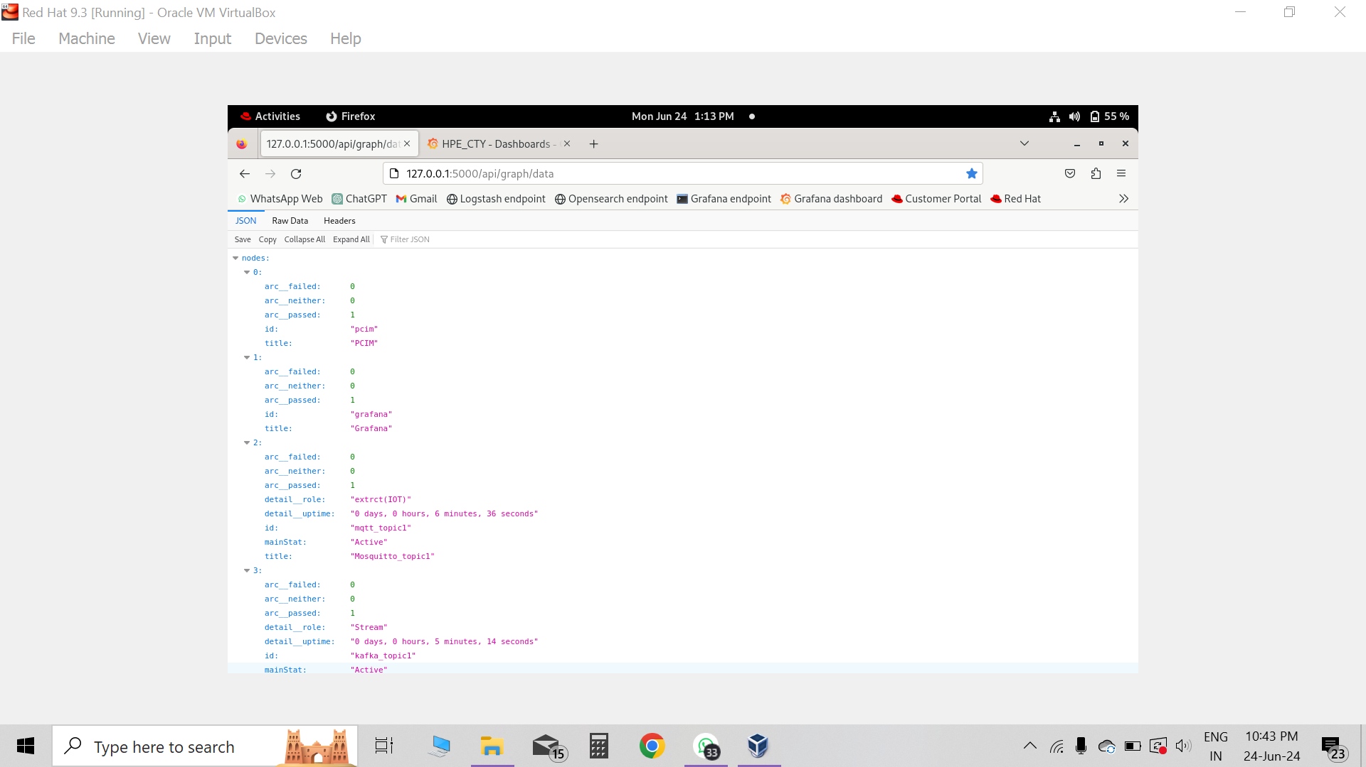
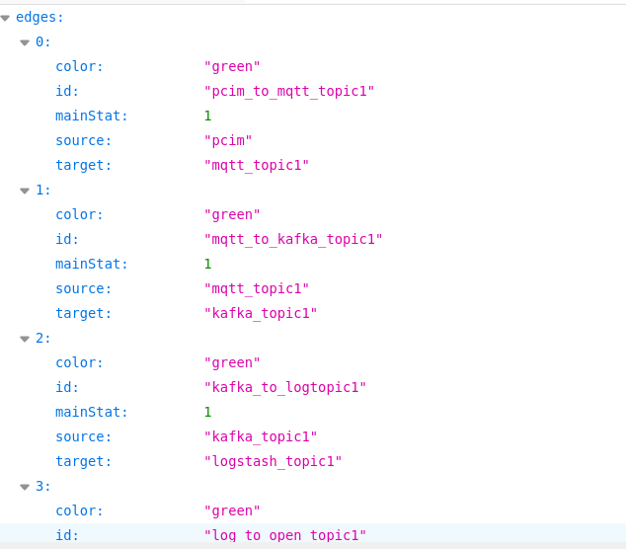
DATA PERSISTENCE – API SERVER

Slide 15
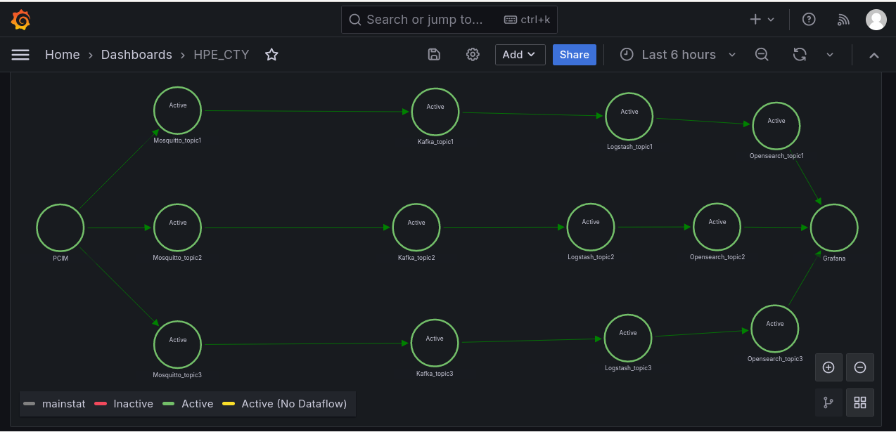
GRAFANA - NODEGRAPH
Grafana Node Graph is a plugin for Grafana that provides a specialized visualization panel for displaying interconnected nodes and edges.
Grafana Node Graph API, on the other hand, is a separate component or functionality that allows interaction with the Grafana Node Graph plugin programmatically through an API interface.
Node Graph API is an API interface that allows programmatic interaction with the node graph visualization.

Slide 16
DEMO

Slide 17
Learnings | Challenges
RHEL Operating System Components – Kafka, Mosquitto, Logstash, Opensearch Logging System Grafana - Dashboard Building CLI REST API Service file configuration Configuring Pipelines Accessing the system services through python | Prometheus vs Nodegraph API Nodegraph vs API plugin API Endpoints – Multiple and Single Setting up monitoring stack Optimization Handling Timeout Errors

Slide 18
FUTURE SCOPE
Developing dashboard for other pipelines
Security enhancements
Build nodegraphs by scanning all the active services and connections dynamically
Developing nodegraphs for multiple instances of all the distributed services
Auto Debugging systems using AI
Improving the performance by optimization

Slide 19
PROJECT TIMELINE , MILESTONE , STATUS
Milestone-2
Meliestone-3
Milestone-1
15//03
28//04
26//06
Milestone | Milestone Description | Tasks | Status | Next Steps / Issues
Milestone-1 | Initial POC with one sample pipeline and minimal metrics | Investigation Design Data Collection / Scrapping tool Data Persistence method Grafana NodeGraph dashboard | Completed the investigation on the data scrapping tool from the required components and written a method for data persistence and created a sample POC dashboard with NodeGraph. | Next: Explore more on data persistence method with NodeGraph plugin Further pipelines implementation Issues: HTTP server hosting for data scrapping DB to Grafana NodeGraph visualization
Milestone-2 | Data flow Integration | Grafana Upgrade Data outflow check for each components Logger Deployment as service | Completed the Data outflow return functions for Kafka, mqtt, opensearch. Completed logger and service deployment Completed data flow edges in Grafana | Next: Further enhancements and final output Grafana dashboard for Cooling devices pipeline
Milestone-3 | Final solution approach | CLI for enable/disable - manageability Code optimization Grafana dashboard Data flow updates in runtime (live) | Completed the CLI implementation Data flow identification is done. Grafana dashboard has been enhanced. | NA

Slide 20
THANK YOU

