Slide 1
Robot Framework Automation Package
November 2019

Slide 2
Highlights
Robot Framework
Jenkins
Git Repository

Slide 3


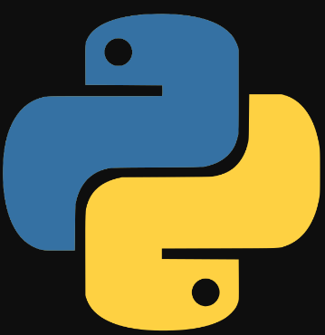
Framework Structure
Report(Email)
Robot Framework Scripts
Robot Framework Keyword
Selenium Library
Unix Library
Database Library
API library

Slide 4
Advantages of Robot Framework
Open source
User doesn't need a programming language to write a Robot Framework test case & run it
Supports Keyword driven, Data-driven and Behaviour-driven (BDD) approaches ,Keyword Driven
RF is application and platform independent
Outstanding Reporting system: The RF automatically generates a report and html log after executing each build

Slide 5
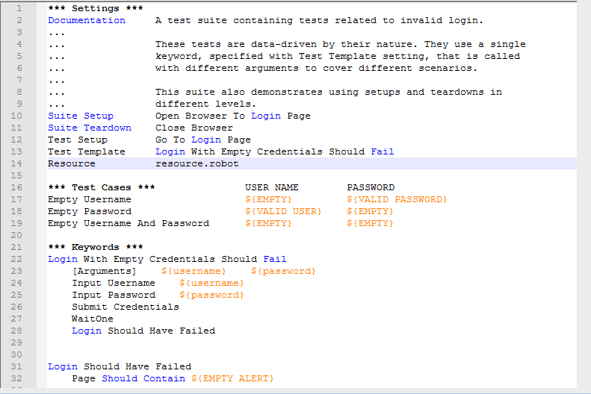
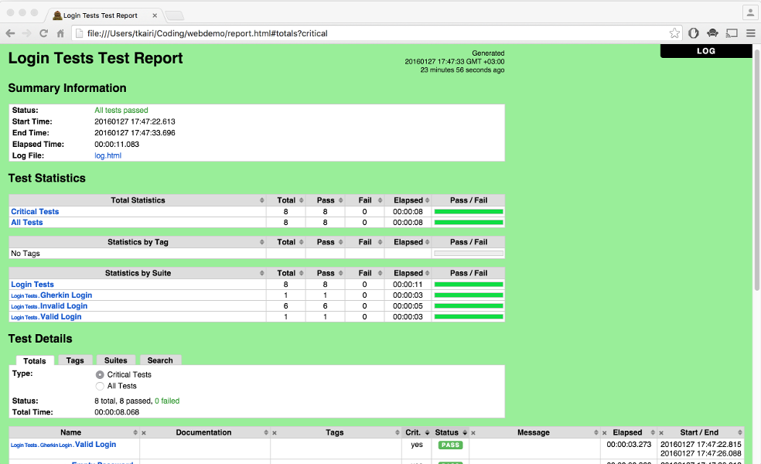
Sample Screenshots

Slide 6
Q &A ?

