Slide 1
Angular
Company: JSpiders

Slide 2
What is Angular?
What is Angular?
Angular is an open-source JavaScript front-end web application development framework primarily supported by Google to develop single-page, cross-platform, and performant applications.

Slide 3
Features of Angular?
What Is A Single-Page Application?
A single-page application is a website or web application that dynamically interacts with the user by rewriting the current page rather than loading the complete page from the server.
What Is A Cross-Platform Application?
A cross-platform application is a piece of software that can run on a variety of computer architectures and operating systems.

Slide 4
SPA vs MPA
SPA – Single Page Application.
MPA – Multi Page Application.

Slide 5
Angular Version History
Angular Version History:
Angular JS : 2010 - Two-way data binding, MVC architecture, dependency injection.
Angular 2 : 2016 - Complete rewrite from AngularJS. Introduced TypeScript, a new component-based architecture, and enhanced performance.
Angular 4 : 2017 - Smaller and faster than Angular 2, new animation package, improved *ngIf and *ngFor.
Angular 5 : 2017 - Build optimizer, improved support for progressive web apps, and faster builds.
Angular 6 : 2018 - Angular Elements, new CLI commands, and tree-shakable providers
Angular 7 : 2018 - CLI prompts, virtual scrolling, drag and drop, and performance improvements
Angular 8 : 2019 - Differential loading, new lazy loading syntax, and Ivy preview (new rendering engine)
Angular 9 : 2020 - Ivy compiler and runtime by default, smaller bundle sizes, improved type checking.

Slide 6
Angular Version History
Angular 10 : 2020 - New date range picker, warnings for CommonJS imports, and stricter settings for project creation
Angular 11 : 2020 - Improved Hot Module Replacement (HMR), stricter types, and updated language service
Angular 12 : 2021 - Stable Ivy Everywhere, Nullish Coalescing, and removal of legacy View Engine
Angular 13 : 2021 - Simplified Angular Package Format (APF), dynamic component creation, and improvements to Angular Tests
Angular 14 : 2022 - Standalone components, better template diagnostics, and strict typing for reactive forms
Angular 15 : 2022 - Enhanced performance, ESBuild support, and improvements in the development server
Angular 16 : 2023 - Improved reactivity, better SSR support, and advanced build optimizations.
Angular 17 : 2023 - Replaces *ngIf, *ngFor, and *ngSwitch directives
Angular 18 : 2024 - Introduced Developer Tool Angular.dev

Slide 7
Angular Versioning and Release
Angular Versioning – 18.0.6
major.minor.patch
Release Frequency
- A major release every 6 months
-1-3 minor releases for each major release
- A patch release every week.

Slide 8
Setting Up Development Env
Setting Up Development Environment to Work with Angular:
Download and Install
Node JS Version - ^18.19.1 || ^20.11.1 || ^22.0.0
Install Type Script Package
Type Script Version - >=5.4.0 <5.5.0
RXJS Version - ^6.5.3 || ^7.4.0
Setup Angular in Local Environment needs install of npm package – Angular CLI
The Angular CLI is a command-line interface tool which allows you to scaffold, develop, test, deploy, and maintain Angular applications directly from a command shell.
Installing Angular CLI
To install the Angular CLI, open a terminal window and run the following command:
npm install -g @angular/cli

Slide 9
Creating a Workspace and Initial Application
Creating a Workspace and Initial Application:
To create a new workspace and initial starter app, run the CLI command ng new and provide the name my-app
ng new my-app
The Angular CLI installs the necessary Angular npm packages and other dependencies. Creates a new workspace and Creates Initial application inside the directory with the same name as workspace.
Run the Application:
The Angular CLI includes a development server, for you to build and serve your app locally. Run the following command:
ng serve –open
ng serve command launches the server, watches your files, as well as rebuilds the app and reloads the browser as you make changes to those files.
--open option automatically opens your browser to http://localhost:4200 to view the generated application

Slide 10
Server Side Rendering(SSR)
Setup:
Angular CLI will set up your project with Angular Universal, which is a technology that allows Angular applications to be rendered on the server.
Rendering:
Your Angular application can be rendered both on the client side (in the browser) and on the server side (before sending it to the client). This improves the performance and SEO(Search Engine Optimization) of your application.
Server Requirements:
You will need a server (e.g., Node.js) to handle the server-side rendering. This adds complexity but can significantly improve the perceived performance and SEO.

Slide 11
Static Site Generation (Prerendering)
Setup:
Angular CLI will configure the project to support prerendering of static pages.
Rendering:
Your application will be able to generate static HTML pages at build time. This is useful for pages that don't change frequently and can be served directly from a CDN.
Server Requirements:
During the build process, Angular will prerender specified routes into static HTML files, which can be served directly to users, further improving performance and SEO.

Slide 12
Traditional Angular App
- The project will be set up without server-side rendering and static site generation.
- Your Angular application will be a traditional Single Page Application (SPA), where all rendering happens on the client side (in the browser).
- Performance and SEO: While simpler to deploy, a client-side rendered application may have slower initial load times and less optimal SEO compared to server-side rendered or prerendered applications.

Slide 13
File Structure – WorkSpace Files
.editorconfig:
EditorConfig helps maintain consistent coding styles for multiple developers working on the same project across various editors and IDEs. The EditorConfig project consists of a file format for defining coding styles and a collection of text editor plugins that enable editors to read the file format and adhere to defined styles.
.gitignore:
Specifies intentionally untracked files that GIT should ignore.
angular.json:
angular.json contains CLI configurations options for build, serve and test angular project.

Slide 14
File Structure – WorkSpace Files
package.json:
configuring the dependencies required for angular project.
package-lock.json:
Provides version information for all packages installed into node_modules by the npm client
README.md:
Documentation for the Angular Project.
tsconfig.app.json:
TypeScript Compiler Settings for application code.
tsconfig.spec.json:
TypeScript Compiler Settings for test code.

Slide 15
File Structure – WorkSpace Files
src/:
src/ directory contains Source files for root level application project.
node_modules/:
node_modules/ directory contains all the installed npm packages.
public/:
public/ directory contains image and other asset files to be served as static files by the dev server.

Slide 16
Application Source Files
app/:
app/ directory contains component files.
index.html:
The main HTML page that is served in Browser. CLI automatically adds all JavaScript and CSS files when building your app.
main.ts:
The main entry point for your application.
styles.css:
Global CSS styles applied to the entire application.
app.config.ts:
Defines the application configuration that tells Angular how to assemble the application.

Slide 17
Application Source Files
Application Source Files
app.component.ts:
Defines the application's root component, named AppComponent
app.component.html:
Defines the HTML template associated with AppComponent.
app.component.css:
Defines the CSS styles for AppComponent.
app.component.spec.ts:
Defines the unit test of AppComponent.
app.routes.ts:
Defines the application's routing configuration

Slide 18
Components
Components:
Components are the fundamental building block for creating applications in Angular.
There are two types of Angular Components:
Traditional Components:
A Non Standalone component is a component that sets standalone: false in its component metadata.
Non Standalone Component uses NgModule to make itself available for Other Components.
Standalone Components: (Angular 14)
A standalone component is a component that sets standalone: true in its component metadata. Standalone components directly import other components, directives, and pipes used in their templates.
Standalone Component is by default available to other components.

Slide 19
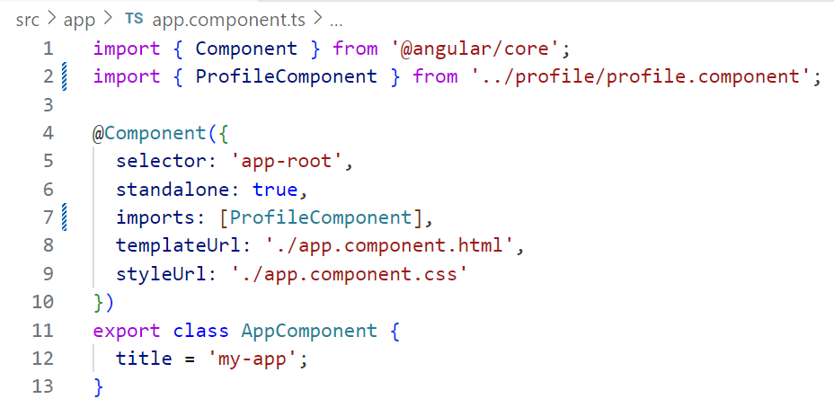
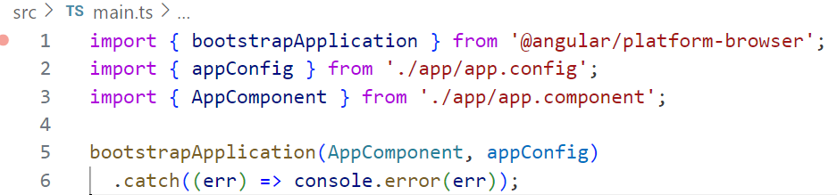
Standalone Component

Slide 20
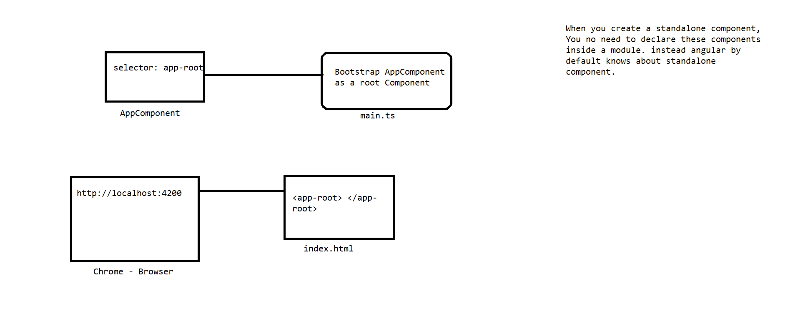
Standalone Component Flow

Slide 21
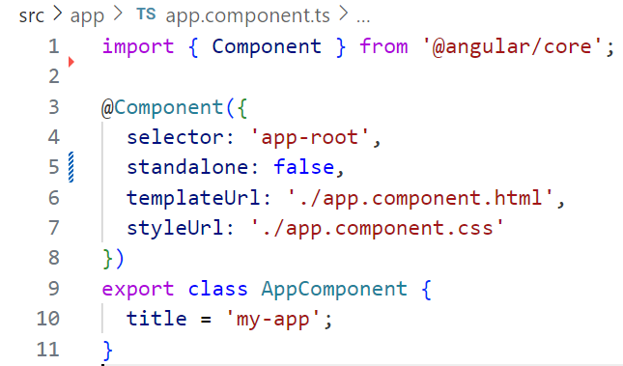
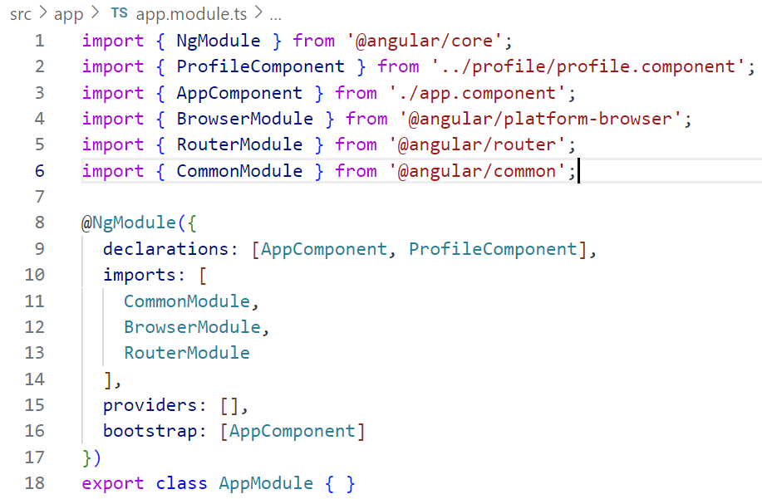
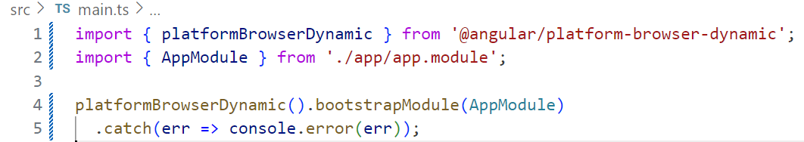
Traditional Components

Slide 22
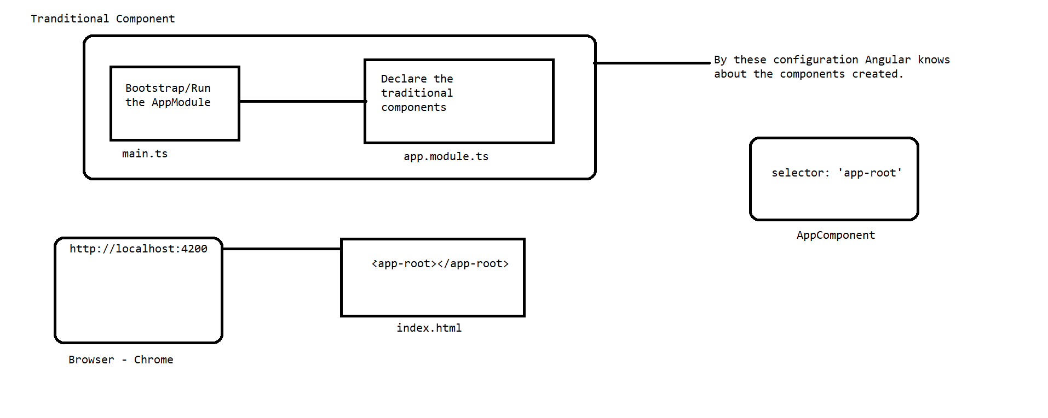
Traditional Component Flow

Slide 23
Components
Angular creates an instance of the component for every matching HTML element it encounters. The DOM element that matches a component's selector is referred to as that component's host element.
The DOM rendered by a component, corresponding to that component's template, is called that component's view.

Slide 24
Style Scoping
Every component has a view encapsulation setting that determines how the framework scopes a component's styles.
There are three types of View Encapsulation Mode
Emulated
ShadowDom
None
ViewEncapsulation.Emulated:
Angular uses emulated encapsulation so that a component's styles only apply to elements defined in that component's template.
In this mode, the framework generates a unique HTML attribute for each component instance, adds that attribute to elements in the component's template, and inserts that attribute into the CSS selectors defined in your component's styles.

Slide 25
Style Scoping
ViewEncapsulation.ShadowDom:
When enabling ViewEncapsulation.ShadowDom mode, Angular attaches a shadow root to the component's host element and renders the component's template and styles into the corresponding shadow tree.
This mode strictly guarantees that only that component's styles apply to elements in the component's template. Global styles cannot affect elements in a shadow tree and styles inside the shadow tree cannot affect elements outside of that shadow tree.

