Slide 1
ABMs as Algebraic Structures
Dr. Gene Callahan
St. Joseph’s College

Slide 2
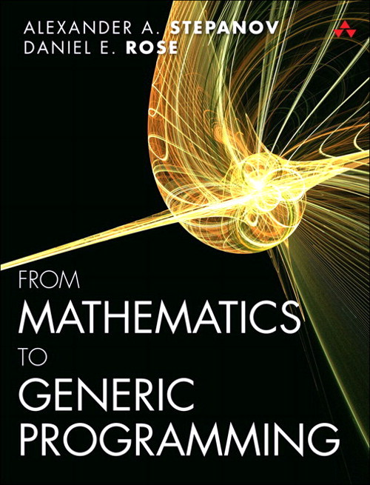
Generic Programming Abstracting logic from data

Slide 3
Generic Programming Abstracting logic from data
Inspired by abstract algebra
“Addition” can be any operation that follows the pattern of addition
The addition operation should:
Be associative
Be commutative
Have an identity element (e.g., 0, or the unknot)
x
y
Z

Slide 4
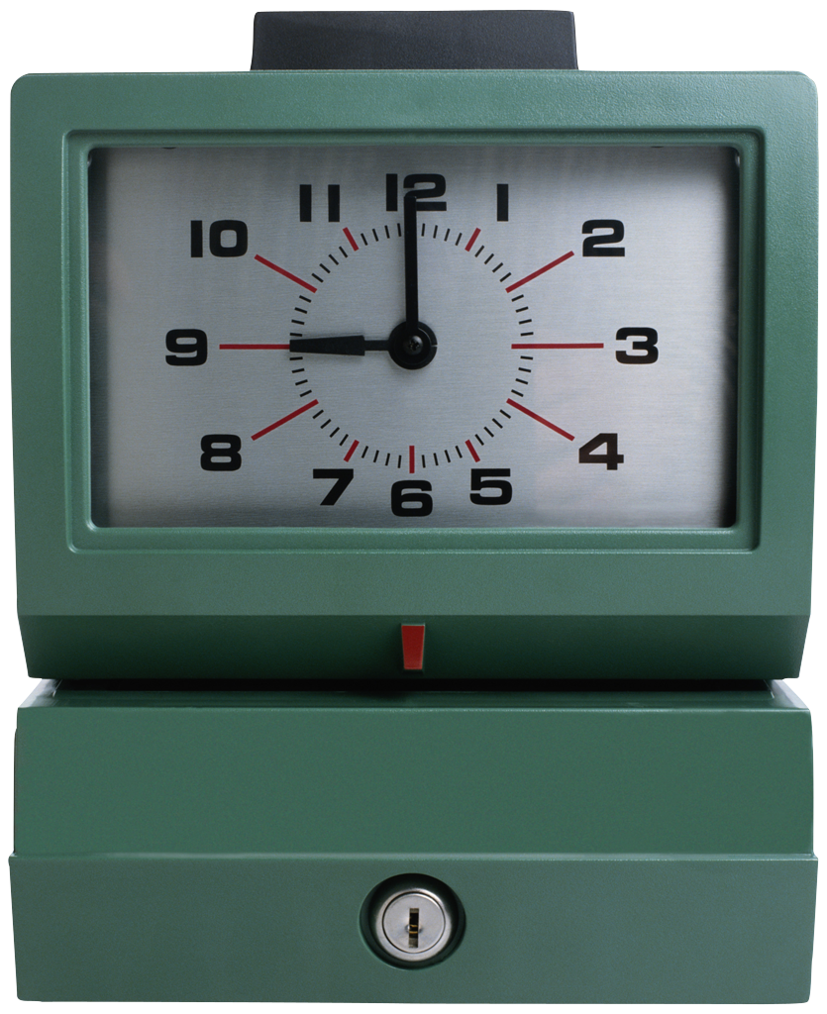

Generic Programming Abstracting logic from data
Addition can apply to clocks and knots, not just integers or reals!

Slide 5
Generic Programming Abstracting logic from data
So if we are writing, e.g., a summation function, we should ask, “Can we write this to handle summing not just familiar numbers, but also clock numbers, knots, vectors, etc.?”
We then pass in an addition function to our sum that correctly handles the particular data type; e.g., for a clock:
8
8
4

Slide 6
Agent-Based Modeling Generating complex macro-behavior from simple rule
Agents:
Exist in some environment
Are called upon to act
Look to the environment to decide what to do
Influence other agents by their actions

Slide 7
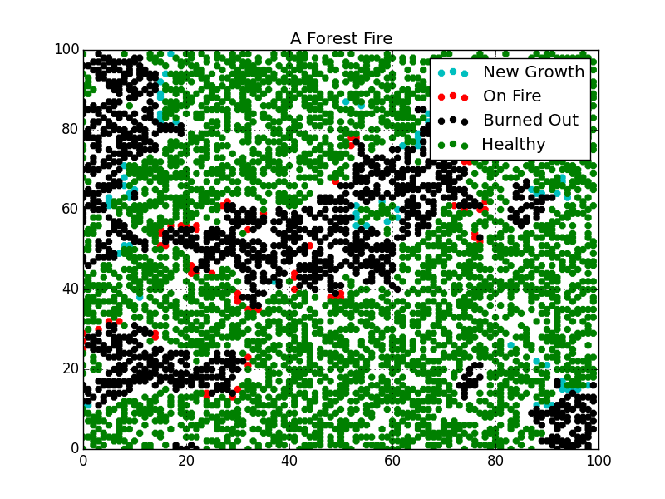
Agent-Based Modeling
Example: a forest fire model
Lightening strikes randomly, starting a fire
Trees on fire ignite neighbors
Trees grow anew in burned out spots

Slide 8
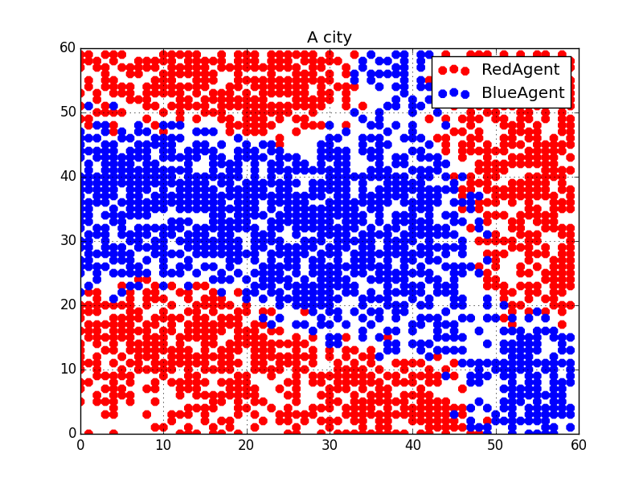
Agent-Based Modeling (ABM)
Example: Schelling’s segregation model
Agent’s preferences are just not to be too small a minority, not for fully segregated neighborhoods
But that can be the result anyway:

Slide 9
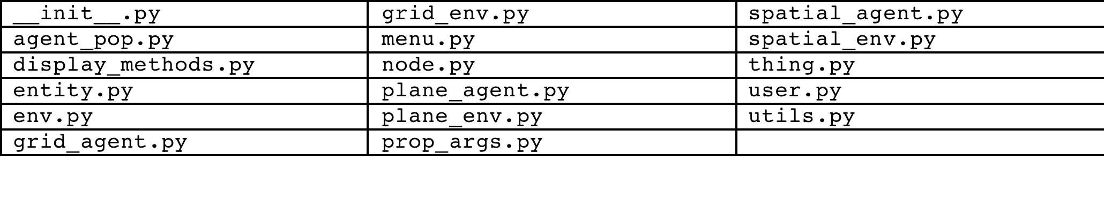
ABM and Generic Programming
Our goal in creating Indra has been to continually to push more and more of the “work” into generic ABM libraries.

Slide 10
ABM and Generic Programming
Space is usually represented as a grid.
For finer-grained space, add more cells!
Many models have agents look at a “neighborhood” around their location, often a square.
Special methods are written to deal with this neighborhood.
A powerful abstraction is the “grid view.” This can be any collection of cells around an agent.
All grid methods work on grid views.

Slide 11
ABM and Generic Programming
Grid views implementation example:
def find_empty(self, grid_view=None):
"""
Return a random, empty cell.
"""
if self.exists_empty_cells():
if grid_view is None:
return random.choice(self.empties)
else:
view_empties = grid_view.get_empties()
if view_empties:
return random.choice(view_empties)
return None

Slide 12
ABM and Generic Programming
Agent loops.
All models have an act_loop.
Optionally, any model can have a preact_loop and/or a postact_loop. These are useful for setting up for acting or clean-up afterwards.
Example: setting state in forest fire model.
Rather than having to write these in each model that needs them, they are turned on by flags and performed in the base environment.

Slide 13
ABM and Generic Programming
Abstracting common patterns from models.
Begin with a fashion model, with trend-setters and followers.
Add a model of asset traders, with value investors and chart followers.
From the two, abstract a “stance model”: a concept.
Insert it “behind” the other two models.
Stance Model
Fashion Model
Finance Model

Slide 14
ABM and Generic Programming
Analyzing the components of an agent’s act():
survey_env()
Get a grid view.
evaluate_env()
Do some calculation on characteristics in the view.
respond_to_cond()
Jump to a new cell; change fashion; eat a sheep.

Slide 15


ABM and Generic Programming
So we get this generic act() function:
def act(self):
env_vars = self.survey_env()
if self.eval_env(env_vars):
self.respond_to_cond(env_vars=env_vars)
This has worked for a number of models.

Slide 16
ABM and Generic Programming
We are now working on ways to treat the entire agent population as a vector, and use matrix multiplication to reset all agents’ states in a single operation.

Slide 17
Python and Generic Programming
Python is well-suited to doing generic programming:
We can already pass various types into a function or a method and its descendants.
We can return various types from a function or a method and its descendants.
We can pass in operators when a function might need to handle different types differently: the operator module.
Thus we could pass in add() for ints and our own operator for knots.

Slide 18
Python and Generic Programming
Concepts:
isinstance(e, collections.Iterable) is along the lines of what Stepanov and Rose are after.
“Duck typing” is a weak substitute for actual, rigorously defined concepts.
Rather than actually working out the abstraction that captures x, y and z, just chuck them all in a duck costume!

Slide 19
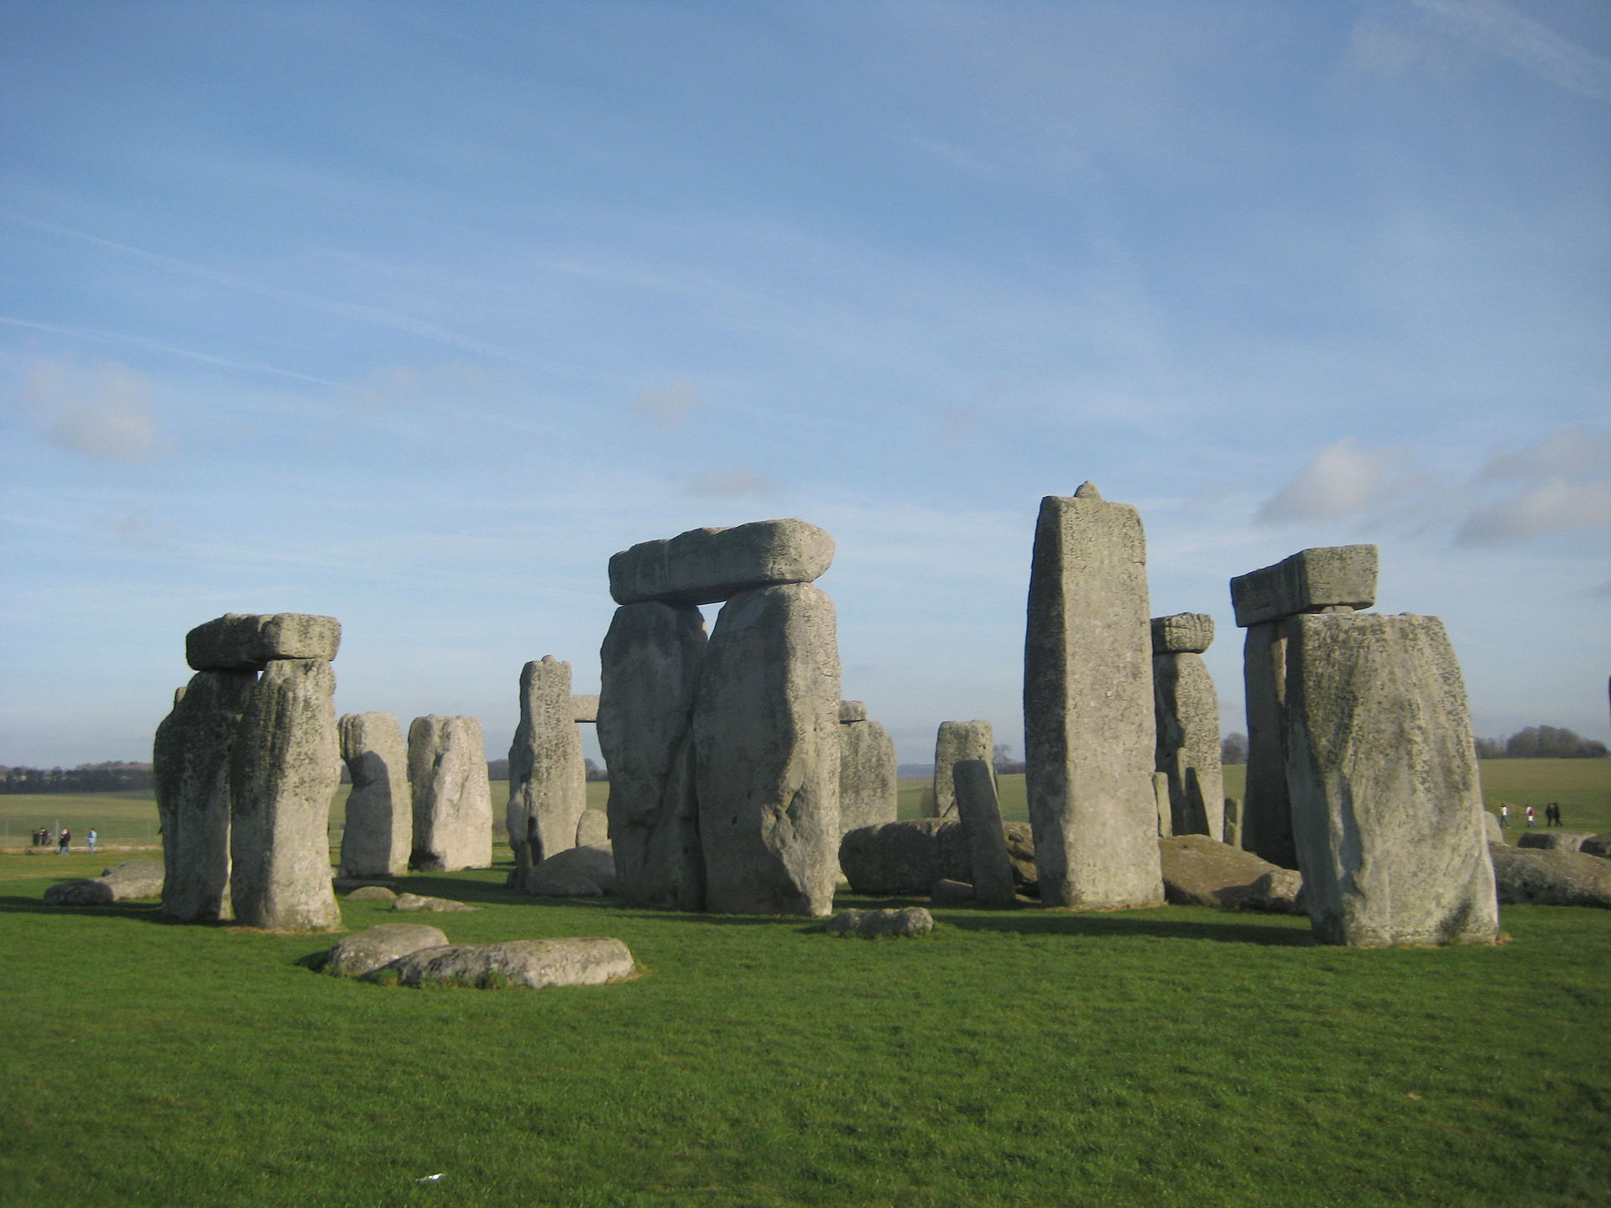
How to Do Generic Programming
In math, the process of generalization was:
Common measures
Natural numbers
Integers
Rational numbers
Polynomials
Real numbers
Complex numbers
Groups
Rings
Fields

Slide 20
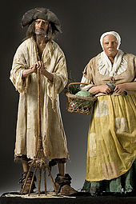
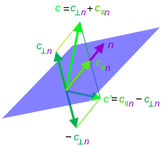
How to Do Generic Programming
How this happened: no one sat down and devised an abstract algebra of rings and fields, and then said, "So farmers: I think you can derive something from this to measure your fields.”

Slide 21
How to Do Generic Programming
Similar in programming!
Rarely a successful strategy to try to start by defining some grand abstraction, and then building one's system around it.
Successful generic programming:
Build concrete applications
Seek out commonalities found in different applications and abstracting them.

Slide 22
How to Do Generic Programming
Flat is better than nested?
We have chosen nested.
Trade-off: the resulting code is going to be harder to grasp for people not familiar with such abstractions.
This is OK, because it enables skilled software engineers to create a “fill-in-the-template” system for the use of social scientists who are not highly skilled programmers.

Slide 23
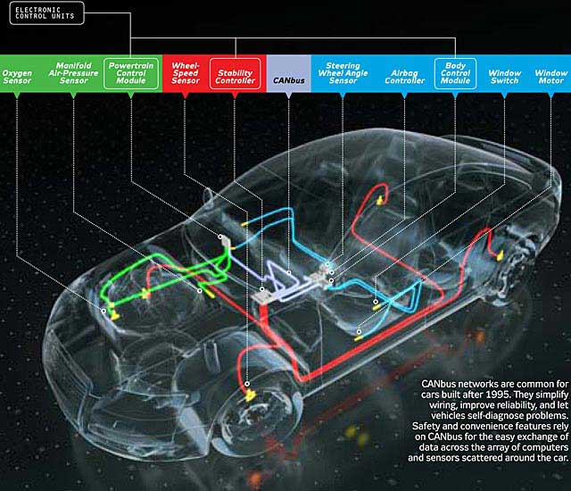
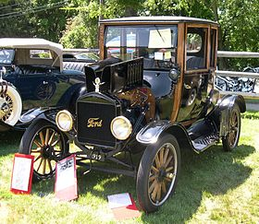
How to Do Generic Programming
Flat is better than nested?
If we build it right, the social scientists never need to “look under the hood.”

Slide 24
Final note
Contributors welcome! The project is on GitHub.

Slide 25
Credits
"Knot with borromean rings in jsj decomp small". Licensed under CC BY-SA 3.0 via Wikipedia - https://en.wikipedia.org/wiki/File:Knot_with_borromean_rings_in_jsj_decomp_small.png#/media/File:Knot_with_borromean_rings_in_jsj_decomp_small.png
"Stonehenge on 27.01.08" by Mavratti - Own work. Licensed under Public Domain via Wikimedia Commons - https://commons.wikimedia.org/wiki/File:Stonehenge_on_27.01.08.jpg#/media/File:Stonehenge_on_27.01.08.jpg
The Mesa team at George Mason has contributed code to this project.

