Slide 1
Generic Programming for ABMs
Dr. Gene Callahan
St. Joseph’s College

Slide 2
Generic Programming Abstracting logic from data
Inspired by abstract algebra
“Addition” can be any operation that follows the pattern of addition
The addition operation should:
Be associative
Be commutative
Have an identity element
x
y
Z

Slide 3
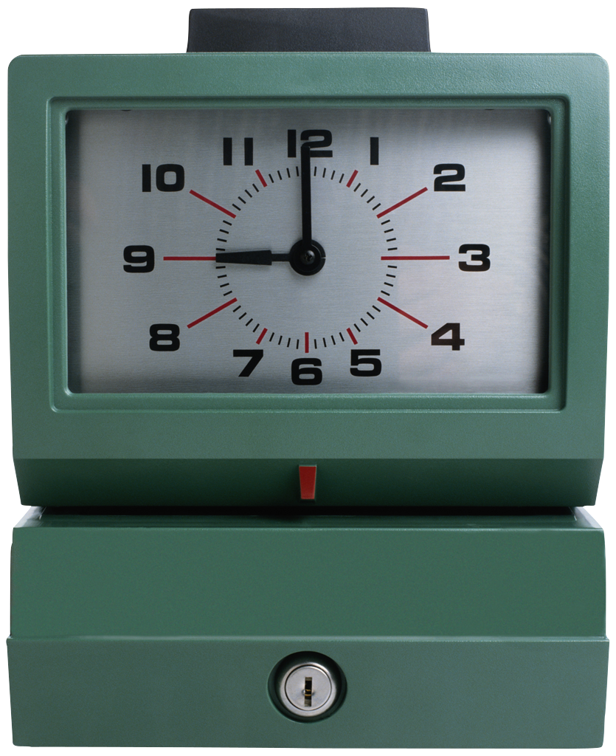

Generic Programming Abstracting logic from data
Addition can apply to clocks and knots, not just integers or reals!

Slide 4
Generic Programming Abstracting logic from data
So if we are writing a summation function, we should ask, “Can we write this to handle summing not just familiar numbers, but also clock numbers, knots, vectors, etc.?”
We then pass in an addition function to our sum that correctly handles the particular data type; e.g., for a clock:
8
8
4

Slide 5
Agent-Based Modeling Generating complex macro-behavior from simple rule
Agents:
Exist in some environment
Are called upon to act
Look to the environment to decide what to do
Influence other agents by their actions

Slide 6
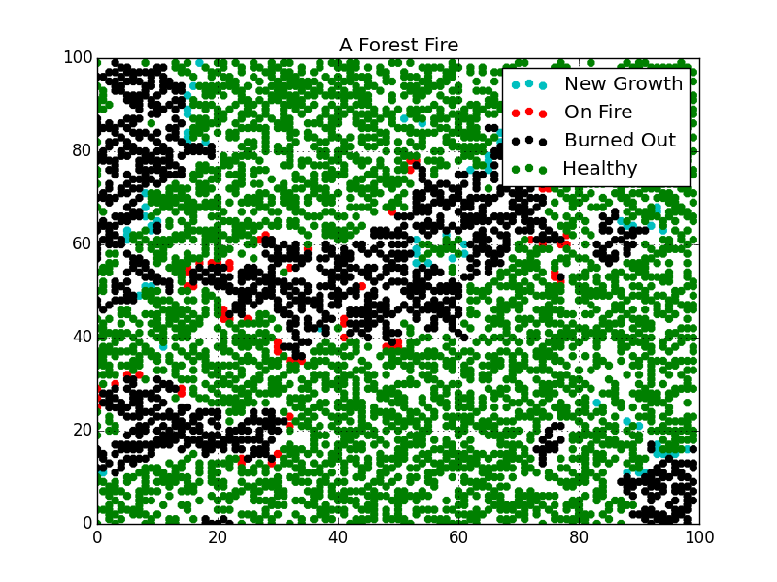
Agent-Based Modeling
Example: a forest fire model
Lightening strikes randomly, starting a fire
Trees on fire ignite neighbors
Trees grow anew in burned out spots

Slide 7
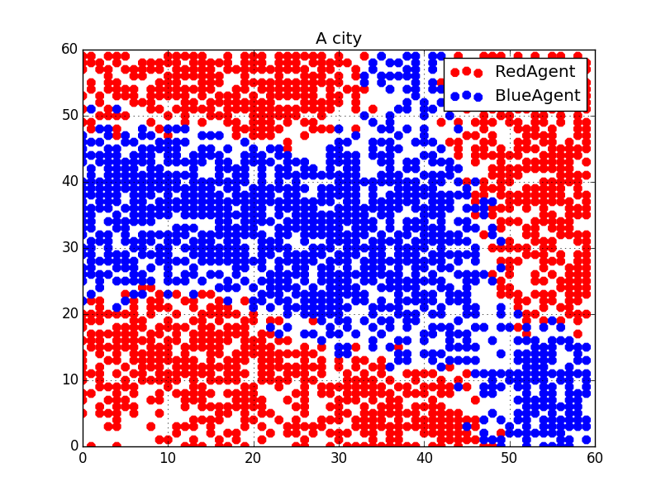
Agent-Based Modeling
Example: Schelling’s segregation model
Agent’s preferences are just not to be too small a minority, not for fully segregated neighborhoods
But that can be the result anyway:

Slide 8
Credits
"Knot with borromean rings in jsj decomp small". Licensed under CC BY-SA 3.0 via Wikipedia - https://en.wikipedia.org/wiki/File:Knot_with_borromean_rings_in_jsj_decomp_small.png#/media/File:Knot_with_borromean_rings_in_jsj_decomp_small.png

Slide 9
Bar Chart Example

Slide 10
Pie Chart Example

Slide 11
PowerPoint Guidelines
Font, size, and color for text have been formatted for you in the Slide Master
Use the color palette shown below
See next slide for additional guidelines
Hyperlink color: www.microsoft.com
Sample Fill
Sample Fill
Sample Fill
Sample Fill
Sample Fill
Sample Fill

Slide 12
Line Chart Example

Slide 13
Area Chart Example

Slide 14
Demo Title
demo
Name
Title
Group

