Slide 1
Modeling Social Cycles with Python
Dr. Gene Callahan

Slide 2
The Problem
Can various macro-level models be given a realistic micro-foundation?

Slide 3
A Social Cycle
Business cycle
Cycles in fashion
Constitutional cycles
Stock market bubbles

Slide 4
Insight
All of these cycles involve a two-population model, and…
We have a simple (macro-level) two-population model in existence

Slide 5
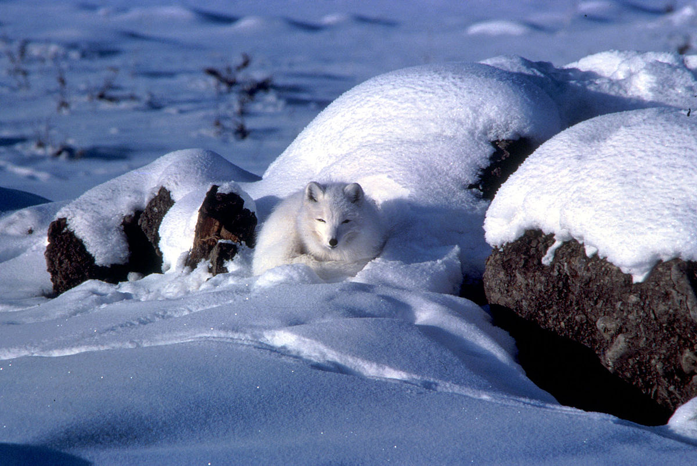
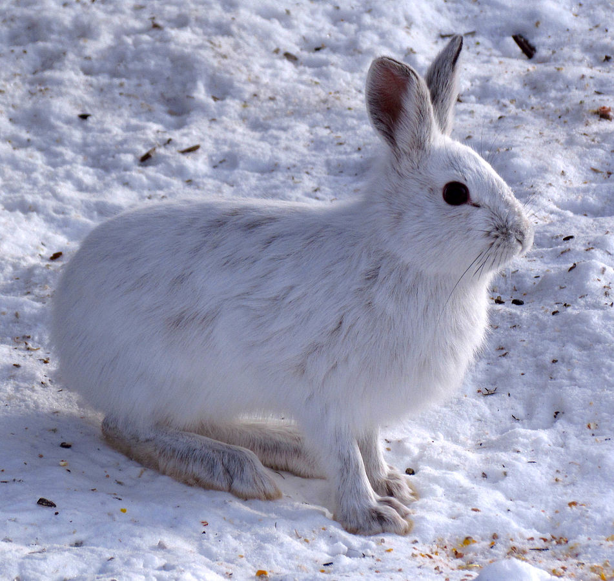
Predator-Prey

Slide 6
Lotka-Volterra Equations
dx / dt = x(α - βy)
dy / dt = y(γ - δx)
But this is a macro-level model: can we give it realistic micro-foundations?

Slide 7
Solution: Agent-Based Programming
Let us create “autonomous” software agents, give them semi-realistic behavior, divide them in two distinct populations, and see if we get the cycles that interest us.

Slide 8
Why Python?
Interactive features make for great experimental environment
Huge amount of library support for scientific computing

Slide 9
Why iPython?
Greatly enhances Python’s interactive capabilities with advanced editing, command recall, etc.
Allows graphics to run simultaneously in its own window

Slide 10
The Object Hierarchy
Top-level object: Entity
Why bother?
We plan on a network of objects, and we can build that machinery once
It also allows us to build debugging and display machinery in one place to some extent

Slide 11
Entity
Agent
Environment
Has an objective
Contains Agents

Slide 12
Agent
SpatialAgent
Is located
Creature
Eats, ages, reproduces
Can move in env
Grass
MobileCreature
Fox
Rabbit
Eats rabbits
Eats grass

