Slide 1
Indra: Agent-Based Modeling in Python
Dr. Gene Callahan

Slide 2
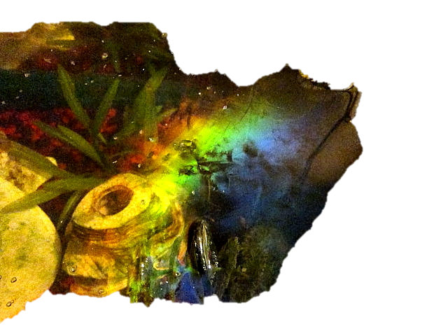

The Problem Set
Can macro-level models be given realistic micro-foundations?
Can we capture phenomena too complex to macro-model through the interaction of agents following simple rules?

Slide 3
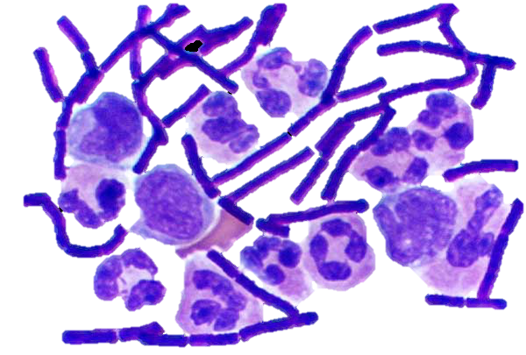
Uses in Biology
Microbial behavior
Spead of epidemics
Population dynamics
Inflammation
Immune system

Slide 4
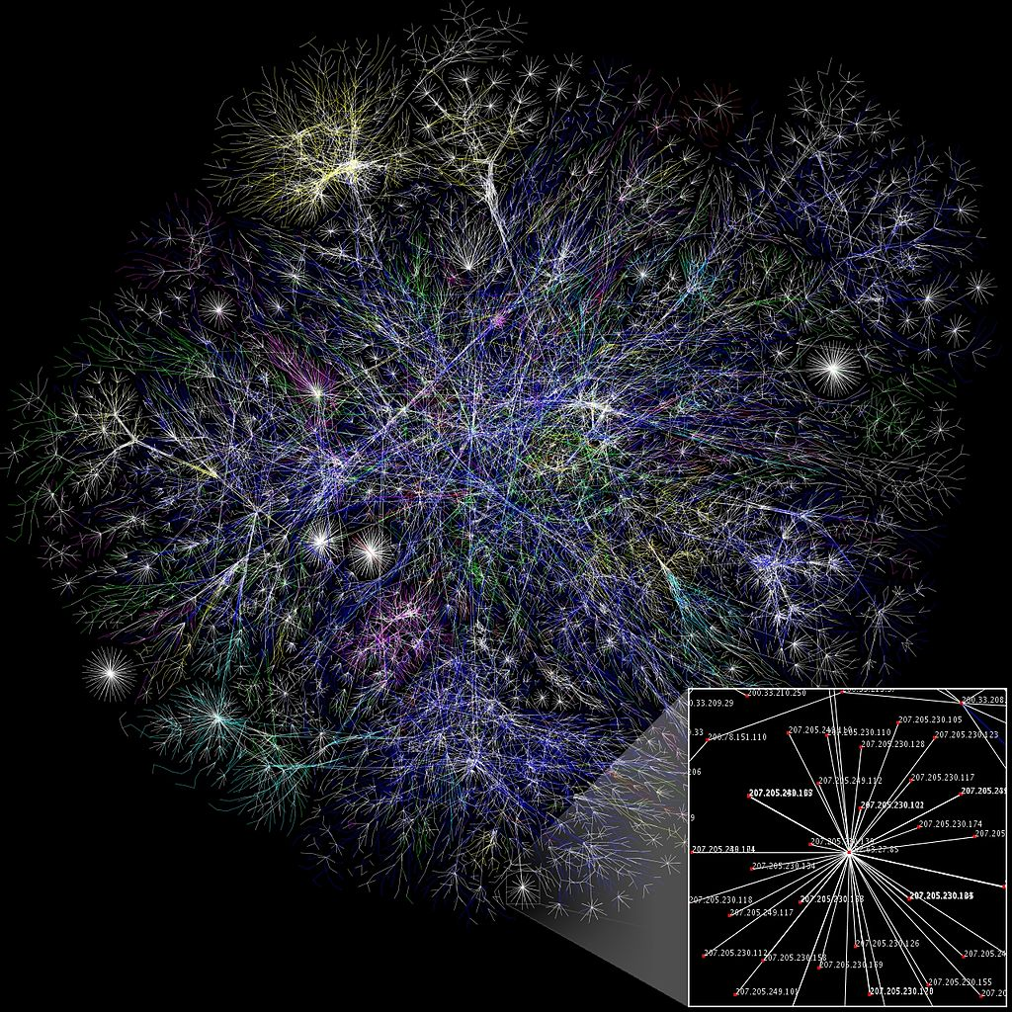
Uses in Business
Supply chain management
Social networks
Portfolio management
Distributed computing

Slide 5
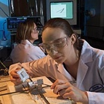
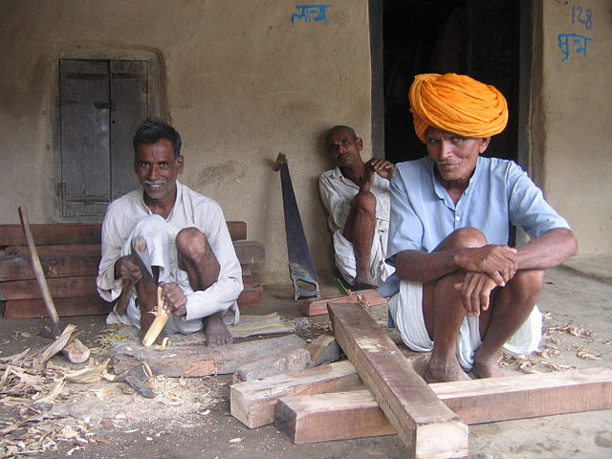
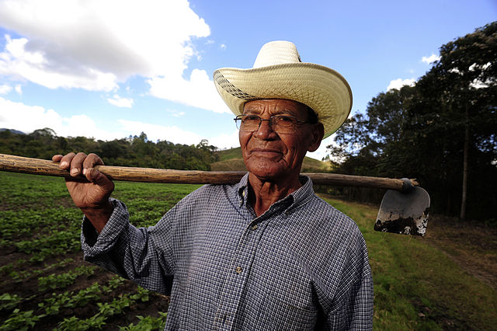
Uses in Social Science
Replace “representative agent” with agents having:
Different goals
Different knowledge
Different endowments
Different abilities
Different settings

Slide 6
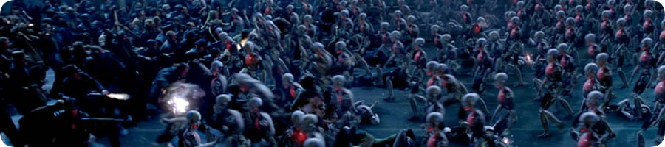
Uses in Animation
Some of the movies using ABM:
Lord of the Rings
The Hobbit
WALL-E
Rise of the Planet of the Apes
Life of Pi
300
King Kong
Avatar
Ender’s Game

Slide 7
Our Problem: Social Cycles
Monarchy
Aristocracy
Democracy
Anarchy
Business cycle
Cycles in fashion
Constitutional cycles
Stock boom-and-bust

Slide 8
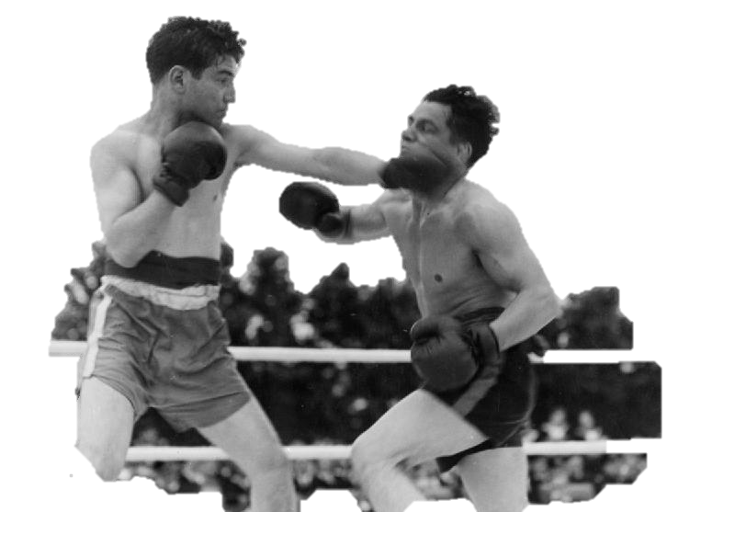
Insight
All of these cycles involve a two-population model, and…
We have a simple (macro-level) two-population model in existence

Slide 9
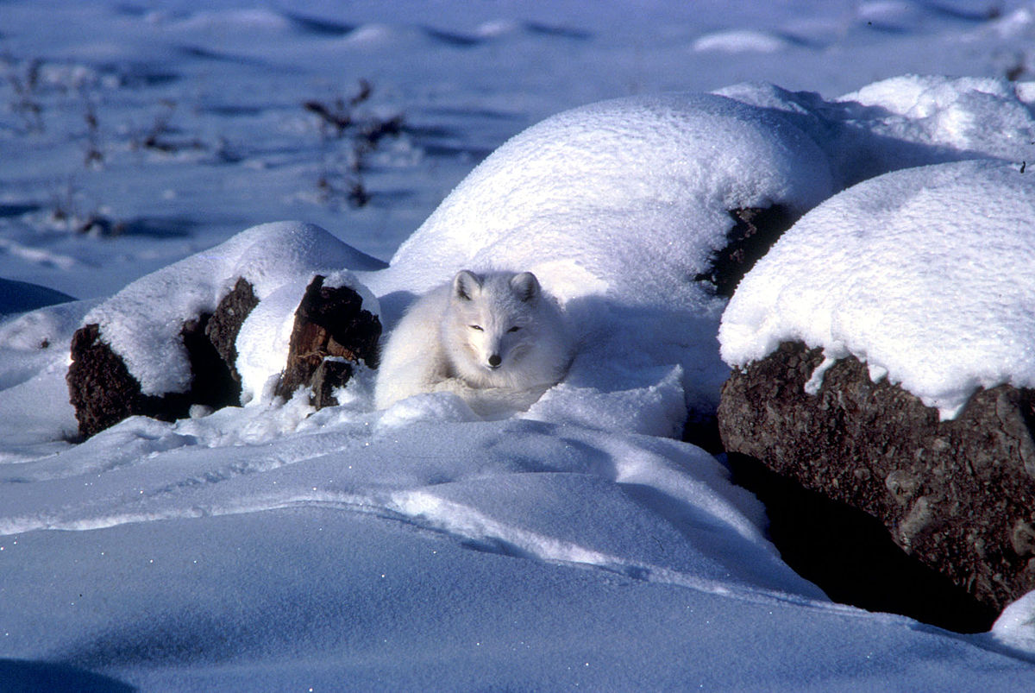
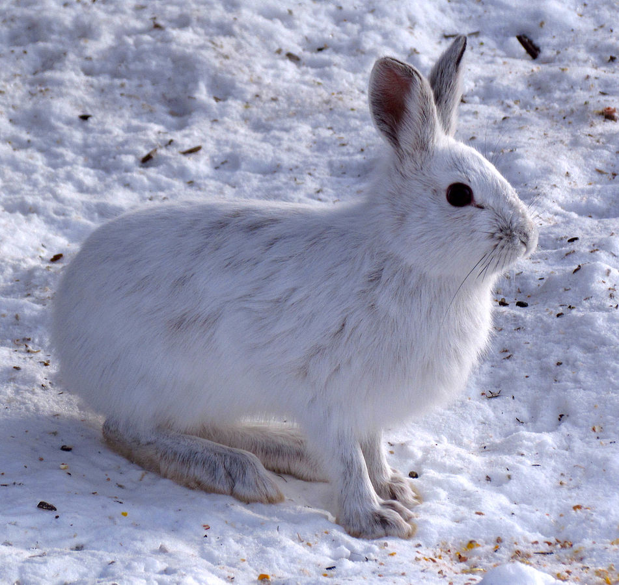
Predator-Prey

Slide 10
Solution: Agent-Based Modeling
Let us create “autonomous” software agents, give them semi-realistic behavior, divide them in two distinct populations, and see if we get the cycles that interest us.

Slide 11
Why Python?
Interactive features make for great experimental environment
Large amount of library support for scientific computing

Slide 12
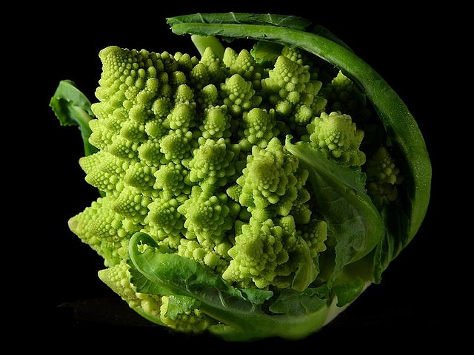
The Object Hierarchy
Top-level object: Entity
Why bother?
We plan on a network of objects, and we can build that machinery once
It also allows us to build debugging and display machinery in one place.

Slide 13
Entity
Agent
Environment
Has an objective
Contains Agents

Slide 14
Agent
SpatialAgent
Is located
Creature
Eats, ages, reproduces
Can move in env
Grass
MobileCreature
Fox
Rabbit
Eats rabbits
Eats grass

Slide 15
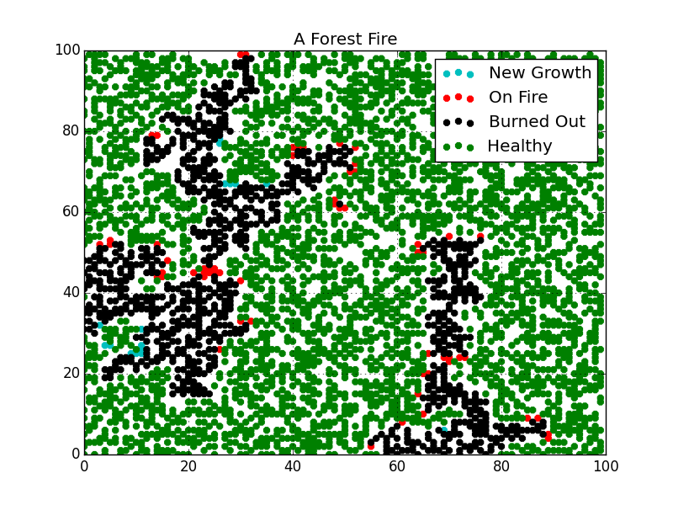
Demos
Forest fire
Neighborhood segregation
Adam Smith’s fashion model

Slide 16
CREDITS
"Fractal Broccoli" by Jon Sullivan - http://pdphoto.org/PictureDetail.php?mat=pdef&pg=8232. Licensed under Public Domain via Commons - https://commons.wikimedia.org/wiki/File:Fractal_Broccoli.jpg#/media/File:Fractal_Broccoli.jpg
"Oscillator" by Grontesca at the English language Wikipedia. Licensed under CC BY-SA 3.0 via Commons - https://commons.wikimedia.org/wiki/File:Oscillator.gif#/media/File:Oscillator.gif
"Iridescent biofilm on a fishtank" by Zaereth - Own work. Licensed under CC0 via Commons - https://commons.wikimedia.org/wiki/File:Iridescent_biofilm_on_a_fishtank.JPG#/media/File:Iridescent_biofilm_on_a_fishtank.JPG
"Gram Stain Anthrax". Licensed under Public Domain via Commons - https://commons.wikimedia.org/wiki/File:Gram_Stain_Anthrax.jpg#/media/File:Gram_Stain_Anthrax.jpg
"Internet map 1024" by The Opte Project - Originally from the English Wikipedia; description page is/was here.. Licensed under CC BY 2.5 via Commons - https://commons.wikimedia.org/wiki/File:Internet_map_1024.jpg#/media/File:Internet_map_1024.jpg

Slide 17
CREDITS
"Farmer, Nicaragua" by Neil Palmer (CIAT) - http://www.flickr.com/photos/ciat/5471862690/. Licensed under CC BY-SA 2.0 via Commons - https://commons.wikimedia.org/wiki/File:Farmer,_Nicaragua.jpg#/media/File:Farmer,_Nicaragua.jpg
"Laura Miller at ANL". Licensed under Public Domain via Commons - https://commons.wikimedia.org/wiki/File:Laura_Miller_at_ANL.jpg#/media/File:Laura_Miller_at_ANL.jpg
"Indiacarpenter" by No machine-readable author provided. Deeptrivia assumed (based on copyright claims). - No machine-readable source provided. Own work assumed (based on copyright claims).. Licensed under CC BY-SA 3.0 via Commons - https://commons.wikimedia.org/wiki/File:Indiacarpenter.jpg#/media/File:Indiacarpenter.jpg
"TwoLorenzOrbits". Licensed under CC BY 2.5 via Commons - https://commons.wikimedia.org/wiki/File:TwoLorenzOrbits.jpg#/media/File:TwoLorenzOrbits.jpg
"Boxing Tournament in Aid of King George's Fund For Sailors at the Royal Naval Air Station, Henstridge, Somerset, July 1945 A29806" by Royal Navy official photographer - http://media.iwm.org.uk/iwm/mediaLib//31/media-31189/large.jpgThis is photograph A 29806 from the collections of the Imperial War Museums.. Licensed under Public Domain via Commons -
"HAL9000" by Cryteria - Own work. Licensed under CC BY 3.0 via Commons - https://commons.wikimedia.org/wiki/File:HAL9000.svg#/media/File:HAL9000.svg

