Slide 1
Write Less Code… Using Algebra!
Dr. Gene Callahan
St. Joseph’s College
Dr. David Seppala-Holtzman
St. Joseph’s College

Slide 2
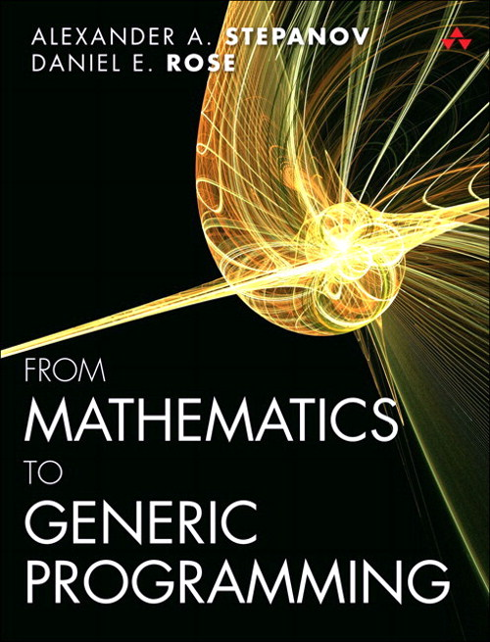
Generic Programming Abstracting logic from data

Slide 3
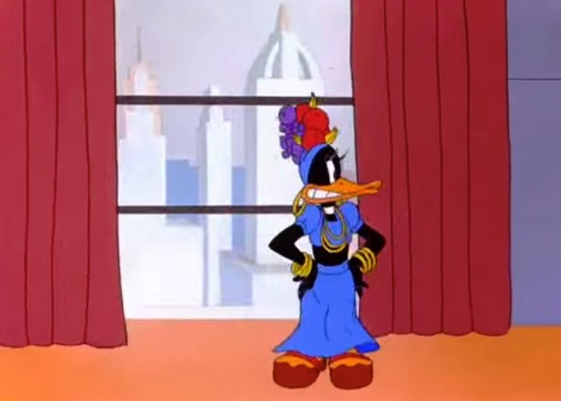
Python
A great generic programming language!
Don’t repeat yourself
Duck typing

Slide 4
Polymorphism
What is the difference between generic programming and polymorphism?
For Python, not much!
Just a greater focus on abstraction.
Languages like C++, with stronger typing, needed extension to support generic programming:
C++ Standard Template Library, written by Stepanov:
“For example, an algorithm to reverse a sequence can be implemented using bidirectional iterators, and then the same implementation can be used on lists, vectors and deques.” (Wikipedia)

Slide 5
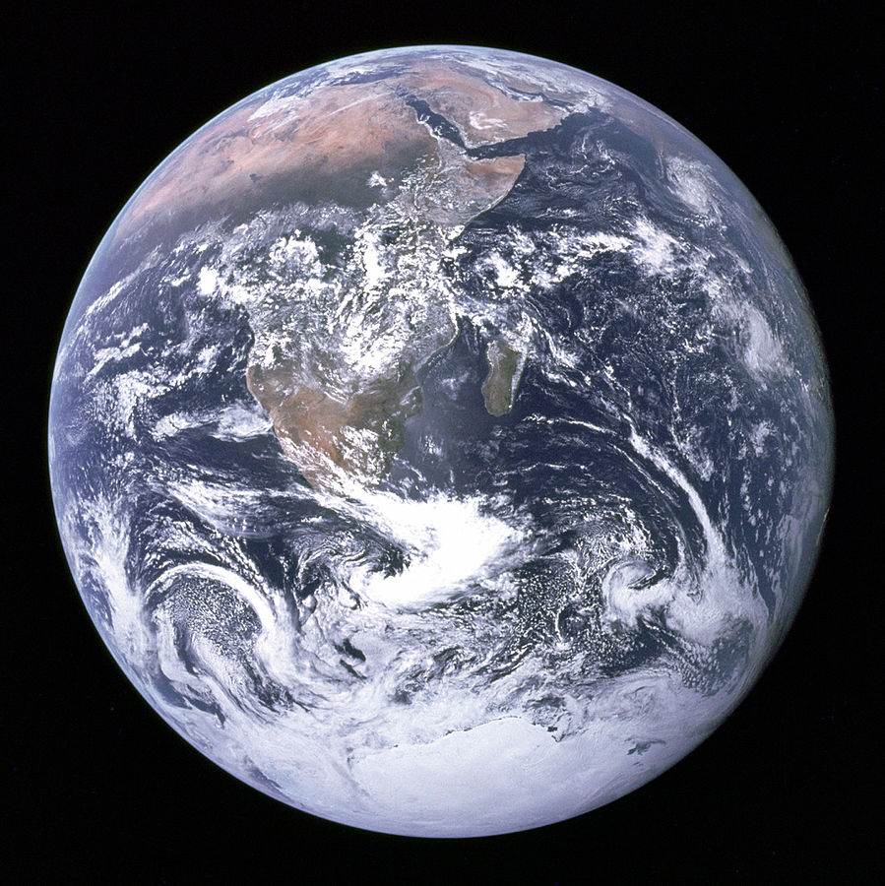

Slide 6
Generic Programming Abstracting logic from data
Inspired by abstract algebra
“Addition” can be any operation that follows the pattern of addition
The addition operation should:
Be associative
Be commutative
Have an identity element (e.g., 0, or the unknot)
x
y
Z

Slide 7
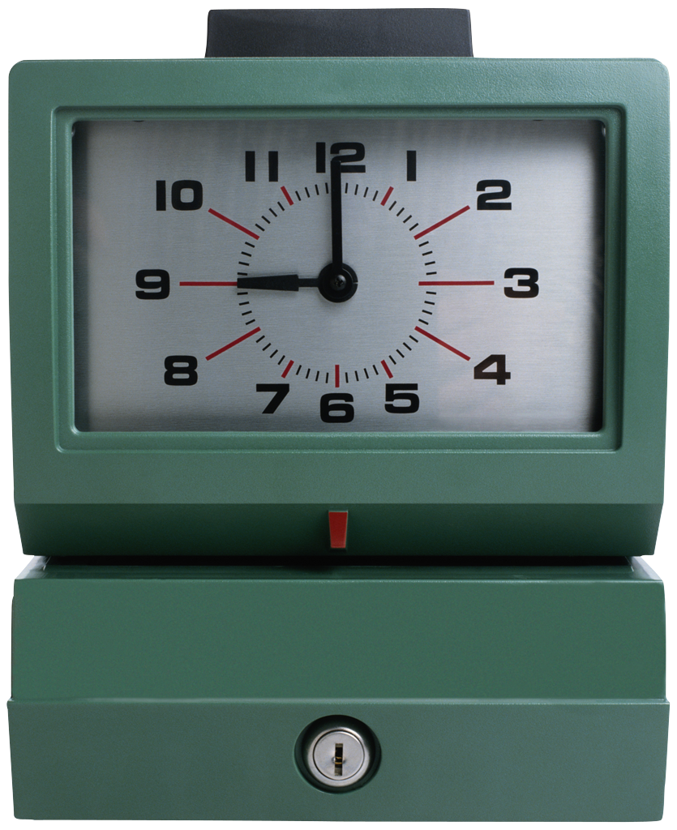
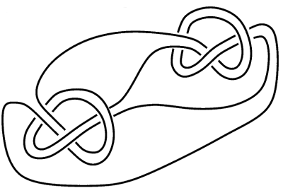
Generic Programming Abstracting logic from data
Addition can apply to clocks and knots, not just integers or reals!

Slide 8
Generic Programming Abstracting logic from data
So if we are writing, e.g., a summation function, we should ask, “Can we write this to handle summing not just familiar numbers, but also clock numbers, knots, vectors, etc.?”
We then pass in an addition function to our sum that correctly handles the particular data type; e.g., for a clock:
8
8
4

Slide 9
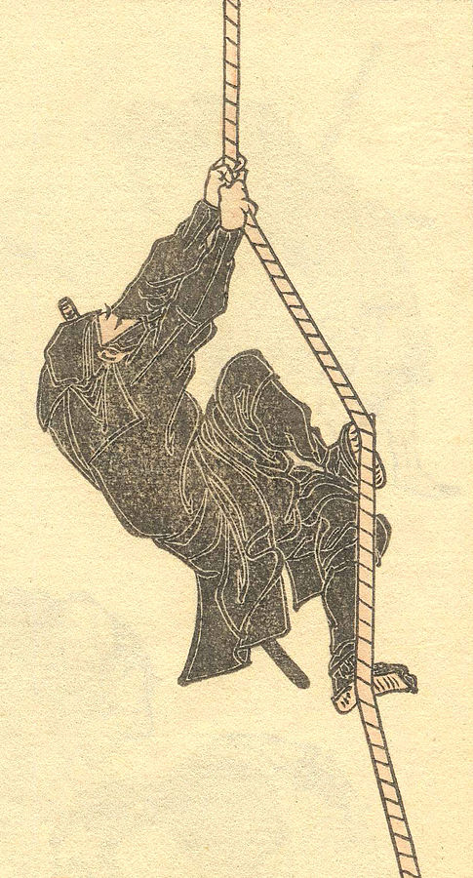
Agent-Based Modeling Generating complex macro-behavior from simple rule
Agents:
Exist in some environment
Are called upon to act
Look to their goals and the environment to decide what to do
Influence other agents by their actions

Slide 10
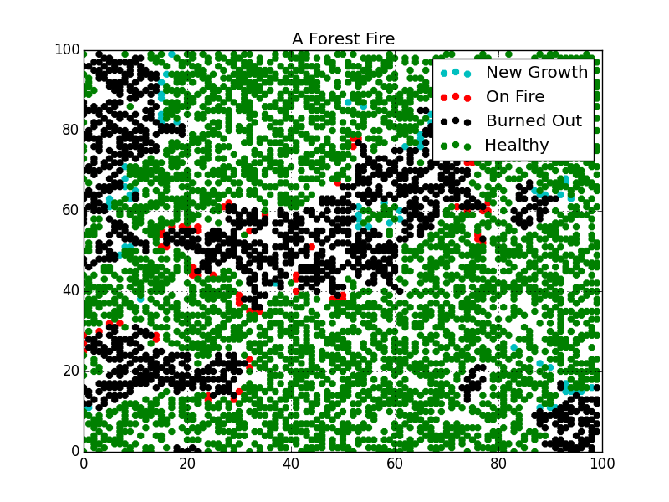
Agent-Based Modeling (ABM)
Example: a forest fire model
Lightening strikes randomly, starting a fire
Trees on fire ignite neighbors
Trees grow anew in burned out spots

Slide 11
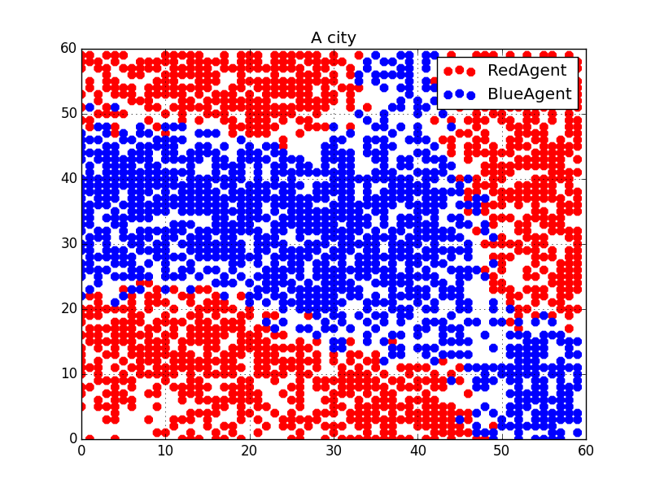
Agent-Based Modeling
Example: Schelling’s segregation model
Agent’s preferences are just not to be too small a minority, not for fully segregated neighborhoods
But that can be the result anyway:

Slide 12
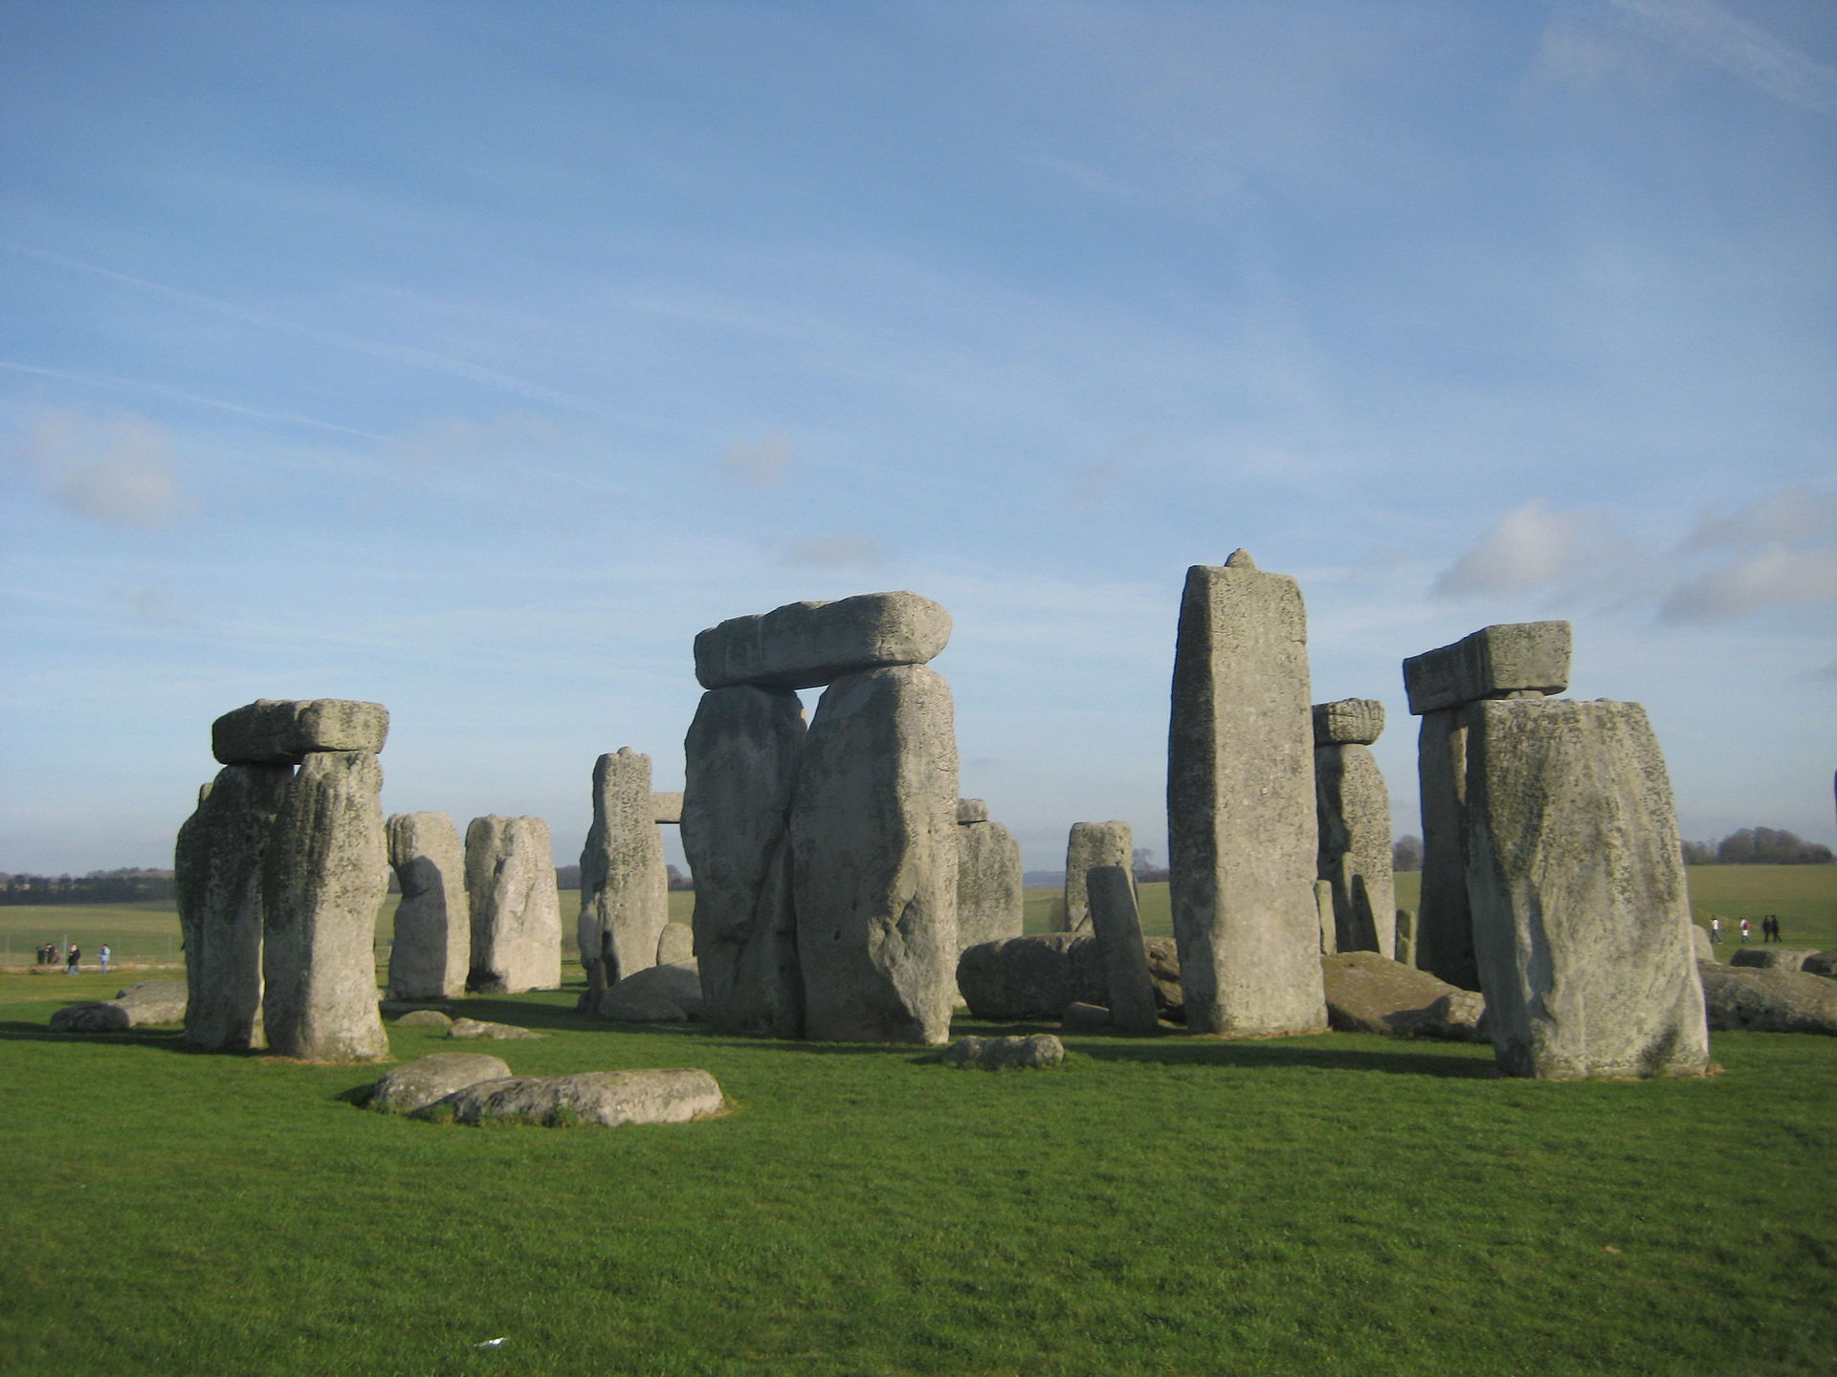
How to Do Generic Programming
In math, the process of generalization was:
Common measures
Natural numbers
Integers
Rational numbers
Polynomials
Real numbers
Complex numbers
Groups
Rings
Fields

Slide 13
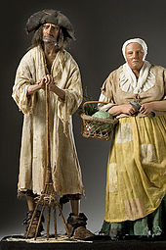
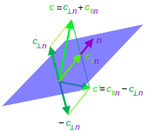
How to Do Generic Programming
How this happened: no one sat down and devised an abstract algebra of rings and fields, and then said, "So farmers: I think you can derive something from this to measure your fields.” (Ex.: Lisp.)

Slide 14
How to Do Generic Programming
Similar in programming!
Rarely a successful strategy to try to start by defining some grand abstraction, and then building one's system around it.
Successful generic programming:
Build concrete applications
Seek out commonalities found in different applications and abstracting them.

Slide 15
An Algebraic Monoid
To be a monoid an algebraic structure must contain a primary set S, satisfying three axioms: closure, associativity, and identity. There is an operator ⊕ which takes two elements of the group and yields an element, and its operation satisfies these axioms.
We may define further requirements and get more restrictively defined structures: e.g, a module must be Abelian, have inverse elements, and contain a secondary set, R, a ring of coefficients, with a second operation, ⊗, which takes an element of R and an element of S and produces an element of S.

Slide 16
Different Strokes for Different Folks
The Forest Fire model turns out to be best represented as a monoid.
Schelling’s segregation model is a module.
We can now see how the second is a subclass of the first with additional axioms.

Slide 17
ABM Interaction as an Algebraic Structure
Elements: Following A. N. Whitehead, we call the elements of our group G prehensions. A prehension can be roughly understood as a state of affairs in the world as seen from a particular point of view.
Agent
Resource
Hazard
Competitor

Slide 18
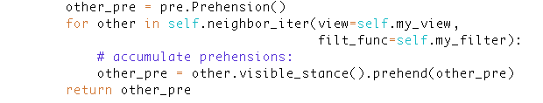
Prehensions
Even before implementing this as a monoid, we had made it easy to:
Get arbitrary slices of the agent’s environment as a “view.”
Filter that view to, e.g., see only agents of a type of particular interest.

Slide 19

Prehending
Prehension1
Prehension2
A prehension
The operation ⊕, which we will call “prehend”, accepts two prehensions as arguments and produces a third prehension (Closure).

Slide 20
Associativity
(a ⊕ b) ⊕ c = a ⊕ (b ⊕ c) for all a, b and c.
We must ensure that, say, a neighborhood can interact with a neighborhood (b ⊕ c), and then with an agent (a ⊕ (b ⊕ c)). Furthermore, this must produce an identical prehension to that produced by an agent interacting with one neighborhood and then another one ((a ⊕ b) ⊕ c).
Agent
Environment
Agent
Environment

Slide 21
Identity
Pre
Null
Pre
Identity: Any prehension prehending the null prehension remains unchanged.

Slide 22
Commutativity
a
b
For Abelian structures, we need:
Commutativity: (a ⊕ b) = (b ⊕ a) for all a and b.

Slide 23
Invertability
Prehension
Prehension
Nothing!
Modules need:
For any prehension, there is another prehension that combines with it to produce the null prehension.

Slide 24
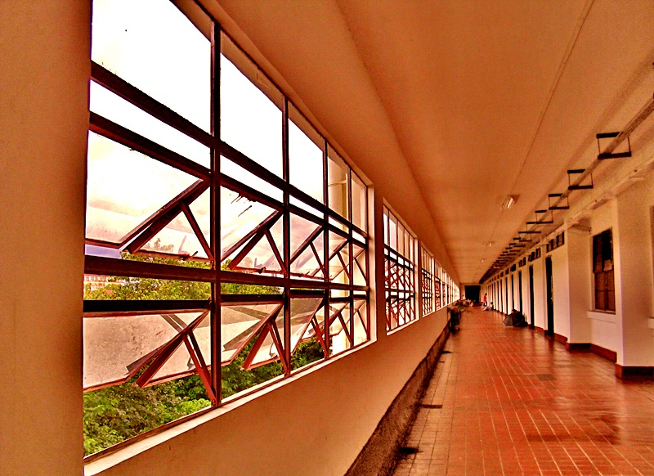
The Meaning of Prehensions
An agent’s prehension of itself is its view of its own internal state.
An agent’s prehension of its environment is its view of its surroundings.
But from the point of view of the prehension module, these prehensions are interchangeable.

Slide 25

Null Prehensions
A null prehension could arise, e.g., from the environment when an agent has no neighbors. It could arise internally when an agent has “no opinion” on the relevant parameters, e.g., a color-blind agent in our fashion model.

Slide 26

Invertibility
Invertibility may occur, for instance, when an agent has some internal tendency (a self-prehension) to act in some way (e.g., to move to a new neighborhood or switch fashions) but some prehension in the environment exactly offsets that tendency (e.g., the “authorities” establish some penalty for so acting).

Slide 27
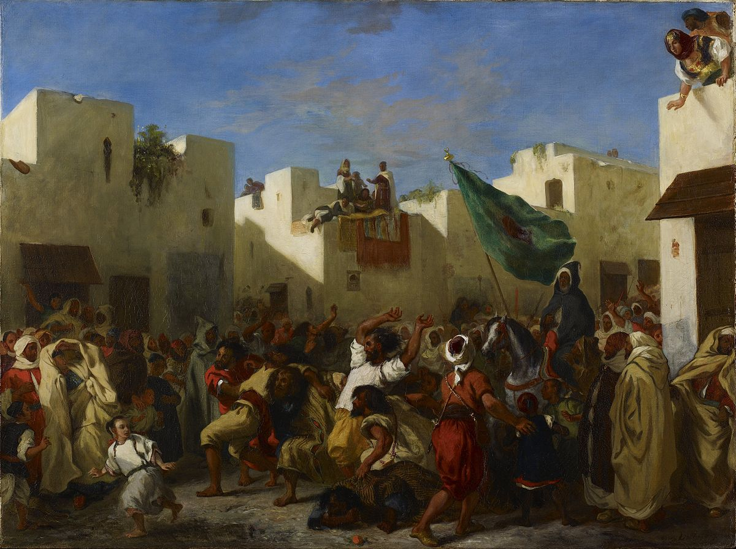
Intensification
An intensification of a prehension leaves the elements of the prehension in the same internal relationship, but they are scaled up or down relative to other prehensions. This is useful for capturing situations like the gradual dissipation of an attitude, or increasing fanaticism over time.

Slide 28
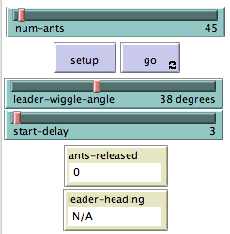
What’s the Point?
We achieve a uniform template for all models as far as how agents interact with their environment. Programming new models then becomes much easier.

Slide 29
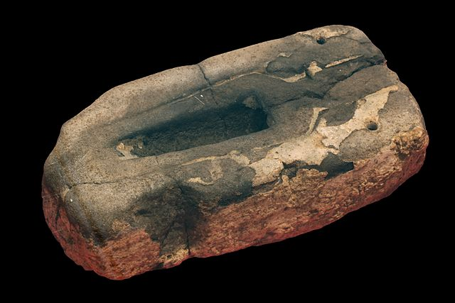
What’s the Point?
We will have taken a huge step towards enabling “fill-in-the-template” style programming of ABMs.

Slide 30
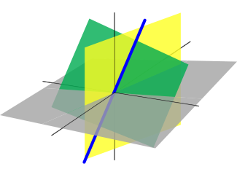
What’s the Point?
We open up the possibility of using known properties of algebraic structures to identify properties of our ABM.

Slide 31
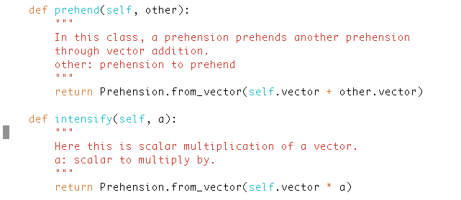
Implementation Sample
Prehensions are a vector space in one class.
However, any other implementation in which the vector-space axioms are true can be sub-classed.

Slide 32
Final note
Contributors welcome! The project is on GitHub: https://github.com/gcallah/Indra

Slide 33
Credits
"Knot with borromean rings in jsj decomp small". Licensed under CC BY-SA 3.0 via Wikipedia - https://en.wikipedia.org/wiki/File:Knot_with_borromean_rings_in_jsj_decomp_small.png#/media/File:Knot_with_borromean_rings_in_jsj_decomp_small.png
"Stonehenge on 27.01.08" by Mavratti - Own work. Licensed under Public Domain via Wikimedia Commons - https://commons.wikimedia.org/wiki/File:Stonehenge_on_27.01.08.jpg#/media/File:Stonehenge_on_27.01.08.jpg
The Mesa team at George Mason has contributed code to this project.

Slide 34
Credits
"Bronze Age spear tip mould IMG 5123" by Photograph by Rama, Wikimedia Commons, Cc-by-sa-2.0-fr. Licensed under CC BY-SA 2.0 fr via Commons - https://commons.wikimedia.org/wiki/File:Bronze_Age_spear_tip_mould_IMG_5123.jpg#/media/File:Bronze_Age_spear_tip_mould_IMG_5123.jpg
"Axentowicz The Anchorite" by Teodor Axentowicz - cyfrowe.mnw.art.pl. Licensed under Public Domain via Commons - https://commons.wikimedia.org/wiki/File:Axentowicz_The_Anchorite.jpg#/media/File:Axentowicz_The_Anchorite.jpg

Slide 35
Credits
"Perspectivephoto". Licensed under CC BY 2.5 via Wikipedia - https://en.wikipedia.org/wiki/File:Perspectivephoto.jpg#/media/File:Perspectivephoto.jpg
"Eugène Delacroix - The Fanatics of Tangier - WGA06195" by Eugène Delacroix - 1. Web Gallery of Art: Image Info about artwork2. The Minneapolis Institute of Arts. Licensed under Public Domain via Commons - https://commons.wikimedia.org/wiki/File:Eug%C3%A8ne_Delacroix_-_The_Fanatics_of_Tangier_-_WGA06195.jpg#/media/File:Eug%C3%A8ne_Delacroix_-_The_Fanatics_of_Tangier_-_WGA06195.jpg

Slide 36
Credits
"Linear subspaces with shading" by Alksentrs at en.wikipedia - Own work (Original text: Own work, based on en::Image:Linearsubspace.svg (by en:User:Jakob.scholbach).)Transferred from en.wikipedia to Commons by User:Ylebru using CommonsHelper.. Licensed under CC BY-SA 3.0 via Commons - https://commons.wikimedia.org/wiki/File:Linear_subspaces_with_shading.svg#/media/File:Linear_subspaces_with_shading.svg

Slide 37
Credits
"Hokusai-sketches---hokusai-manga-vol6-crop" by Katsushika Hokusaiderivative work: AMorozov - Hokusai_sketches_-_hokusai_manga_vol6.jpg. Licensed under Public Domain via Commons - https://commons.wikimedia.org/wiki/File:Hokusai-sketches---hokusai-manga-vol6-crop.jpg#/media/File:Hokusai-sketches---hokusai-manga-vol6-crop.jpg
Daffy Duck: By Directed by Friz Freleng, (Warner Bros.) - YouTube, Public Domain, https://commons.wikimedia.org/w/index.php?curid=34296734

Slide 38
Credits
Earth: By NASA/Apollo 17 crew; taken by either Harrison Schmitt or Ron Evans - http://www.nasa.gov/images/content/115334main_image_feature_329_ys_full.jpgAlt: http://grin.hq.nasa.gov/ABSTRACTS/GPN-2000-001138.html (direct link), Public Domain, https://commons.wikimedia.org/w/index.php?curid=43894484

