Slide 1

Master of computer application
Database management system lab project
Covid vaccination management system
SUBMITTED TO:
SUBMITTED BY:
ABHILASH BHADORIYA
205120003
DR. Jiterndra kumar
ROLL No. :

Slide 2
Abstract :
My project title is “COVID VACCINATION MANAGEMENT SYSTEM”. This is the online website of a vaccination Centre of name “LAKSHYA VACCINATION CENTRE”, in which all the work of response to vaccination is managed.
By the help of these portal work regarding vaccination become more easier and also time saving. Also much more work can be manages by these portal for both user and admin purpose.
Generally, it has two types of interface, one of which is user interface in which features like registration, vaccine information, certificate download so the user who needs it can use it under some suitable conditions.
And the second interface which is the admin interface. This interface will be accessed by the centre management, whose features are secure, only the right person can access. Because in this interface, all the information of the person who has come to the center will be checked, whether the person has registered or not, if it is done, then for which dose it is valid. After checking valid date and all the information properly, with the help of the features of this interface, the center management can access the database and either save or update all the records of that person regarding vaccination.
Admin can also be access and check the data of dose available in the centre .

Slide 3
ER-model:
S.NO
injection
PIN_Code
Vaccine
Centre_ID
Password
dose_available
admin_security
Manages
Jabbed
first_name
Refer_ID
Reference_ID
last_name
Identity
Address
For
vaccination_status
user_data
First_Dose
Identity
first_date
Mobile_Number
Second_Dose
vaccinated_by
Date
Age
second_date
vaccine_type
Date_Of_Birth
Gender

Slide 4
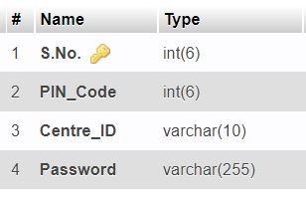
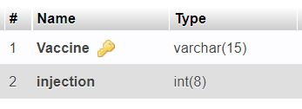
The details of relational Schema:
There is a database named `vaccine_record` of this portal. It is very important to keep record of lot of information related to the person and a lot of other information related to vaccination record and to keep systematic record of these different information, I have created four types of tables in this database, such tables is –
1. admin_security :
2. dose_available :
It keep records of login
details for the admin.
It has all information about vaccine
and injections like which vaccine
and how much dose is available.

Slide 5
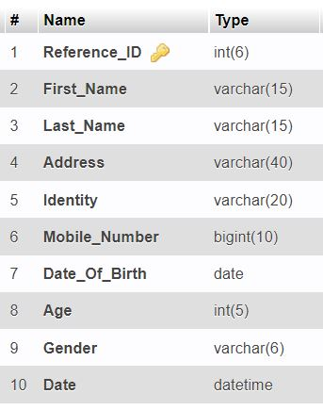
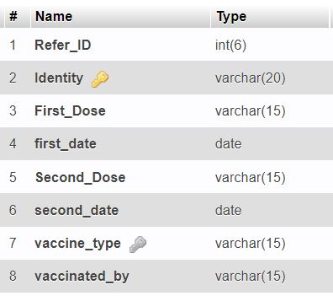
3. vaccination_status :
4. user_data :
It has all the records of vaccination
status of user who registered for
Vaccination like first or second dose
success or not if success then also its
date, which vaccine he/she got and
also the doctor/nurse name.
This table has record of all important and required information of all the user who registered for vaccination on the portal.

Slide 6
TABLES RELATIONS AND WORKING:
The first table `admin_security` , in this table `S.No.` is a primary key because this no. is uniquely generated, this table has the record for login credentials that’s why all the information in these table must be private so this table applied by hashing for security purpose. If an admin can enter the information on admin login page then three data i.e. PIN_CODE , Centre_ID and Password will be checked by the data available in this table.
The second table is `dose_available` , in this table primary key is `Vaccine` because each vaccine name is unique, these table has the record of the vaccine and injections. If any person came for vaccine in the centre then first of all admin have to check either vaccine doses will be available or not. So admin can check the number of doses and vaccine by these table. Suppose more vaccine and doses come to the centre then admin can also update by adding the number of doses of any vaccine in these table.
The third table is `vaccination_status` , in this table primary key is `Identity`because each person have their unique identity number like aadhaar number , voter id , etc and foreign key is `vaccine_type` which taking references from the table `dose_available` of attribute `Vaccine`. Suppose a user can registered for vaccine on portal then in these table also insert the user Refer_ID which is generated by centre and identity of the user and all other entities become NULL than if person came for centre than all other attributes can be accessed by admin by the suitable condition like valid for which dose, vaccine name person got, name of doctor/nurse who vaccinated.
The fourth table is `user_data` , in this table `Reference_ID` is primary key because this is unique ID which is generated by the centre for each person. If user can register on the portal for vaccination then the all information of the user can be inserted in this table.

Slide 7







Front end :
Back end :
Platform used :
THANK YOU

