Slide 1

Docker

Slide 2
Overview
Why Docker?
What is Container?
Docker vs Virtual Machine

Slide 3
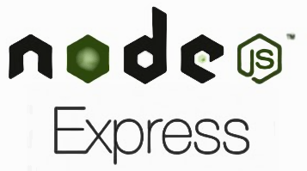
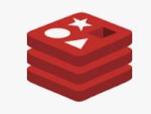


Why Docker?
Web Server
Session Management
Database
MQ
Libraries
Dependencies
Host Operating System
Hardware Infrastructure

Slide 4
What is Docker?
Docker isn’t programming Language
Docker isn’t framework
Docker is a tool that helps
Installing, removing, upgrading, distributing and running software

Slide 5
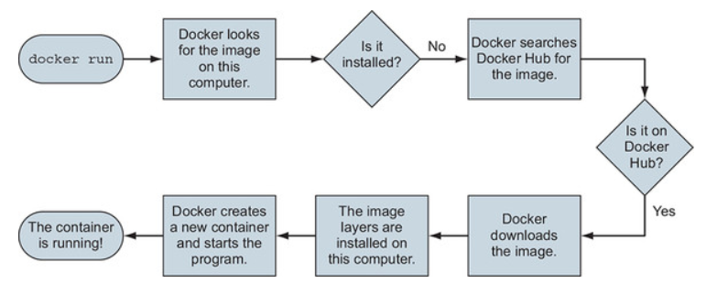
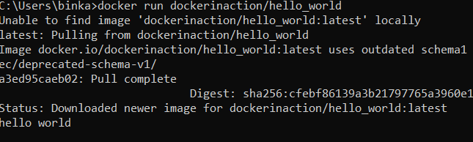

Docker run command
First time execution
Second time execution

Slide 6
What is Container?
A way to package applications with all the necessary dependencies and configurations
Application runs quickly and reliably from one environment to another
Container contains code, runtime, System tools, system libraries and settings

Slide 7
Containerized Application
App A
App B
App C
App D
App E
App F
App G
Docker
Host Operating System
Infrastructure

