Slide 1

Docker

Slide 2
Overview
cf push
What is Docker
What is Container

Slide 3

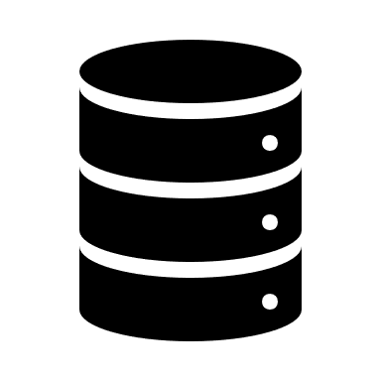

cf push
Build Pack (Converts code to Container Image
Build pack
BLOB Store
Code + manifest
Cloud Controller
Application Code
Runtime
Agent
Run Command
Build pack
Diego
VM

Slide 4
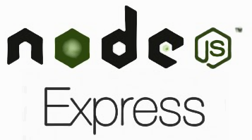
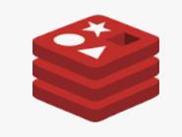


Why Docker?
Web Server
Session Management
Database
MQ
Libraries
Dependencies
Host Operating System
Hardware Infrastructure

Slide 5
Spring Boot + Docker
Spring Boot
Create
DockerFile
Docker Build
Docker Image
Docker run
Docker Container
Docker File: Text file with instructions to build Docker Image

Slide 6
DockerFile Script
# Need to tell Docker what type of application is being deployed. The below command downloads the image from Docker Hub
#FROM <IMAGE-NAME:VERSION>
FROM openjdk:8
#Add the JAR which is built by our application into the Docker Container
ADD target/spring-boot-docker.jar spring-boot-docker.jar
#Expose application port
EXPOSE 8080
#EntryPoint is the command used to start the container
ENTRYPOINT [“java”, “-jar”, “spring-boot-docker.jar”]

Slide 7
Run DockerFile
Build the application in Docker Container by creating a docker image
#docker build –f <FILE-NAME> -t <IMAGE-NAME> <Directory path of the DockerFile>
docker build –f DockerFile –t docker-image-name .
Run the Docker container
#docker run –p <system port>: <container port> <IMAGE-NAME>
docker run –p 8080:8080 docker-image-name

Slide 8
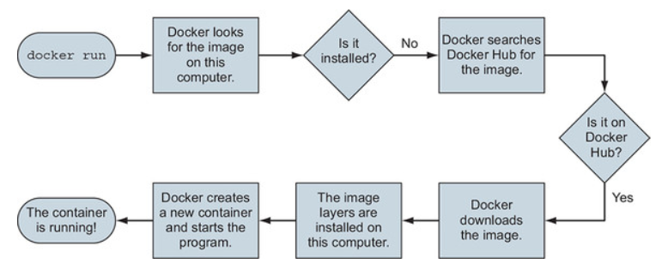
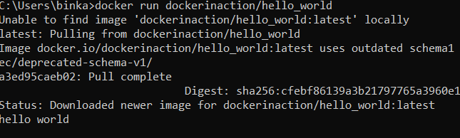

Docker run command
First time execution
Second time execution

Slide 9
What is Container?
A way to package applications with all the necessary dependencies and configurations
Application runs quickly and reliably from one environment to another
Container contains code, runtime, System tools, system libraries and settings

Slide 10
Containerized Application
App A
App B
App C
App D
App E
App F
App G
Docker
Host Operating System
Infrastructure

