Slide 1
Instagram Bot
Developed by
Abhilash Datta

Slide 2

Getting Started
Instagram Bot

Slide 3

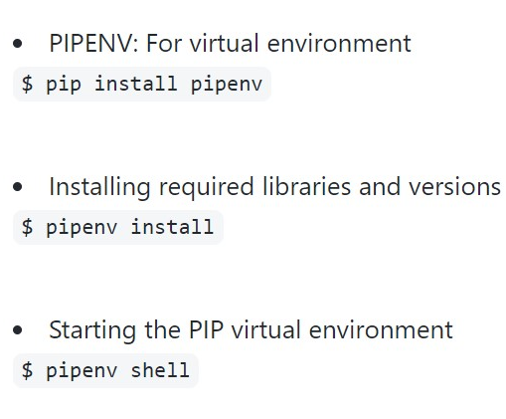
Setting Up The Environment
After downloading and extracting the zip file from the GitHub Repository, We need to setup the virtual environment and install the required python libraries.
Instagram Bot

Slide 4
Initialization of the Bot
Inside the directory, either open a new python file or edit the example.py file which has been given as a template.
from BOT import Bot bot = Bot()
Instagram Bot

Slide 5
All About BOT
Login
Download
Like
Single DM
From List
Group DM
From Inbox
Retrieval
The BOT module
DM
DM from database
From CSV
DM all Followers
Share
Follow
Logout
Instagram Bot

Slide 6
Commercial features
Mass direct-message Followers
Retrieving messages from Inbox
Sharing Latest Post
Instagram Bot

Slide 7
Mass Direct-Message all Followers
Import the bot and initialize it.
Login using your own credentials.
Call the multiple_dm_followers function and pass a general message as an argument.
Finally Logout.
from BOT import Bot
bot = Bot()
bot.login(username, password)
bot.multiple_dm_followers(general_message)
bot.logout()
Instagram Bot

Slide 8


Retrieving all new messages from Inbox
UPDATE THE IMAGES DIRECTORY WITH CROPPED SCREENSHOTS TAKEN FROM YOUR COMPUTER.
IMAGES’ NAME AND FORMAT SHOULDN’T CHANGE.
CROP THE IMAGES FROM TOP AND LEFT AS MUCH AS POSSIBLE.
UPDATE THE DATABASE CREDENTIALS IN db_credentials.py FILE.
Pre-requisites
Instagram Bot

Slide 9
Retrieving all new messages from Inbox
Working:
First the function opens our inbox and searches for new messages.
It uses object detection by pixel matching to search the latest message and then copies it and stores it in our back-end database.
It waits and check for new messages until it can tolerate and then exits.
Tolerance: It’s the number of incoming messages that the function can sustain without giving error.
Instagram Bot

Slide 10
Retrieving all new messages from Inbox
How to Use:
Code:
Import the bot and initialize it.
Login using your own credentials.
Call the retrieve_messages_from_inbox function and pass a tolerance value as an argument.
Finally Logout.
from BOT import Bot
bot = Bot()
bot.login(username, password)
bot.retrieve_messages_from_inbox(tolerance = 2)
bot.logout()
Instagram Bot

Slide 11
Sharing Latest Post
Working:
First the function will do a Caption analysis of our latest post.
Then it’ll compare the category of our post with the category each user in our database likes.
Finally it’ll send the post to every user who like the category.
Instagram Bot

Slide 12
Sharing Latest Post
How to Use:
Code:
Import the bot and initialize it.
Login using your own credentials.
Call the share_latest_post function without any argument.
Finally Logout.
from BOT import Bot
bot = Bot()
bot.login(username, password)
bot.share_latest_post()
bot.logout()
Instagram Bot

Slide 13
Retrieve and Share at the same time
Concept:
Code:
We can retrieve messages from the inbox and share our latest post if their category matches at the same time.
from BOT import Bot
bot = Bot()
bot.login(username, password)
bot.retrieve_messages_from_inbox(tolerance = 2)
bot.share_latest_post()
bot.logout()
Instagram Bot

Slide 14
Thank You
Instagram Bot

