Slide 1
Presentation on 3D Brain Image Segmentation

Slide 2
Index:
Dataset Structure
Model
Training Part
Results
Future Scope

Slide 3
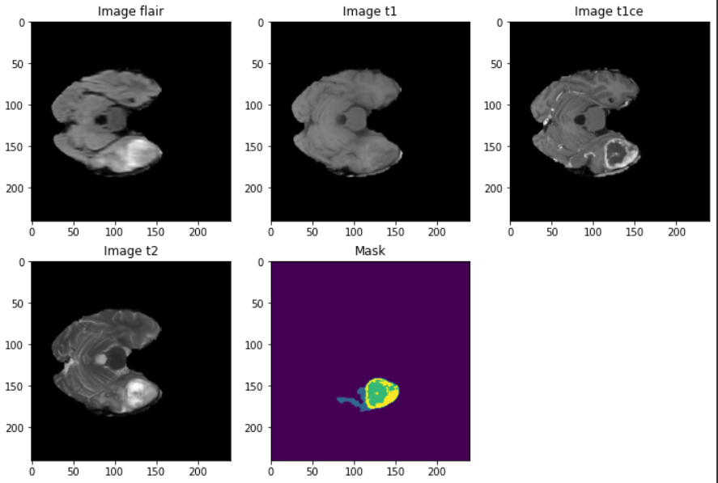
Dataset Structure (before pre-processing)
495 train images and 485 train masks
289 testing images (without mask)
Original sizes:
For image => 4 * 240 * 240 * 155
For mask => 1 * 240 * 240 * 155
Highlighted volume (2nd voxel) of image didn’t show much information almost for all images. So eliminated that voxel at the time of preprocessing of data.

Slide 4
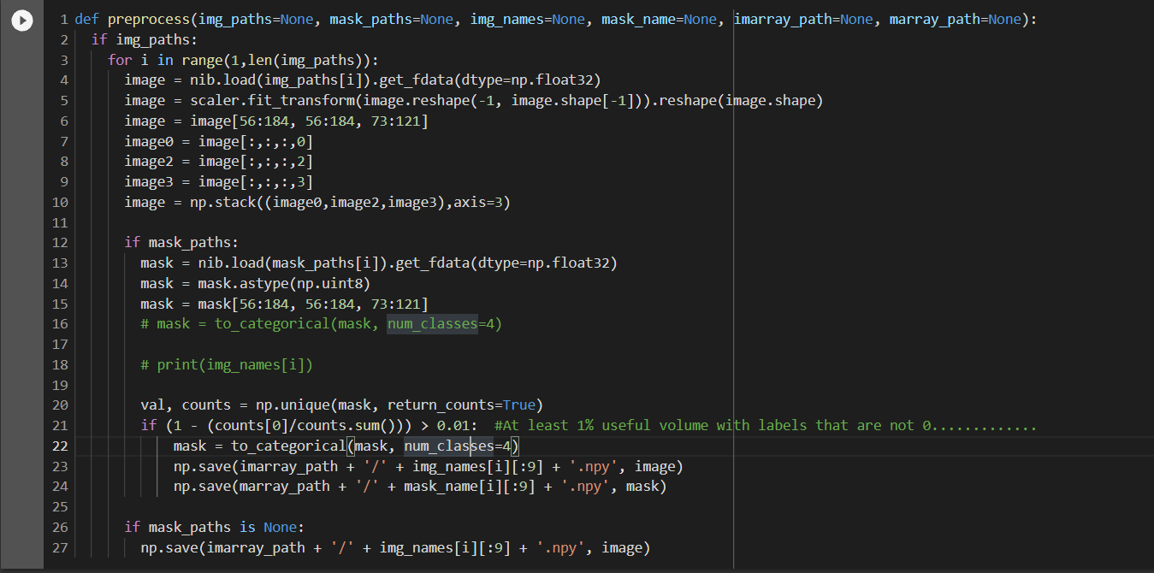

Slide 5
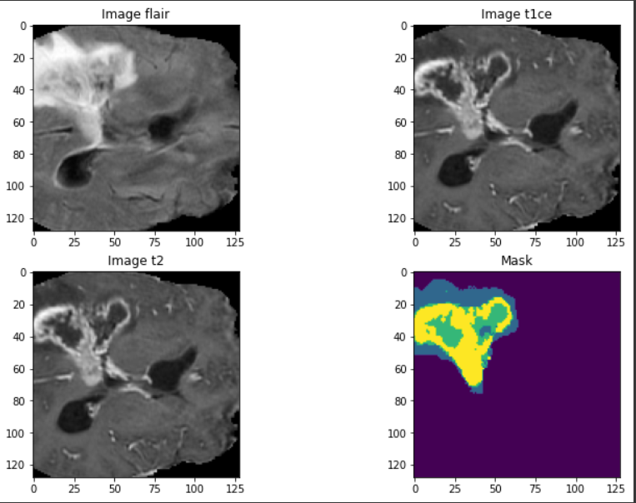
Dataset Structure (After pre-processing)
370 train images and masks
47 train images and masks
264 testing images (without mask)
size after preprocessing:
For image => 3 * 128 * 128 * 48
For mask => 4 * 128 * 128 * 48

Slide 6
Model (3D UNET)
Model contains 4 encoder blocks and 3 decoder block followed by 1*1*1 convolution at last layer
Activation function: ReLU
Normalization: Batch Normalization
Upsampling: Transposed convolution
Biases are initialized by zeros and weights by kaiming_uniform
Concatenated along channel dimensions.
Total trainable parameters: 5,605,635

Slide 7
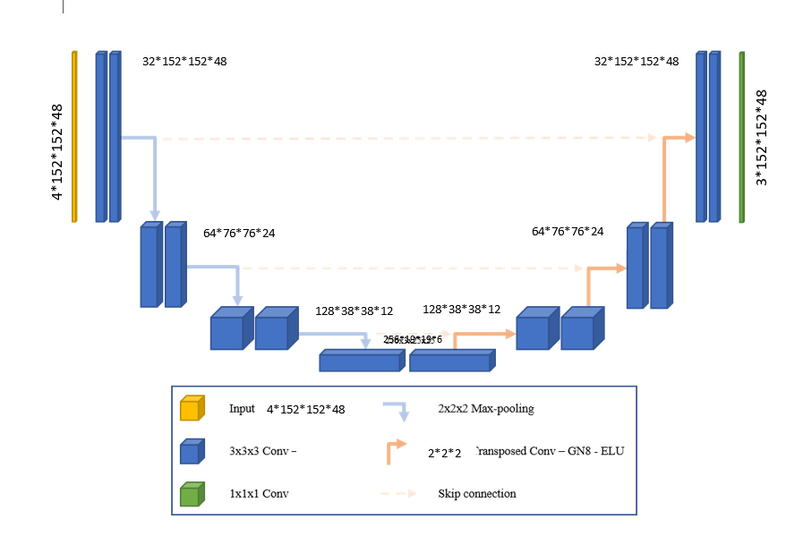

Slide 8
Training Part:
Optimizer used: Adam
Schedular: ReduceLROnPlateau
Loss function: Focal Tversky Loss
Trained for 33 epochs
Results:
Training mean loss: 0.063 and Training dice score: 0.975
Validation mean loss: 0.081 and Validation dice score: 0.962

Slide 9
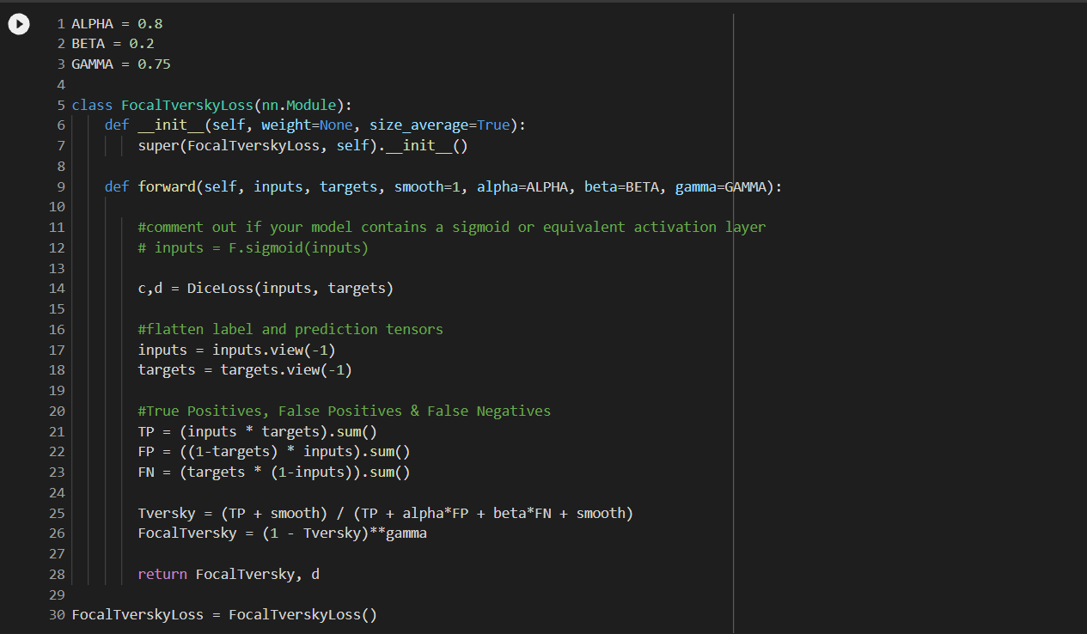

Slide 10
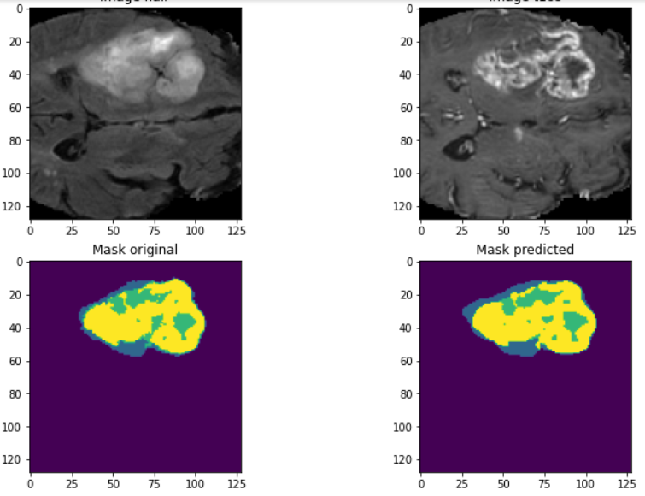
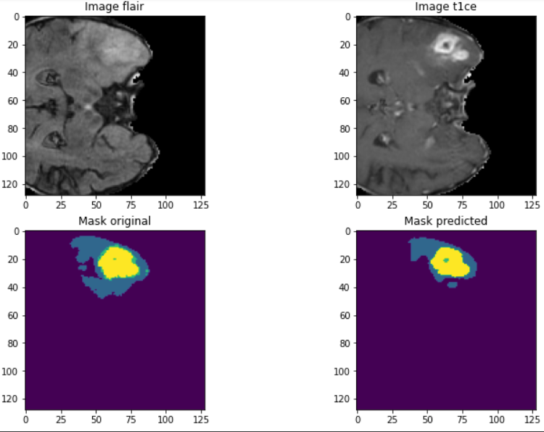
Results

Slide 11
Notebook Link:
https://colab.research.google.com/drive/1qcWU__tyfZ-eVumetxm11pr3PIFwn8mE?usp=sharing

