Slide 1

PROJECT: TELUGU AI ASSISTANT
TASK: TELUGU AUTOMATIC SPEECH RECOGNITION

Slide 2
Explore Essential Topics:
→ TELUGU ASR
→ HUGGING FACE
→ WHISPER MODEL
→ WAV2VEC2 MODEL
→ BERT MODEL
→ CODE FOR MODELS
→ DATA
→ DEMO

Slide 3
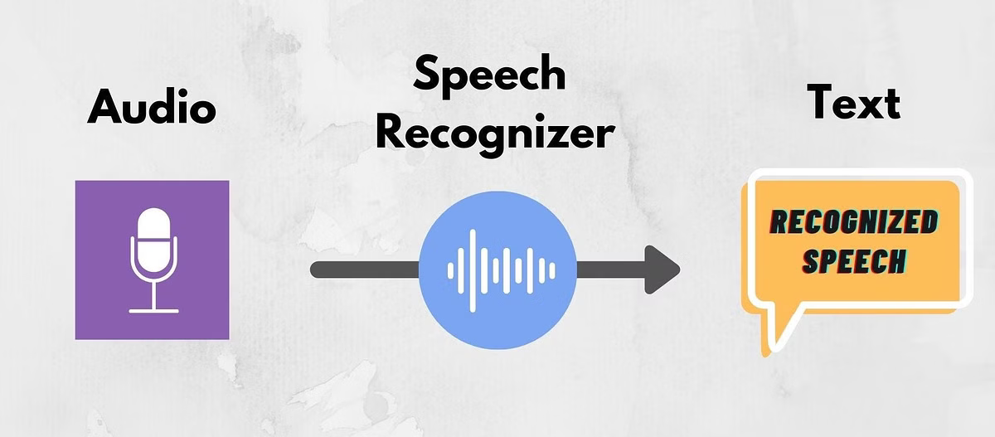
Telugu Automatic Speech Recognition:
→ ASR is a technology and it’s converts spoken language into text
→ ASR uses complex algorithms and Machine Learning to Process Audio signals ,it’s interaction b/w the human and machines , to enable voice controlling
→ ASR helps those with disabilities by enabling speech- to-text, making technology more inclusive and user- friendly.

Slide 4

Hugging Face:
→ Hugging Face makes advanced ASR (Automatic Speech Recognition) technology accessible to everyone by offering open-source models like Wav2Vec2, which are easy to use and help convert speech to text with high accuracy.
→ They support multiple languages, including those with fewer resources, making speech recognition technology more inclusive and available to a global audience.

Slide 5
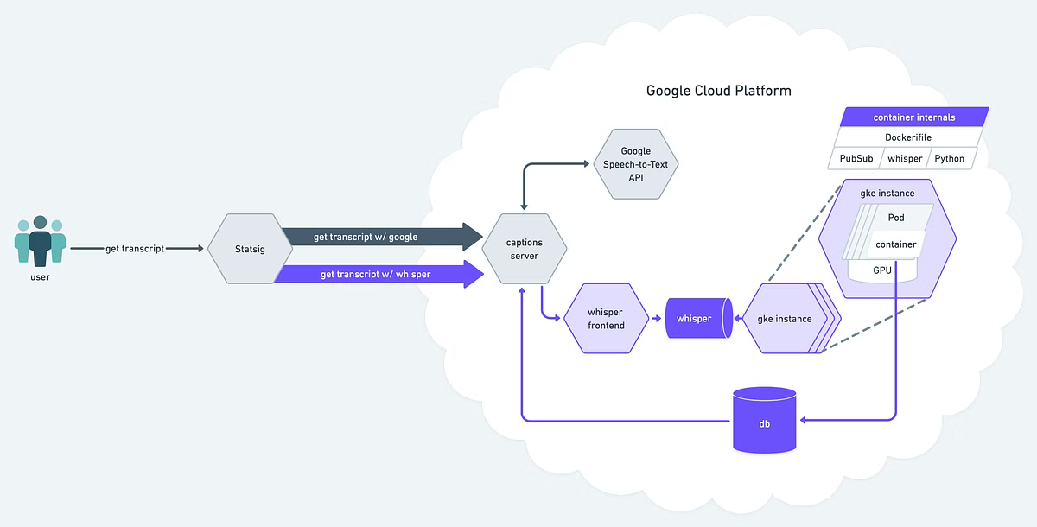
Whisper Models for Speech to Text:
Multilingual Support:
Whisper models can recognize speech in over 100 languages, including Telugu.
Flexible Deployment:
Whisper models can be fine-tuned and deployed on a variety of hardware platforms.
Open-Source:
Whisper models are freely available and can be customized for specific use cases.

Slide 6
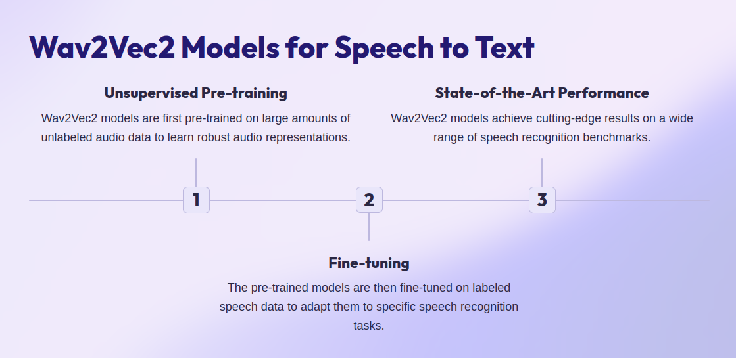

Slide 7
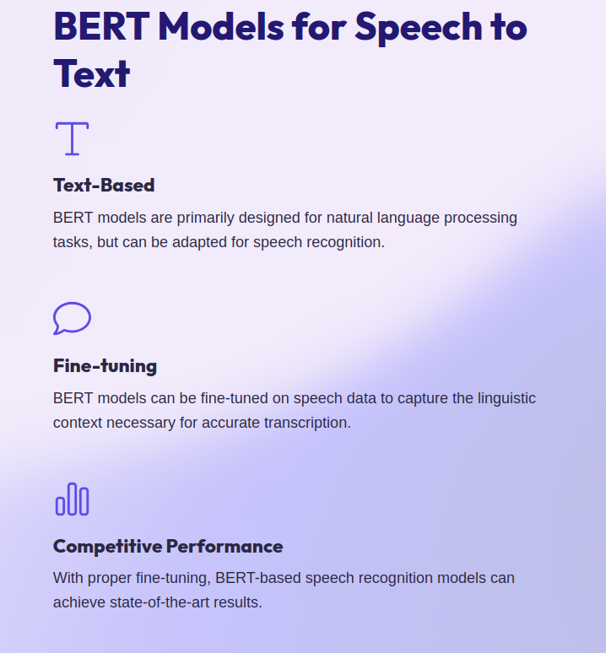
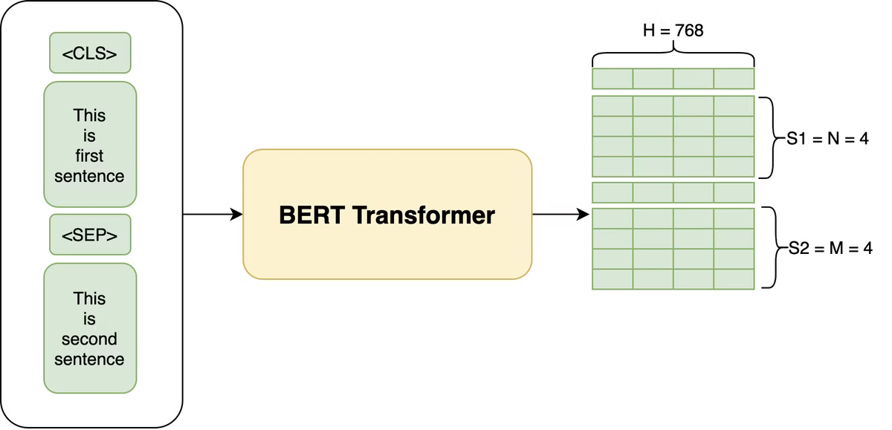

Slide 8
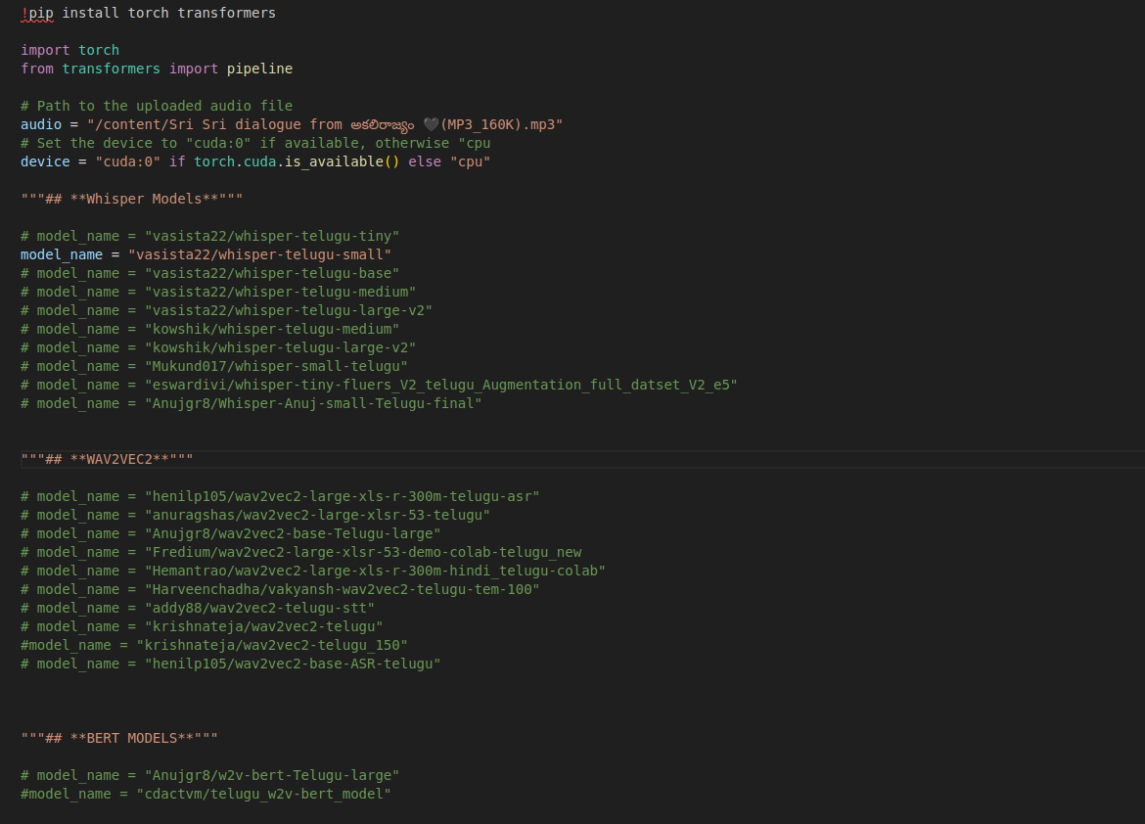
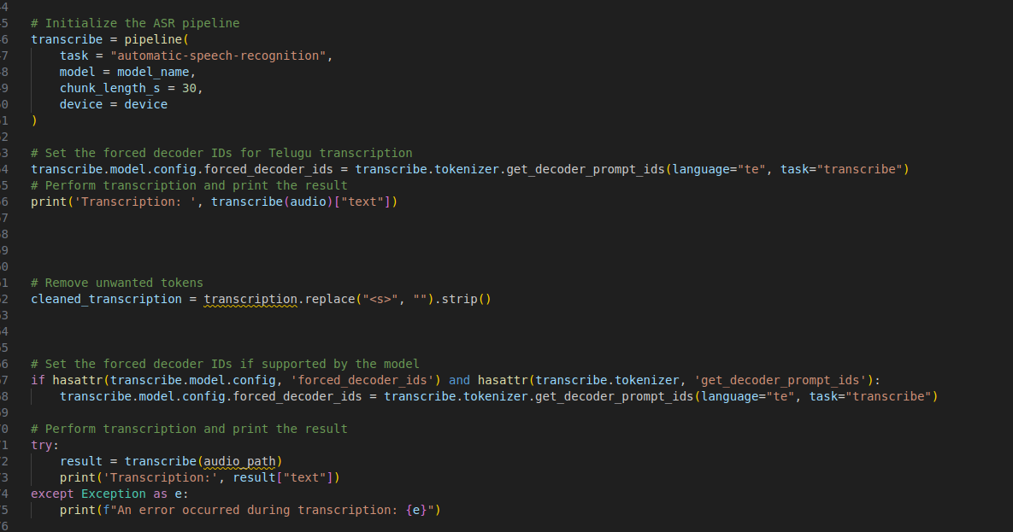
Code For Models:
Transcription -
భారత దేశంలో అత్యధికంగా మాట్లాడే భాషలలు తెలుగు ఒకటిఇది భారత దేశంలోని దక్షిణ ప్రాంతాలలో ఎక్కువగా మాట్లడబడుతుందితెలుగు సాహిత్యానికి గొక్ప చరిత్ర ఉంది మరియు సాంస్కృతిక సమాచారంతూ నిండి ఉంది

Slide 9
Doclink:-
https://docs.google.com/spreadsheets/d/1qVogJ97i_tJBMMlo3R2ciMrDjCPRiVc1bIJX6ligKyk/edit?pli=1&gid=833119231#gid=833119231

Slide 10
THANK YOU

