Slide 1


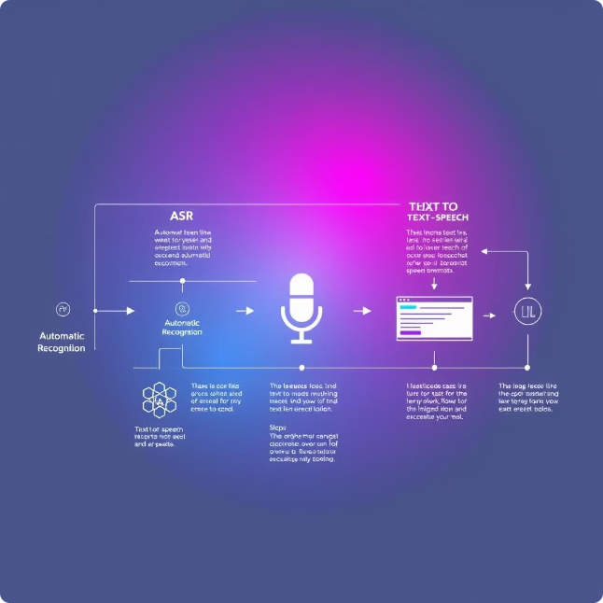
ASR2TTS
ASR2TTS stands for Automatic Speech Recognition to Text-to-Speech.

Slide 2
Table of Contents
1
Introduction
2
Workflow Explanation
3
ASR and TTS Overview
Overview of ASR2TTS project.
Step-by-step guide of the project's process.
In-depth discussion of ASR and TTS technologies.
4
ASR Process Explained
5
LLM Process Explained
6
Telugu to English Translation
Details on how ASR converts speech to text.
Understanding the role of large language models.
Demonstration of language translation capabilities.
7
TTS Process Explained
Explanation of how TTS synthesizes speech from text.

Slide 3
Workflow Explanation
Speech Input
1
The process begins with the user providing audio input.
2
Automatic Speech Recognition (ASR)
ASR converts the audio into text.
Large Language Model (LLM)
3
The LLM processes the text, performing tasks like translation.
4
Text-to-Speech (TTS)
TTS synthesizes speech from the processed text.
Speech Output
5
The final output is spoken language, based on the original input.

Slide 4
ASR and TTS Overview
Automatic Speech Recognition (ASR)
Text-to-Speech (TTS)
ASR is a technology that converts spoken language into text. It uses algorithms to analyze audio signals and identify words.
TTS is a technology that converts text into spoken language. It uses algorithms to create synthetic speech that sounds natural.

Slide 5





ASR Process Explained
Audio Input
The process begins with capturing audio input.
Signal Processing
The audio is then converted into a digital signal.
Acoustic Modeling
Acoustic models identify sounds and phonemes in the signal.
Language Modeling
Language models predict the most likely words based on context.
Text Output
The final output is a text representation of the spoken language.

Slide 6

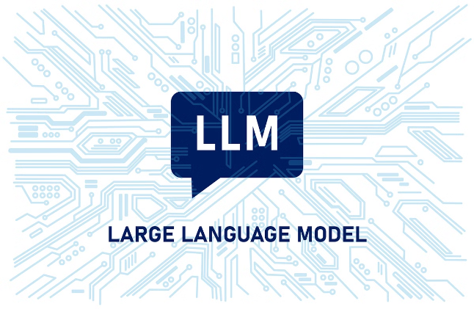
LLM Process Explained
Input Processing
Language Understanding
The LLM receives the text output from ASR.
The LLM analyzes the text, understanding its meaning and context.
Task Execution
Output Generation
The LLM performs the desired task, such as translation or summarization.
The LLM produces a modified text output for the TTS.

Slide 7
Telugu to English Translation
Telugu
English
నీకు నేను ఎలా సహాయపడగలను?
How can I help you?
నేను మీకు సహాయం చేయడానికి ఇక్కడ ఉన్నాను.
I am here to assist you.
ధన్యవాదాలు, మీ సహాయానికి.
Thank you for your help.

Slide 8





TTS Process Explained
Text Input
Text-to-Speech Synthesis
Audio Synthesis
The TTS receives the processed text from the LLM.
These parameters are used to generate the final audio output.
TTS converts the text into a series of speech parameters.

Slide 9
THANK YOU

