Slide 1
RV College of Engineering®
(Autonomous Institution affiliated to VTU, Belgavi)
Comparative Analysis of various Direction Of Arrival Estimation Algorithms
Minor Project Presentation
Abhilash R Namboodiri 1RV16EC004
Abhishek P 1RV16EC009
Under the guidance of
Dr. Shushrutha K.S.
Associate Professor
Department of Electronics and Communication
RV College of Engineering

Slide 2
Presentation Outline
Introduction
Literature Survey
Problem Statement
Motivation
DOA Algorithms
Beamforming Algorithms
Details of Software Used
Results
Conclusion
References

Slide 3
Introduction
Array processing deals with techniques for the analysis and processing of signals collected by a group of sensors.
The collection of sensors makes up the array, and the manner in which the signals from the sensors are combined and handled constitutes the processing.
The type of processing is dictated by the needs of the particular application.
Array processing has found widespread application in a large number of areas, including radar, sonar, communications, seismology, geophysical prospecting for oil and natural gas, diagnostic ultrasound, and multichannel audio systems.

Slide 4
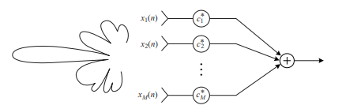
Beamforming
Generally, an array receives spatially propagating signals and processes them to emphasize signals arriving from a certain direction; that is, it acts as a spatially discriminating filter.
This spatial filtering operation is known as beamforming, because essentially it emulates the function of a mechanically steered antenna.
An array processor steers a beam to a particular direction by computing a properly weighted sum of the individual sensor signals.

Slide 5
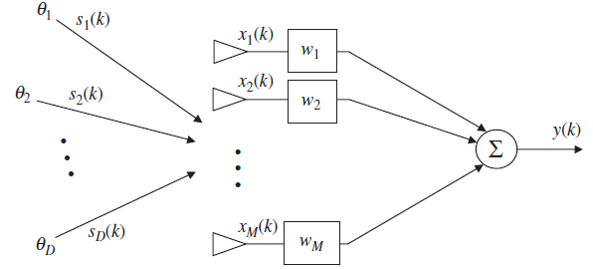
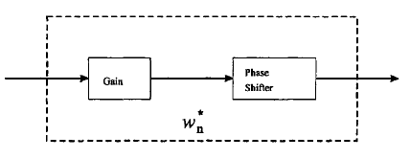

Slide 6
Literature Survey
Ref No. | Paper Title | Journal / Conference | Major Observations
1. | Smoothing Periodograms from Time Series with Continuous Spectra | Nature, 161:686- 87, 1948 | Description of Bartlett’s method for spectral estimation
2. | High-resolution frequency-wavenumber spectrum analysis | Proceedings of the IEEE, vol. 57, no. 8, pp. 1408–1418, 1969 | MVDR Beamformer for conventional beamforming and DOA estimation
3 | ESPRIT-Estimation of Signal Parameters via Rotational Invariance Techniques | IEEE Trans on Acoustics Speech and Signal Processing. July 1989. Vol. 37. No.7 pp 984~995. | An algorithm which exploits the rotational invariance of signal subspace induced by sensor array

Slide 7
Literature Survey
Ref No. | Paper Title | Journal / Conference | Major Observations
4. | Multiple Emitter Location and signal Parameter Estimation | IEEE Trans. On Antennas and Propagation, March 1986. Vol. 34. No. 3. pp 276-280. | Introduction and description of MUSIC algorithm for DOA
5. | Two decades of array signal processing research: The parametric approach | IEEE Signal Processing Magazine, vol. 13, no. 4, pp. 67–94, Jul. 1996. | Brief Overview of Current trends in Array Signal Processing

Slide 8
Problem Statement
Performance Analysis of various Direction Of Arrival algorithms :
Bartlett’s Method
MVDR
MUSIC
ESPRIT
Simulation of beamforming using conventional and adaptive algorithms

Slide 9
Motivation
DOA estimation is a key research area with various engineering applications, such as wireless communications, radar, tracking of various objects, earthquake, medicine etc.
Positioning and Location-Awareness are key objectives in networks of the future
One way to accomplish this is via array signal processing with algorithms which estimate the direction-of-arrival (DOA) of the received waves from various sources.

Slide 10
Objectives
Study and analysis of various DOA algorithms using MATLAB
(Specifically Bartlett, MVDR, MUSIC, ESPRIT for linear arrays)
Study and simulation of planar arrays and DOA using MVDR and MUSIC algorithm.
Study and simulation of beamformers using conventional and adaptive algorithms
(Specifically conventional, optimal MVDR, SMI)

Slide 11
Methodology
1
Simulation of various DOA algorithms on MATLAB
2
Performance analysis of algorithms on MATLAB based on parameters like SNR, No. of Snapshots and Resolution.
3
Simulating Adaptive Beamformers based on conventional, optimal and adaptive algorithms
4
5
Extending linear array to a planar array and implementing planar MVDR and planar MUSIC
Modifying the standard MUSIC for improved resolution and source coherence issue

Slide 12
DOA Algorithms
DOA Algorithms
Conventional
Subspace
Bartlett
MVDR
MUSIC
ESPRIT
Direct method

Slide 13
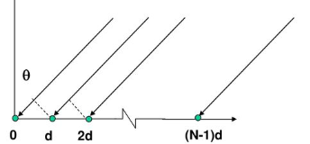
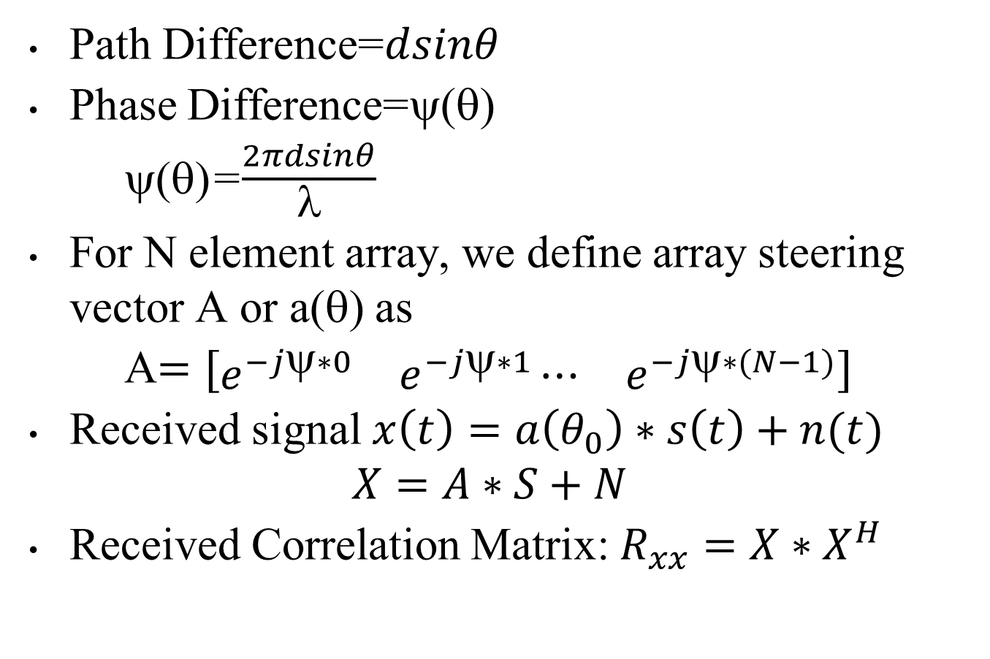
Array Signal Model
Path Difference=$dsinθ$
Phase Difference=ψ(θ)
ψ(θ)=$\frac{2πdsinθ}{λ}$
For N element array, we define array steering vector A or a(θ) as
A$=[\begin{matrix}e^{−jψ∗0} & e^{−jψ∗1}⋯ & e^{−jψ∗(N−1)}\end{matrix}]$
Received signal $x\left(t\right)=a\left(θ_{0}\right)∗s\left(t\right)+n(t)$
$$X=A∗S+N$$
Received Correlation Matrix: $R_{xx}=X∗X^{H}$

Slide 14
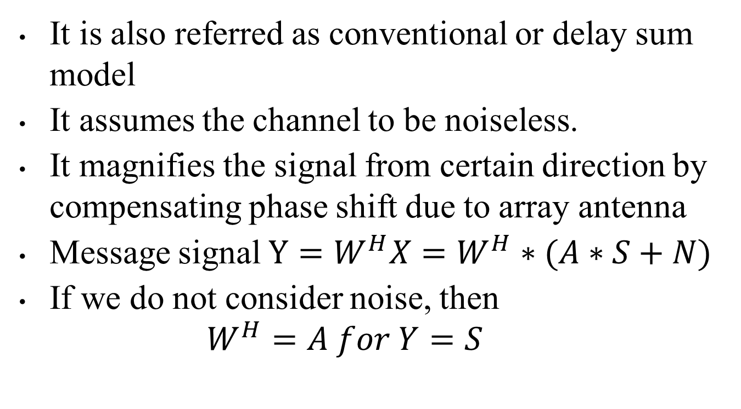
Bartlett’s Algorithm
It is also referred as conventional or delay sum model
It assumes the channel to be noiseless.
It magnifies the signal from certain direction by compensating phase shift due to array antenna
Message signal $Y=W^{H}X=W^{H}∗(A∗S+N)$
If we do not consider noise, then
$$W^{H}=A for Y=S$$

Slide 15
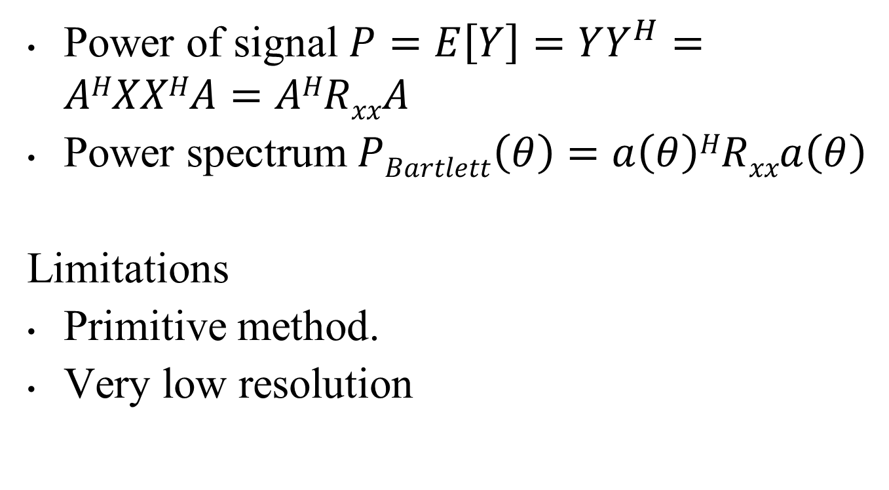
Power of signal $P=E\left[Y\right]=YY^{H}=AHXXHA=AHRxxA$
Power spectrum $PBartlett\left(θ\right)=a\left(θ\right)HRxxa\left(θ\right)$
Limitations
Primitive method.
Very low resolution

Slide 16

Receiver
Spectral Estimation
Plotting Power Spectrum
Transmitter
Channel
A*S(t)
A*S(t) + N
Y = W^{H} *(A*S(t) + N)
Where W^{H} =A
E(Y)
$$PBartlett\left(θ\right)=a\left(θ\right)HRxxa\left(θ\right)$$

Slide 17
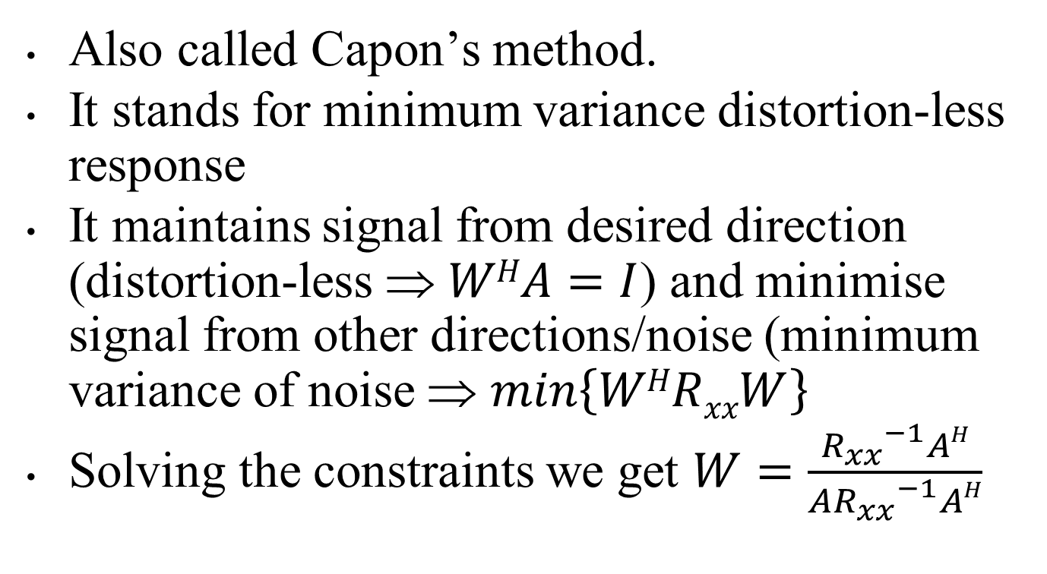
MVDR
Also called Capon’s method.
It stands for minimum variance distortion-less response
It maintains signal from desired direction (distortion-less ⇒ $WHA=I$) and minimise signal from other directions/noise (minimum variance of noise ⇒ $min\left\{WHRxxW\right\}$
Solving the constraints we get $W=\frac{{R_{xx}}^{−1}AH}{A{R_{xx}}^{−1}AH}$

Slide 18
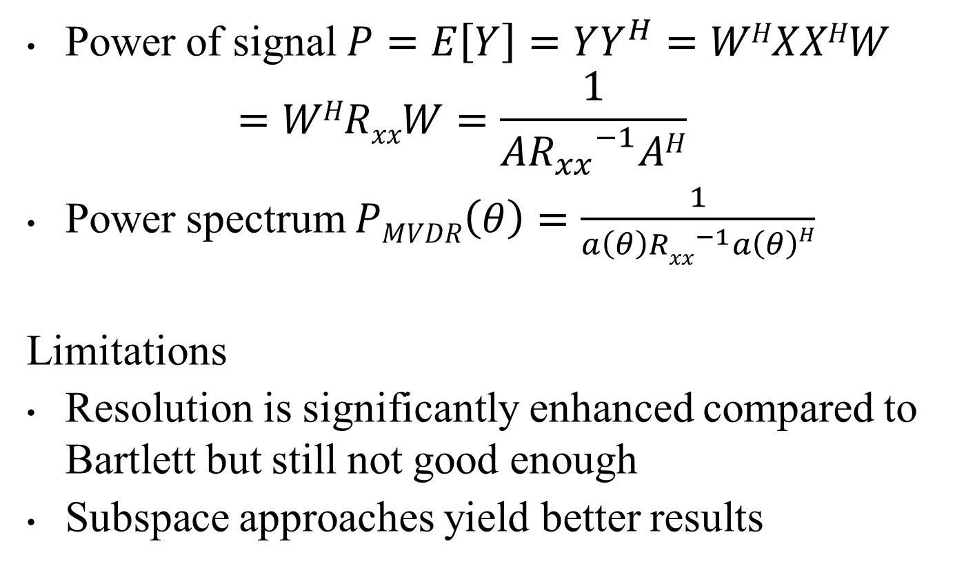
Power of signal $P=E\left[Y\right]=YY^{H}=WHXXHW$
$$=WHRxxW=\frac{1}{A{R_{xx}}^{−1}AH}$$
Power spectrum $PMVDR\left(θ\right)=\frac{1}{a\left(θ\right){Rxx}^{−1}a\left(θ\right)H}$
Limitations
Resolution is significantly enhanced compared to Bartlett but still not good enough
Subspace approaches yield better results

Slide 19


Receiver
Spectral Estimation
Plotting Power Spectrum
Transmitter
Channel
A*S(t)
A*S(t) + N
Y = W^{H} *(A*S(t) + N)
where,
$$W=\frac{{R_{xx}}^{−1}AH}{A{R_{xx}}^{−1}AH}$$
E(Y)
$$PMVDR\left(θ\right)=\frac{1}{a\left(θ\right){Rxx}^{−1}a\left(θ\right)H}$$

Slide 20
MUSIC
MUSIC stands for Multiple Signal Classification.
MUSIC was proposed by R.O.Schmidt.
MUSIC conducts characteristic decomposition for the covariance matrix of any array output data, resulting in both signal subspace and noise subspace.
MUSIC detects DOA by a spectral peak search of these subspaces

Slide 21
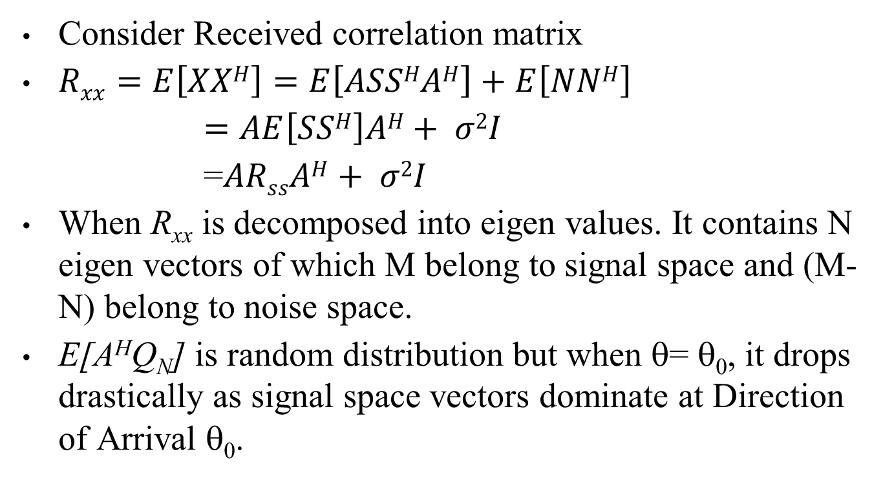
Consider Received correlation matrix
$Rxx=E\left[XXH\right]=E\left[ASSHAH\right]+E\left[NNH\right]$
$=AE\left[SSH\right]AH+ σ2I$
=$ARssAH+ σ2I$
When R_{xx} is decomposed into eigen values. It contains N eigen vectors of which M belong to signal space and (M-N) belong to noise space.
E[A^{H}Q_{N}] is random distribution but when θ= θ₀, it drops drastically as signal space vectors dominate at Direction of Arrival θ₀.

Slide 22
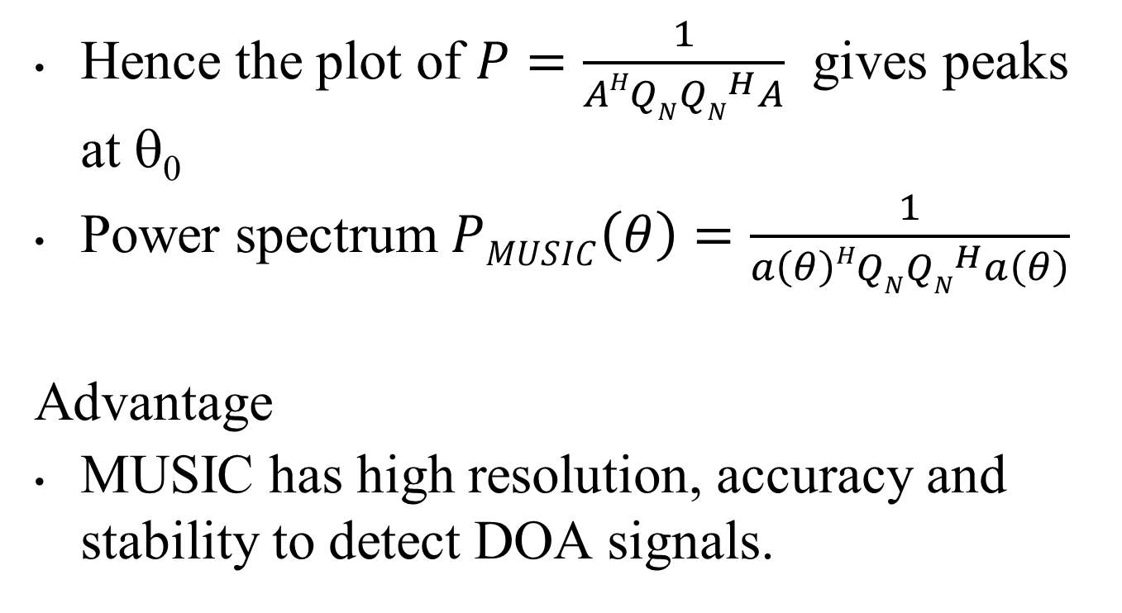
Hence the plot of $P=\frac{1}{AHQN{QN}^{H}A}$ gives peaks at θ₀
Power spectrum $PMUSIC\left(θ\right)=\frac{1}{a\left(θ\right)HQN{QN}^{H}a\left(θ\right)}$
Advantage
MUSIC has high resolution, accuracy and stability to detect DOA signals.

Slide 23

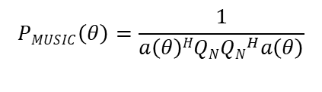
Receiver
Find Noise subspace of R_{xx}
Plotting Power Spectrum
Transmitter
Channel
A*S(t)
A*S(t) + N
R_{xx} $= ARssAH+ σ2I$
E[A^{H}Q_{N}]
$$PMUSIC\left(θ\right)=\frac{1}{a\left(θ\right)HQN{QN}^{H}a\left(θ\right)}$$

Slide 24
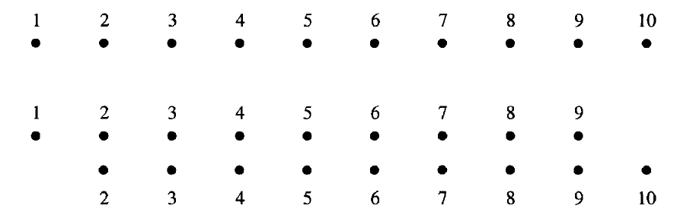
ESPRIT
It stands for Estimation of Signal Parameters via Rotational Invariance Techniques
We assume by rotational invariance property of ULA that array is composed of 2 sub arrays with array manifold vectors A₁ & A₂

Slide 25
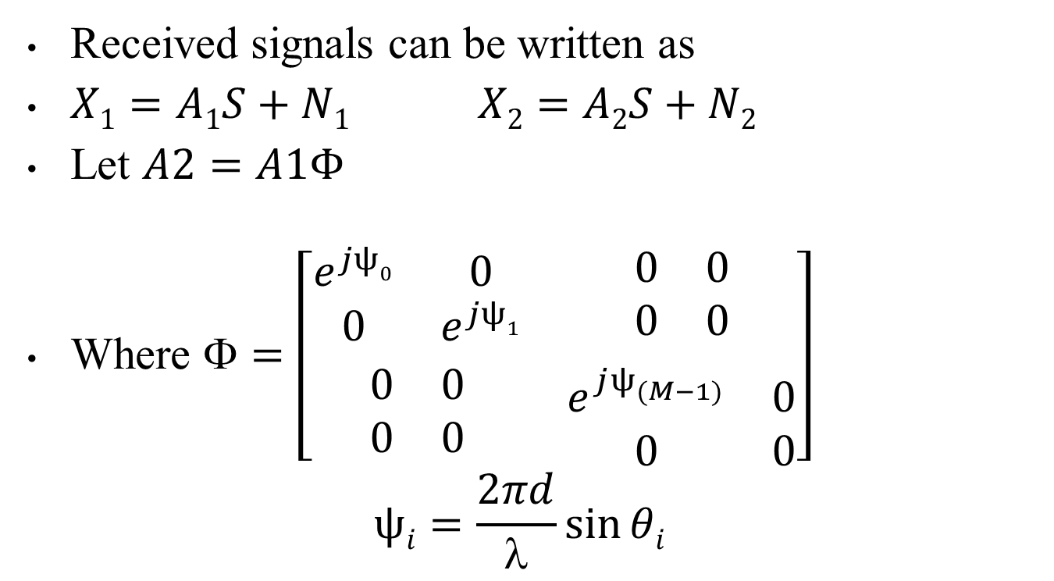
Received signals can be written as
$X1=A1S+N1 X2=A2S+N2$
Let $A2=A1Φ$
Where $=\left[\begin{matrix}\begin{matrix}e^{jψ0} & 0 \\ 0 & e^{jψ1}\end{matrix} & \begin{matrix}0 & 0 \\ 0 & 0\end{matrix} \\ \begin{matrix}0 & 0 \\ 0 & 0\end{matrix} & \begin{matrix}e^{jψ_{(M−1)}^{}} & 0 \\ 0 & 0\end{matrix}\end{matrix}\right]$
$$ψi=\frac{2πd}{λ}\sin{θi}$$

Slide 26
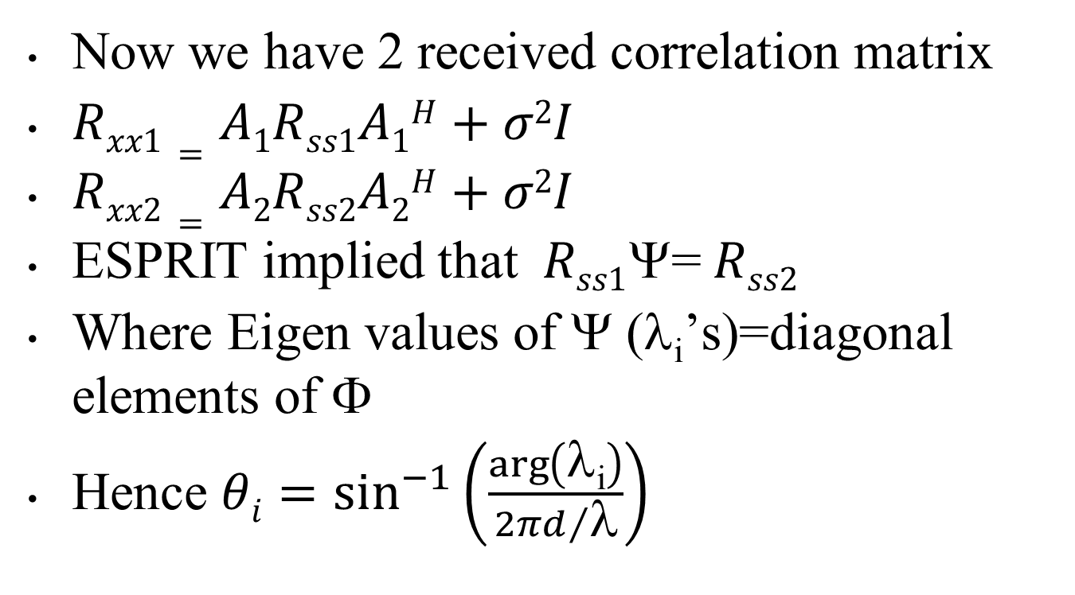
Now we have 2 received correlation matrix
$Rxx1=A1Rss1A1H+σ2I$
$Rxx2=A2Rss2A2H+σ2I$
ESPRIT implied that$Rss1$Ψ= $Rss2$
Where Eigen values of Ψ (λ_{i}’s)=diagonal elements of $$
Hence $θi=\sin^{−1}\left(\frac{\arg\left(\text{λ}\text{i}\right)}{{2πd}/{\text{λ}}}\right)$

Slide 27
Beamformers
Beamformers
Conventional
Optimal-MVDR
Adaptive - SMI

Slide 28
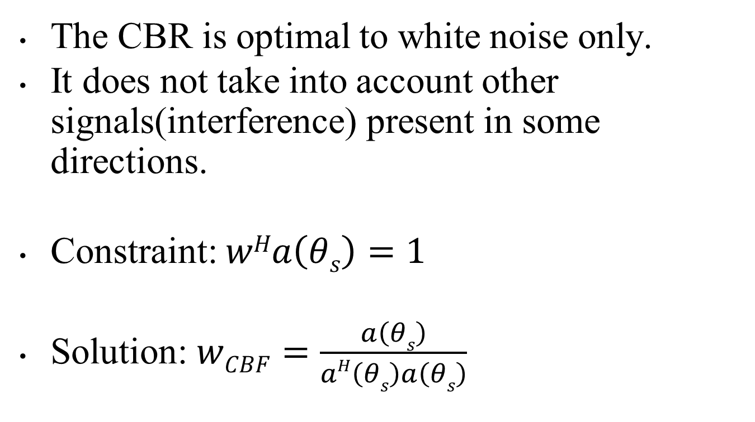
Conventional Beamformer (CBR)
The CBR is optimal to white noise only.
It does not take into account other signals(interference) present in some directions.
Constraint: $wHa\left(θs\right)=1$
Solution: $wCBF=\frac{a\left(θs\right)}{aH\left(θs\right)a\left(θs\right)}$

Slide 29
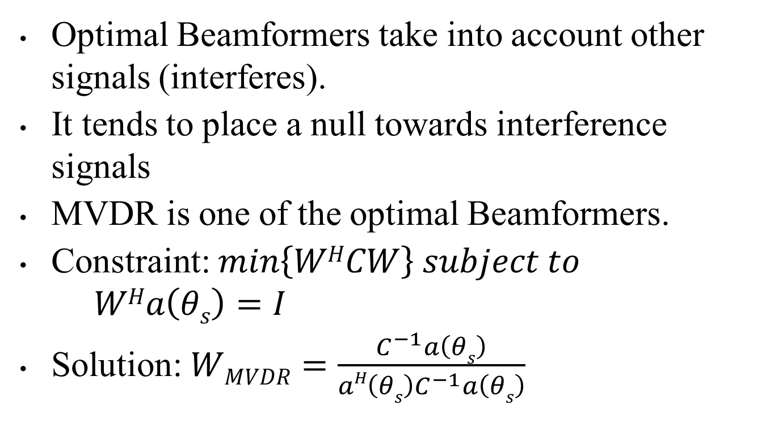
Optimal MVDR
Optimal Beamformers take into account other signals (interferes).
It tends to place a null towards interference signals
MVDR is one of the optimal Beamformers.
Constraint: $min\left\{WHCW\right\} subject to$ $WHa\left(θs\right)=I$
Solution: $WMVDR=\frac{C^{−1}a\left(θs\right)}{aH\left(θs\right)C^{−1}a\left(θs\right)}$

Slide 30
Adaptive SMI
Adaptive beamformer is improvisation of Optimal Beamformer.
Optimal beamformers consider the interference and channel characteristics as fixed statistics.
But in practice, this is not the case.
Hence we require Adaptive Beamformers which change their weights adaptively based on interference characteristics

Slide 31
Details of Software /Hardware
MATLAB

Slide 32
Results
I. Conducted Simulation of:
Bartlett
MVDR
MUSIC
Static Parameters:
Number of elements : 8
Snapshots : 200
SNR : 20db
Source : -40º 20º 60º

Slide 33
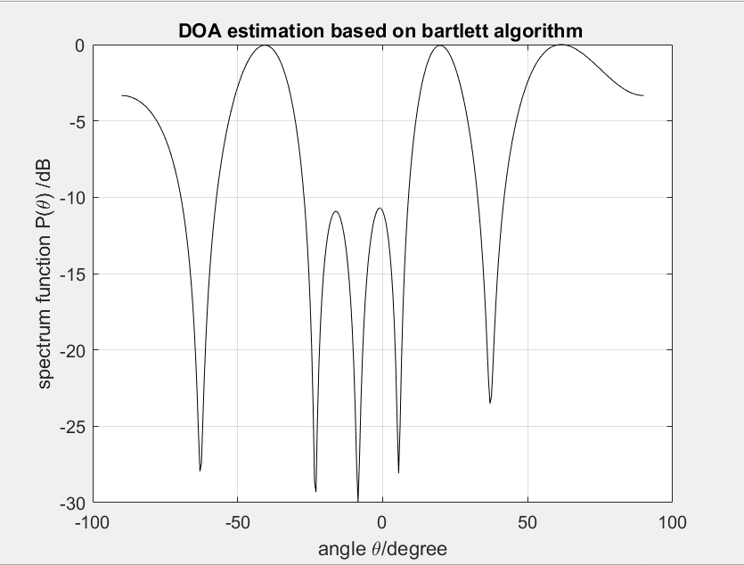
Bartlett’s Algorithm

Slide 34
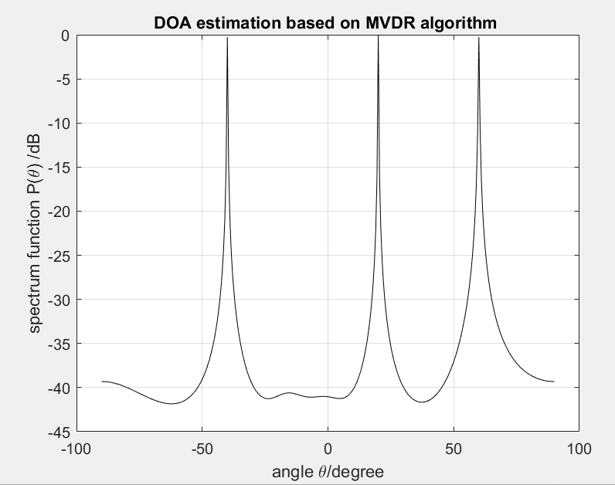
MVDR

Slide 35
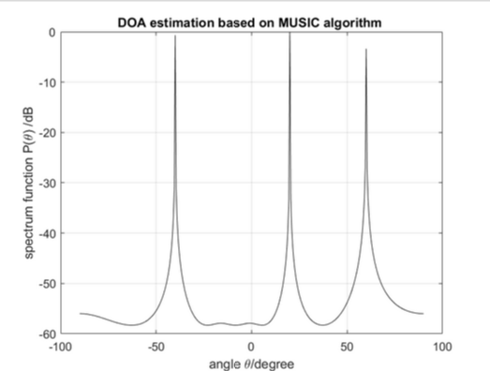
MUSIC

Slide 36
Results (cont)
II. Conducted performance analysis of:
Bartlett
MVDR
MUSIC
Following parameters were varied:
SNR
Resolution

Slide 37
Measurement of SNR
Static Parameters:
Number of elements : 8
Snapshots : 200
Source : -50º 0º 50º

Slide 38
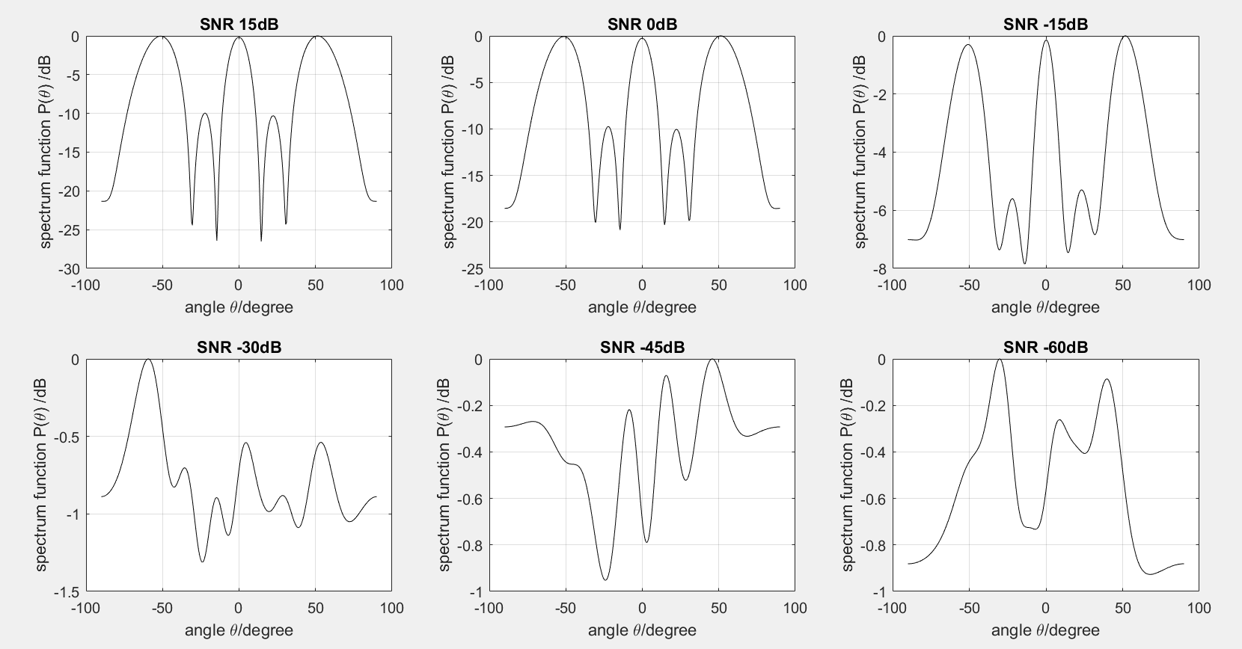
Bartlett’s Algorithm

Slide 39
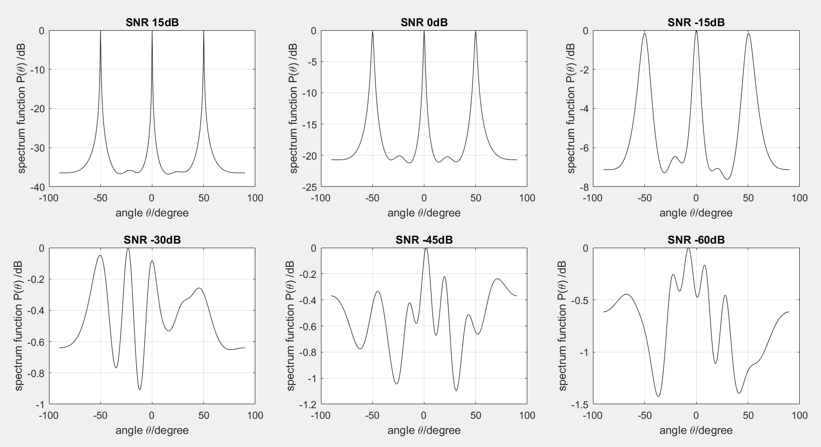
MVDR

Slide 40
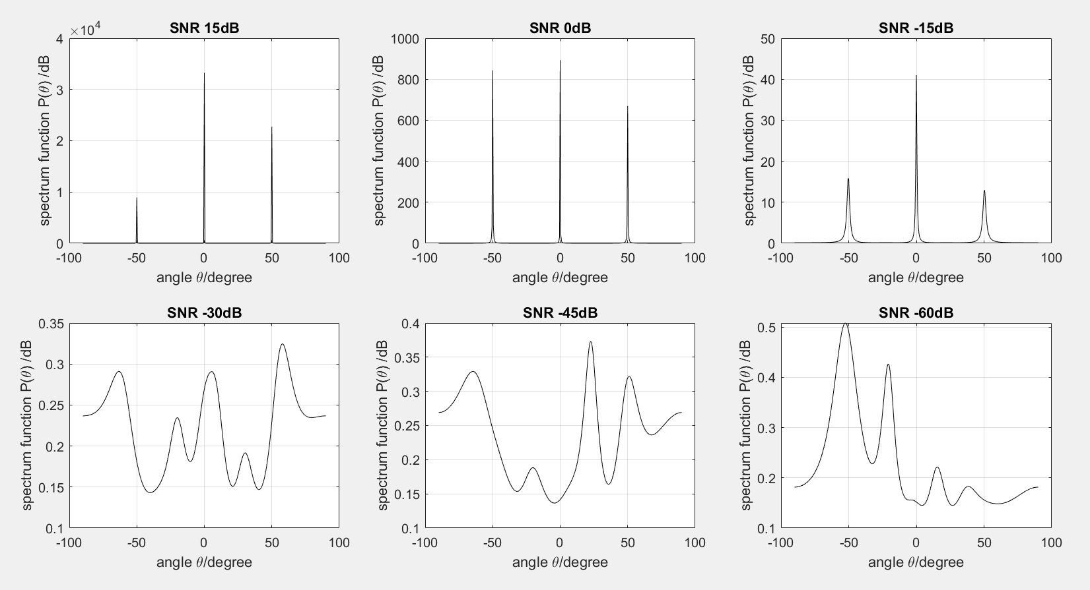
MUSIC

Slide 41
Measurement of Resolution
Static Parameters:
Number of elements : 8
Snapshots : 200
SNR : 0db

Slide 42
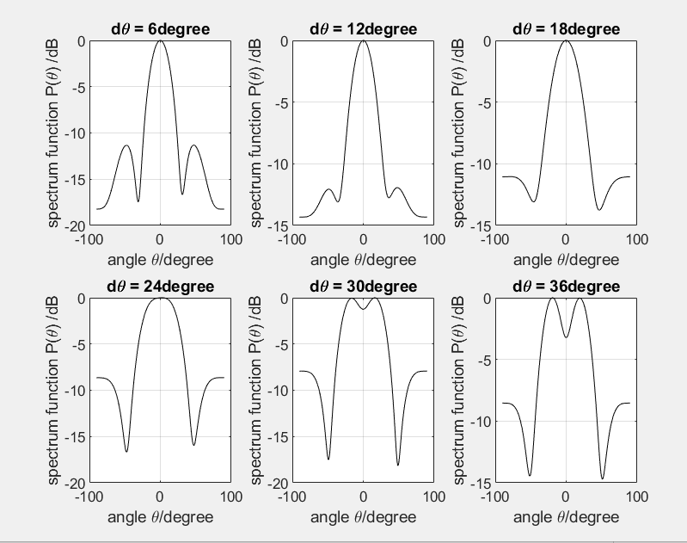
Bartlett’s Algorithm

Slide 43
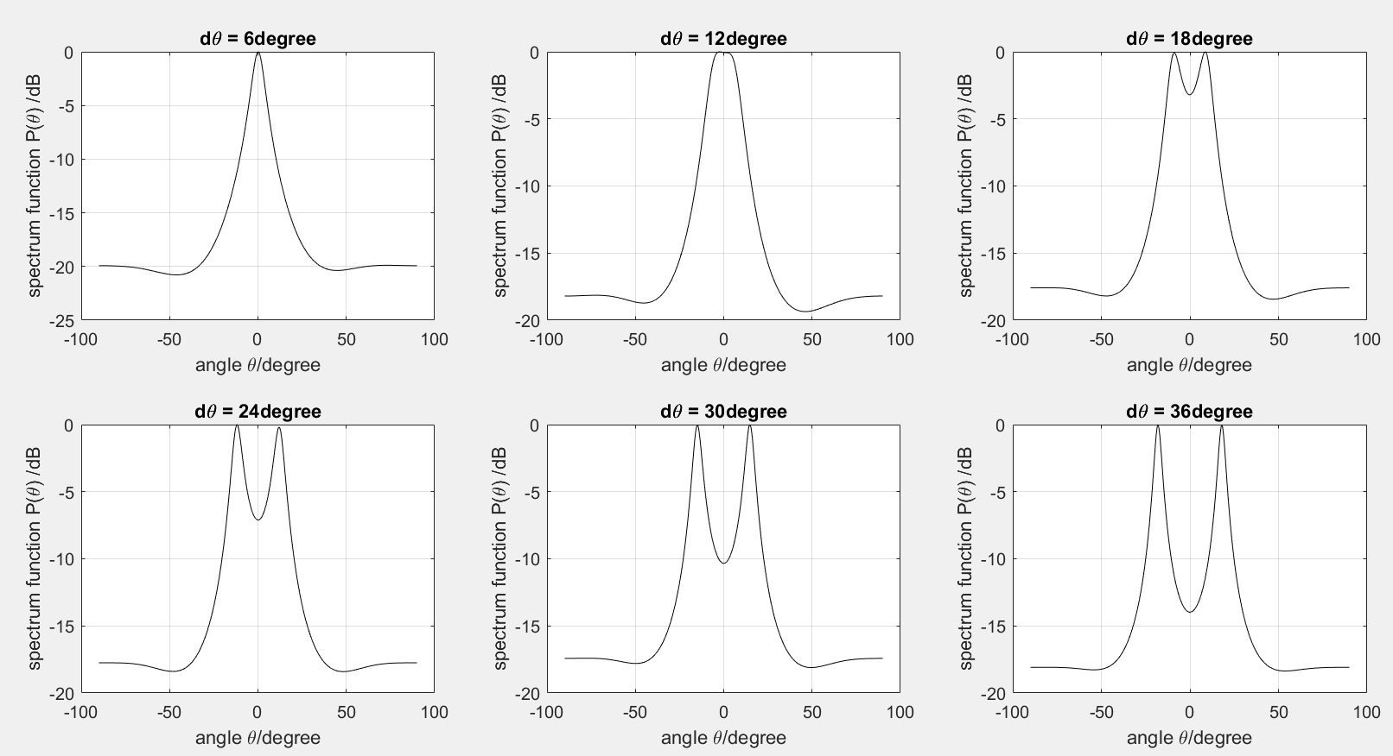
MVDR

Slide 44
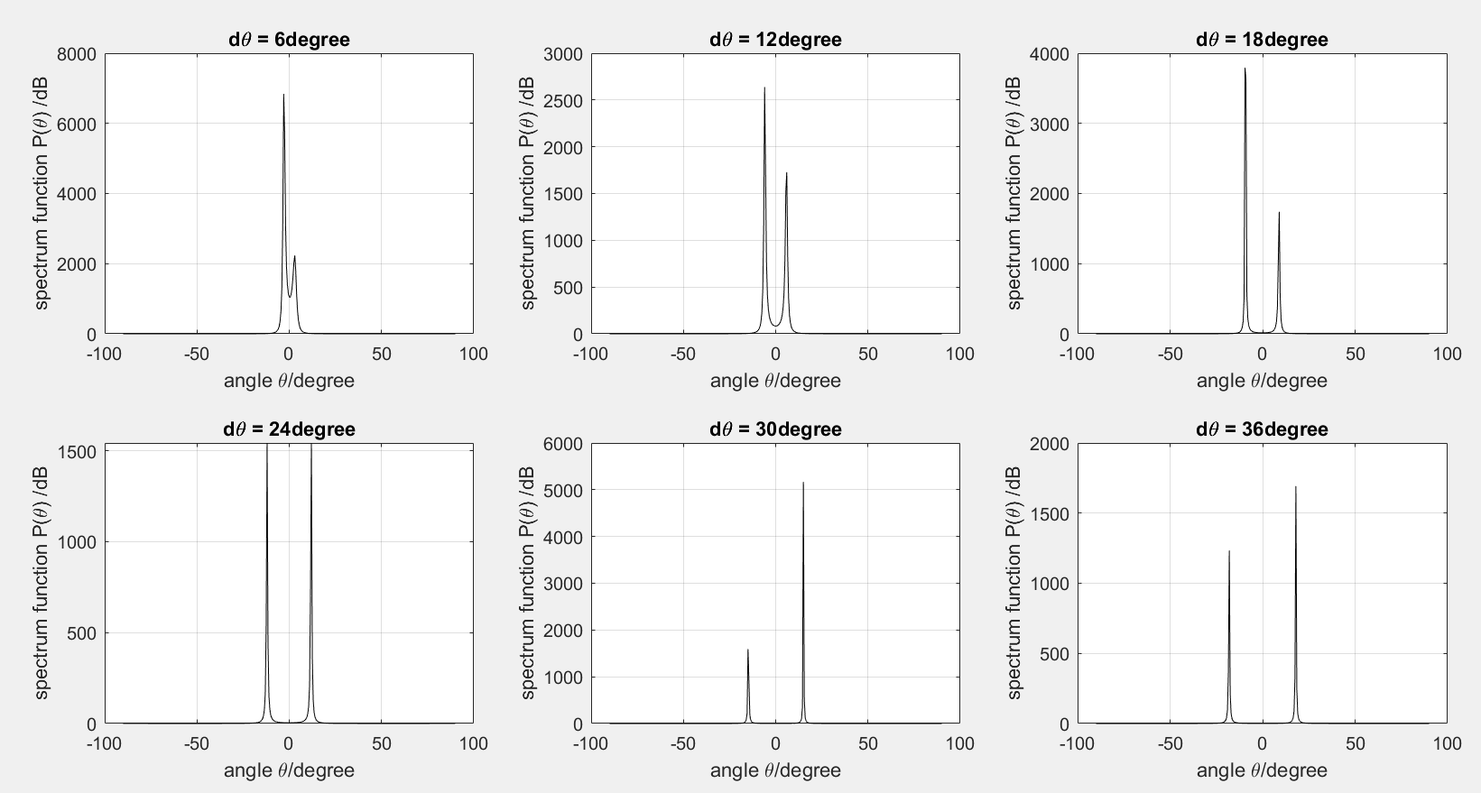
MUSIC

Slide 45
Comparison of Different Algorithm
Algorithm | SNR (Lowest distinguishable) | Resolution
Bartlett | -15dB | 24º
MVDR | -15dB (Higher Accuracy than Bartlett) | 18º
MUSIC | -30dB | 6º

Slide 46
Results (cont)
III. Conducted detailed performance analysis of:
MUSIC
Following parameters were varied:
SNR
Resolution
Number of Snapshots
Number of Array elements
Distance between array elements
Coherence

Slide 47
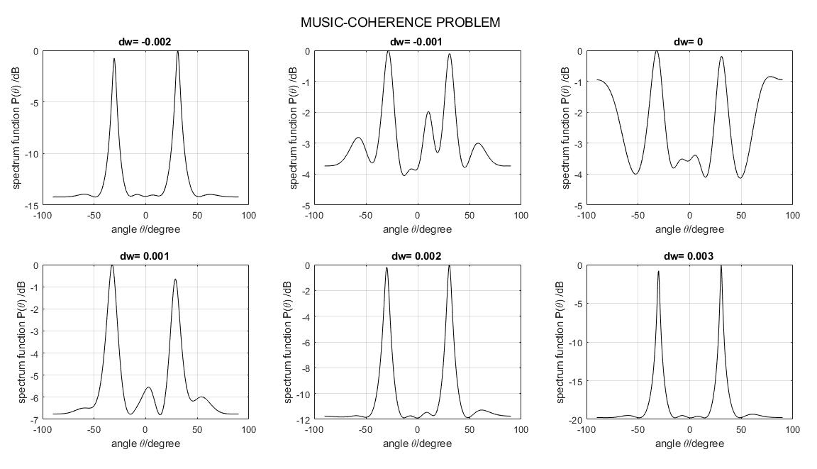
MUSIC – Coherence Problem

Slide 48
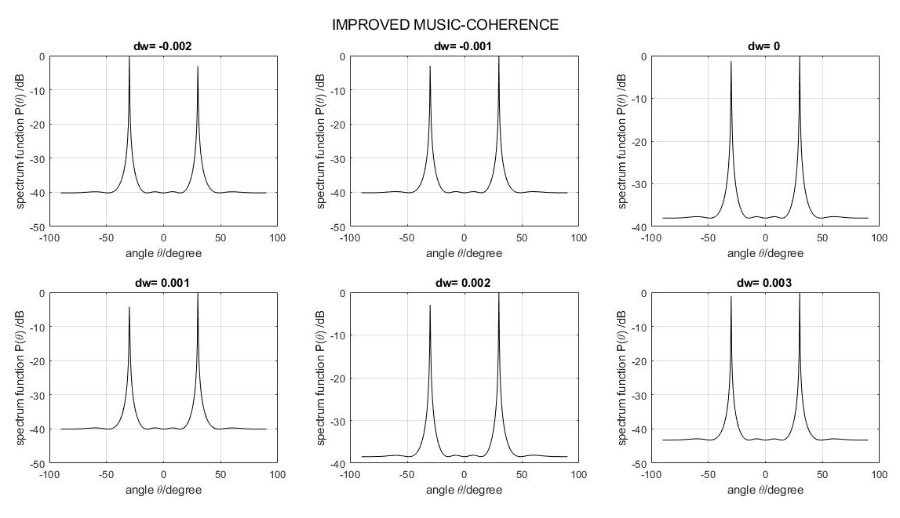
MODIFIED MUSIC – Coherence

Slide 49
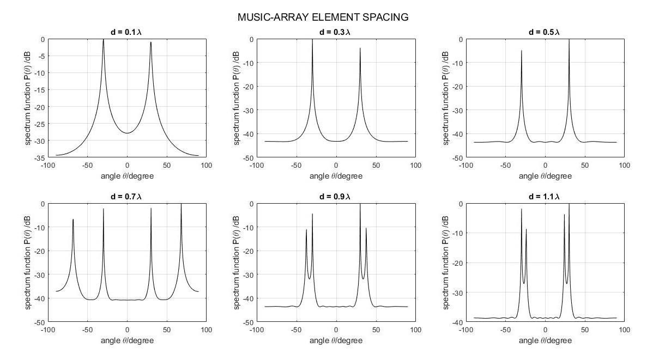
MUSIC – Array element spacing

Slide 50
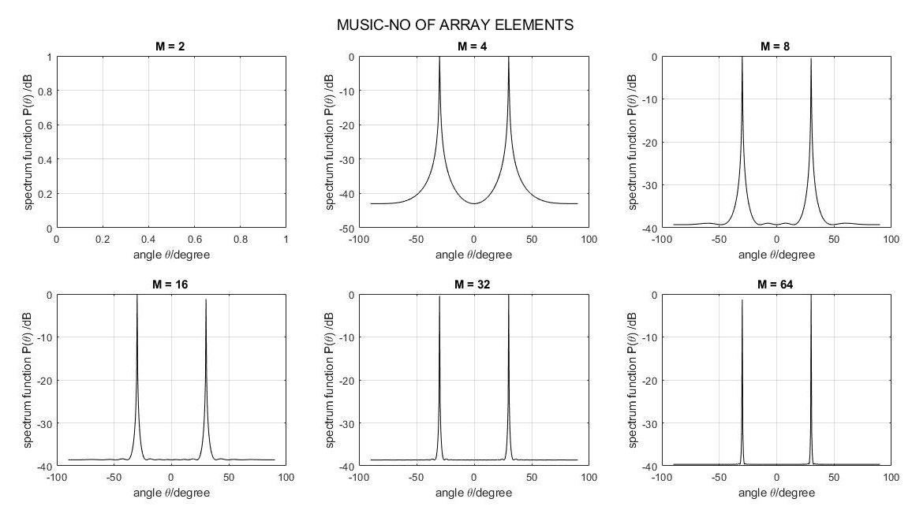
MUSIC – No of Array Elements

Slide 51
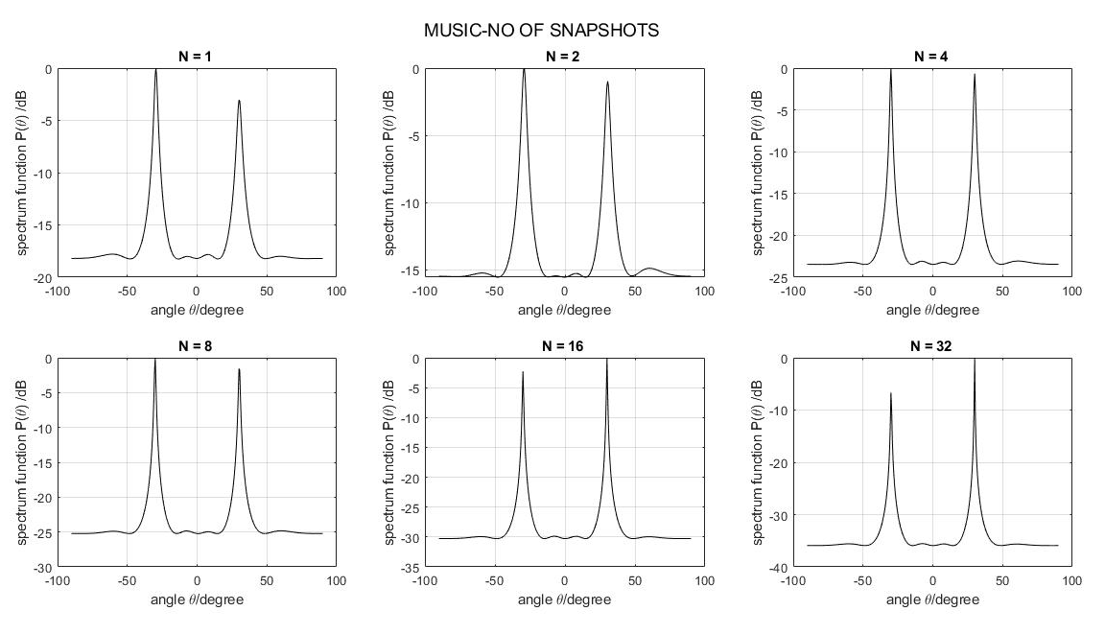
MUSIC – No of Snapshots

Slide 52
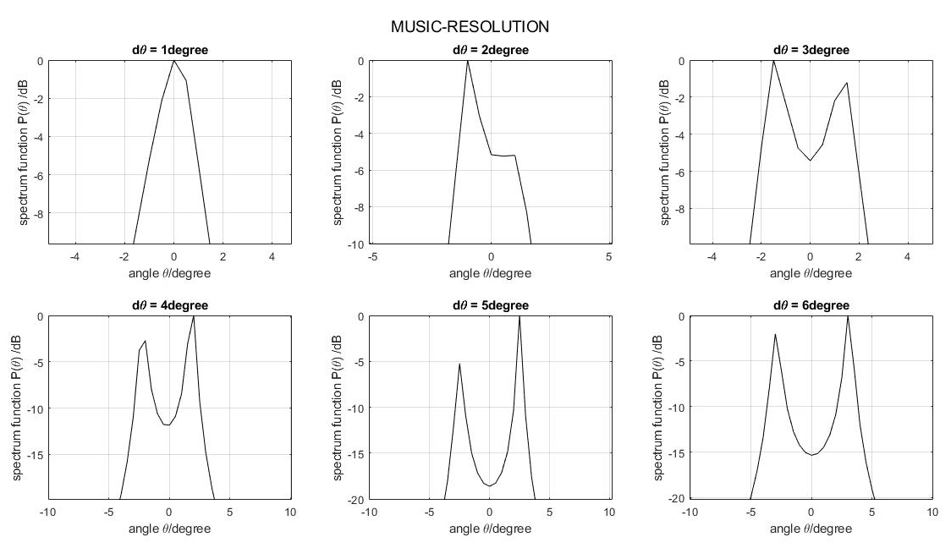
MUSIC – Resolution

Slide 53
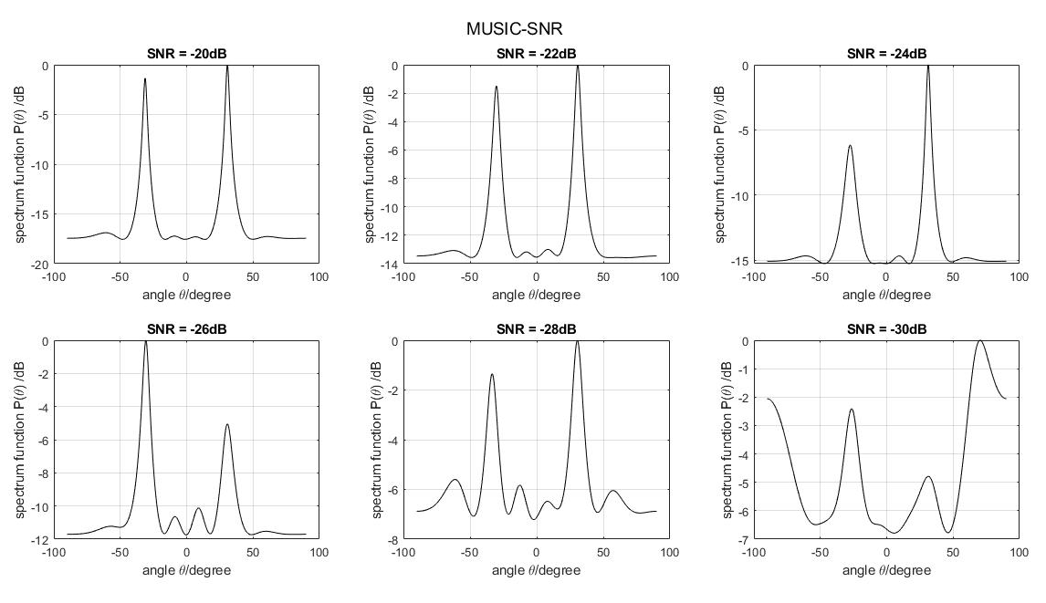
MUSIC – SNR

Slide 54
Results (cont)
III. Conducted performance analysis of:
ESPRIT
Following parameters were varied:
SNR
Number of Snapshots

Slide 55
SNR DOA angles
0 -30 45
-3 -30 45
-6 -30 45
-9 -30 46
-12 -29 45
-15 -28 45
-18 -29 47
-21 -34 41
Snapshots DOA angles
1 -34 46
2 -28 46
3 -30 44
4 -29 44
5 -31 44
6 -30 44
7 -30 43
8 -30 45
9 -30 45
10 -31 45

Slide 56
Results (cont)
IV. Simulation of planar DOA estimation algorithms:
Planar MVDR
Planar MUSIC
Static Parameters:
Number of elements : 8*8
Snapshots : 100
SNR : 0db

Slide 57
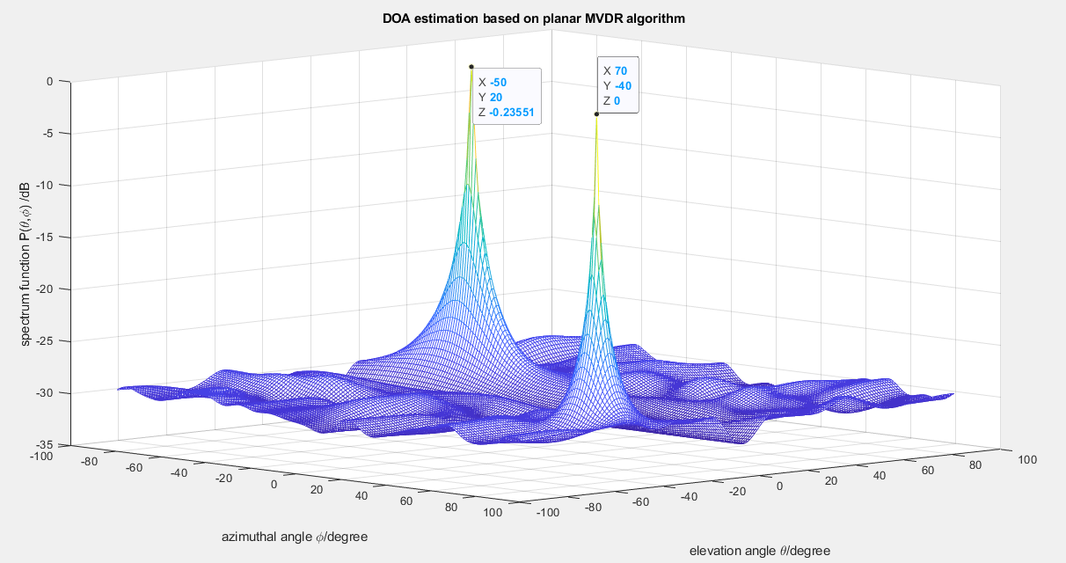
Planar MVDR

Slide 58
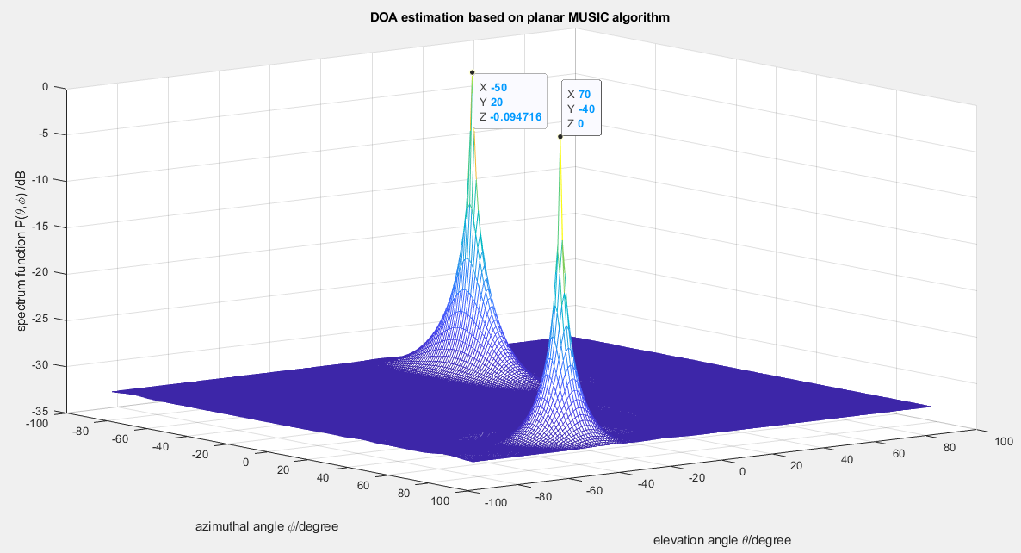
Planar MUSIC

Slide 59
Results (cont)
V. Simulation of following beamformers:
Conventional
Optimal MVDR
Adaptive SMI
Static Parameters:
Number of elements : 8
Signal Directions: -30⁰
Interfere Direction: 45⁰

Slide 60
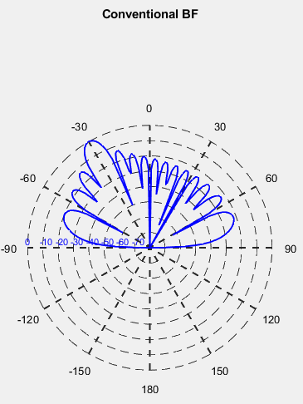
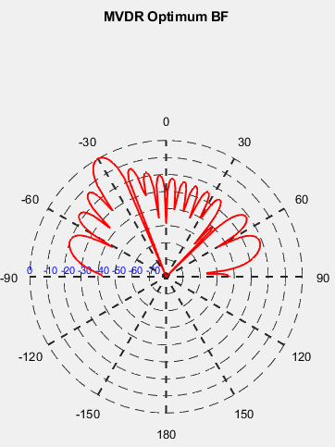
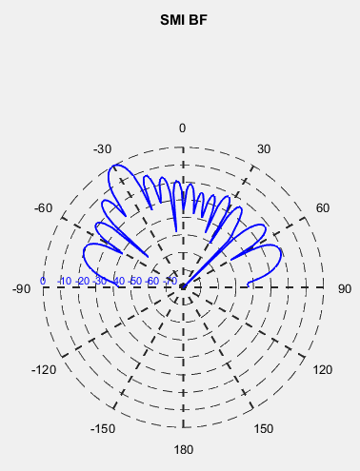
Beam patterns

Slide 61
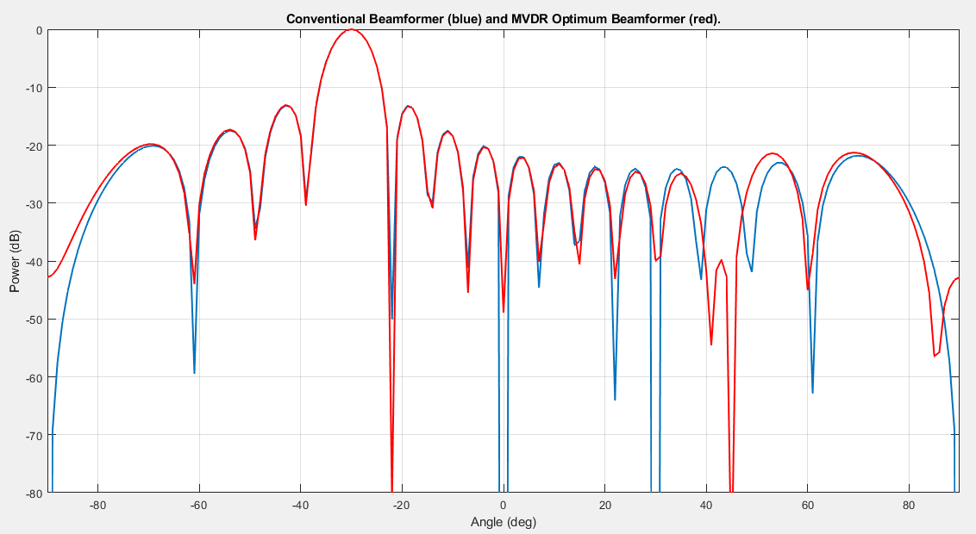

Slide 62
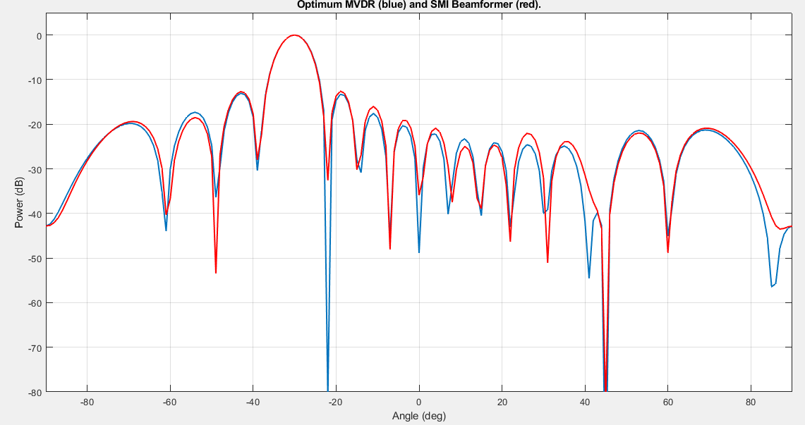

Slide 63
Future scope
Conclusion
Simulated and analysed various DOA algorithms using MATLAB for linear arrays.
Detailed study of MUSIC algorithm and modification of MUSIC was made to mitigate frequency coherence issue.
Extended linear array approach to planar array DOA and observed functionality only in one half of the azimuth plane.
Simulated beamformers: conventional, optimal (MVDR) and adaptive (SMI)

Slide 64
References
[1]Ralph O, Schmidt. Multiple Emitter Location and signal Parameter Estimation. IEEE Trans. On Antennas and Propagation, March 1986. Vol. 34. No. 3. pp 276-280.
[2]Perte Stoica, Maximum Likelihood Method for Direction of Arrival Estimation. IEEE Trans on ASSP. 1990. Vol. 38(7). P1132~1143.
[3]Richard Roy, Thonas Kailath. ESPRIT-Estimation of Signal Parameters via Rotational Invariance Techniques. IEEE Trans on Acoustics Speech and Signal Processing. July 1989. Vol. 37. No.7 pp 984~995.
[4]Honghao Tang, “DOA estimation based on MUSIC algorithm,”Institutionen För Fysik och Elektroteknik.
[5]Harry L. Van Trees, Optimum Array Processing, John Wiley & Sons, Inc., NY, 2002.
[6]Ronald D, Degrot. The Constrained MUSIC Problem. IEEE Trans on SP.1993. Vol. 41(3). P1445~1449.
[7]Harry B. Lee etc. Resolution Threshold Beamspace MUSIC for Two Closely Spaced Emitters. IEEE Trans on ASSP. 1990. Vol. 38(9). P723~738.
[8] Direction-of-Arrival Estimation Based on Deep Neural Networks With Robustness to Array Imperfections.
10-08-2019

Slide 65
[9] Burg, J.P., "The Relationship Between Maximum Entropy Spectra and Maximum Likelihood Spectra," Geophysics, Vol. 37, pp. 375-376, April 1972.
[10] H. G. Ong and R. I. Kitney, "Application of the Pisarenko harmonic decomposition method to physiological data," Journal of Biomedical Engineering, vol. 8, no. 4, pp. 313-319, Oct. 1986.
[11] R. A. Poisel, Target acquisition in communication electronic warfare systems (Artech house information warfare library). United States: Artech House Publishers, 2004.
[12] R. A. Fisher, "Theory of statistical estimation," Mathematical Proceedings of the Cambridge Philosophical Society, vol. 22, no. 05, p. 700, Jul. 1925.
[13] H. Krim and M. Viberg, "Two decades of array signal processing research: The parametric approach," IEEE Signal Processing Magazine, vol. 13, no. 4, pp. 67–94, Jul. 1996.
[14] Constantine A. Balanis, “Antenna theory - Analysis and Design”, Wiley publications, second edition, 2010, ISBN: 978-81-265-2422-8.
[15] Constantine A. Balanis, Panayiotis I. Ioannides, “Introduction to Smart Antennas”, Morgan & Claypool publishers, first edition, 2007, ISBN: 1598291769.
[16] J. Capon, "High-resolution frequency-wavenumber spectrum analysis," Proceedings of the IEEE, vol. 57, no. 8, pp. 1408–1418, 1969.

