Slide 1
15-1 CONNECTING DEVICES
In this section, we divide connecting devices into five different categories based on the layer in which they operate in a network..
Topics discussed in this section:
Passive Hubs Active Hubs Bridges
Two-Layer Switches Routers
Three-Layer Switches Gateways
15.1

Slide 2
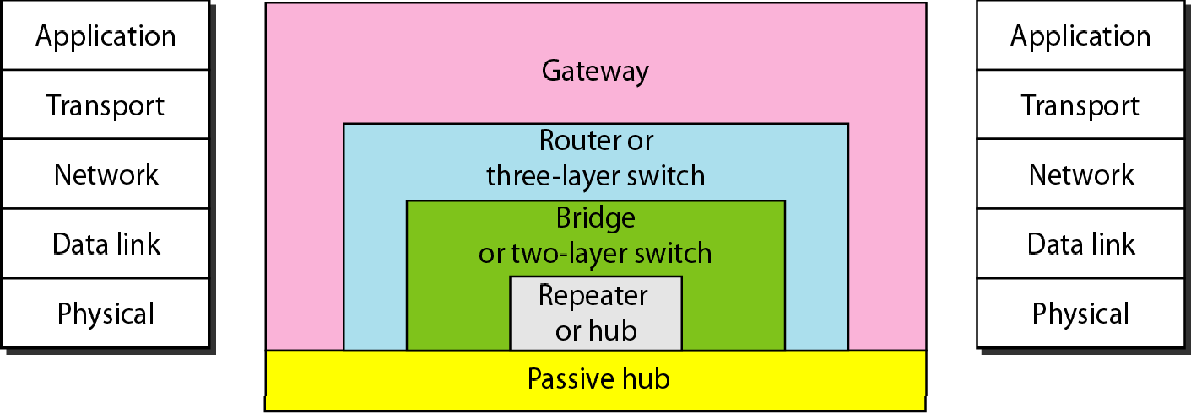
Figure 15.1 Five categories of connecting devices
15.2

Slide 3
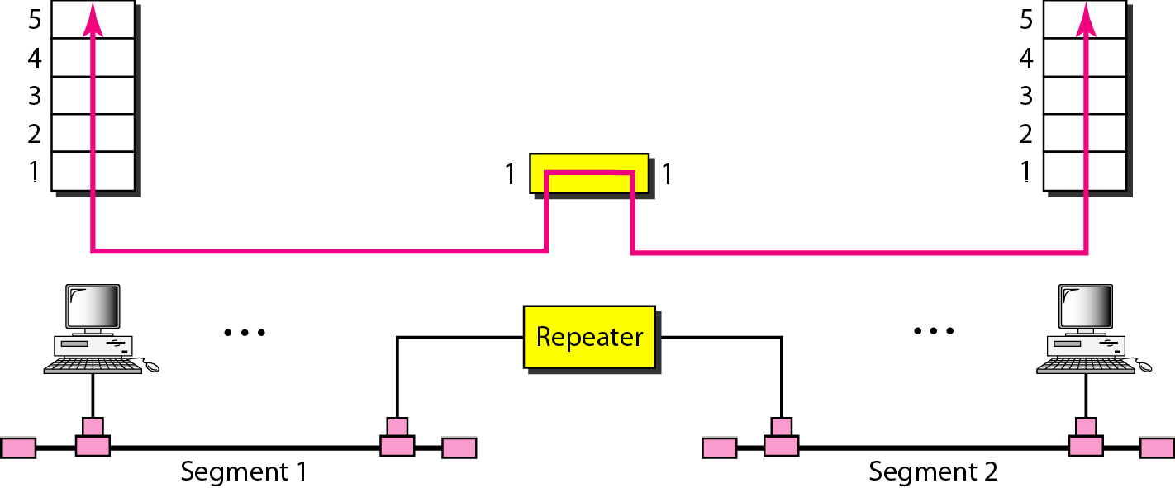
Figure 15.2 A repeater connecting two segments of a LAN
15.3

Slide 4

Note
A repeater connects segments of a LAN.
A repeater is a regenerator, not an amplifier.
A repeater forwards every frame; it has no filtering capability.
15.4

Slide 5
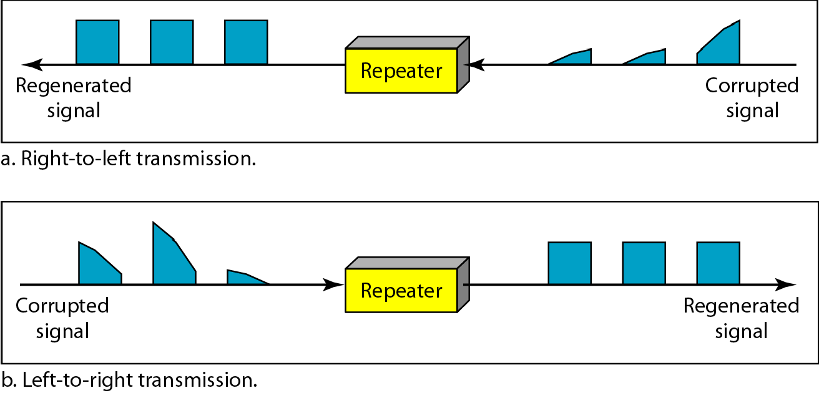
Figure 15.3 Function of a repeater
15.5

Slide 6
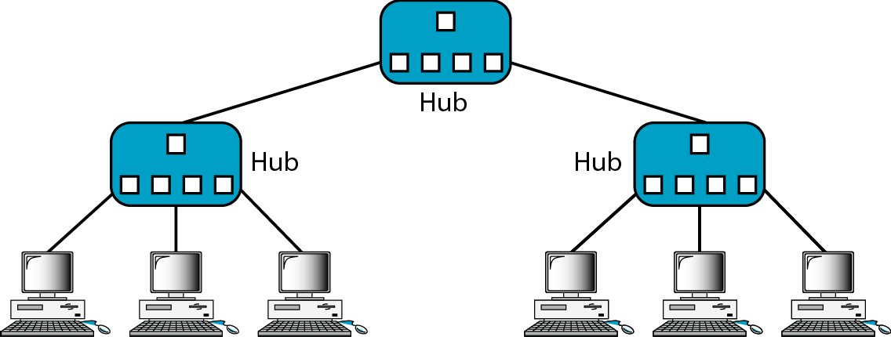
Figure 15.4 A hierarchy of hubs
15.6

Slide 7
Hubs are used to bridge media segments together in a networks. Types of Hubs 1.Passive Hubs 2.Active Hubs 3.Intelligent Hubs 1.Passive Hubs: Reduce the cabling distance by half because it does not boost the signals and infact absorbs some of the signal. There is no signal processibng or regeneration.

Slide 8
2.Active Hubs: have electronic components for regeneration and amplification of signals. By using Active Hubs the distance between devices can be increased. The main drawback of active hubs is that they amplify noise along with signals.They are also much expensive than Passive Hubs. 3.Intelligent Hubs: In addition to signal regeneration , Intelligent Hubs perform some network managementand intelligent path selection

Slide 9
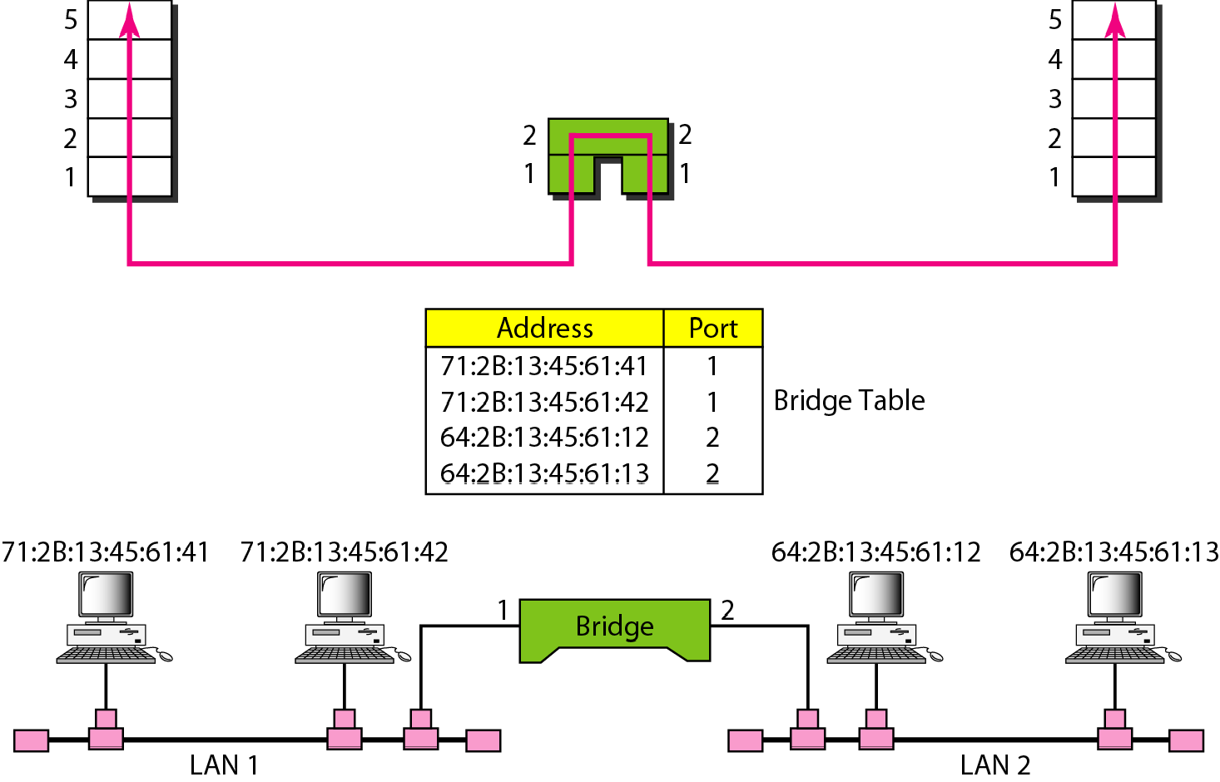
Figure 15.5 A bridge connecting two LANs

Slide 10
Note
A bridge does not change the physical (MAC) addresses in a frame.

Slide 11
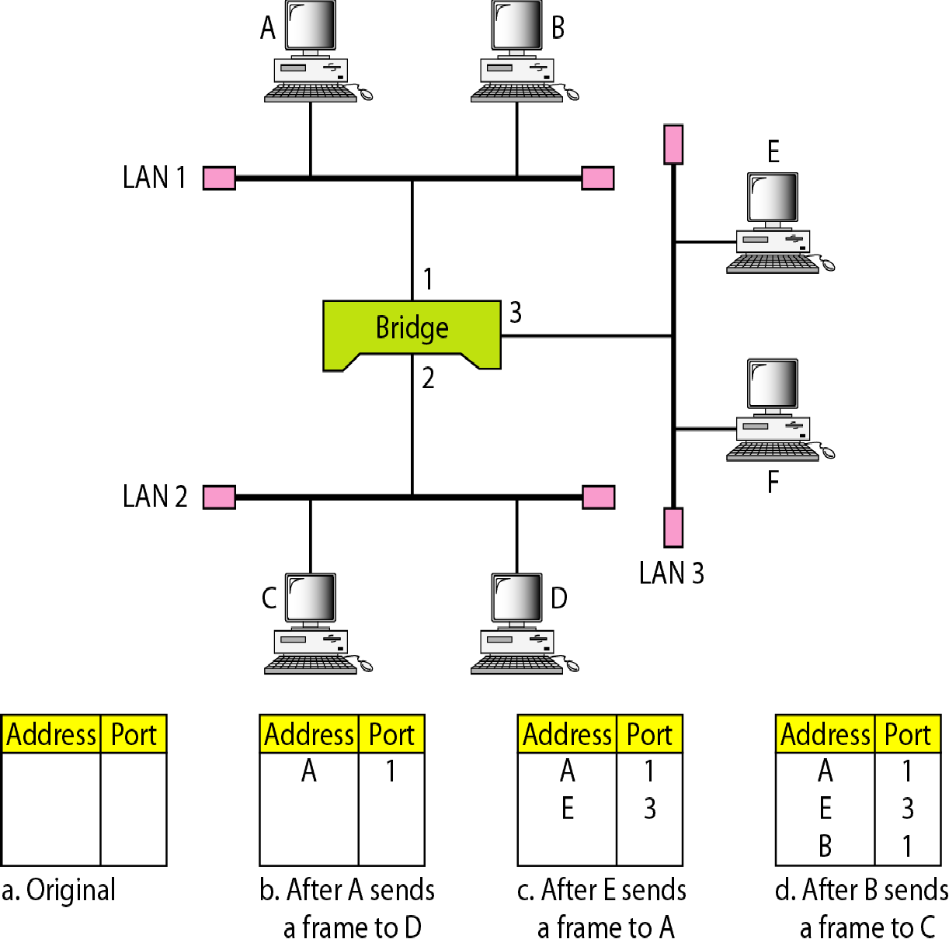
Figure 15.6 A learning bridge and the process of learning

Slide 12
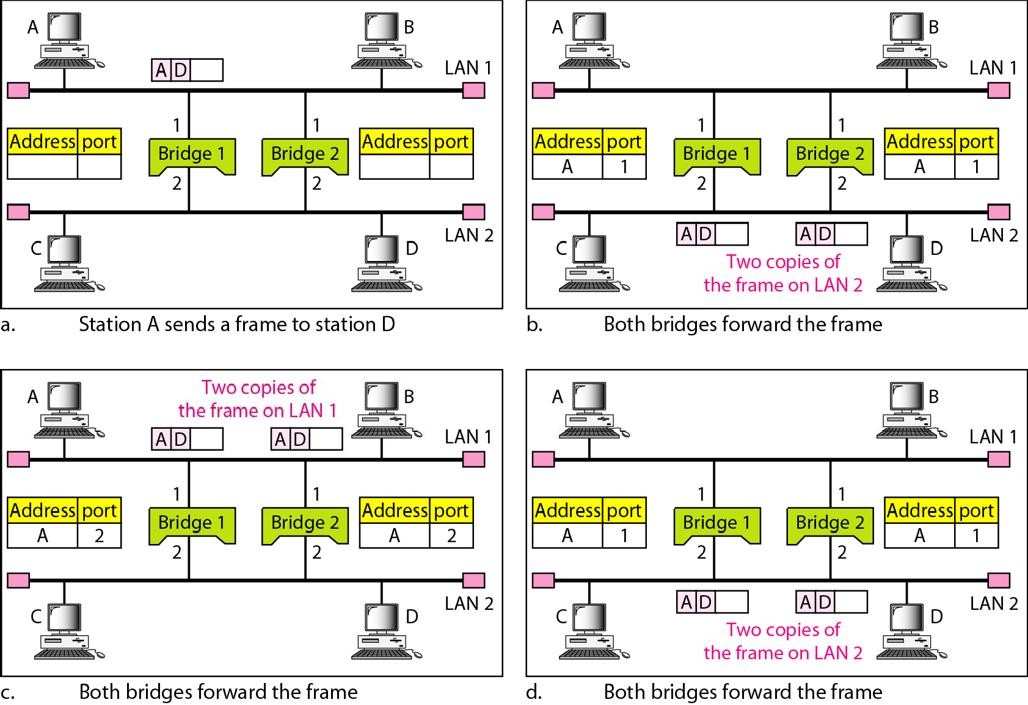
Figure 15.7 Loop problem in a learning bridge

Slide 13
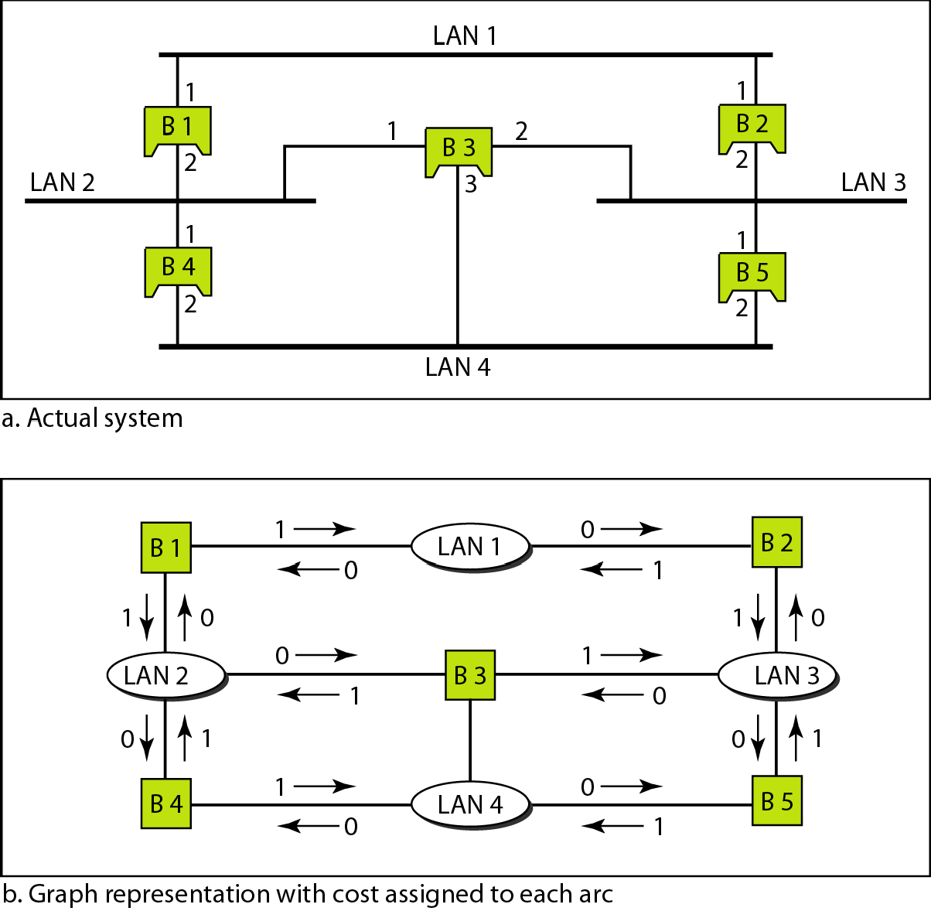
Figure 15.8 A system of connected LANs and its graph representation

Slide 14
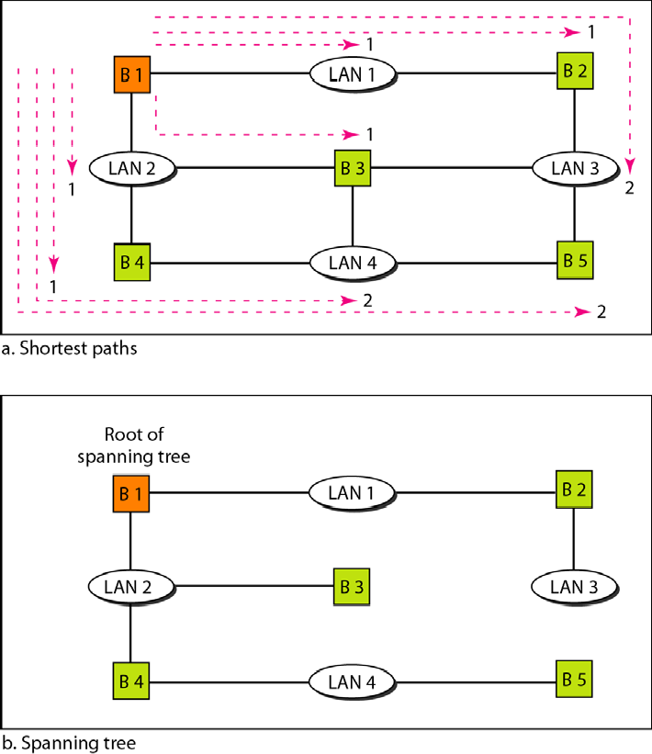
Figure 15.9 Finding the shortest paths and the spanning tree in a system of bridges

Slide 15
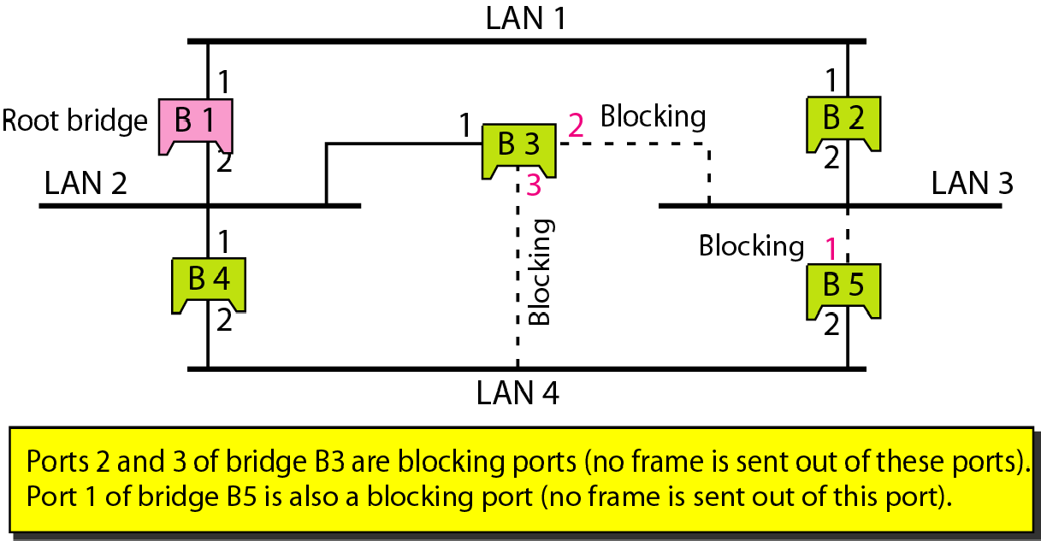
Figure 15.10 Forwarding and blocking ports after using spanning tree algorithm

Slide 16
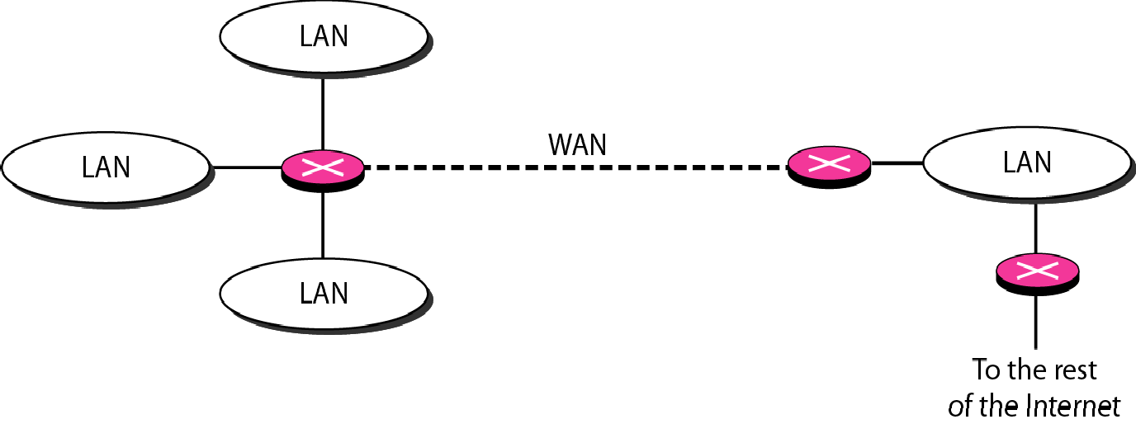
Figure 15.11 Routers connecting independent LANs and WANs

Slide 17
15-2 BACKBONE NETWORKS
A backbone network allows several LANs to be connected. In a backbone network, no station is directly connected to the backbone; the stations are part of a LAN, and the backbone connects the LANs.
Topics discussed in this section:
Bus Backbone Star Backbone
Connecting Remote LANs

Slide 18
Note
In a bus backbone, the topology of the backbone is a bus.

Slide 19
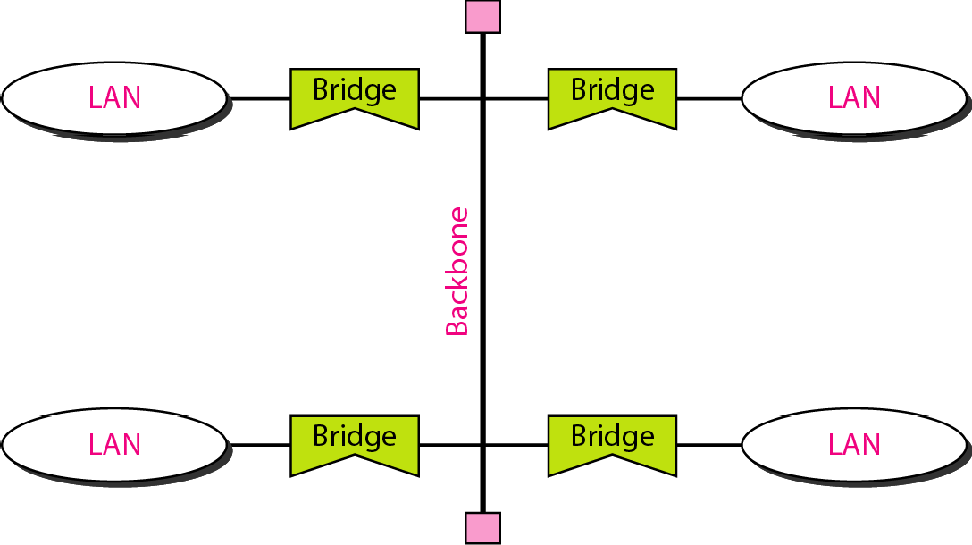
Figure 15.12 Bus backbone

Slide 20
Note
In a star backbone, the topology of the backbone is a star;
the backbone is just one switch.

Slide 21
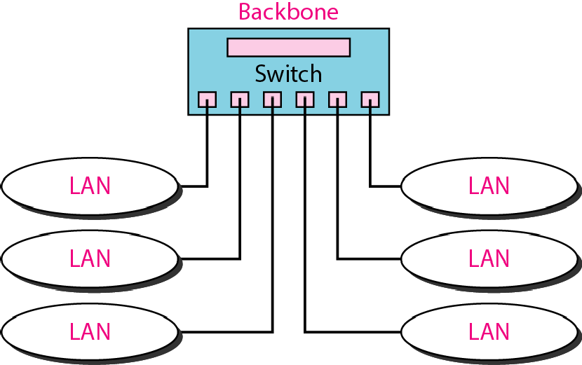
Figure 15.13 Star backbone

Slide 22
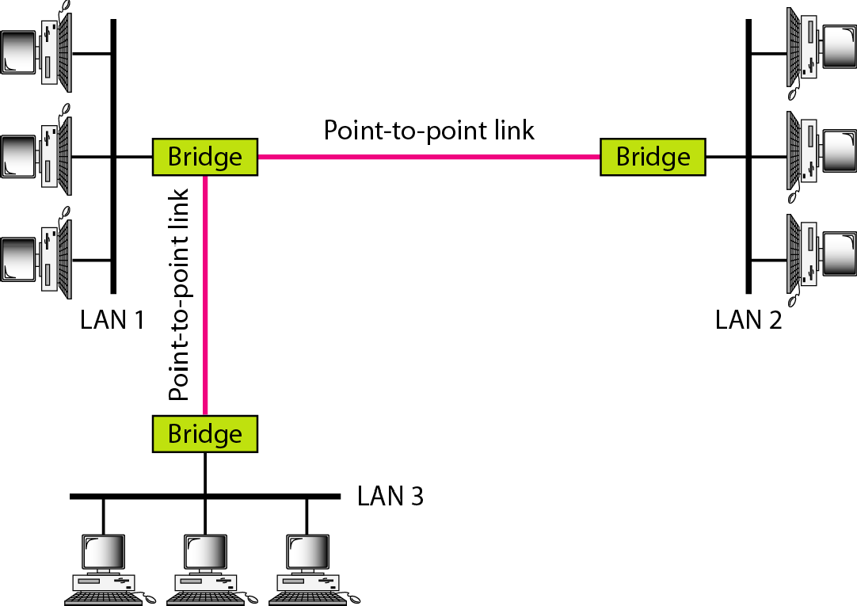
Figure 15.14 Connecting remote LANs with bridges

Slide 23
Note
A point-to-point link acts as a LAN in a remote backbone connected by remote bridges.

Slide 24
15-3 VIRTUAL LANs
We can roughly define a virtual local area network (VLAN) as a local area network configured by software, not by physical wiring..
Topics discussed in this section:
Membership Configuration
Communication between Switches

Slide 25
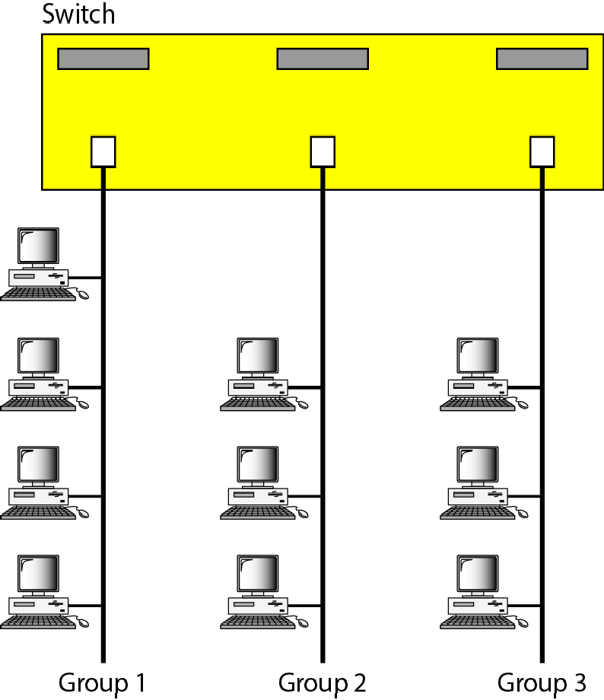
Figure 15.15 A switch connecting three LANs

Slide 26
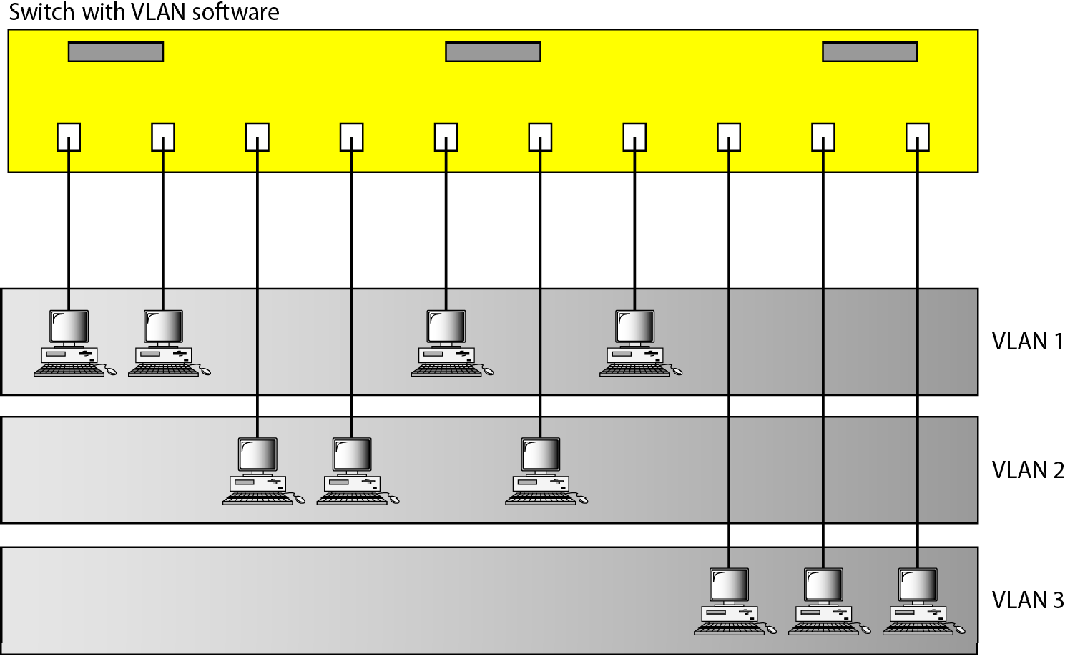
Figure 15.16 A switch using VLAN software

Slide 27
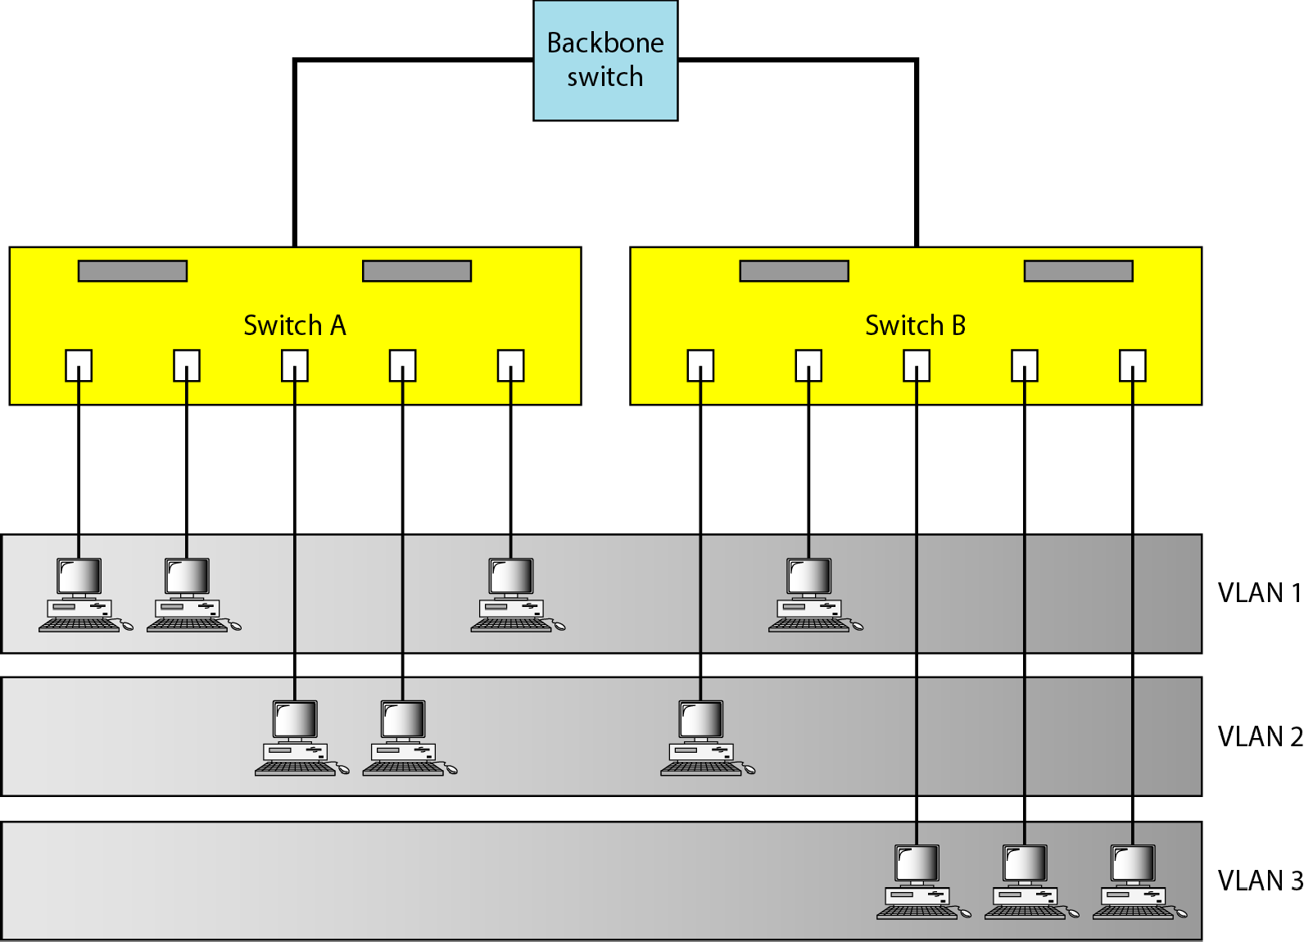
Figure 15.17 Two switches in a backbone using VLAN software

Slide 28
Note
VLANs create broadcast domains.

