Slide 1
Chapter 11 Data Link Control
11.1

Slide 2



























11-2 FLOW AND ERROR CONTROL
The most important responsibilities of the data link layer are flow control and error control. Collectively, these functions are known as data link control.
Flow control refers to a set of procedures used to restrict the amount of data that the sender can send before waiting for acknowledgment.
Error control in the data link layer is on automatic repeat request, which is the retransmission of data.
11.2

Slide 3

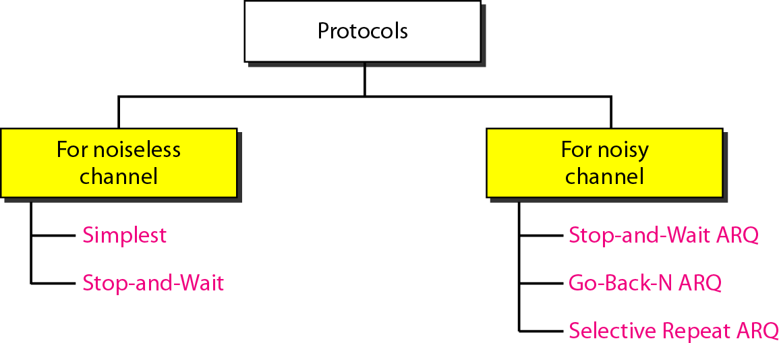
11-3 PROTOCOLS

Slide 4





























11-4 NOISELESS CHANNELS
Let us first assume we have an ideal channel in which no frames are lost, duplicated, or corrupted. We introduce two protocols for this type of channel.
Topics discussed in this section:
Simplest Protocol
Stop-and-Wait Protocol

Slide 5
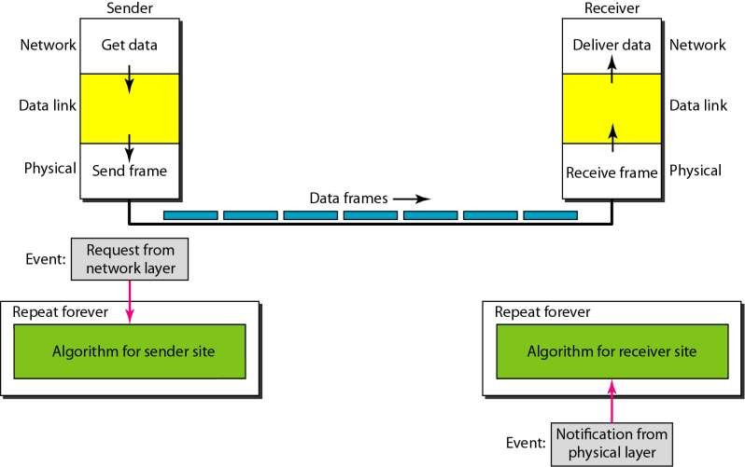
Figure 11.6 The design of the simplest protocol with no flow or error control

Slide 6
Example 11.1
Figure 11.6 shows an example of communication using this protocol. It is very simple. The sender sends a sequence of frames without even thinking about the receiver. To send three frames, three events occur at the sender site and three events at the receiver site. Note that the data frames are shown by tilted boxes; the height of the box defines the transmission time difference between the first bit and the last bit in the frame.

Slide 7
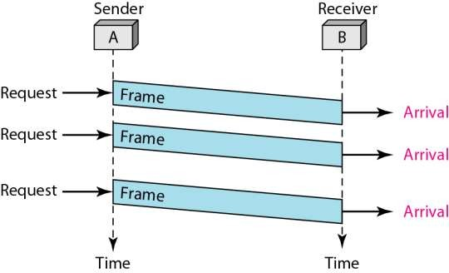
Figure 11.7 Flow diagram for Example 11.1

Slide 8
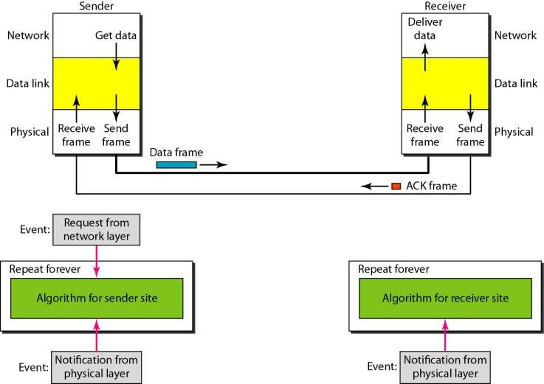
Figure 11.8 Design of Stop-and-Wait Protocol

Slide 9
Example 11.2
Figure 11.8 shows an example of communication using this protocol. It is still very simple. The sender sends one frame and waits for feedback from the receiver. When the ACK arrives, the sender sends the next frame. Note that sending two frames in the protocol involves the sender in four events and the receiver in two events.

Slide 10
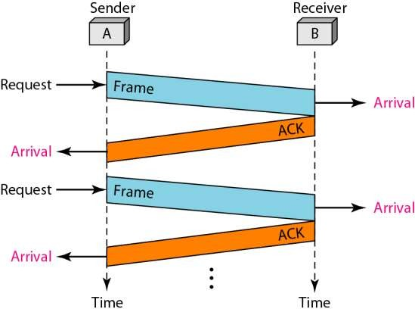
Figure 11.9 Flow diagram for Example 11.2

Slide 11



































11-5 NOISY CHANNELS
Although the Stop-and-Wait Protocol gives us an idea of how to add flow control to its predecessor, noiseless channels are nonexistent. We discuss three protocols in this section that use error control.
Topics discussed in this section:
Stop-and-Wait Automatic Repeat Request Go-Back-N Automatic Repeat Request Selective Repeat Automatic Repeat Request

Slide 12

Note
Error correction in Stop-and-Wait ARQ is done by keeping a copy of the sent frame and retransmitting of the frame when the timer expires.we use sequence numbers to number the frames. The sequence number of the next frame expected as acknowledgment number.

Slide 13
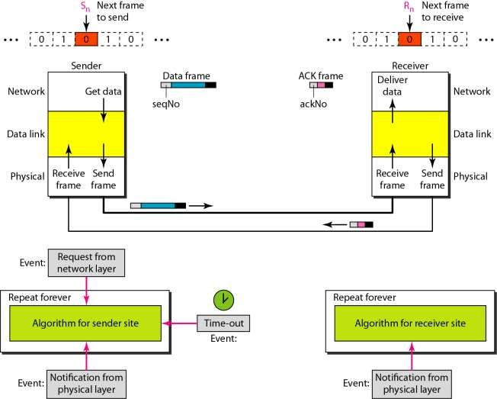
Figure 11.10 Design of the Stop-and-Wait ARQ Protocol

Slide 14
Example 11.3
Figure 11.10 shows an example of Stop-and-Wait ARQ. Frame 0 is sent and acknowledged. Frame 1 is lost and resent after the time-out. The resent frame 1 is acknowledged and the timer stops. Frame 0 is sent and acknowledged, but the acknowledgment is lost. The sender has no idea if the frame or the acknowledgment is lost, so after the time-out, it resends frame 0, which is acknowledged.

Slide 15
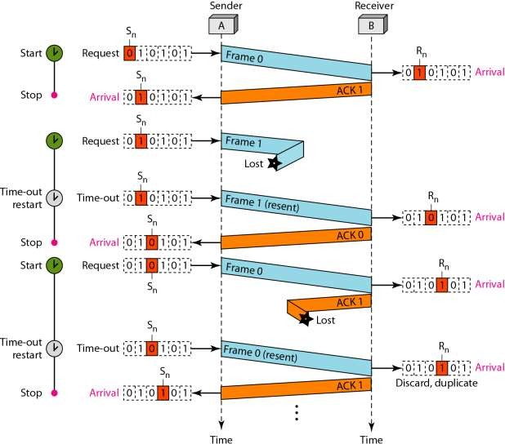
Figure 11.11 Flow diagram for Example 11.3

Slide 16
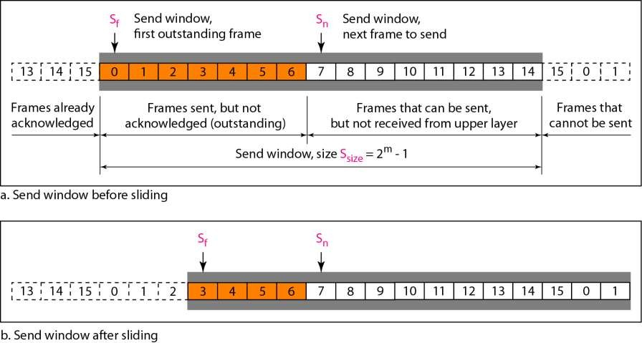
Figure 11.12 Send window for Go-Back-N ARQ

Slide 17
Note
The send window is an abstract concept defining an imaginary box of size 2^{m} − 1 with three variables: S_{f}, S_{n}, and S_{size}.
The send window can slide one or more slots when a valid acknowledgment arrives.

Slide 18
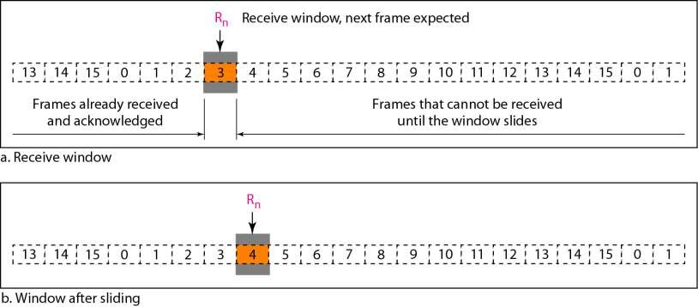
Figure 11.13 Receive window for Go-Back-N ARQ

Slide 19
Note
The receive window is an abstract concept defining an imaginary box of size 1 with one single variable R_{n}.
The window slides when a correct frame has arrived; sliding occurs one slot at a time.

Slide 20
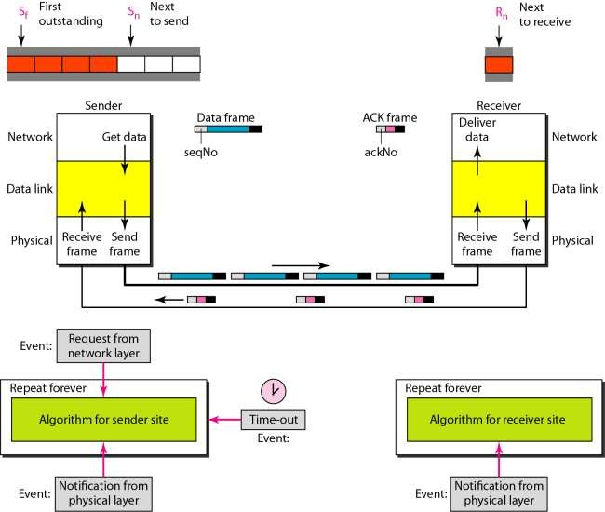
Figure 11.14 Design of Go-Back-N ARQ

Slide 21
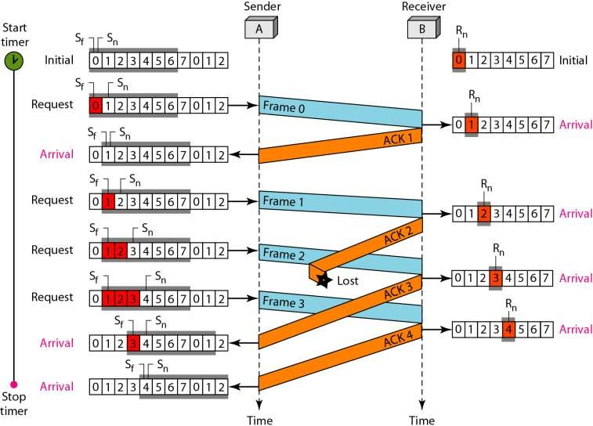
Figure 11.16 Flow diagram for Example 11.6

Slide 22
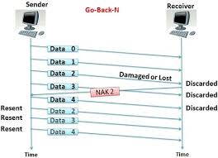

Slide 23
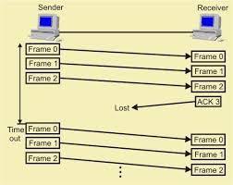

Slide 24
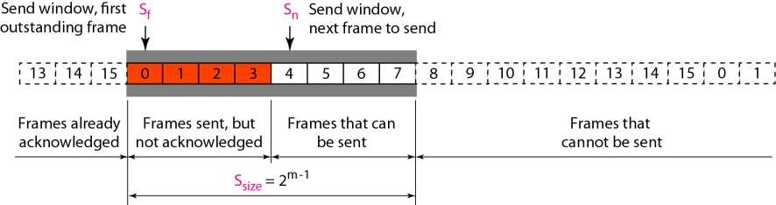
Figure 11.18 Send window for Selective Repeat ARQ

Slide 25
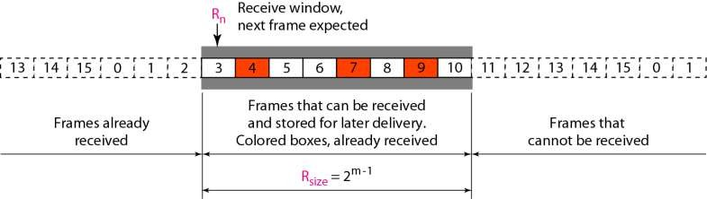
Figure 11.19 Receive window for Selective Repeat ARQ

Slide 26
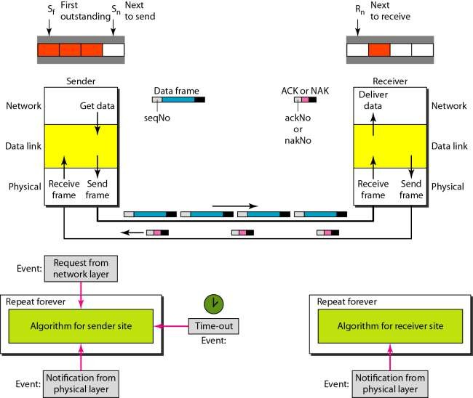
Figure 11.20 Design of Selective Repeat ARQ

Slide 27
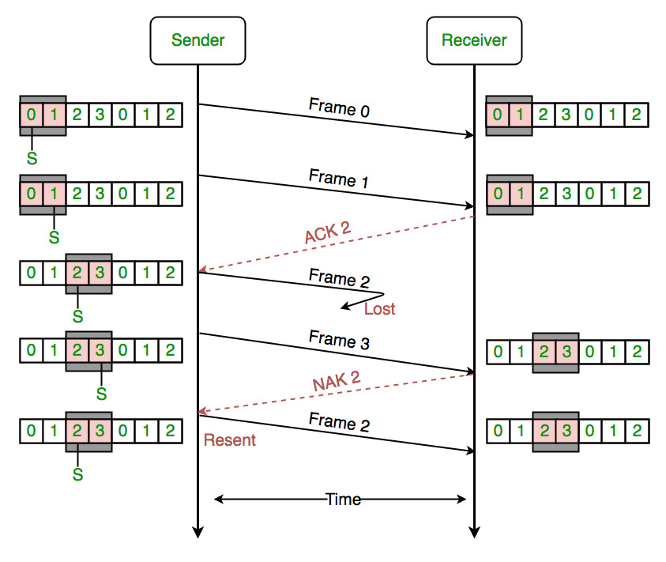
Figure 11.21 Selective Repeat ARQ, window size(2^{m-1} )

Slide 28
Note
In Selective Repeat ARQ, the size of the sender and receiver window
must be at most one-half of 2^{m}.

