Slide 1
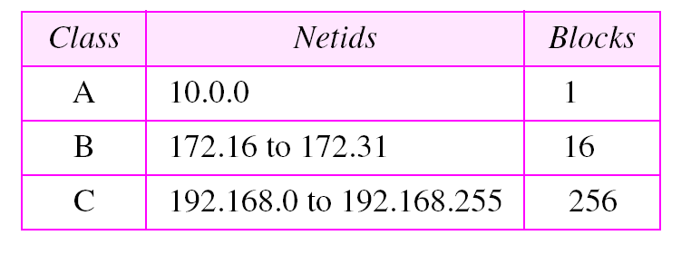
Addresses for private networks

Slide 2
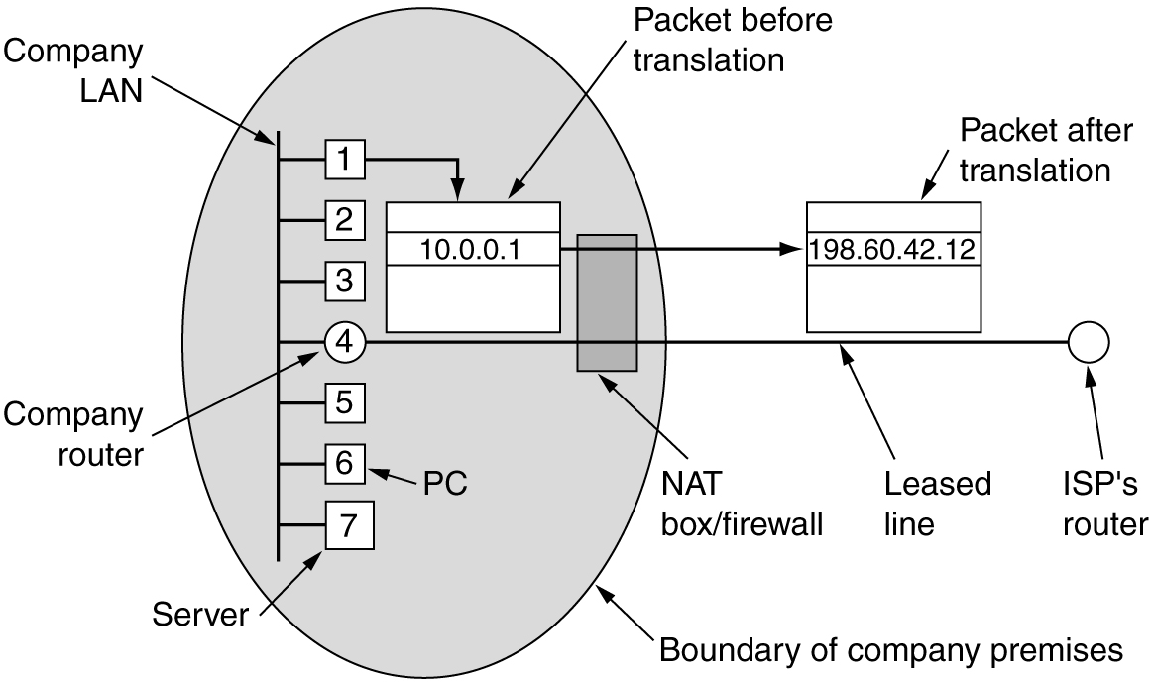
NAT – Network Address Translation
Placement and operation of a NAT box.

Slide 3
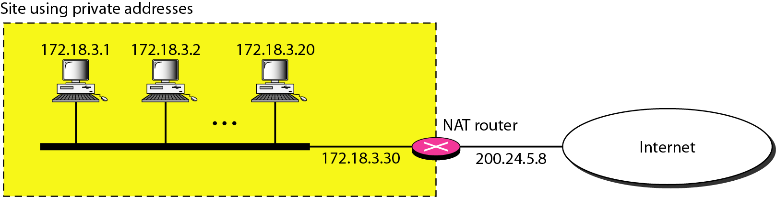
A NAT implementation

Slide 4
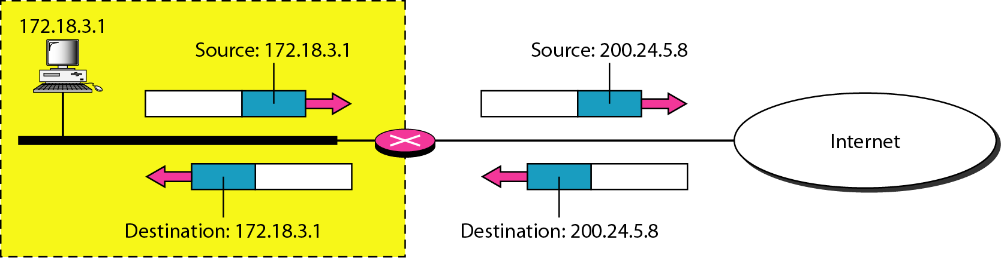
Addresses in a NAT

Slide 5
ICMP V4 -Introduction
The IP protocol has no error-reporting or error correcting mechanism.
What happens if something goes wrong? What happens if a router must discard a datagram because it cannot find a router to the final destination, or
Because the time-to-live field has a zero value?
These are examples of situations where an error has occurred and the IP protocol has no built-in mechanism to notify the original host.
The solution is ICMP protocol

Slide 6
ICMP V4 -MESSAGES
ICMP messages are divided into two broad categories:
error-reporting messages
query messages.
The error-reporting messages report problems that a router or a host (destination) may encounter when it processes an IP packet.
The query messages, help a host or a network manager get specific information from a router or another host. Also, hosts can discover and learn about routers on their network and routers can help a node redirect its messages.

Slide 7
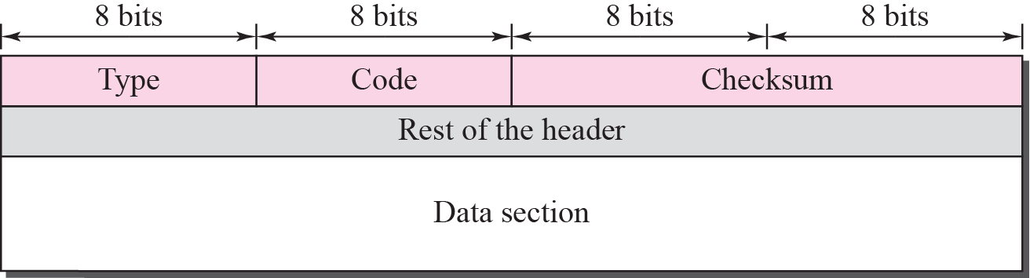
General format of ICMP messages or ICMP header

Slide 8
Basic ICMP Header
Headers are 32 bits in length; all contain same three fields
type - 8 bit message type code
Thirteen message type are defined
code - 8 bit;
indicating why message is being sent
checksum - standard internet checksum
for purpose of calculation the checksum field is set to zero

Slide 9
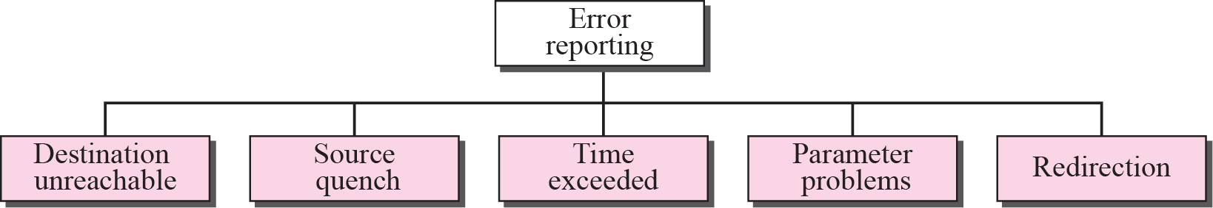
Error-reporting messages

Slide 10
Query Messages
Query Messages
Echo Request
Echo
Reply
Timestamp Request
Timestamp Reply

Slide 11
ICMP V6- INTRODUCTION
Another protocol that has been modified in version 6 of the TCP/IP protocol suite is ICMP.
This new version, Internet Control Message Protocol version 6 ( ICMPv6 ), follows the same strategy and purposes of version 4.
ICMPv6, however, is more complicated than ICMPv4: some protocols that were independent in version 4 are now part of ICMPv6 and
some new messages have been added to make it more useful.

Slide 12
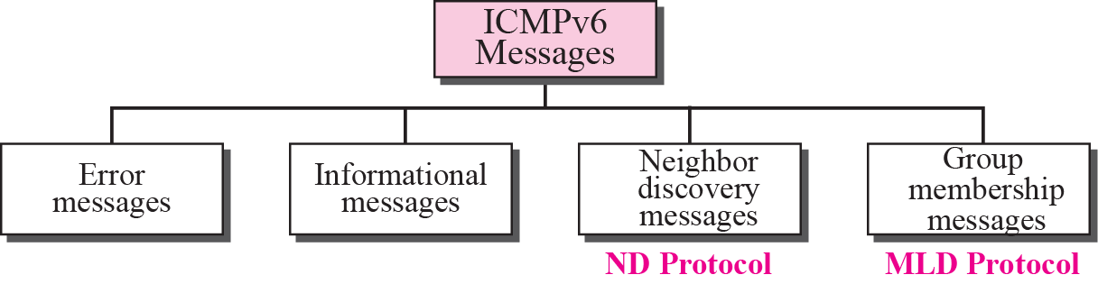
Taxonomy of ICMPv6 messages

Slide 13
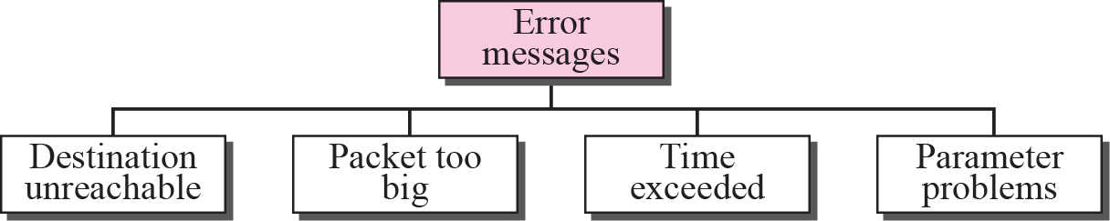
Error-reporting messages

Slide 14
Informational Messages
Two of the ICMPv6 messages can be categorized as informational messages: echo request and echo reply messages.
The echo request and echo response messages are designed to check if two devices in the Internet can communicate with each other.
A host or router can send an echo request message to another host; the receiving computer or router can reply using the echo response message.

Slide 15
Neighbor-Discovery Messages
The most important issue is the definition of two new protocols that clearly define the functionality of these group messages:
Neighbor-Discovery (ND) protocol
Inverse-Neighbor-Discovery (IND) protocol.
These two protocols are used by nodes (hosts or routers) on the same link (network).

Slide 16
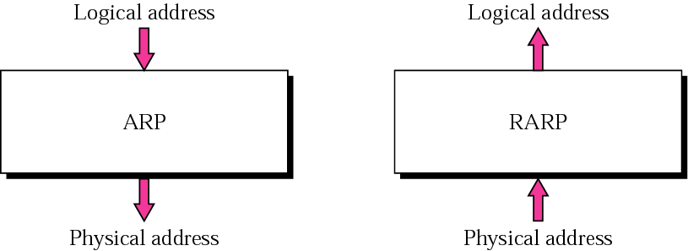
ARP and RARP

Slide 17
ARP (Address Resolution Protocol)
ARP associates an IP address with its physical address. On a typical physical network, such as a LAN, each device on a link is identified by a physical or station address that is usually imprinted on the NIC.
The delivery of a packet to a host or a router requires two levels of addressing: logical and physical.
We need to be able to map a logical address to its corresponding physical address and vice versa. These can be done using either static or dynamic mapping.
Logical address to physical address translation can be done statically (not practical) or dynamically (with ARP).

Slide 18
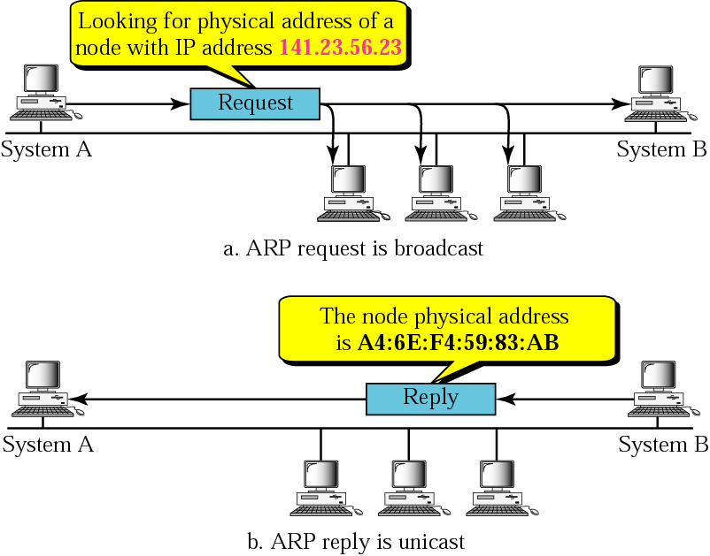
ARP operation

Slide 19
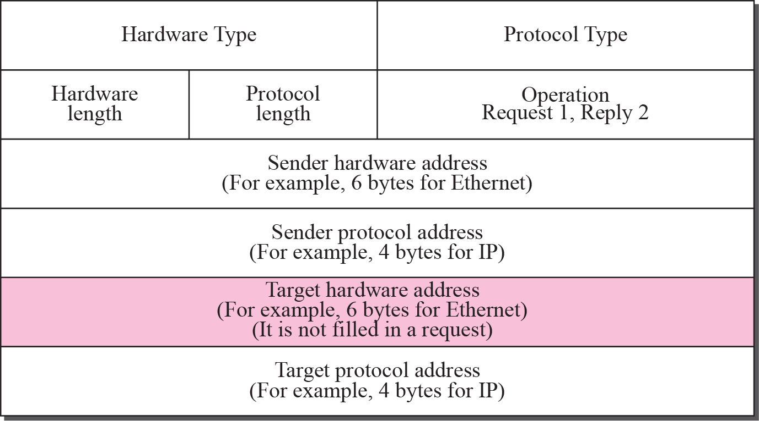
ARP packet

Slide 20

Note
An ARP request is broadcast; an ARP reply is unicast.

Slide 21
RARP (Reverse Address resolution Protocol)
RARP finds the logical address for a machine that only knows its physical address. RARP requests are broadcast, RARP replies are unicast.
This if often encountered on thin-client workstations. No disk, so when machine is booted, it needs to know its IP address (don’t want to burn the IP address into the ROM).
If a thin-client workstation needs to know its IP address, it probably also needs to know its subnet mask, router address, DNS address, etc.So we need something more than RARP. BOOTP, and now DHCP have replaced RARP.

Slide 22
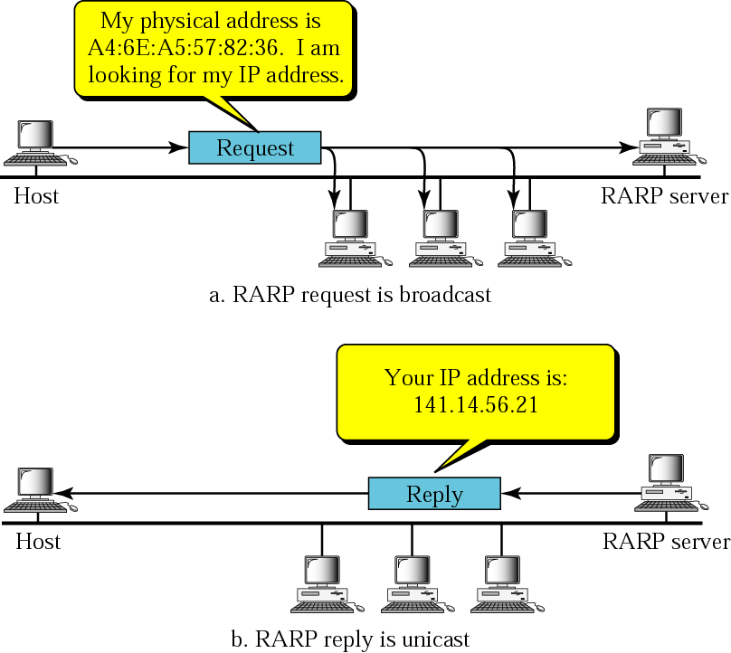
RARP operation

Slide 23
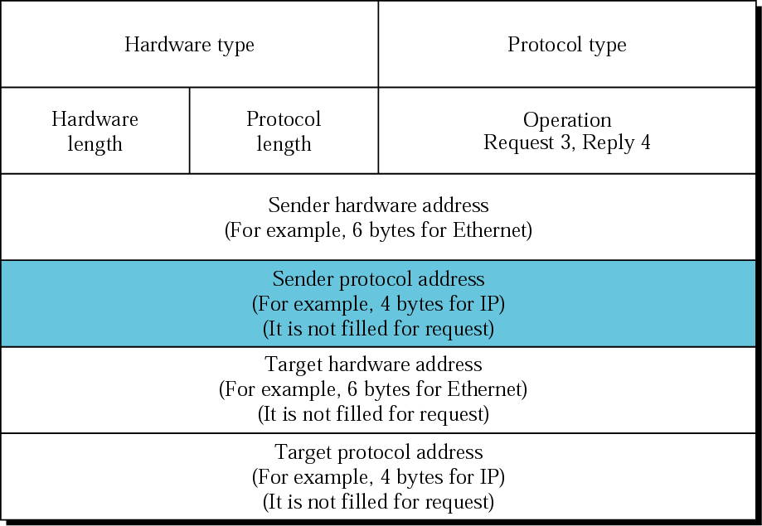
RARP packet

