Slide 1
INTERNETWORKING
connecting networks together to make an internetwork or an internet..

Slide 2
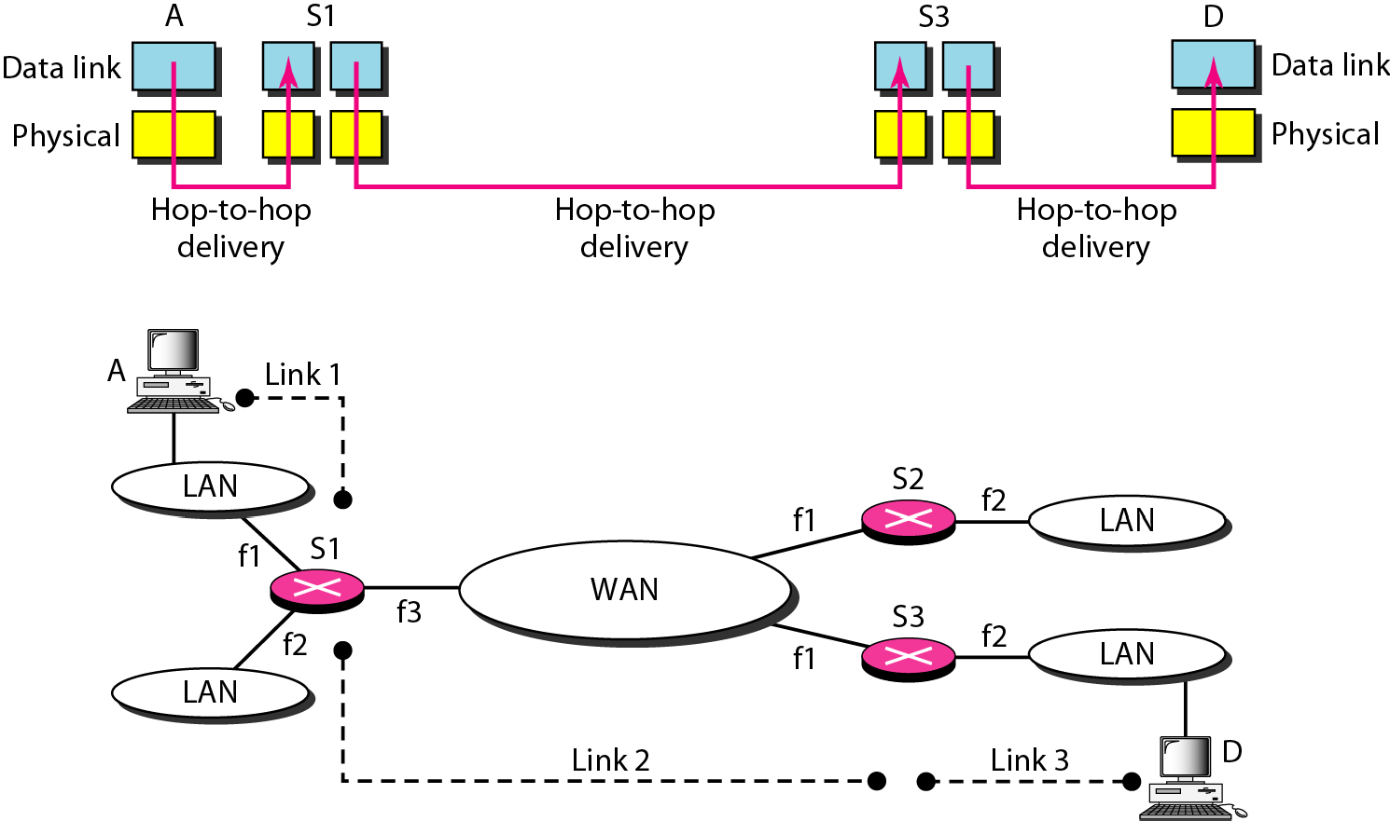
Links between two hosts

Slide 3
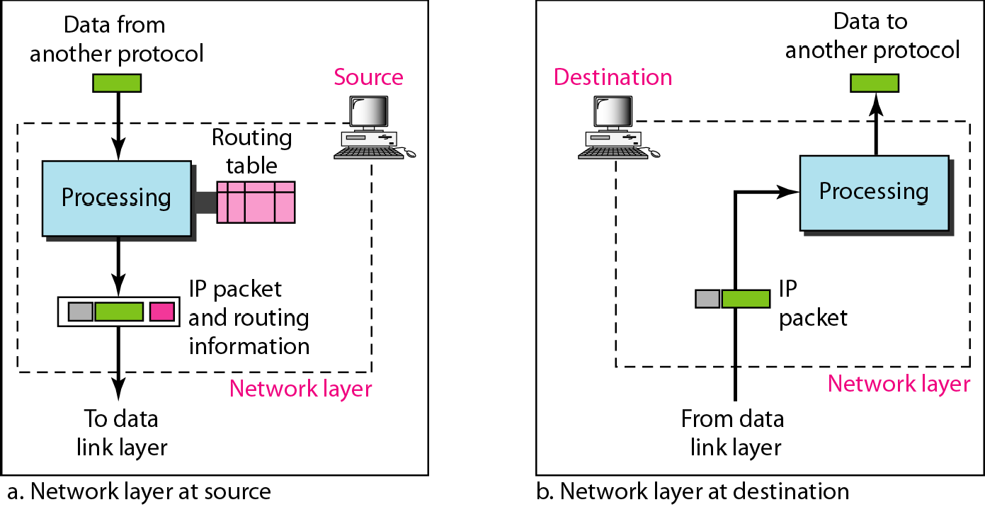
Network layer at the source, router, and destination

Slide 4
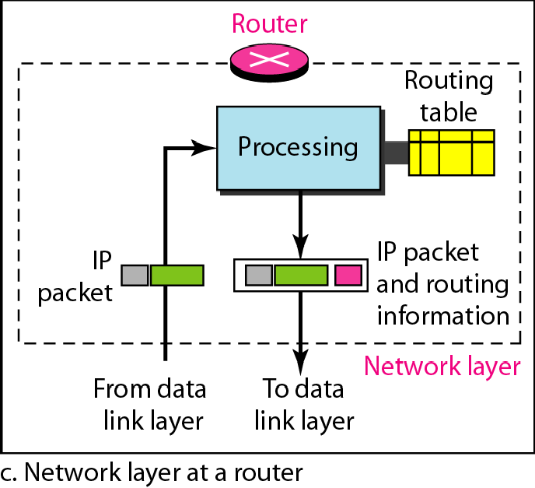
Network layer at the source, router, and destination

Slide 5
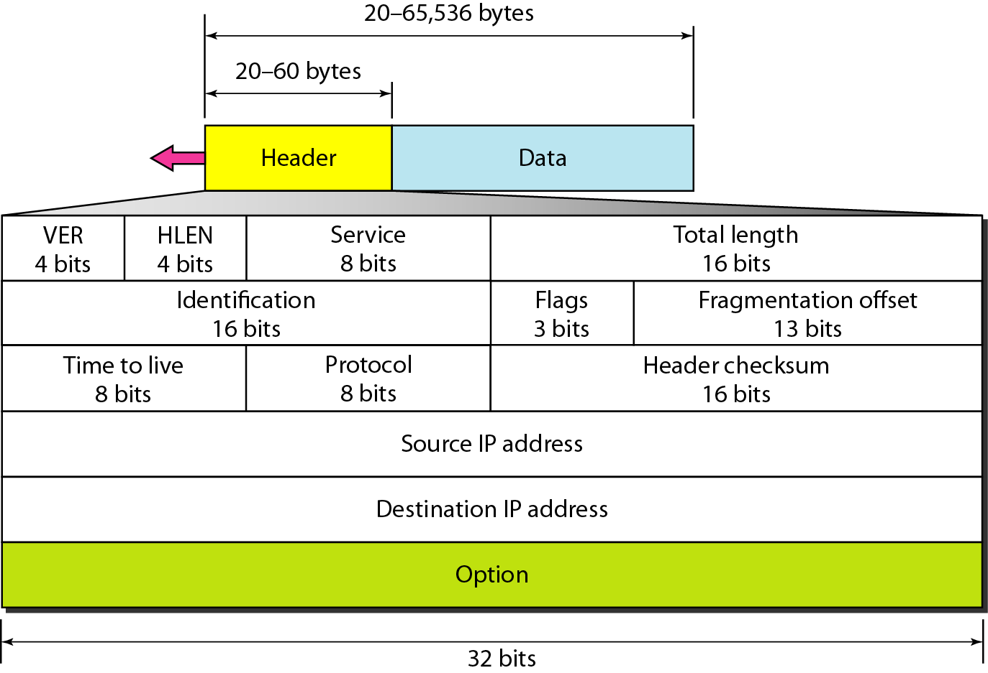
IPv4 datagram format (IPV4 Header)

Slide 6
IPv4 datagram format (IPV4 Header)
Version: IP Version
4 for IPv4
6 for IPv6
HLen: Header Length
32-bit words (typically 5)
TOS: Type of Service
Priority information
Identifier, flags, fragment offset → used primarily for fragmentation
Time to live
Must be decremented at each router
Packets with TTL=0 are thrown away
Ensure packets exit the network
Protocol
Demultiplexing to higher layer protocols
TCP = 6, ICMP = 1, UDP = 17…
Header checksum
Ensures some degree of header integrity
Relatively weak – only 16 bits
Options
E.g. Source routing, record route, etc.
Performance issues at routers
Poorly supported or not at all
Source Address
32-bit IP address of sender
Destination Address
32-bit IP address of destination

Slide 7
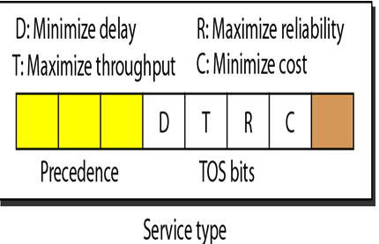
Service type field in IPV4

Slide 8
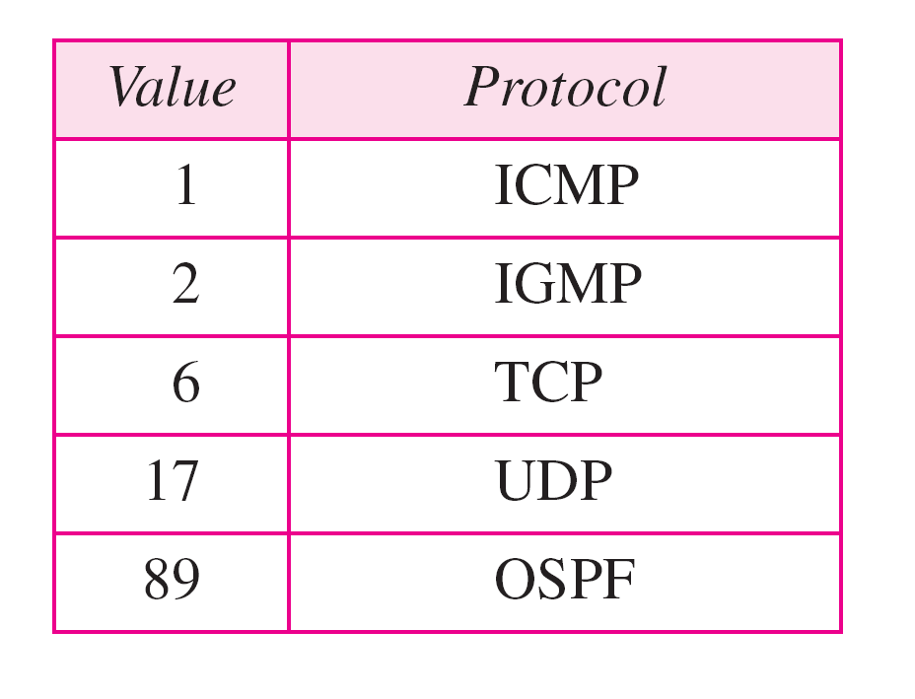
Protocol values

Slide 9
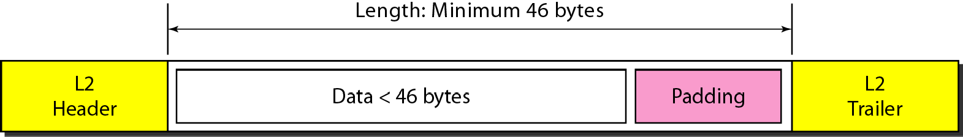
Encapsulation of a small datagram in an Ethernet frame

Slide 10
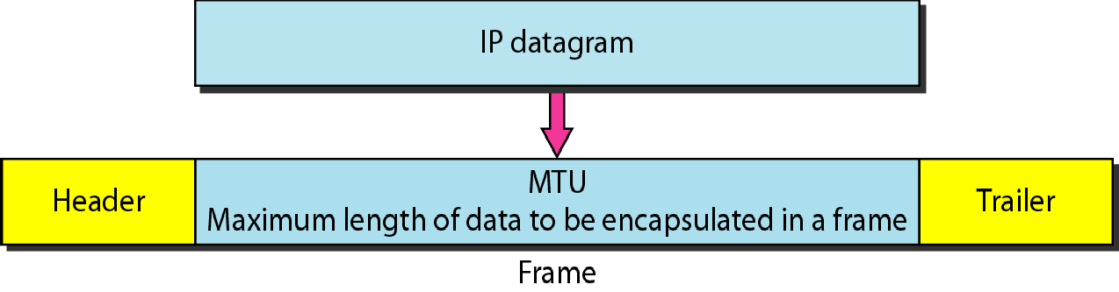
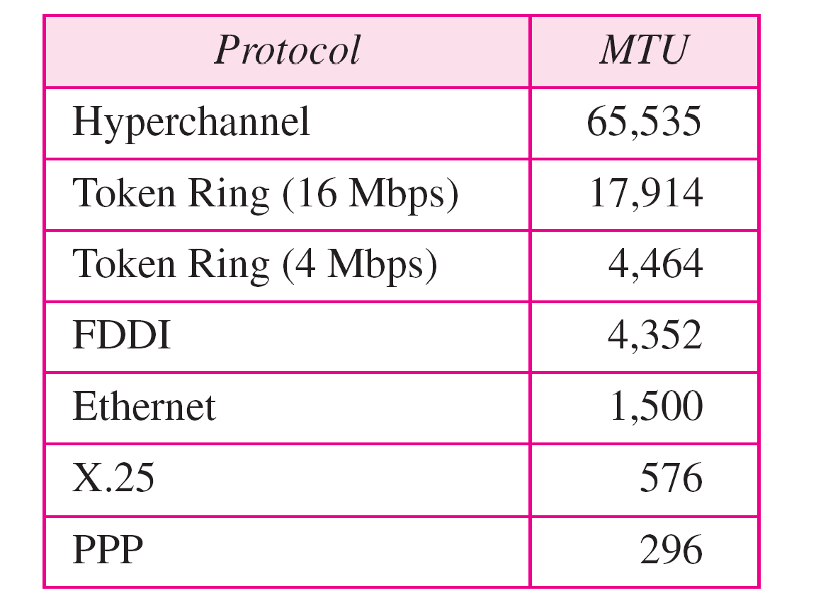
Maximum transfer unit (MTU)

Slide 11

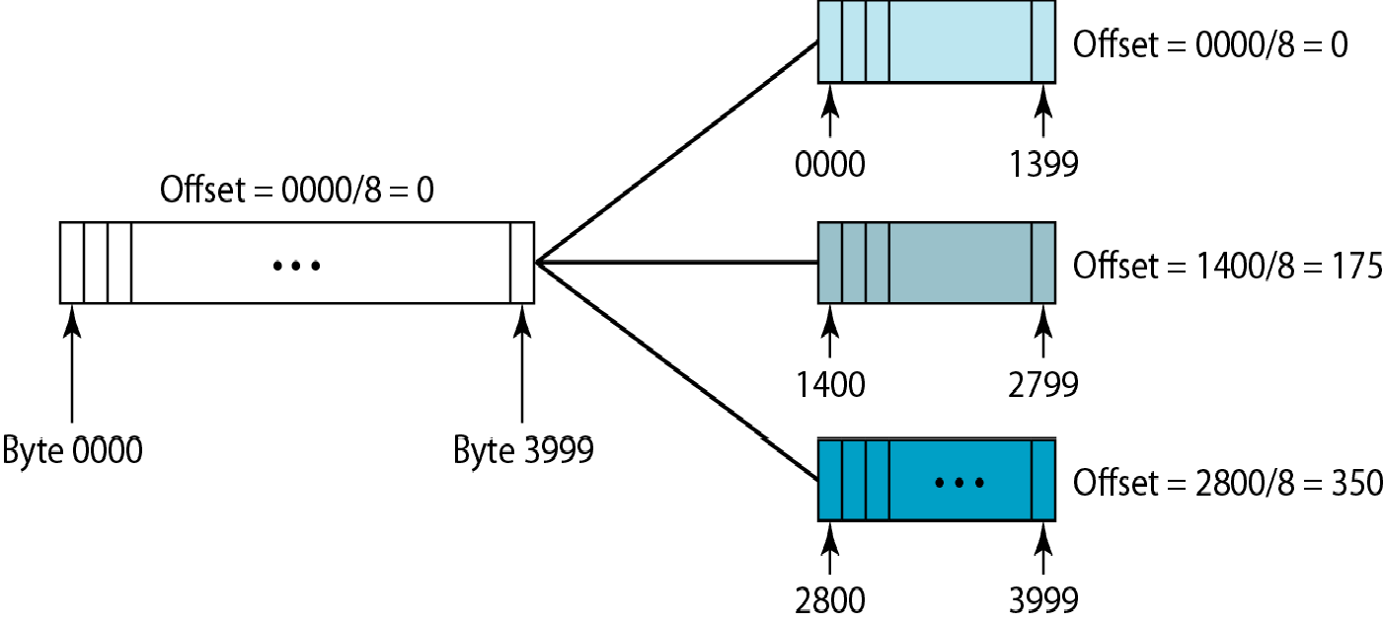
Flags used in fragmentation
Fragmentation example

Slide 12
EXAMPLE:A packet has arrived with an M bit value of 1 and a fragmentation offset value of 0. Is this the first fragment, the last fragment, or a middle fragment?
Solution
Because the M bit is 1, it is either the first fragment
or a middle one Because the offset value is 0,
fragment.

Slide 13
IPv6 ADDRESSES
Despite all short-term solutions, address depletion is still a long-term problem for the Internet. This and other problems in the IP protocol itself have been the motivation for IPv6.

Slide 14

Note
An IPv6 address is 128 bits long.

Slide 15
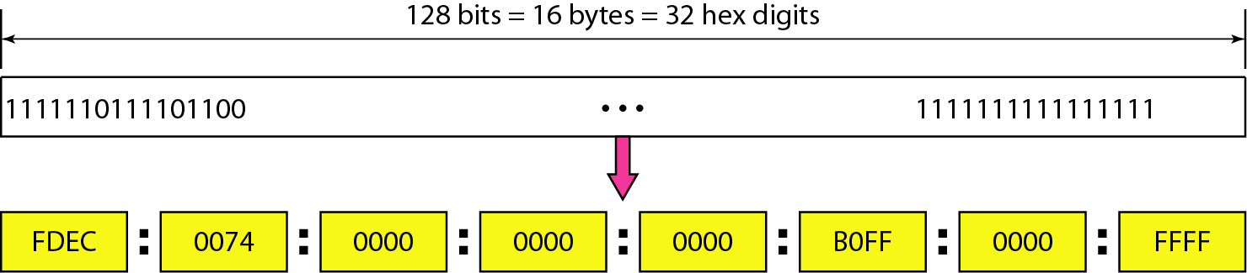
IPv6 address in binary and hexadecimal colon notation

Slide 16
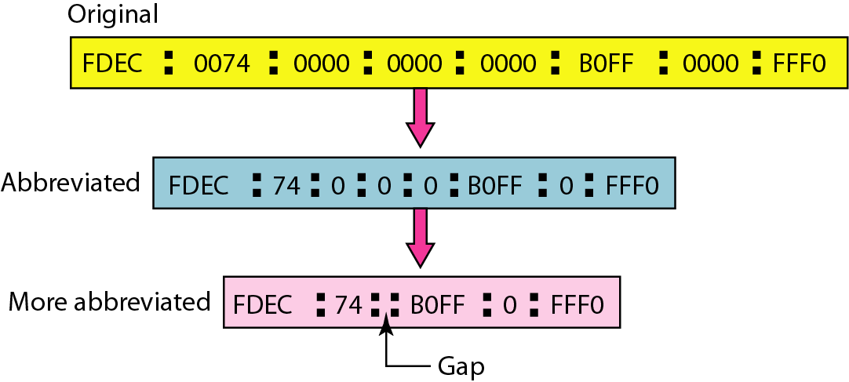
Abbreviated IPv6 addresses

Slide 17
IPv6 Colon Hexadecimal Notation
128 bit number expressed as dotted decimal
104.230.140.100.255.255.255.255.0.0.17.128.150.10.255.255 becomes
68E6:8C64:FFFF:FFFF:0:1180:96A:FFFF
Hex notation allows zero compression
A string of repeated zeros is replaced with a pair of colons
FF05:0:0:0:0:0:0:B3 becomes FF05::B3
Can be applied only once in any address

Slide 18
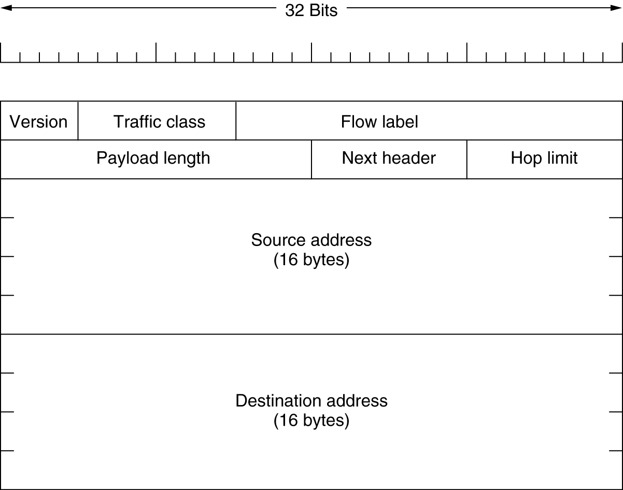
The Main IPv6 Header
The IPv6 fixed header (required).

Slide 19
IPV6 Header Description
Version (4-bits): It represents the version of Internet Protocol
Traffic Class (8-bits): These 8 bits are divided into two parts. The most significant 6 bits are used for Type of Service & The least significant 2 bits are used for Explicit Congestion Notification (ECN).
Flow Label (20-bits): This label is used to maintain the sequential flow of the packets belonging to a communication. Payload Length (16-bits): This field is used to tell the routers how much information a particular packet contains in its payload.

Slide 20
IPV6 Header Description
Next Header (8-bits): This field is used to indicate either the type of Extension Header.
Hop Limit (8-bits): This field is used to stop packet to loop in the network infinitely. The value of Hop Limit field is decremented by 1 as it passes a link (router/hop). When the field reaches 0 the packet is discarded.
Source Address (128-bits): This field indicates the address of originator of the packet.
Destination Address (128-bits): This field provides the address of intended recipient of the packet.

Slide 21
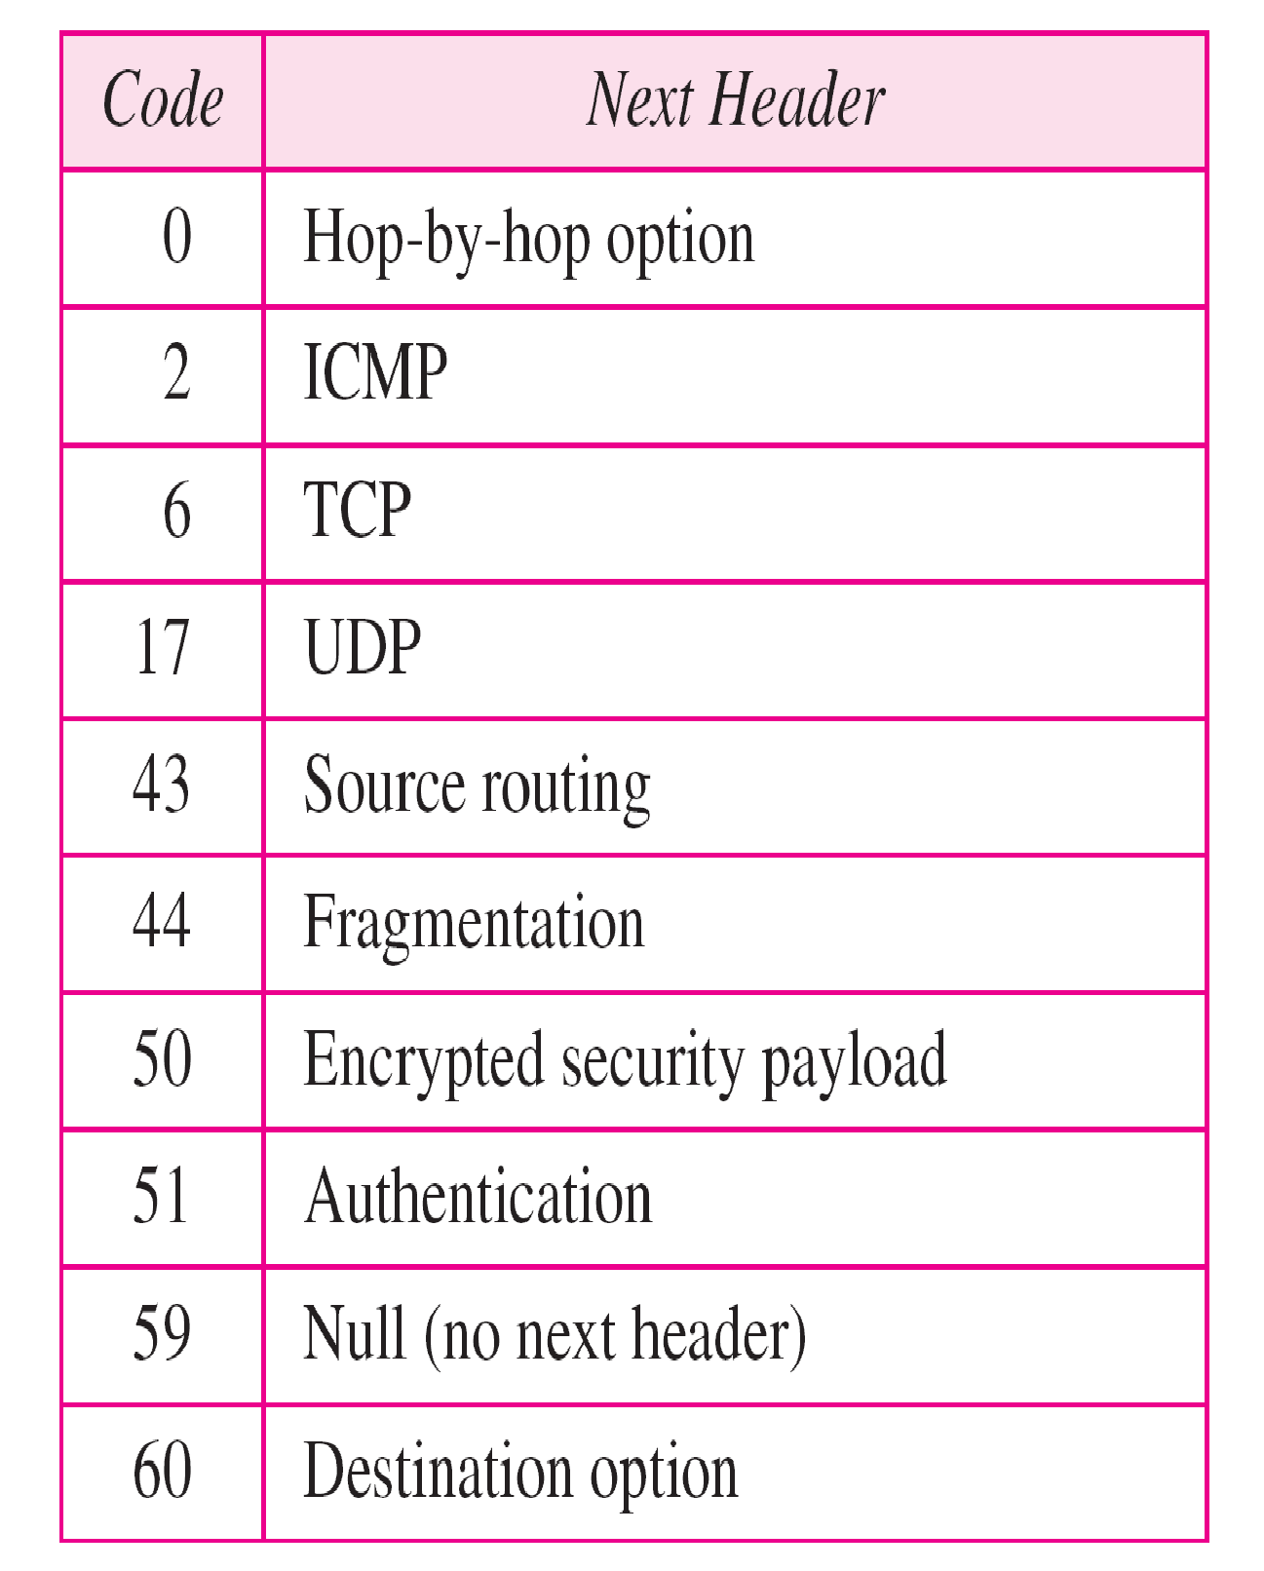
Next header codes for IPv6

Slide 22
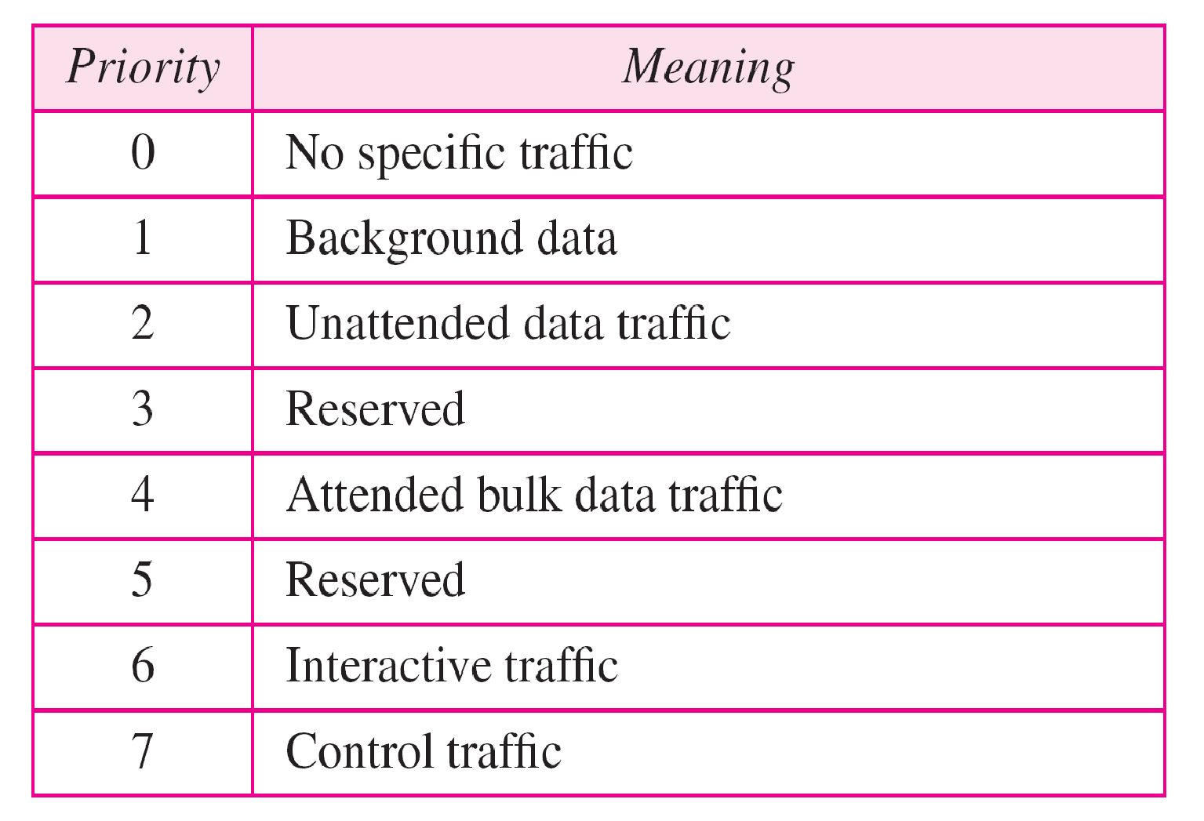
Priorities for congestion-controlled traffic

Slide 23
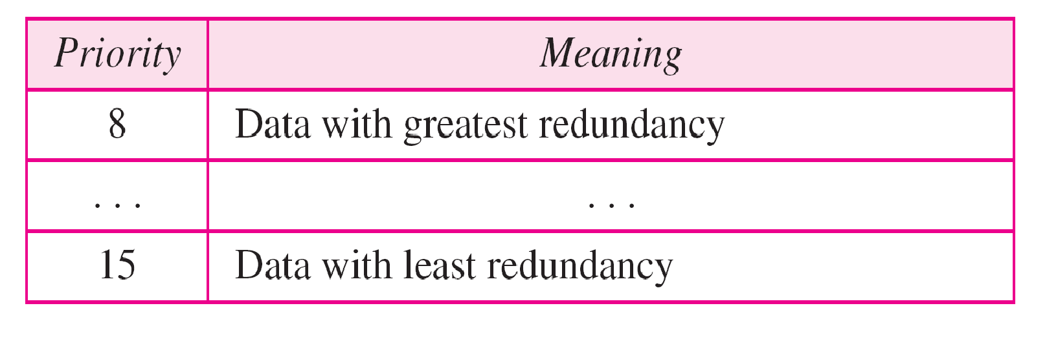
Priorities for noncongestion-controlled traffic

Slide 24
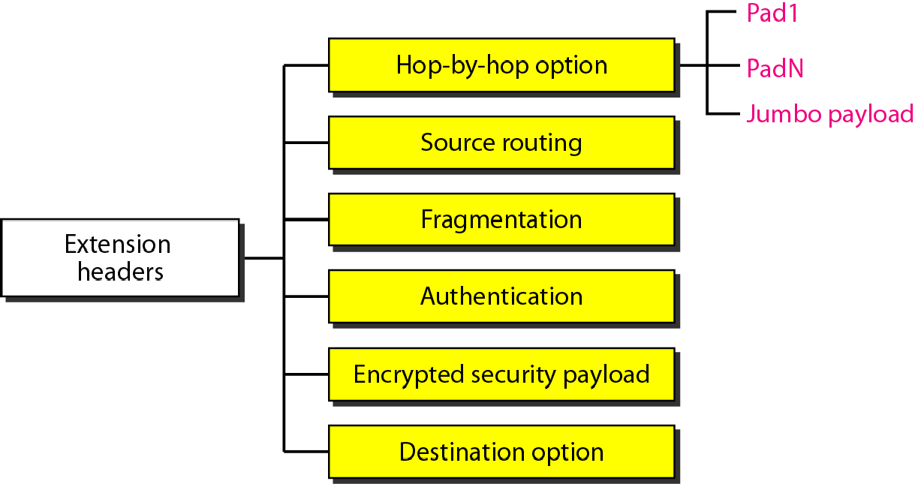
Extension header types

Slide 25
Advantages of IPv6 over IPv4(Ipv4 v/s Ipv6)
Feature | IPv4 | IPv6
Source and destination address | 32 bits | 128 bits
Address Format | Dotted Decimal | Hexadecimal Notation
No of Address | 2^32 | 2^128
IPSec | Optional | required
Payload ID for QoS in the header | No identification | Using Flow label field
Fragmentation | Both router and the sending hosts | Only supported at the sending hosts
Header checksum | included | Not included
Resolve IP address to a link layer address | broadcast ARP request | Multicast Neighbor Solicitation message

Slide 26
Advantages of IPv6 over IPv4 (Ipv4 v/s Ipv6) (2)
Feature | IPv4 | IPv6
Determine the address of the best default gateway | ICMP Router Discovery(optional) | ICMPv6 Router Solicitation and Router Advertisement (required)
Send traffic to all nodes on a subnet | Broadcast | Link-local scope all-nodes multicast address
Configure address | Manually or DHCP | Autoconfiguration
Manage local subnet group membership | (IGMP) | Multicast Listener Discovery (MLD)

