Slide 1
Arima Forecast - Group 1
Abhilasha Singh
Abhinay Shete
Anitha Jothi
Ashok Gummadi
Geetha Nandimandalam
Hima Shah
Krishnasree Mukkavilli
Pratish Shetty
Rakesh M
Satheeshkumar Ap
Sean Oneill

Slide 2
ARIMA Forecast model
ARIMA - Autoregressive Integrated Moving Average.
Used to analyze and forecast time series data.
Time series data is data that can be plotted in accordance with its position in time relative to the other data points.
Calculated in python utilizing the pandas and stats models libraries.
Auto regression means the calculations use previous data points to determine new data points.

Slide 3





Solution Architecture (High Level)
UI Layer
Angular Application
Service Layer
Python REST API
Backend
Mongo DB

Slide 4

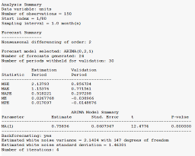
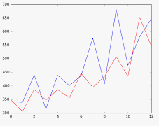
Flow Diagram
Upload historical data using file upload screen on UI.
Used node server for upload functionality
Rest API (Python) used to read file.
Python has built-in modules with ARIMA APIs which has capability to calculate forecast.
ARIMA module in python used to get model summary and forecast information.
Data returned from API displayed on UI.
Angular UI used to create UI screens.
Bootstrap used to make UI screen responsive.

Slide 5
Challenges
Understanding the ARIMA model.
Identifying technology component which can help getting ARIMA charts and data.
Extracting ARIMA summary and forecast data into JSON format in python.
Passing ARIMA Summary and forecast data to UI from REST API.
Database integration to pull historical data and pass it to ARIMA APIs in python.
Integrating Angular application with Python rest APIs with CORS.
Application hosting on cloud platform.

Slide 6
Demo

Slide 7
Thank You

