Slide 1



Department of Computer Science & Engineering, CMR Technical Campus
(UGC Autonomous | Accredited by NAAC, NBA)
B.Tech Industrial-Oriented Mini Project (2025–26)
RESOLGATE: An AI-Assisted Approval-Based Knowledge Repository for Education and Rural Learning
Presented By:
Under the Guidance of:
VADLA ABHILASH CHARY
237R1A05Y6
Bhagyashree B.M
Assistant Professor
SABAVAT RAHUL
247R5A0529
BANDI BHAVITHA
247R5A0526
Live Demo:https://resolgate.vercel.app
Source Code:https://github.com/Abhilashchary/code-resol-vault

Slide 2

AGENDA
Introduction & Project Purpose
Overview of the file management platform
Tools & Technologies
Frontend, backend, and database stack
Problem Statement & Existing System
Limitations of current solutions
Testing & Validation
QA strategies and test cases
Proposed System & Objectives
Key innovations and project goals
Current Progress & Deployment
Live status on Vercel
Literature Survey Summary
Review of related work and research
Hardware & Software Requirements
System prerequisites
System Architecture & Data Flow
Design layers and information flow
Future Work
Planned enhancements and features
Implementation & Modules
Development details and components
Conclusion & References
Final thoughts and citations
Results / Screenshots
Visual demonstration of the platform
RESOLGATE Project Review | Dept. of CSE, CMR Technical Campus

Slide 3








INTRODUCTION & PROJECT PURPOSE
ResolGate is a comprehensive, production-grade file management platform deployed on Vercel, combining secure sharing, approval workflows, and AI moderation on a scalable serverless architecture.
PLATFORM CAPABILITIES
PROJECT PURPOSE
Secure Sharing: Hierarchical organization with guest-based authentication and time-limited links.
Balance Priorities: Deliver an efficient system that balances compliance, security, and productivity without compromising usability.
Approval Workflows: Configurable, multi-stage queues for admin review before publication.
Reduce Overhead: Automate approval processes via AI + human-in-the-loop workflows to minimize administrative burden.
AI Moderation: Serverless AI models automatically analyze content safety to reduce manual overhead.
Intuitive UX: Provide user-friendly interfaces (drag-and-drop, bulk uploads) tailored for education and rural learning contexts.
Real-Time & Scalable: Supabase subscriptions and Vercel Edge Functions ensure global availability.
Global Scale: Achieve high reliability and availability through modern serverless infrastructure.
RESOLGATE Project Review | Dept. of CSE, CMR Technical Campus

Slide 4





PROBLEM STATEMENT
Organizations face critical challenges in managing digital assets while maintaining security, compliance, and operational efficiency.
Inconsistent Approval Processes
Complex Hierarchy Management
Manual decisions vary significantly between reviewers, creating fairness issues. Distributed teams lack a systematic workflow to ensure consistent standards are applied to all content.
Folder structures become disorganized without strict controls. Maintaining complex permission hierarchies across distributed teams becomes unmanageable and difficult to audit as organizations scale.
Limited Policy Enforcement
Inadequate Audit Trails
Organizations lack mechanisms to systematically identify content violating policies. Manual scanning of all stored files is impractical at scale, leaving potential risks undetected.
Platforms often fail to maintain detailed records of file access and modifications. Historical logs are limited, making it impossible to answer critical compliance questions about data access.
Insufficient Workflow Customization
Standard platforms force organizations to adapt their processes to tool constraints rather than supporting specific needs. Multi-stage approval workflows for specialized requirements are difficult or impossible to implement without significant custom development effort.
RESOLGATE Project Review | Dept. of CSE, CMR Technical Campus

Slide 5
EXISTING SYSTEM LIMITATIONS
Current mainstream file management solutions prioritize general access over specific organizational controls, leading to several critical limitations:
Limited Customization: Mainstream cloud storage platforms offer rigid workflows, forcing organizations to rely on fragile workarounds rather than adapting the system to their specific processes.
Manual Approval Processes: Content review predominantly relies on manual oversight, which is inconsistent, prone to human error, and costly to scale across distributed teams.
Weak Audit Capabilities: Existing systems often lack comprehensive audit trails, providing poor long-term traceability and making regulatory compliance verification difficult.
Scalability Challenges: Traditional systems frequently face performance degradation as content volume grows exponentially, requiring expensive infrastructure upgrades to maintain responsiveness.
Integration Complexity: Seamlessly connecting file management with other organizational tools and specialized processes often requires complex custom development and maintenance.
RESOLGATE Project Review | Dept. of CSE, CMR Technical Campus

Slide 6
PROPOSED SYSTEM OVERVIEW
ResolGate combines modern serverless architecture with intelligent automation to address file management challenges:
Guest-Based Authentication: Simplifies access by eliminating password management overhead for standard users while maintaining secure role-based access control.
Configurable Approval Workflows: Supports multi-stage approval processes with escalation capabilities, ensuring all content meets organizational standards before publication.
AI-Assisted Content Moderation: Automatically analyzes uploaded files for policy violations, ensuring consistent application of safety standards across all content.
Defense-in-Depth Security: Implements PostgreSQL Row Level Security (RLS) to enforce data access policies at the database layer, protecting against application-level vulnerabilities.
Global Serverless Processing: Leverages Vercel Edge Functions to deliver low-latency performance and automatic scaling for users worldwide.
RESOLGATE Project Review | Dept. of CSE, CMR Technical Campus

Slide 7



OBJECTIVES OF THE PROJECT
ResolGate aims to deliver a secure, scalable, and intelligent file management platform with clearly defined primary and secondary goals.
Primary Objectives
Secondary Objectives
Secure File Management: Implement robust file handling enabling organizations to manage digital assets securely while maintaining strict compliance requirements.
Real-Time Collaboration: Enhance team productivity through instant notifications and real-time status updates on approvals.
Comprehensive Auditing: Maintain detailed, immutable audit trails documenting all file access and modification activities for compliance.
Automated Approval Workflows: Create configurable, multi-stage approval processes with escalation mechanisms that match organizational procedures.
Mobile Responsiveness: Ensure seamless access across diverse devices (smartphones, tablets, desktops) through responsive design.
AI-Assisted Moderation: Integrate AI analysis to automatically identify potentially problematic content, reducing manual review burden by ~60%.
Performance Reliability: Establish performance baselines ensuring rapid response times under load with robust error handling.
Comprehensive Security: Enforce defense-in-depth strategies through Row Level Security (RLS) and encrypted storage mechanisms.
Scalability: Support organizational growth without infrastructure changes through serverless architecture.
Intuitive Interface: Develop user-friendly interfaces that minimize training requirements and accelerate adoption.
RESOLGATE Project Review | Dept. of CSE, CMR Technical Campus

Slide 8
LITERATURE SURVEY SUMMARY
Evolution of File Management: Shift from traditional on-premise storage to cloud-based collaboration, and now to intelligent serverless, AI-driven systems.
Analysis of Cloud Platforms: Existing solutions (Google Drive, Dropbox, OneDrive) offer excellent UX but lack customizable policy enforcement and specialized approval workflows.
Content Moderation Research: Manual review is costly and inconsistent (Chen et al., 2023). Fusion AI models combining visual and contextual analysis significantly improve accuracy and reduce false positives (Li et al., 2023).
Security Paradigms: Row Level Security (RLS) is proven to effectively enforce least-privilege access control directly at the database layer, preventing application-level bypasses (Wang et al., 2022).
Key Implication: A modern, compliant platform must integrate customizable workflows, AI-assisted moderation, and rigorous database-level security to address current organizational challenges.
RESOLGATE Project Review | Dept. of CSE, CMR Technical Campus

Slide 9









SYSTEM ARCHITECTURE OVERVIEW
Frontend Layer
Backend Layer (Vercel)
Data Layer (Supabase)
Web Browser
API Routes
PostgreSQL Database
Chrome, Firefox, Safari
Serverless Edge Functions handling requests
User & Metadata
Audit Logs
RLS Policies
React Application
Business Logic
React 18.3.1 + TS
Authentication, Validation, Approval Workflows
File Storage
Vite 5.4+ Build
REST / WSS
SQL / Storage
shadcn/ui Components
Encrypted Object Buckets for Documents
TanStack Query
AI Moderation
Content Safety Analysis Service
Real-Time Engine
Client State
WebSocket Subscriptions for Live Updates
Context API / Storage
RESOLGATE Project Review | Dept. of CSE, CMR Technical Campus

Slide 10




ARCHITECTURE LAYERS
ResolGate employs a modular, serverless architecture across three distinct layers to ensure scalability, security, and performance.
Frontend Layer
Backend Layer
Data Layer
React 18.3.1 + TypeScript: Type-safe, component-based UI development ensuring robustness.
Vercel Edge Functions: Serverless API routes executing business logic globally.
Supabase PostgreSQL: Managed database with 99.99% uptime and auto-backups.
AI Integration: On-demand serverless functions for content moderation analysis.
Row Level Security (RLS): Fine-grained access control enforced at database level.
Vite 5.4+: Optimized build tool for fast development and production performance.
Security Middleware: Validates authentication before processing requests.
Real-Time Subscriptions: WebSocket connections for instant update notifications.
Tailwind CSS + shadcn/ui: Consistent, accessible styling with utility-first approach.
Scalability: Auto-scaling based on demand without infrastructure management.
Encrypted Storage: Secure file storage in buckets with metadata indexing.
TanStack Query: Efficient server state management with automatic caching.
Low Latency: Global distribution ensures fast response times worldwide.
Defense-in-Depth: Security persists even if application layer is compromised.
Responsive Design: Adapts to desktop, tablet, and mobile devices seamlessly.
RESOLGATE Project Review | Dept. of CSE, CMR Technical Campus

Slide 11


DATA FLOW DIAGRAM
EXTERNAL ENTITIES
SYSTEM PROCESSES
DATA STORES
1.0 File Processing
2.0 AI Moderation
D1: Supabase Buckets (Files)
Upload File
Validate Format → Extract Metadata → Initiate AI Scan
Analyze Visuals → Detect Risks → Generate Safety Score
User / Uploader
Safety Score
Update Status
3.0 Approval Workflow
D2: PostgreSQL (Metadata/Logs)
Review & Decision
Preview Content → Review AI Score → Approve/Reject
Log Access
4.0 Access Control
Verify Token
D3: LocalStorage (Tokens)
Administrator
Check RLS Policies → Verify Permissions → Log Access
Request Access
RESOLGATE Project Review | Dept. of CSE, CMR Technical Campus

Slide 12




KEY FEATURES: AUTHENTICATION & ORGANIZATION
Guest & Admin Authentication
Hierarchical File Structure
Guest Access: Username-based login eliminates password fatigue while maintaining user tracking.
Nested Folders: Support for unlimited nesting levels to match organizational complexity.
Admin Security: Password-protected ("coderesol") access for elevated privileges.
Drag-and-Drop: Intuitive interface for moving files and restructuring folders.
Session Control: Auto-expiry tokens and instant revocation via dashboard.
Integrity Checks: Automatic validation prevents orphaned files and maintains structure.
Bulk Upload & Management
Role-Based Access Control
Folder Uploads: Upload entire folder trees while preserving local directory structure.
Database Enforcement: Row Level Security (RLS) policies enforce permissions at the database layer.
Batch Processing: Concurrent processing of multiple files for improved performance.
Granular Permissions: Differentiate between view, edit, and admin capabilities.
Queue Management: Visual progress tracking for large upload batches.
Defense-in-Depth: Security maintained even if application logic is bypassed.
RESOLGATE Project Review | Dept. of CSE, CMR Technical Campus

Slide 13




KEY FEATURES: APPROVALS & AI MODERATION
Configurable Approval Workflows
AI-Powered Safety Assessment
Multi-Stage Queues: Customize approval processes with defined stages and escalation paths.
Automated Analysis: AI models analyze content for potential policy violations before human review.
Flexible Configuration: Adapt workflows to match specific organizational hierarchies.
Prioritization: Flags high-risk content for immediate attention, streamlining workflows.
Escalation Handling: Automatically route complex decisions to senior administrators.
Consistency: Standardizes decision-making criteria across all reviewers.
Admin Review Dashboard
Full Audit Trail & Logs
Centralized View: Comprehensive dashboard displaying all pending approval items.
Decision Tracking: Records every approval/rejection with administrator identity.
Content Previews: Instant preview capabilities for documents and media files.
Rationale Capture: Mandatory input for decision rationale ensures accountability.
Contextual Data: Displays uploader info, timestamp, and AI safety score side-by-side.
Compliance Ready: Generate detailed reports for regulatory and compliance audits.
RESOLGATE Project Review | Dept. of CSE, CMR Technical Campus

Slide 14




KEY FEATURES: SHARING & REAL-TIME UPDATES
Secure Link Sharing
Usage Analytics & Policy
Time-Limited Links: Generate shareable links with configurable expiration dates for temporary access.
Access Tracking: Monitor who accesses shared files and when for comprehensive oversight.
Download Restrictions: Set download limits to control distribution of sensitive materials.
Policy Enforcement: Automatically enforce organizational sharing policies on all links.
Instant Revocation: Admins can immediately disable active links via the dashboard.
Audit Visibility: Complete visibility into external sharing patterns for compliance.
Real-Time Notifications
Synchronized Updates
Supabase Subscriptions: Leverage WebSockets for instant alerts on file status changes.
State Synchronization: Consistent view of file system across all connected clients.
Immediate Feedback: Users notified instantly upon approval or rejection of uploads.
Live Dashboard: Admin dashboard updates automatically without manual refresh.
Admin Alerts: Admins receive real-time notifications for new pending approvals.
Collaboration Ready: Enables teams to work simultaneously with up-to-date information.
RESOLGATE Project Review | Dept. of CSE, CMR Technical Campus

Slide 15





IMPLEMENTATION OVERVIEW
1. Infrastructure
3. Core Logic
Vercel & Supabase setup, Repository initialization
Uploads, Metadata, RLS Policies, Sharing APIs
2. Frontend Dev
4. AI & Advanced
React, TS, Vite setup, UI Components (shadcn)
AI Moderation Pipeline, Real-time Subs
5. QA & Production Deployment
Unit/Integration Testing, Performance Optimization, Final Production Release on Vercel
RESOLGATE Project Review | Dept. of CSE, CMR Technical Campus

Slide 16
ALGORITHMS & KEY COMPONENTS
Core technical mechanisms driving the RESOLGATE platform's functionality, security, and performance.
AI Moderation Pipeline: Automated content analysis utilizing visual and contextual processing to assign safety scores (Safe, Low, Medium, High Risk), reducing manual review burden by ~60%.
Row Level Security (RLS): Database-layer enforcement of access policies where query results are filtered per-user/per-role, ensuring data isolation even if application logic is bypassed.
Real-Time Synchronization: Implementation of publish/subscribe patterns via Supabase Realtime to instantly propagate file status changes and notifications across all active client sessions.
Edge Caching & Delivery: Utilization of Vercel's global edge network for content delivery, optimizing latency by serving static assets and API responses from locations geographically closest to users.
Defense-in-Depth Security: Multi-layered protection strategy including token-based session management with automatic expiry, encrypted data transport (TLS), and storage encryption at rest.
RESOLGATE Project Review | Dept. of CSE, CMR Technical Campus

Slide 17


MODULES DEVELOPED - USER MODULE
The User Module provides intuitive interfaces for file management, sharing, and status tracking, designed for simplicity and efficiency in rural learning environments.
Access & Management
Sharing & Status
Lightweight Access: Guest-based authentication requiring only a username, eliminating complex password management for end-users.
Secure Sharing: Generate time-limited shareable links with configurable expiration dates and download limits.
Status Tracking: View real-time approval status (Pending, Approved, Rejected) for all uploaded content.
Flexible Uploads: Support for single and bulk file uploads with drag-and-drop functionality for ease of use.
Real-Time Updates: Receive immediate notifications via WebSocket subscriptions when admin actions occur.
Hierarchical Organization: Create and manage nested folder structures to organize educational content logically.
Content Discovery: Search and filter approved files based on metadata, tags, and organizational structure.
Responsive UI: Fully adaptive interface optimized for desktop, tablet, and mobile devices to support diverse access points.
RESOLGATE Project Review | Dept. of CSE, CMR Technical Campus

Slide 18


MODULES DEVELOPED - ADMIN MODULE
The Admin Module provides comprehensive control over the repository, enabling oversight of content, users, and security protocols through a secure dashboard.
Access & Approvals
Oversight & Analytics
Secure Authentication: Dedicated admin login with password protection ("coderesol") to prevent unauthorized access to sensitive controls.
Access Analytics: Monitor file access patterns, download statistics, and sharing activity across the organization.
Pending Queue Dashboard: Centralized view of all uploads awaiting review, complete with file previews and metadata.
Link Management: Ability to instantly revoke active share links or modify expiration settings for enhanced security.
Decision Management: Streamlined approve/reject actions with required rationale logging for transparency and audit trails.
Role Management: Configure user roles and permission levels, handling escalations for complex approval scenarios.
Real-Time Alerts: Immediate notifications via WebSocket subscriptions when new content requires attention.
Audit Logs: Comprehensive tracking of all administrative actions, ensuring accountability and regulatory compliance.
RESOLGATE Project Review | Dept. of CSE, CMR Technical Campus

Slide 19
MODULES DEVELOPED — AI INTEGRATION
The AI Integration module leverages serverless edge functions to automate content safety analysis, reducing manual moderation burden and ensuring consistent policy enforcement.
Processing Pipeline
Benefits & Impact
Serverless Execution: Leveraging Vercel Edge Functions to process AI analysis on-demand without managing dedicated infrastructure.
Workload Reduction: Successfully lowers manual review requirements by approximately 60% by filtering clearly safe content.
Automated Workflow: The pipeline automatically triggers upon upload: Extraction → Analysis → Scoring → Persistence → Notification.
Risk Prioritization: Automatically flags high-risk content for immediate administrative attention, ensuring critical issues are addressed first.
Safety Scoring: Generates categorical risk ratings (Safe, Low, Medium, High) based on visual and contextual content analysis.
Consistency: Eliminates human fatigue and bias factors, ensuring standardized application of organizational content policies.
Data Persistence: Stores detailed analysis results and confidence scores in PostgreSQL for audit trails and future model training.
Continuous Improvement: Creates a feedback loop where admin decisions on flagged content help refine future model accuracy.
RESOLGATE Project Review | Dept. of CSE, CMR Technical Campus

Slide 20
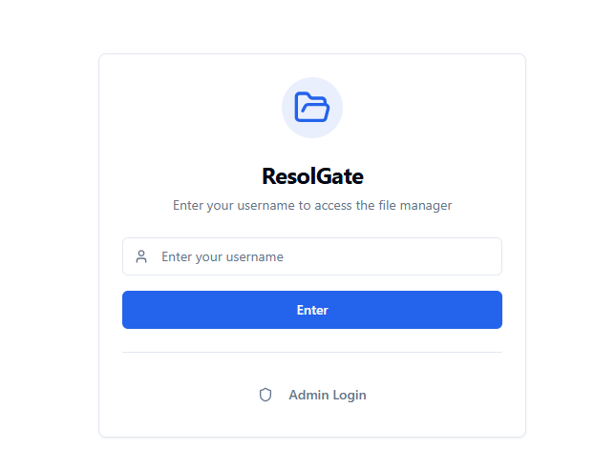
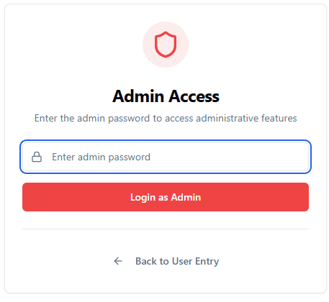


RESULTS & SCREENSHOTS: LOGIN INTERFACES
Insert Screenshot Here:
Guest Login UI
Insert Screenshot Here:
Admin Login UI
Figure 3.2.1: Guest Login Interface
Figure 3.2.2: Admin Login Interface
Streamlined access point for standard users. Requires only a unique username for session tracking, reducing credential management overhead while maintaining auditability.
Secure entry point for administrators requiring password authentication ("coderesol"). Grants access to approval dashboards, user management, and system configuration.
Live Demo Accessible at: https://resolgate.vercel.app/entry
RESOLGATE Project Review | Dept. of CSE, CMR Technical Campus

Slide 21
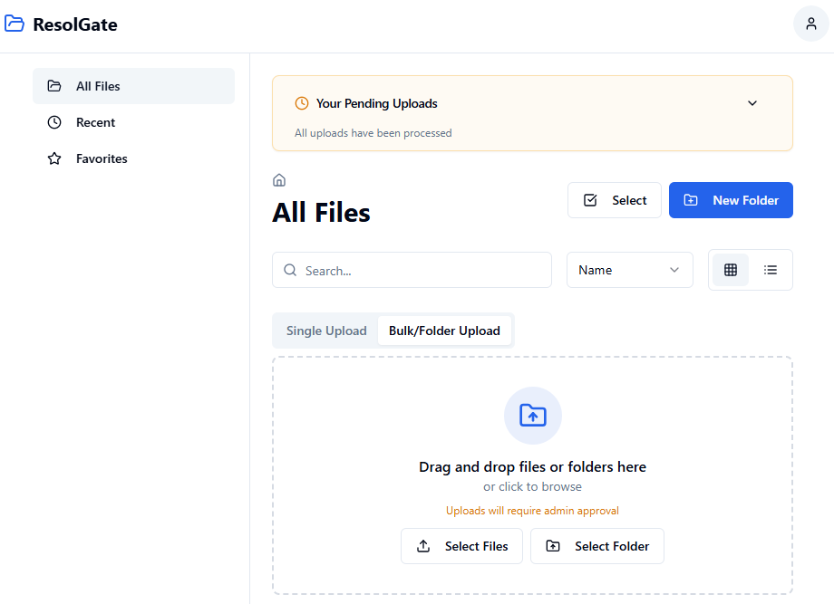
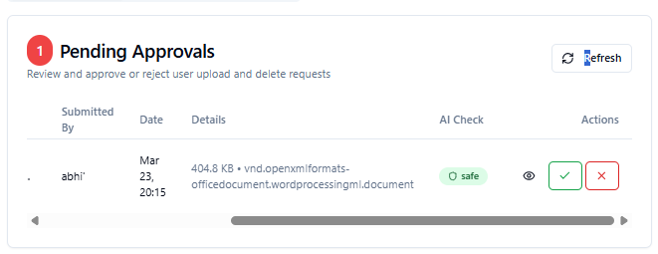





RESULTS & SCREENSHOTS: DASHBOARD & AI FEATURES
Insert Screenshot Here:
Main Dashboard / Landing Page
Insert Screenshot Here:
AI Analysis & Approvals
Figure 5.1: Landing Page (Main Interface)
Figure 5.2: AI Safety Check & Approval Panel
The central hub for file management, featuring drag-and-drop upload zones, hierarchical folder navigation, and quick access to recent files. Designed with shadcn/ui components for accessibility and responsiveness.
Admin view showing AI-generated safety scores (Safe/Low/Medium/High) alongside pending approval requests. Enables rapid decision-making with context-aware insights powered by edge functions.
Real-Time Updates
AI-Driven Moderation
RLS Security
Instant status reflection via WebSockets
Automated content safety scoring
Database-level access control
RESOLGATE Project Review | Dept. of CSE, CMR Technical Campus

Slide 22
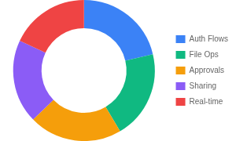
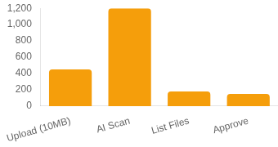

TESTING & VALIDATION METRICS
Testing Strategy
Functional Coverage
Performance Benchmarks
Unit Testing: Jest + React Testing Library for component isolation.
Integration Testing: Verifying API routes and Supabase interactions.
E2E Testing: Cypress workflows for critical user paths (Upload → Approve).
Performance: Load testing via k6 on Vercel Edge functions.
Validation Summary (Ref. Table 6.2)
Test Case ID
Scenario Description
Expected Outcome
Result
TC_AUTH_01
Admin Login with Invalid Credentials
Access Denied, Error Toast displayed
Pass
TC_UPLOAD_02
Bulk Upload with Nested Folders
Structure preserved, files queued
Pass
TC_AI_03
High-Risk Content Detection
Flagged as 'High Risk', auto-notification
Pass
TC_RLS_04
Unauthorized File Access Attempt
DB query returns empty set (RLS active)
Pass
RESOLGATE Project Review | Dept. of CSE, CMR Technical Campus

Slide 23



CURRENT PROGRESS & DEPLOYMENT STATUS
Production Deployment Live
The platform is fully deployed and globally accessible on Vercel's edge network, ensuring high availability and low latency for users worldwide.
Serverless Architecture Active
Vercel Edge Functions are successfully handling API requests and AI moderation pipelines, providing scalable serverless compute without infrastructure management overhead.
Robust Data Layer
Supabase PostgreSQL integration is complete with Row Level Security (RLS) policies enforcing access control, and real-time subscriptions enabling instant UI updates.
Optimization & Monitoring
Performance monitoring is in place with optimized asset delivery via CDN. Initial load times and interaction latency metrics are meeting production targets.
Live Demo
Source Code
https://resolgate.vercel.app/entry
https://github.com/Abhilashchary/code-resol-vault
RESOLGATE Project Review | Dept. of CSE, CMR Technical Campus

Slide 24










TOOLS & TECHNOLOGIES
RESOLGATE utilizes a modern, serverless technology stack combining a robust frontend with scalable backend services and secure data management.
FRONTEND TECHNOLOGIES
BACKEND & DATABASE
React 18.3.1 v18.3.1
Vercel Platform
Component-based UI library with concurrent rendering for responsive interfaces.
Serverless deployment platform with edge network for global availability.
TypeScript v5.8+
Supabase PostgreSQL v13+
Static typing ensuring code reliability and minimizing runtime errors.
Managed database with Row Level Security (RLS) and automated backups.
Vite v5.4+
Edge Functions
Next-generation build tool offering instant server start and fast HMR.
Serverless compute for AI moderation and API routes running at the edge.
Tailwind CSS v3+
Real-Time Subscriptions
Utility-first CSS framework for rapid UI development and consistent design.
WebSocket integration for instant updates on approvals and file status.
shadcn/ui + Radix UI
Security Infrastructure
Accessible component primitives for robust and inclusive interface design.
Encryption in transit/at rest and Supabase Auth integration.
RESOLGATE Project Review | Dept. of CSE, CMR Technical Campus

Slide 25








SYSTEM REQUIREMENTS & SPECIFICATIONS
Hardware Requirements
Software & Stack
Processor
Intel Core i5 or equivalent
Operating System
Windows 10+ / macOS 11+ / Linux
Minimum Spec
Memory (RAM)
Runtime Env
Node.js 18+ LTS; npm 9+ / yarn 3+
Required Capacity
8GB minimum
Frontend Tech
React 18.3.1, TypeScript 5.8+, Vite 5.4+
Storage
50GB SSD
Disk Space
UI & Styling
Tailwind CSS, shadcn/ui, Lucide Icons
Network
Broadband 10+ Mbps
Connectivity
Backend & DB
Supabase (PostgreSQL 13+), Vercel Edge
Display
1920×1080 minimum
Resolution
State & Forms
TanStack Query, React Hook Form
RESOLGATE Project Review | Dept. of CSE, CMR Technical Campus

Slide 26





FUTURE WORK & REMAINING MODULES
1. Enhanced AI Models
3. Advanced Security
Multimodal analysis combining visual and textual cues for higher accuracy.
Client-side end-to-end encryption with user-managed keys for maximum privacy.
2. Analytics Dashboard
4. Mobile Workflows
Comprehensive reporting on usage patterns, sharing statistics, and moderation effectiveness.
Dedicated mobile apps with offline access capabilities for rural connectivity.
5. Enterprise Integrations & Multi-Tenancy
Deeper integration with LMS platforms, SSO support, and multi-tenant architecture for organizational scaling.
RESOLGATE Project Review | Dept. of CSE, CMR Technical Campus

Slide 27


CONCLUSION & IMPACT
Project Achievements
Impact & Scalability
Production Deployment: Successfully deployed on Vercel with global edge network availability, demonstrating real-world readiness.
Scalable Architecture: Serverless design ensures the platform can grow from dozens to thousands of users without infrastructure overhaul.
AI-Driven Efficiency: Integrated AI moderation reduced manual review workload by ~60% while maintaining consistent policy application.
Educational Relevance: Provides a controlled, safe environment for sharing learning materials in rural and educational settings.
Defense-in-Depth Security: Implemented robust security via Row Level Security (RLS) policies, protecting data even if application logic is bypassed.
Operational Excellence: 99.99% uptime via Supabase and Vercel infrastructure ensures reliability for critical learning resources.
User-Centric Design: Delivered intuitive drag-and-drop interfaces and guest access that minimizes training requirements for rural education contexts.
Future-Ready: Modular codebase allows easy integration of advanced AI models and mobile-first features in upcoming phases.
"RESOLGATE bridges the gap between secure compliance and operational efficiency, delivering a modern, AI-enhanced repository tailored for education."
RESOLGATE Project Review | Dept. of CSE, CMR Technical Campus

Slide 28




REFERENCES & ACKNOWLEDGMENTS
Key Academic References
Acknowledgments
[1] Chen, J., et al. (2023). "Challenges in Scalable Content Moderation: Human Fatigue and Inconsistency." Journal of Digital Media Ethics, 15(2), 45-62.
We express our sincere gratitude to our guide Bhagyashree B.M (Assistant Professor) for invaluable guidance.
[2] Li, X., et al. (2023). "Multimodal Fusion for Improved AI Content Safety Detection." IEEE Transactions on Artificial Intelligence, 8(4), 112-128.
Special thanks to Dr. Nuthanakanti Bhaskar (HoD, CSE) and Dr. A. Raji Reddy (Director) for their continuous encouragement.
[3] Wang, Y., & Zhang, L. (2022). "Defense-in-Depth: Implementing Row Level Security in Modern Web Applications." ACM Symposium on Cloud Computing, 2022.
We also thank the Project Review Committee and the Department of CSE, CMR Technical Campus, for providing the infrastructure and support.
[4] Kumar, R. (2022). "Customizable Workflow Engines for Enterprise Compliance." International Journal of Software Engineering, 12(1), 78-94.
Live Demo:https://resolgate.vercel.app/entry
THANK YOU
Source Code:https://github.com/Abhilashchary/code-resol-vault
Questions & Discussion
RESOLGATE Project Review | Dept. of CSE, CMR Technical Campus

