Slide 1
NoSQL Database
What is NoSQL?
NoSQL is a non-relational DMS, that does not require a fixed schema, avoids joins, and is easy to scale.
NoSQL database is used for distributed data stores with humongous data storage needs. NoSQL is used for Big data and real-time web apps. For example, companies like Twitter, Facebook, Google that collect terabytes of user data every single day.
NoSQL database stands for "Not Only SQL" or "Not SQL."

Slide 2
NoSQL Database
Why NoSQL?
The concept of NoSQL databases became popular with Internet giants like Google, Facebook, Amazon, etc. who deal with huge volumes of data. The system response time becomes slow when you use RDBMS for massive volumes of data.
To resolve this problem, we could "scale up" our systems by upgrading our existing hardware. This process is expensive.
The alternative for this issue is to distribute database load on multiple hosts whenever the load increases. This method is known as "scaling out.“
NoSQL database is non-relational, so it scales out better than relational databases as they are designed with web applications in mind.

Slide 3
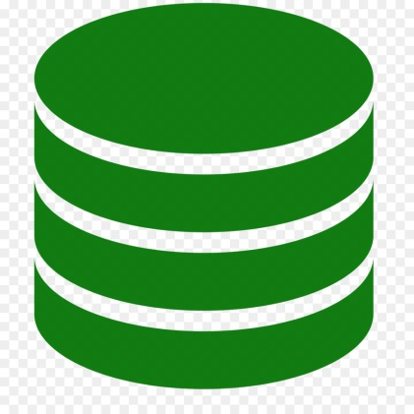
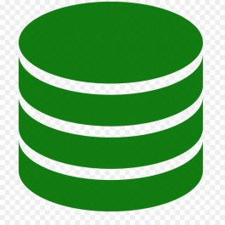


NoSQL Database
More RAM
More CPU
More HDD
Scale-Up(Vertical Scaling)
Commodity hardware
Scale-Out(Horizontal Scaling)

