Slide 1
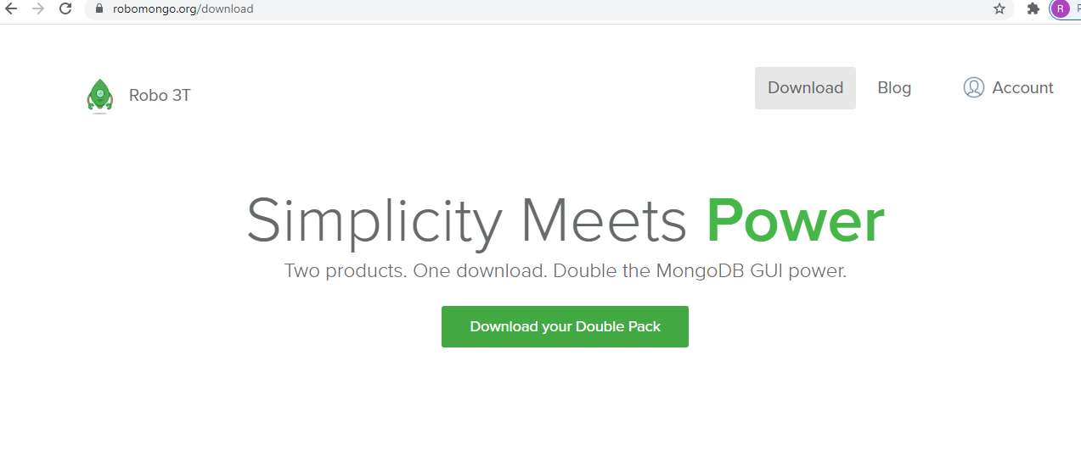
Install Robo 3T On Windows
https://robomongo.org/download

