Slide 1
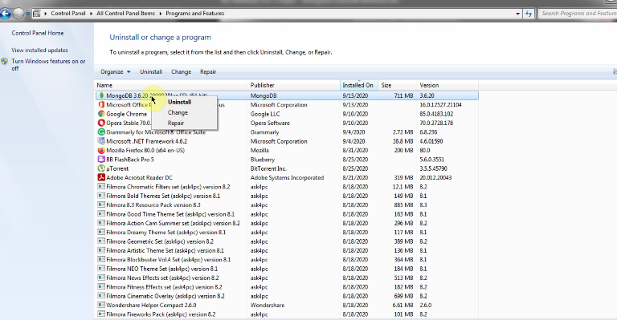
Uninstall MongoDB On Windows

