Slide 1
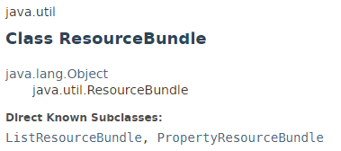
ResourceBundle
The ResourceBundle class is used to internationalize the messages. In other words, we can say that it provides a mechanism to globalize the messages.
The java.util.ResourceBundle is a library used for internationalization (multiple languages). It is able to return messages as per the default Locale configured for the system. Such a functionality is used when one develops systems to be used all over the world.

Slide 2
ResourceBundle
MyMessage_en_US.properties
English
Greeting = Hi, how are you?
The hardcoded message is not considered good in terms of programming, because it differs from one country to another. So we use the ResourceBundle class to globalize the massages.
The ResourceBundle class loads these information's from the properties file that contains the messages.
Conventionally, the name of the properties file should be filename_languagecode_country code for example MyMessage_en_US.properties.
MyMessage_fr_FR.properties
French
Greeting = Salut comment ca va?

Slide 3
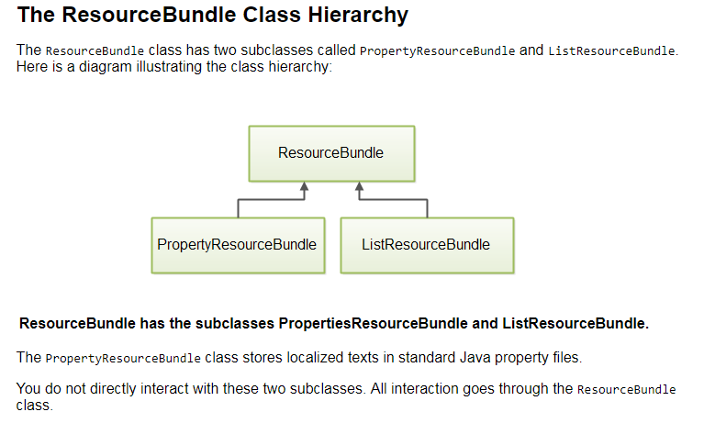
ResourceBundle

Slide 4
ResourceBundle
https://docs.oracle.com/javase/8/docs/api/index.html?java/util/ResourceBundle.html
http://www.oracle.com/technetwork/java/javase/javase7locales-334809.html

