Slide 1
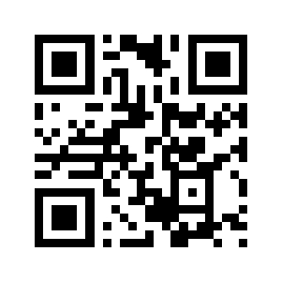
KOKA
✦ Built for busy medical professionals
Your patients are searching for you online.
Make sure they find a doctor they trust.
KOKAO writes your health content, designs your visuals, and publishes to every platform — so you can build your practice's reputation while you focus on patients.
Patients check first Most patients look up a doctor online before booking a consultation.
You have no time Writing posts, designing graphics and managing 6 platforms isn't your job.
Agencies cost a fortune ₹20,000–50,000 per month, with days of back-and-forth for every post.
WHAT KOKAO DOES FOR YOUR PRACTICE
1
Writes in your voice Health tips, myth-busters, awareness-day posts, patient FAQs and clinic updates — generated in minutes.
2
Designs the visuals too On-brand images and carousels matched to your clinic's colours and identity, automatically.
3
Publishes everywhere at once Facebook, Instagram, LinkedIn, X, YouTube and Threads — from one dashboard.
4
You stay in control Nothing goes out without your approval. Schedule a week's content in one sitting.
1/10th
the cost
A fraction of an agency's monthly fee — with content ready in minutes, not days. Consistent posting builds patient trust, referrals and walk-ins over time.
Start free today → app.kokao.in
Scan the QR code, sign up in under a minute, and generate your first week of clinic content — no credit card, no designer, no agency.
KOKAO — Your personal brand, on autopilot. · app.kokao.in

