Slide 1
Recommender System
for Books based on User
Ratings
Presented By: Abhilash Rajaram, Apurva Saha, Khushal Arora

Slide 2

Introduction
Large OTT platforms like Netflix,Amazon, Hostar have side lined the interest for books in general public
Our Idea : To create awareness among the not so avid readers about the books which are not very popular but with high ratings,, using the recommender system.

Slide 3
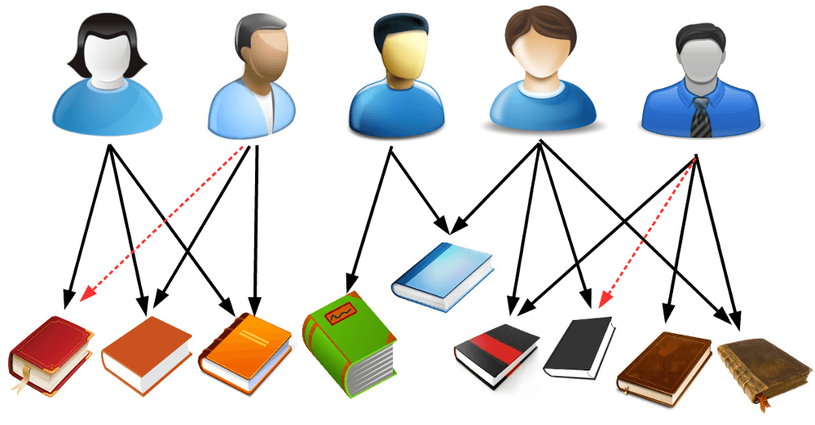
Recommender Systems
Decisions making strategy for users under complex information environments.
Algorithms aimed at suggesting relevant items to users, e.g.movies to watch, text to read or products to buy

Slide 4
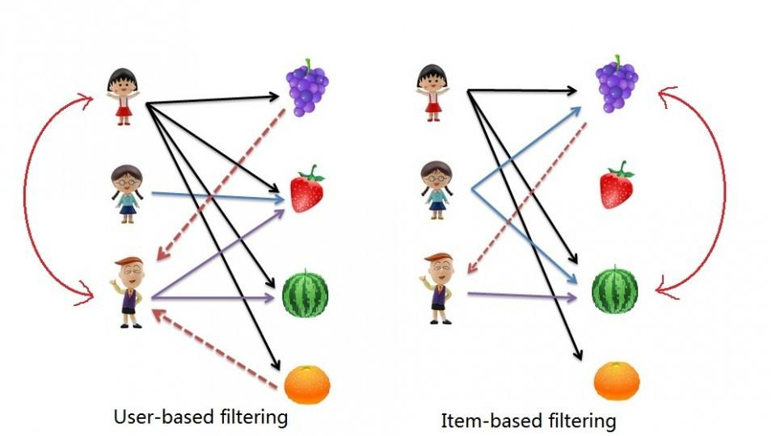
Type of Recommendation Systems
User Based Collaborative Filtering methods (UBCF):
Based on the previous “user and item interactions” to help predict/provide some new recommendations.
Item Based Collaborative Filtering(IBCF):
Similarity between items calculated using people's ratings of those items.

Slide 5
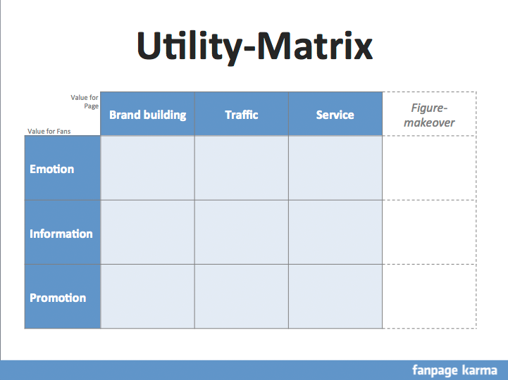
Conceptual Approach
The reciprocation of the ratings by the users are in this case need to be stored in the form of a Utility Matrix.
Without the utility matrix making recommendations will be nearly impossible to make.
The ratings are preferred on a defined scale (1 to 5, 1 to 10 etc.)

Slide 6
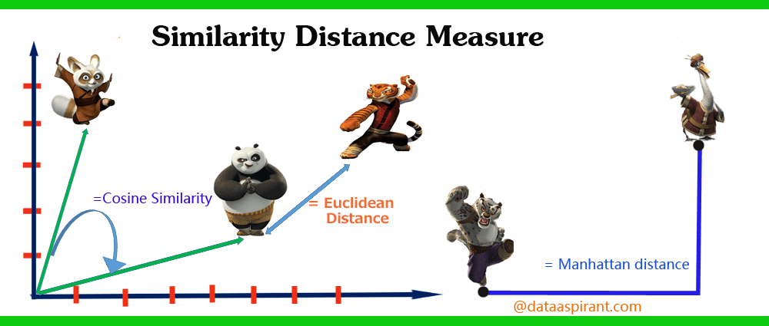
Similarity:
How two people are alike or their preference are also likewise is what can be said as similarity.
This concept can be extended to formulate numeric ways to see how akin two ratings are in this case, which gives rise the need to go different types of similarities.

Slide 7
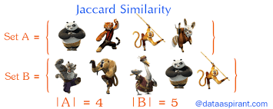
Jaccard Similarity
Jaccard similarity is used after we convert the matrix into a binary (0,1) matrix. We find the common items compared to the total items they have interacted with and get the ratio giving us a similarity of what items they possible prefer.
simJaccard(X , Y) = |X ∩ Y|/|X ∪ Y|
This just takes into account the common items between users without caring for the value of the rating

Slide 8
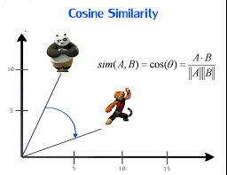
Cosine Similarity
In the cosine distance we get the similarity from the formula for the cross product between vectors.
In this method we consider the null values as 0 and proceed with the method.
The drawback is that the ‘0’ ratings are considered as ‘negative’ ratings. This is unfavourable in many cases.

Slide 9
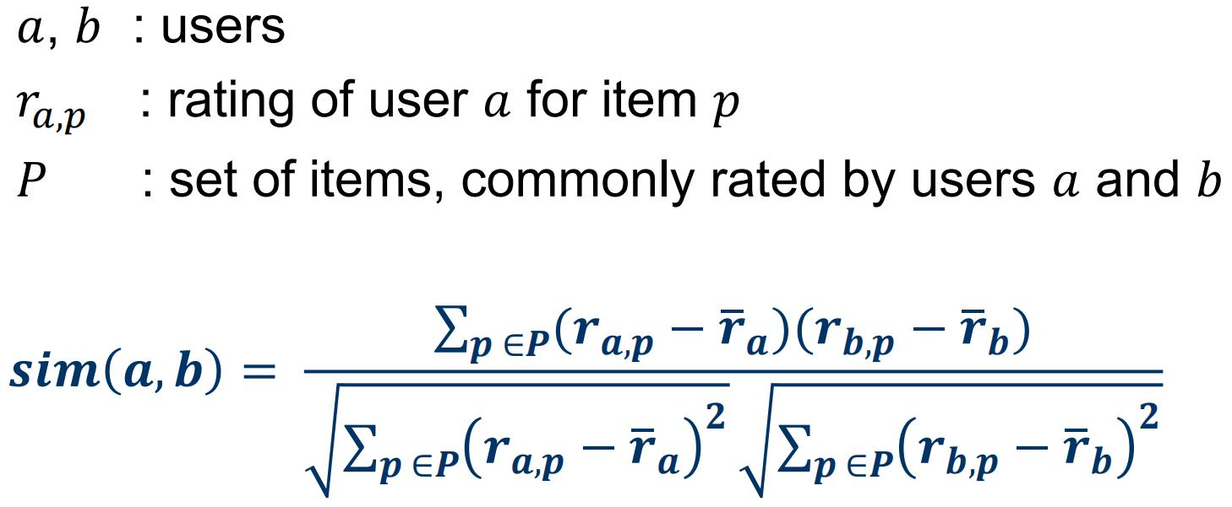
Pearson Similarity
There is a user’s bias which can be present in the rating matrix.
To guard against it we normalize the dataset by subtracting the average user rating and centering each users rating around 0.
This helps give a more accurate similarity calculation.

Slide 10
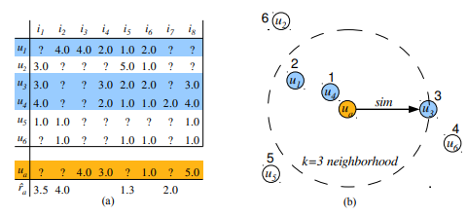
Prediction Criteria
We consider the ‘k’ nearest neighbors similar to the user based on ratings and can take to approaches to predict new ratings-
i) rˆaj = (1/ |N (a)|) * ∑ i∈N(a) (rij)
The normal average over the nearest user ratings.
rˆaj = (1/ ∑ i∈N(a) (sai)) * ( ∑ i∈N(a) (sai * rij))
Here we take the weighted average by including the similarity between the users.

Slide 11
Structure of the Data
Link: https://www.kaggle.com/arashnic/book-recommendation-dataset
The data consists of 3 datasets
Users: User-ID - primary attribute. Demographic data: (`Location`, `Age`), NA - if not specified.
Books : ISBN - primary attribute, with other features.
Ratings: Connected by User-ID and ISBN.
Either Explicit (0-10) or Implicit (0 - no ratings)
The datasets are merged and only unique users and books are considered.

Slide 12
Data Preprocessing:
The missing values are determined.
The AGE variable is inconsistent with 110762 missing values.
The Image URL’s are removed.
Ratings with 0 rating values are removed.
The non-zero ratings of (0-10) is converted into (0-5) ratings.
The top users who have rated is determined. The user who have rated above 40 books are considered for recommendation.
The top books which have been rated is determined. The books with total ratings of 200 and above are considered for recommendation.

Slide 13
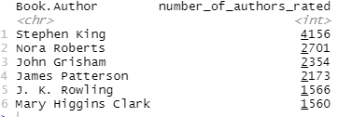
Authors whose books are rated the most times

Slide 14
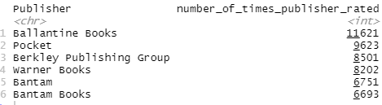
Publishing houses with high number of books rated
Notes:
just say this may point towards the publishing house being more popular or bigger.

Slide 15
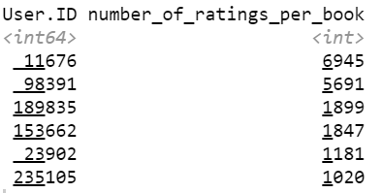
Users who have rated most number of times

Slide 16
Users who have rated most number of times

Slide 17
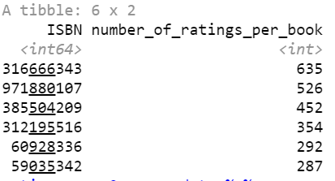
Books that are rated most number of times

Slide 18

Computational Approach
The recommenderlab package provides the infrastructure to develop and test recommender algorithms for rating data.
Preprocessed data is converted into realRatingMatrix object which stores the data in sparse format.
3 types of Recommender systems are built

Slide 19
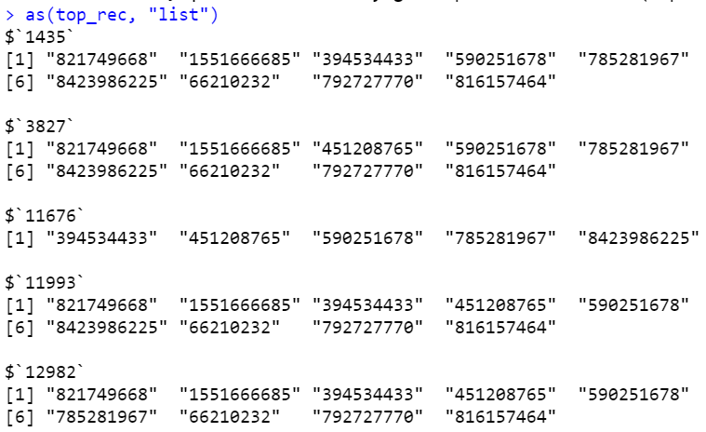

Popularity- Based Recommendation System

Slide 20
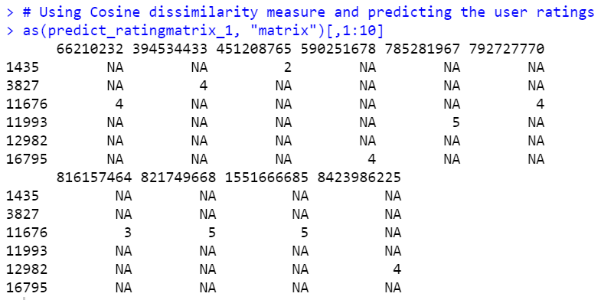
User- Based Recommendation System

Slide 21
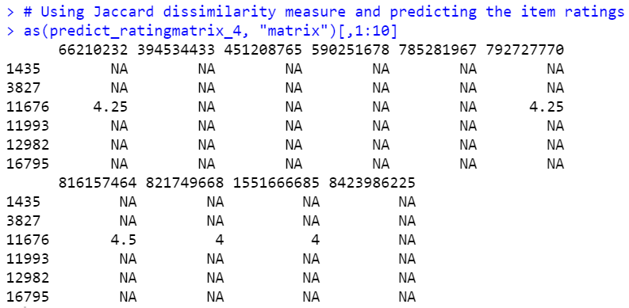
Item- Based Recommendation System

Slide 22


Matrix Factorization with Collaborative Filtering
To deal with the large dataset we propose the factorization of the matrix using different techniques:
1). Vanilla Matrix Factorisation :
2). Matrix Factorization with Biases:

Slide 23


3) Matrix Factorization with Side Features:
4) Matrix Factorization with Temporal Features

Slide 24
Matrix Factorization in Recommendation System
Keynote:
When splitting up the data into training and test sets, you should randomly select (user, book) pairs, not select random users or books.
The whole idea is the model should be able to predict ratings for books users haven't seen, based on the ratings provided for ones you have. If a user is present only in the testing set, the model cannot possibly be basing predictions based on their other ratings

Slide 25
Thank You!

