Slide 1
RADAR
RADAR — Click-by-Click Walkthrough
From 500 suppliers to the ones that matter — and the moment one starts to slip.

Slide 2
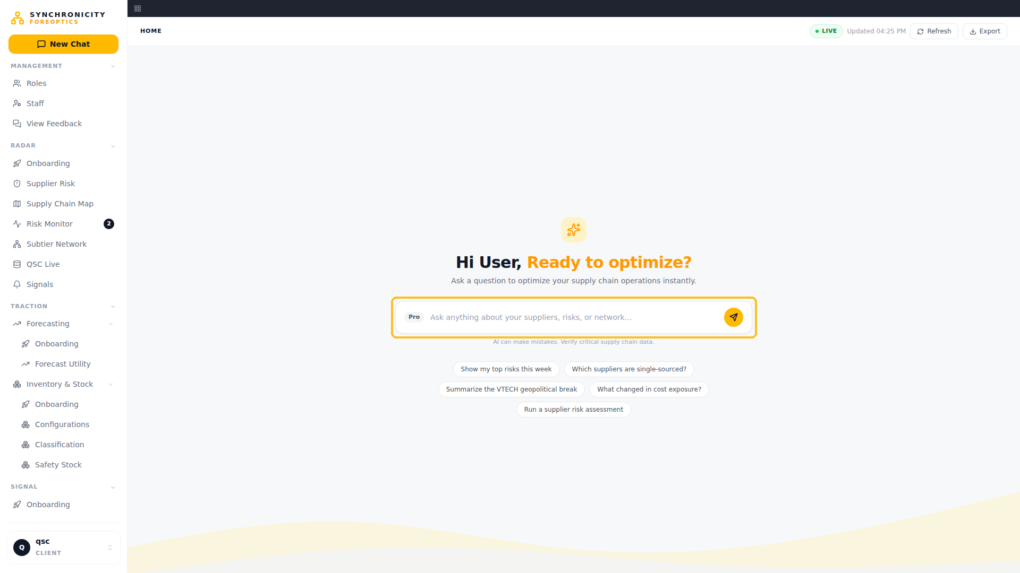
WHAT CHANGED: The front door — New Chat lands on a single question box over the whole supply base.
FOR THE VP: One entry point: ask, and the workspaces answer.
FOR THE SUPPLY CHAIN MANAGER: No hunting through menus — ask or jump straight to the worklist.

Slide 3
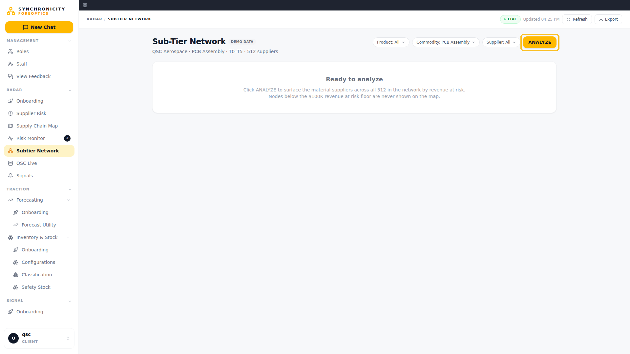
WHAT CHANGED: Landing — the full network exists but nothing is prioritized yet.
FOR THE VP: this is the before state — visibility without triage.
FOR THE SUPPLY CHAIN MANAGER: 500+ suppliers, no way to know where to start.

Slide 4
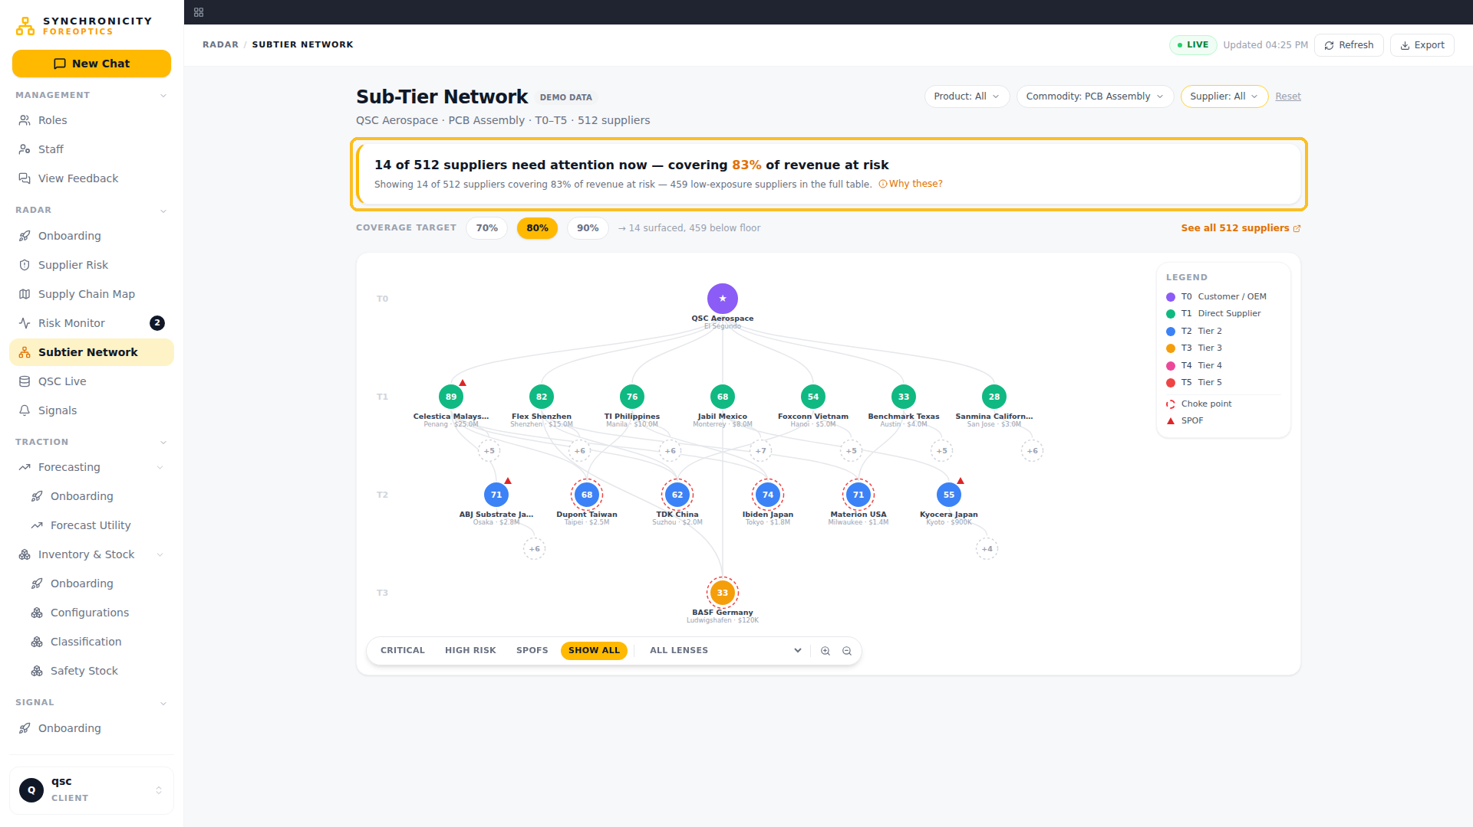
WHAT CHANGED: ANALYZE surfaces only the suppliers that matter, with the selection rule stated on screen.
FOR THE VP: one defensible answer instead of a wall — the "why these" is written on the view.
FOR THE SUPPLY CHAIN MANAGER: my worklist just built itself.

Slide 5
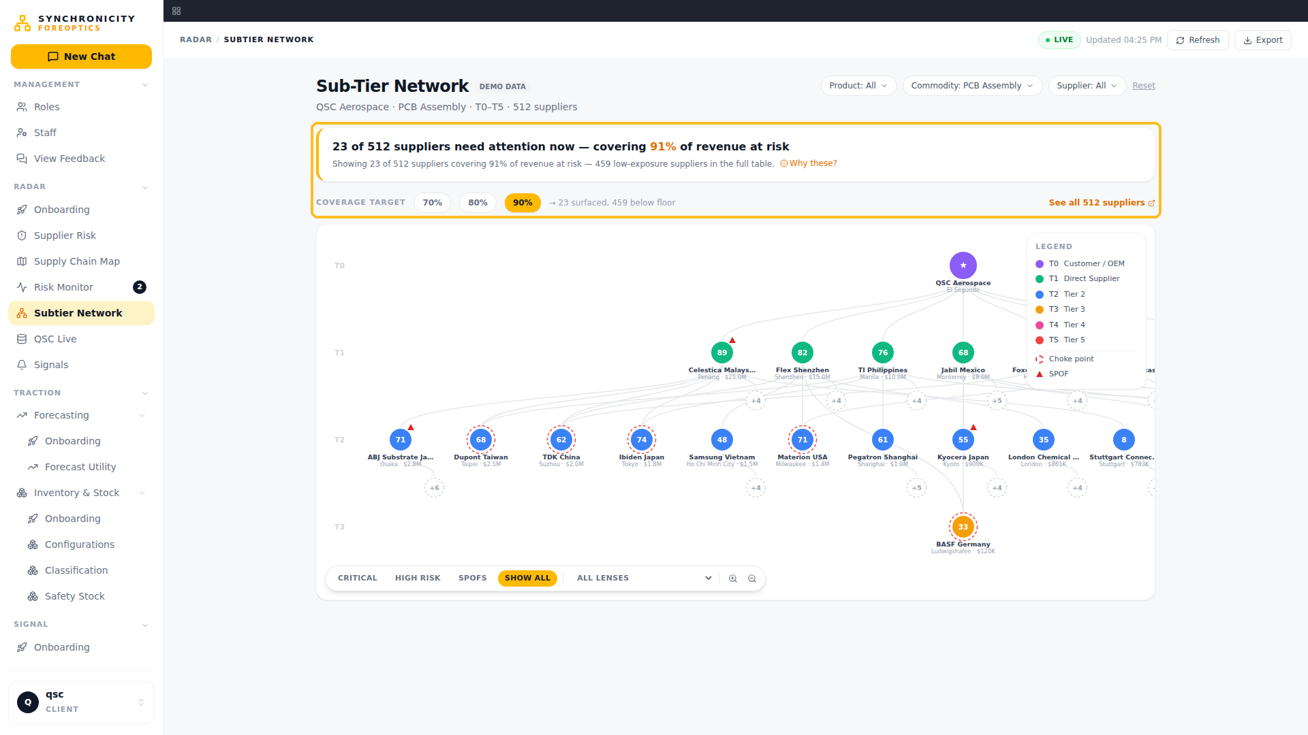
WHAT CHANGED: Coverage moved to 90% — the surfaced set widens and the headline recounts.
FOR THE VP: I choose how wide the net is; the screen sizes itself to the answer.
FOR THE SUPPLY CHAIN MANAGER: more coverage when I want it, never a fixed magic number.

Slide 6
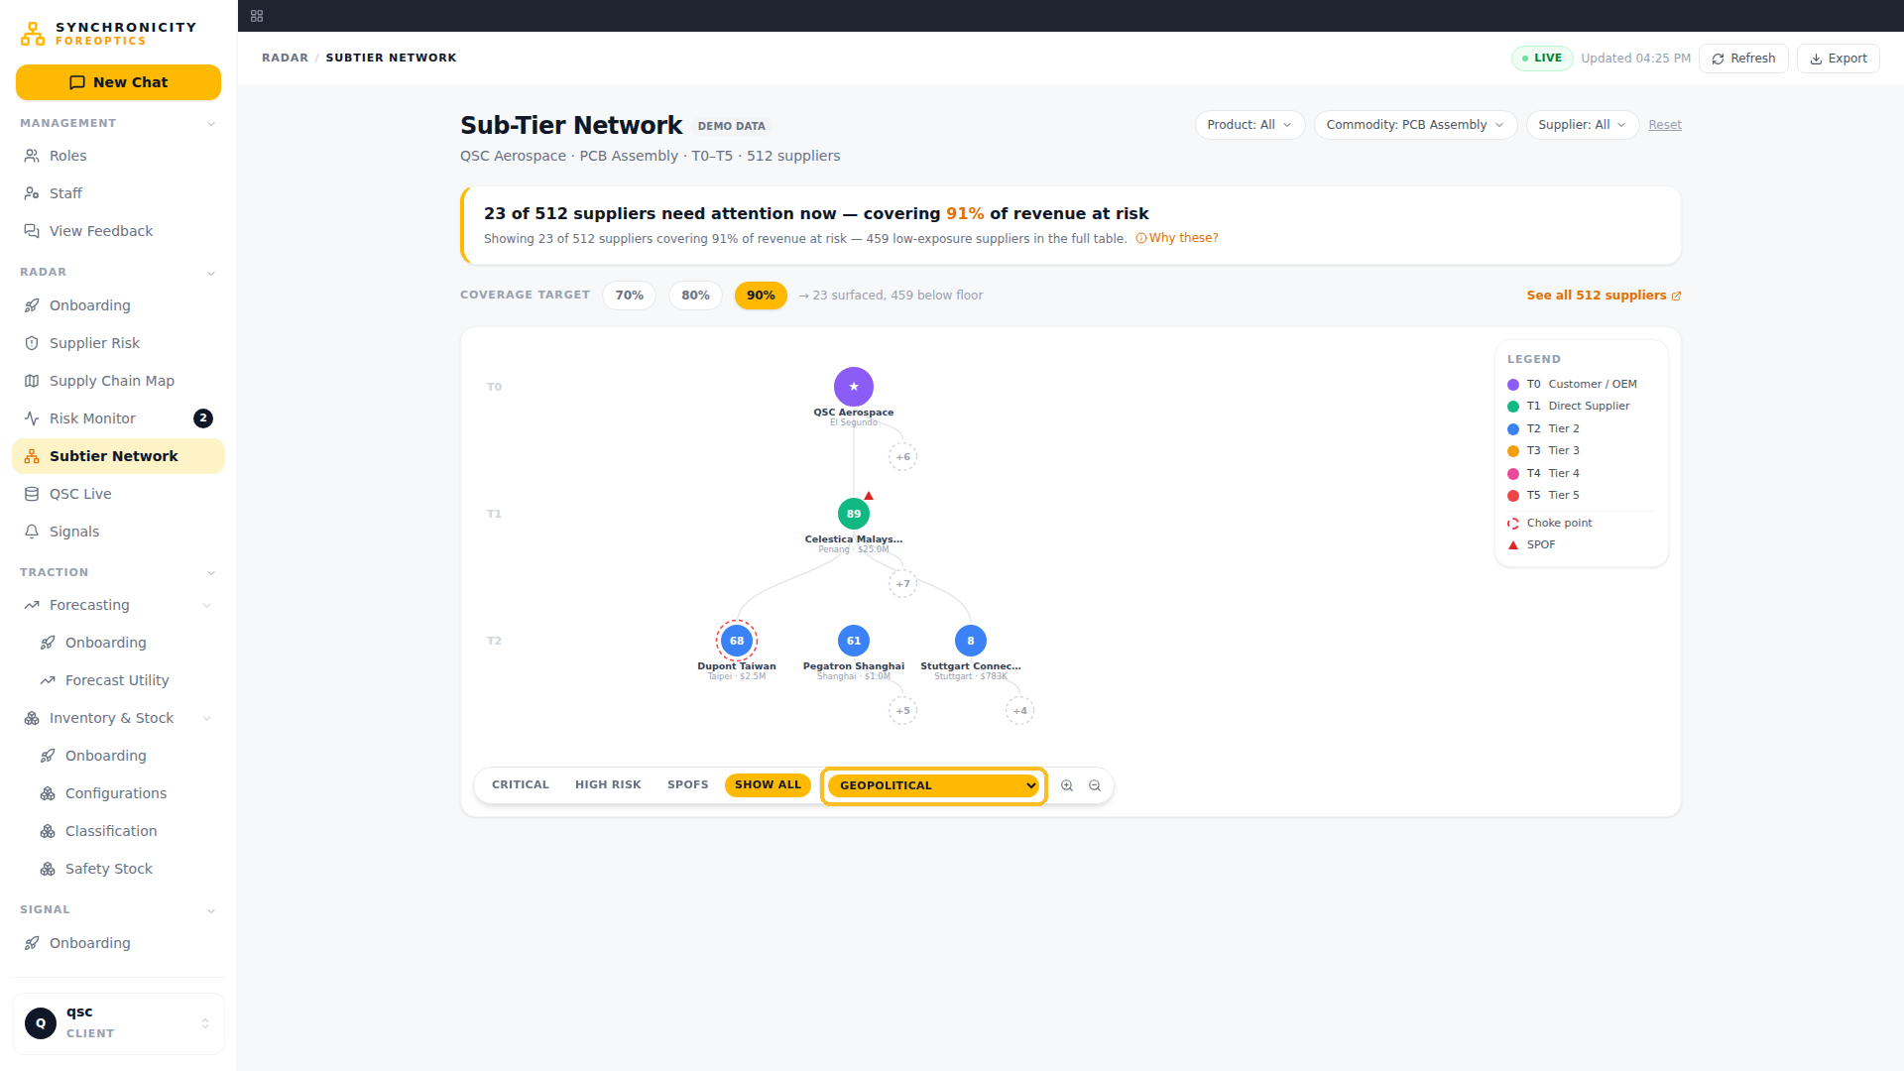
WHAT CHANGED: Lens filter narrows the map to geopolitical risk only.
FOR THE VP: one dimension of risk isolated across the whole network.
FOR THE SUPPLY CHAIN MANAGER: "where is my geopolitical exposure" answered in one click.

Slide 7
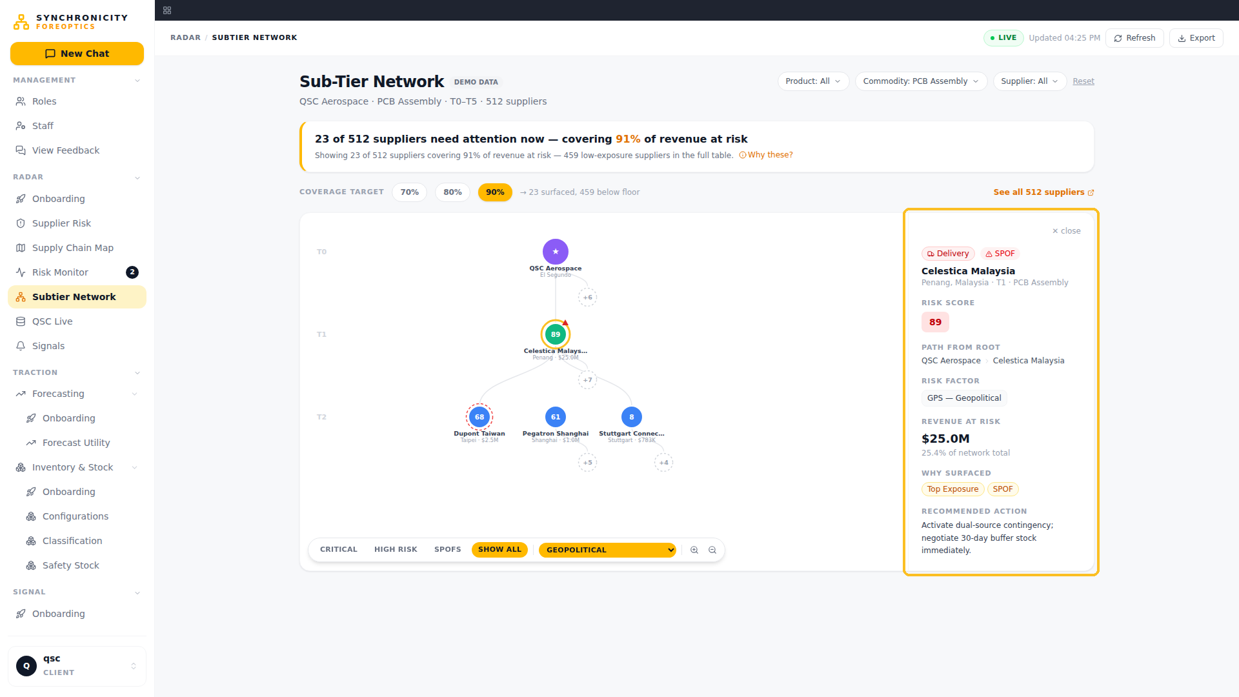
WHAT CHANGED: Clicking a node opens risk factor, exposure, path from root, and the recommended action.
FOR THE VP: every node carries its dollar stake.
FOR THE SUPPLY CHAIN MANAGER: the reason and the next move travel with the alert.

Slide 8
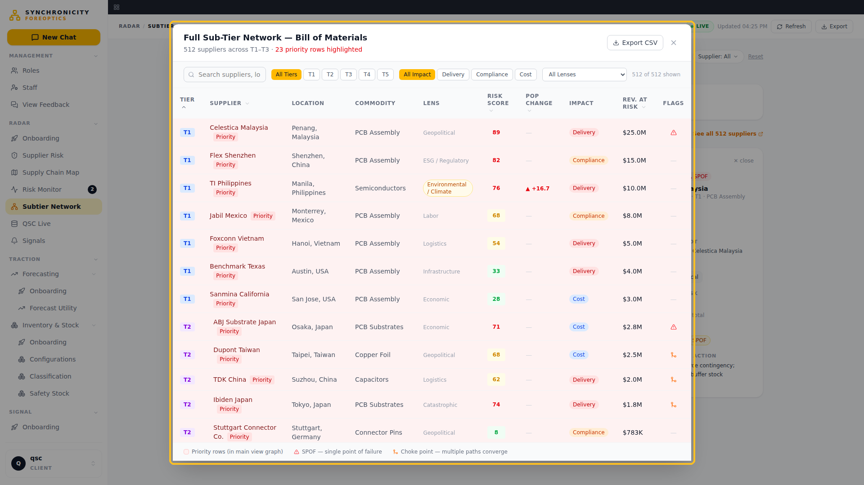
WHAT CHANGED: "See all" opens the full indented BOM — nothing is hidden, the long tail is one click away.
FOR THE VP: triage without loss of audit.
FOR THE SUPPLY CHAIN MANAGER: the complete list when I need to dig.

Slide 9
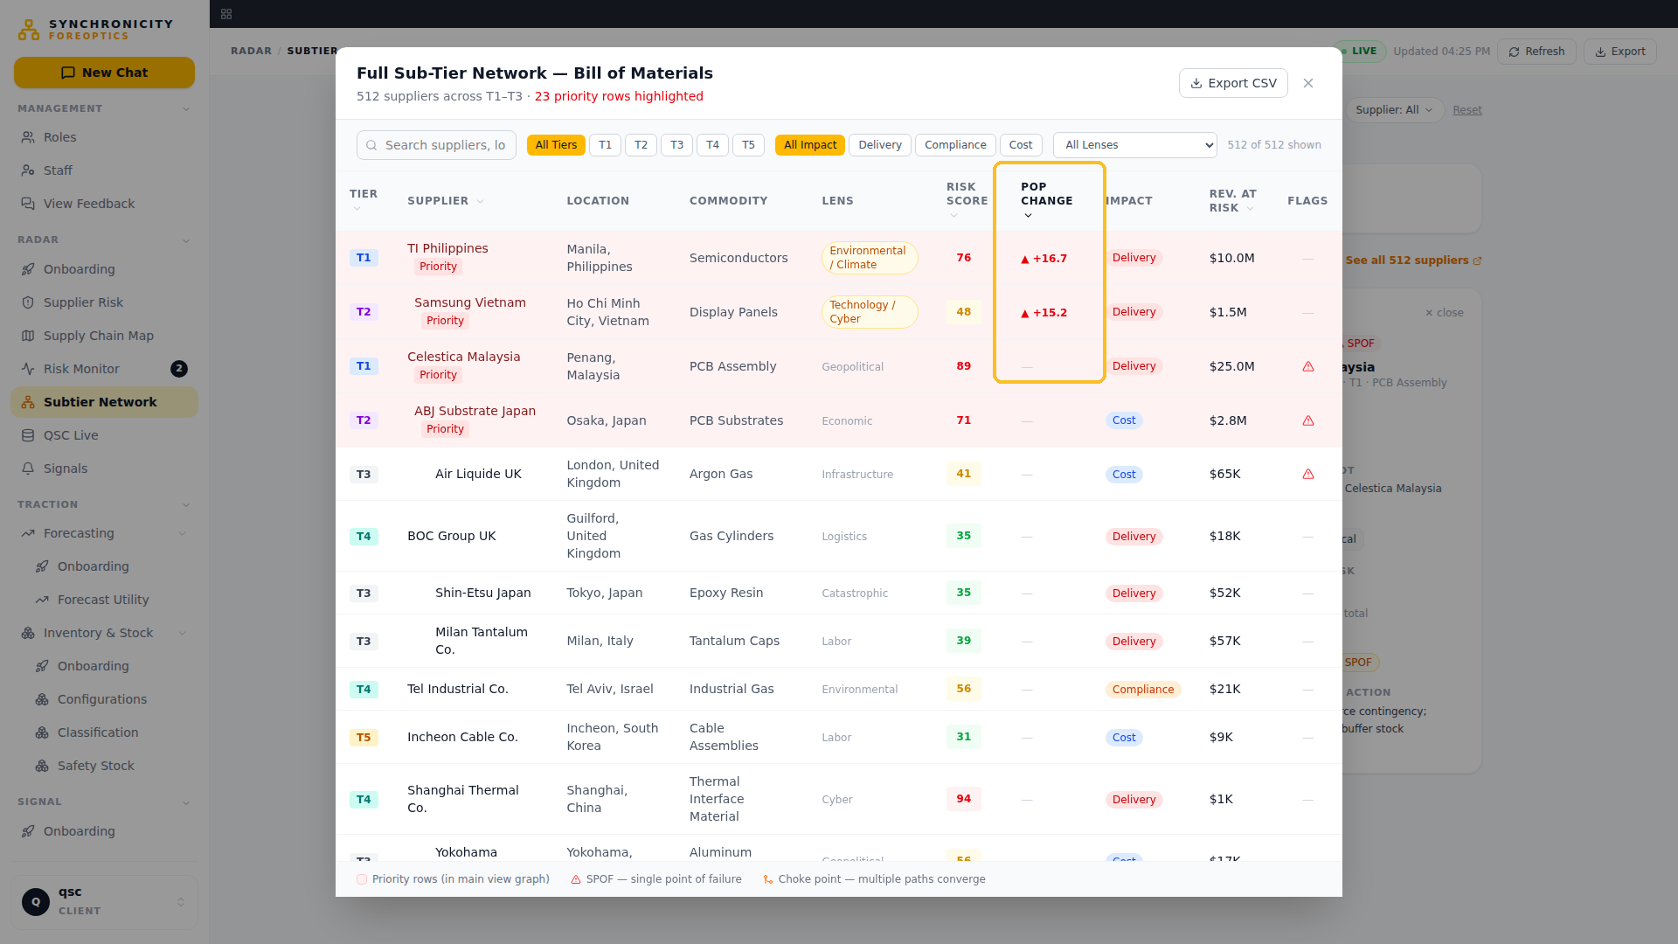
WHAT CHANGED: Sorted by POP Change — the biggest movers since last period rise to the top.
FOR THE VP: the weekly staff-meeting question — better or worse than last week — answered by a column.
FOR THE SUPPLY CHAIN MANAGER: reds on top, chase the change not the noise.

Slide 10
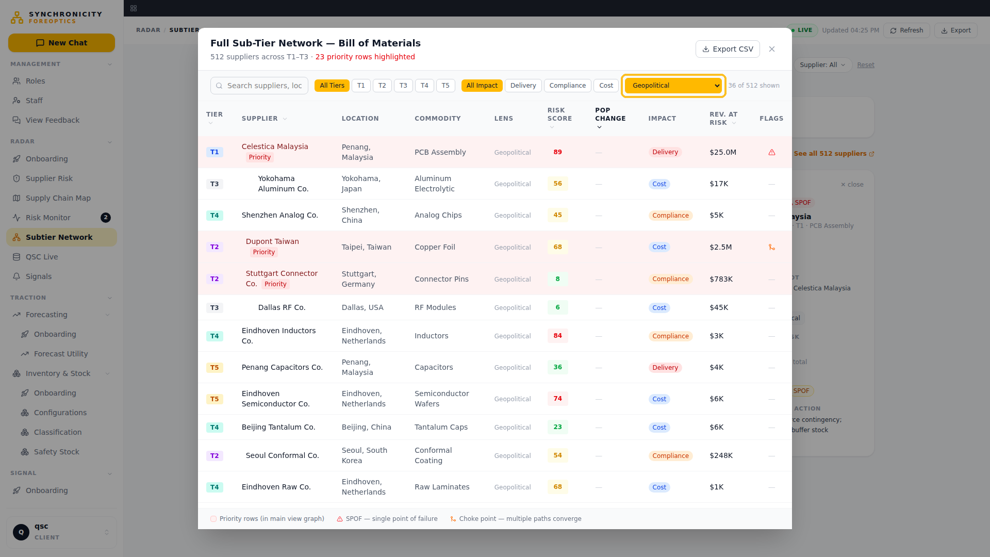
WHAT CHANGED: Lens filter inside the table — movement isolated by risk dimension.
FOR THE VP: change, by lens, by supplier, exportable.
FOR THE SUPPLY CHAIN MANAGER: filter to my commodity's risk and work the list.

Slide 11
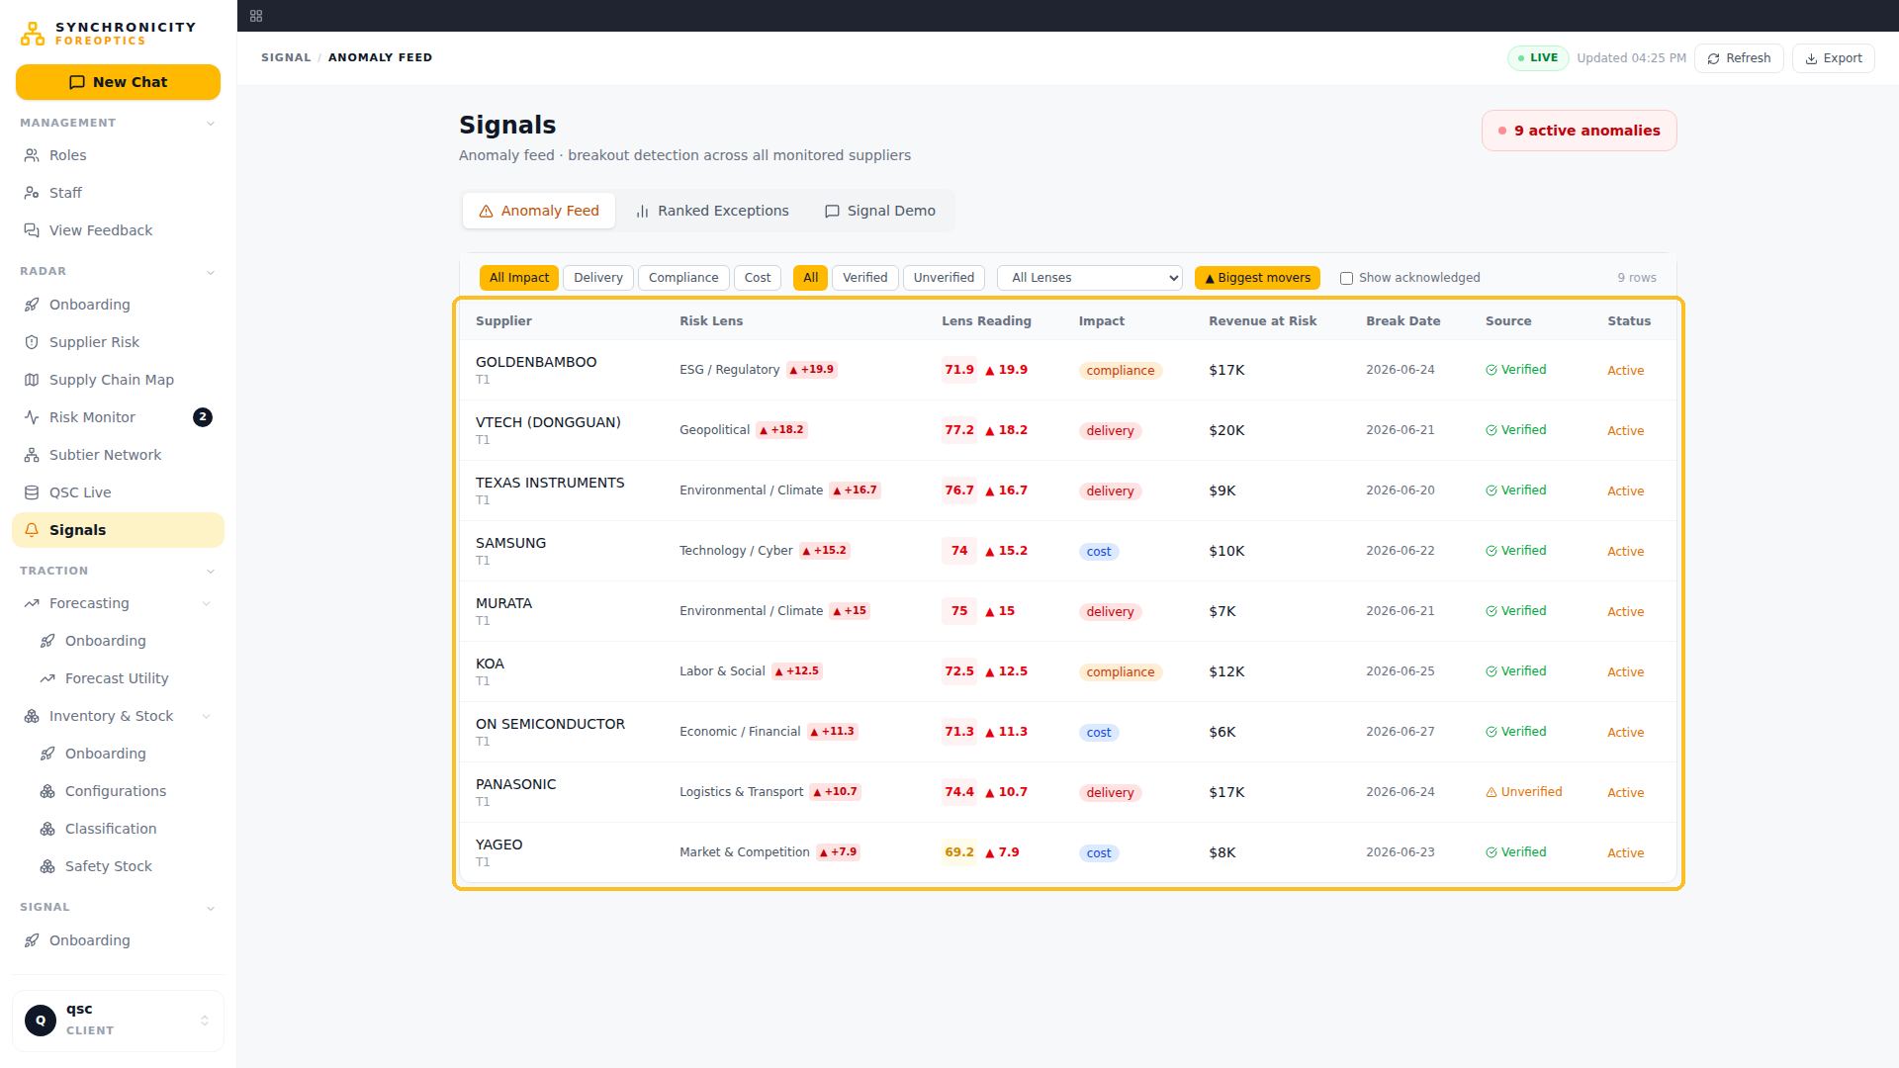
WHAT CHANGED: Signals — the daily screen: every anomaly with score, delta, exposure, break date, source.
FOR THE VP: the morning view of what moved.
FOR THE SUPPLY CHAIN MANAGER: my day starts here, not in email.

Slide 12
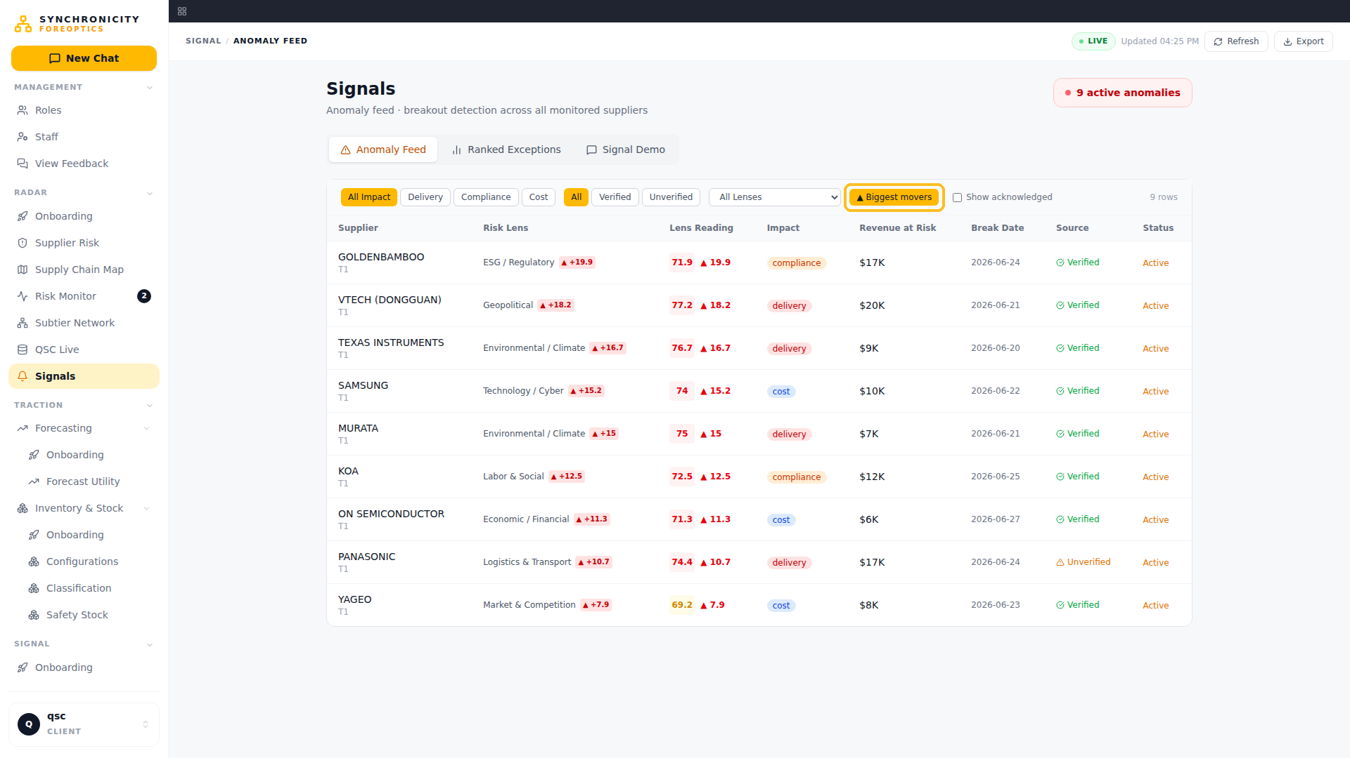
WHAT CHANGED: Sorted by biggest delta — the sharpest breaks first.
FOR THE VP: attention ordered by change x dollars.
FOR THE SUPPLY CHAIN MANAGER: worst first, always.

Slide 13
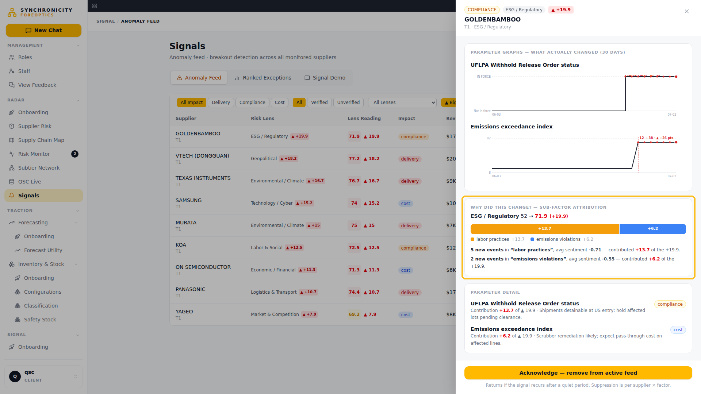
WHAT CHANGED: The drawer proves it — 30-day baseline, marked breakout, and the sub-factor bar showing exactly what drove the jump.
FOR THE VP: a number my board can interrogate — baseline, break, cause, source.
FOR THE SUPPLY CHAIN MANAGER: I can defend this alert to anyone in one screen.

Slide 14
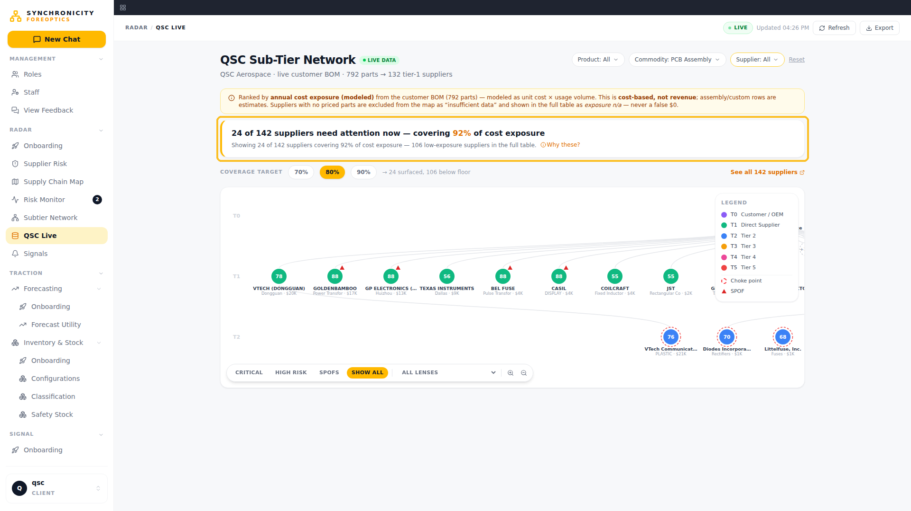
WHAT CHANGED: The same engine on QSC's real 792-part BOM — live data, not a demo set.
FOR THE VP: this is our supply base, ranked.
FOR THE SUPPLY CHAIN MANAGER: real parts, real suppliers, real exposure.

Slide 15
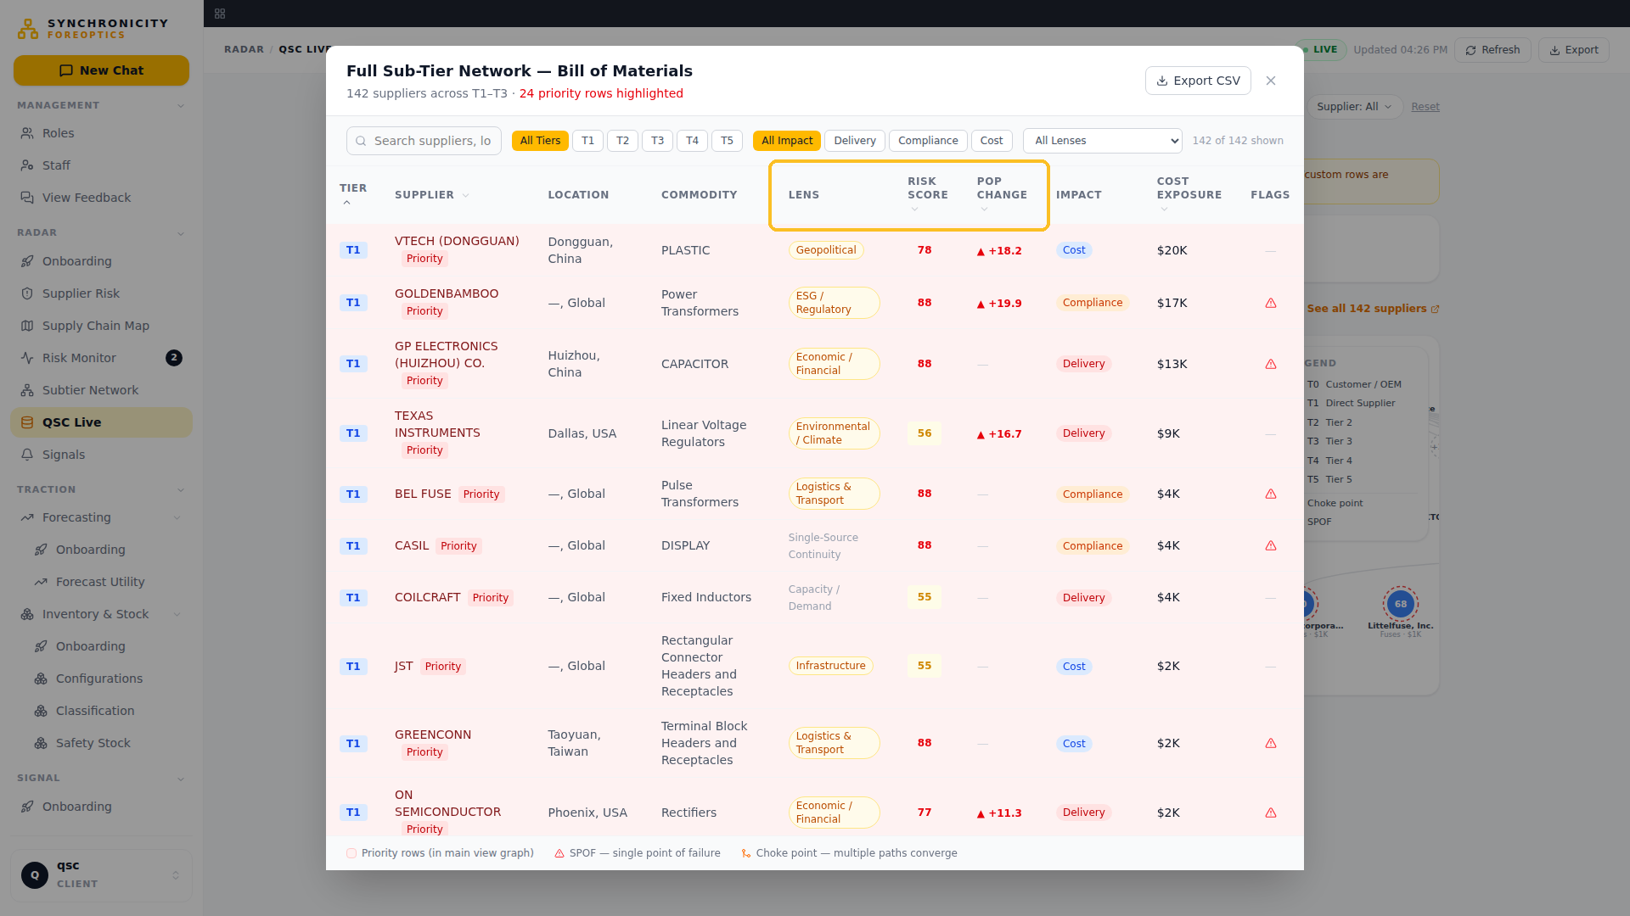
WHAT CHANGED: The full QSC table with POP and Lens columns — the complete network, sortable and exportable.
FOR THE VP: the audit trail behind the map.
FOR THE SUPPLY CHAIN MANAGER: everything, filterable, in one place.

Slide 16
RADAR does not give you more to look at. It tells you where to look — in order of money, before your supplier calls you.

