Slide 1
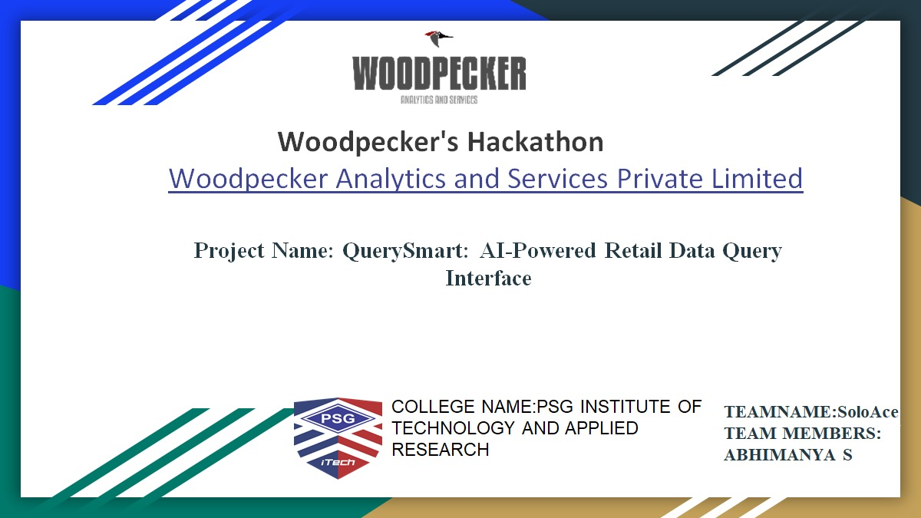

Slide 2
PROBLEM STATEMENT
AI-Powered Data Query Interface:
Organizations often struggle with efficiently accessing and
understanding client data stored in internal databases. Traditional methods of data
retrieval and analysis can be time-consuming and cumbersome, leading to delays in
decision-making and inefficiencies in client management. There is a need for a
streamlined and intuitive solution that allows organization members to query and receive
timely, accurate insights from the database through a user-friendly interface.
Objective: Develop a chat interface that leverages a Large Language Model (LLM) to
read and interpret client data from an internal database. This interface will enable
organization members to query the database and receive accurate, contextually relevant
responses about the data.
Domain: Not Applicable

Slide 3
INTRODUCTION
In today's fast-paced business environment, organizations are increasingly challenged with efficiently accessing and leveraging their internal data for informed decision-making and client management. Traditional methods of data retrieval and analysis often prove to be time-consuming and cumbersome, leading to delays in crucial decision-making processes and operational inefficiencies.
Our project addresses these challenges by introducing an innovative AI-powered data query interface designed specifically for the retail sector. Leveraging advanced Natural Language Processing (NLP) capabilities provided by a Large Language Model (LLM), our interface allows organization members to intuitively query internal databases. This streamlined approach not only enhances data accessibility but also ensures that users receive timely and accurate insights, empowering them to make informed decisions swiftly.
Through this presentation, we will delve into the architecture, functionality, and key features of our AI-powered data query interface. We'll highlight its potential to revolutionize how organizations interact with and extract value from their data assets, ultimately driving operational efficiency and strategic decision-making in the retail domain.

Slide 4

PROPOSED SOLUTION
Develop an AI-powered data query interface tailored for retail operations using Streamlit, SQLite, and Google's Generative AI. This solution integrates Natural Language Processing (NLP) to interpret plain language queries, leveraging Google's Generative AI to generate SQL commands that directly query an SQLite database .
The interface facilitates real-time access to critical retail data, including sales transactions, inventory levels, and customer preferences.
By translating user queries into SQL commands and presenting actionable insights through an intuitive Streamlit interface, the solution aims to streamline data retrieval processes, optimize decision-making efficiency, and support personalized marketing strategies based on up-to-date, contextual information.
This approach enhances operational agility and empowers retail stakeholders with timely, accurate insights essential for competitive advantage and customer satisfaction.
PSG Institute of Technology and Applied Research

Slide 5
Work flow:
User Interaction: Input Query: User enters a natural language query related to retail data (e.g., sales, inventory, customer preferences) into the Streamlit interface.
NLP Processing:NLP Interpretation: Streamlit sends the query to the backend Python application.
Google's Generative AI: Utilizes the GenerativeModel from GenAI to interpret the query and generate a corresponding SQL command.
SQL Query Execution:SQLite Database Interaction: Python connects to the SQLite database using the sqlite3 module.
Query Execution: Executes the generated SQL command to retrieve relevant data from tables like SALES, INVENTORY, or CUSTOMERS.
Data Retrieval and Processing : Fetch Data: Retrieves queried data (e.g., sales figures, inventory levels, customer details) from the SQLite database.
Format Results: Formats the retrieved data into a structured format suitable for presentation.
Response Generation: Prepares the formatted data as a response to the user query.
Display Output: Displays the response within the Streamlit interface for user review and interaction.
User Feedback and Iteration: User reviews the displayed results and may refine or ask further queries.

Slide 6
Flowchart for AI-Powered Data Query Interface:
Start
└─ User Inputs Query via Streamlit Interface
└─ Streamlit Sends Query to Backend Python Application
└─ Backend Python Application Processes Query
├─ Utilizes Google's Generative AI (GenAI)
│ └─ Generates SQL Command Based on Query
└─ Executes SQL Command on SQLite Database (retail.db)
└─ Retrieves Data from Tables (e.g., SALES, INVENTORY, CUSTOMERS)
└─ Formats Retrieved Data
└─ Prepares Response to User Query
└─ Displays Response in Streamlit Interface
End

Slide 7
TECHNOLOGY STACK
Frontend: Streamlit: Python library for building interactive web applications, used for the user interface where queries are inputted and results displayed.HTML/CSS: Customization for styling within Streamlit to improve user experience.
Backend: SQLite Database: Lightweight SQL database engine storing retail data (e.g., sales, inventory, customers).SQLite3 Python Module: Enables Python to interact with SQLite, executing queries and managing connections.
AI and NLP Integration: Google's Generative AI (GenAI): Powers NLP capabilities to interpret natural language queries and generate SQL commands. Generative Model from GenAI: Specifically used to convert user queries into SQL commands tailored for retail data.
Deployment and Tools: Python: Core language for backend logic, including query generation and application logic.Cloud or Local Deployment: Deployable on cloud platforms (e.g., AWS, Azure) or locally based on scalability needs.
Development Environment:IDE: PyCharm, VS Code, or Jupyter for coding and testing.
Version Control: Git for collaborative development and code management.
Security Encryption: Ensures data security, especially sensitive information stored in SQLite.Access Controls: Implemented to manage database access securely.
PSG Institute of Technology and Applied Research

Slide 8
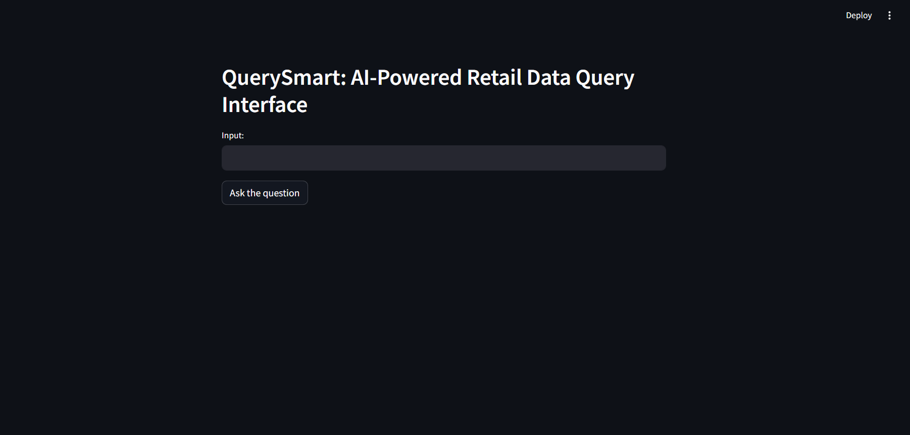
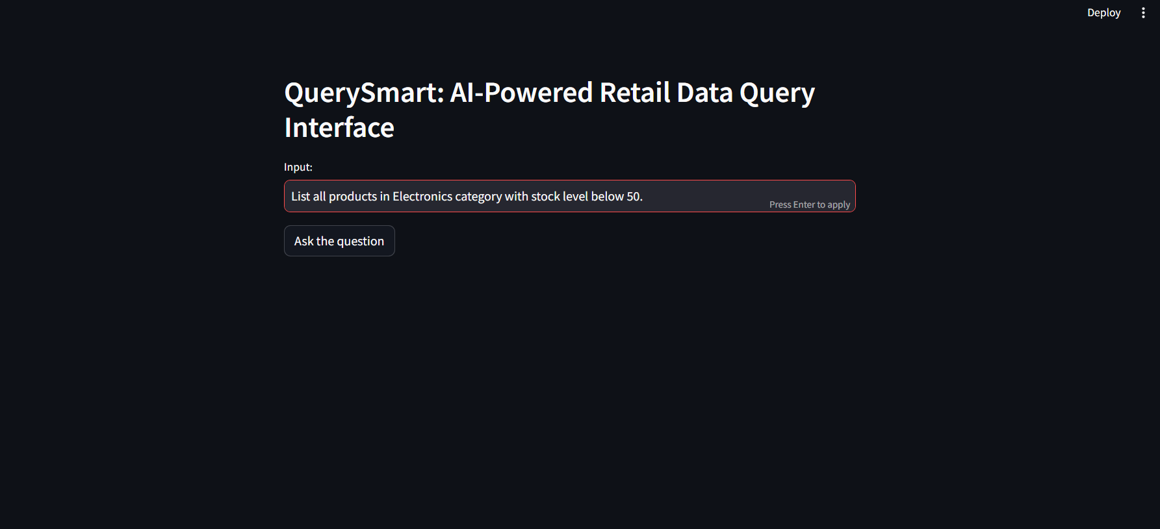
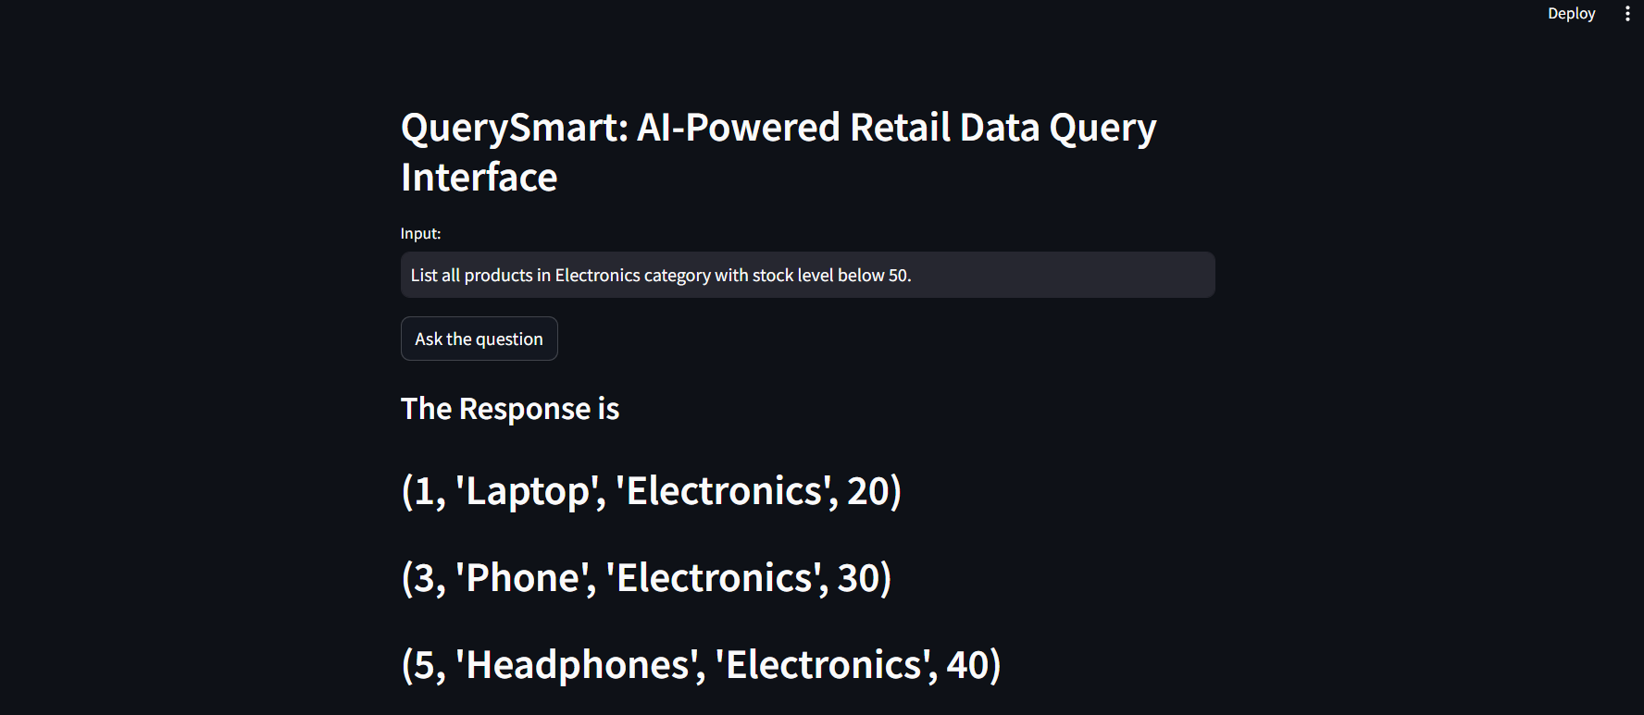
Sample outputs:

Slide 9
NOVELTY
Uses advanced NLP to interpret queries in plain English.
Automatically generates SQL commands for data retrieval.
Provides a user-friendly interface with Streamlit.
Offers real-time insights from an SQLite database.Ensures scalability and robust security measures.
Customizes responses for specific retail data needs.
PSG Institute of Technology and Applied Research

Slide 10
Use Case Scenarios
Sales Analysis and Forecasting
Retrieve insights into sales performance by category and time period.
Inventory Management Optimization
Monitor and manage inventory levels to prevent stockouts and optimize stock replenishment.
Customer Insights and Personalization
Segment customers based on preferences and purchase history for targeted marketing.
Market Basket Analysis
Identify product associations and buying patterns to optimize cross-selling strategies.
Trend Analysis and Seasonal Variations
Analyze seasonal trends and variations in product sales to adjust inventory and marketing plans.

Slide 11
Challenges and Mitigation:
Complexity of Queries Challenge: Handling complex SQL queries and ensuring accurate interpretation of user intents.Mitigation: Implement robust natural language processing (NLP) models to parse and understand user queries effectively. Provide feedback mechanisms to refine query understanding over time.
Data Integration and Compatibility Challenge: Integrating with diverse data sources and ensuring compatibility with various database formats and structures.Mitigation: Develop adapters and connectors that support seamless integration with popular database systems. Use standardized data formats and protocols to facilitate smooth data exchange.
Performance and ScalabilityChallenge: Ensuring high performance and scalability to handle large volumes of data queries efficiently.Mitigation: Employ efficient database indexing and query optimization techniques. Utilize cloud infrastructure for scalable computing resources and parallel query processing.
Data Security and PrivacyChallenge: Safeguarding sensitive customer and business data from unauthorized access or breaches.Mitigation: Implement robust encryption methods for data storage and transmission. Adhere to industry standards and regulations (e.g., GDPR, CCPA) for data privacy compliance. Conduct regular security audits and updates.
User Adoption and TrainingChallenge: Encouraging user adoption of the new AI-powered interface and ensuring proper training on its functionalities.Mitigation: Provide user-friendly interfaces with intuitive design and interactive tutorials. Offer ongoing support and training sessions to familiarize users with the interface capabilities and best practices.
Maintaining Data QualityChallenge: Ensuring the accuracy and reliability of data retrieved and analyzed by the interface.Mitigation: Implement data validation checks and quality assurance processes. Integrate data cleansing and normalization techniques to improve data accuracy. Monitor data sources and update algorithms to handle evolving data patterns.

Slide 12
Future Vision:
Advanced Predictive Analytics: Integrate machine learning for real-time insights into customer behavior and demand, enhancing decision-making.
Personalized Customer Experiences: Utilize AI for tailored product recommendations and interactive customer engagement, boosting satisfaction.
IoT and AR/VR Integration: Implement IoT sensors for smart inventory management and leverage AR/VR for immersive retail experiences.
Agile Development and Ethical AI: Embrace agile practices for continuous innovation, ensuring ethical AI use and data privacy compliance.

Slide 13
Thank you !!

