Slide 1
Digitally signed degree certificates NSC Assignment 4

Slide 2
Backend
Flask based Python application
Student data in CSV
Uses name, roll no. & last 4 digits of Aadhar for unique identification
PDF creation from HTML template using ‘weasyprint’. Watermark added using ‘PyPDF4’ & canvas from ‘reportlab.pdfgen’
UTC time from https://worldtimeapi.org/api/timezone/Etc/UTC
Worldtimeapi is a well known and reputed provider of time data.
The API request uses https which ensures security

Slide 3
Backend - 2
Registrar’s signature
SHA256 hash of PDF file using ‘hashlib’
Encryption of hash||UTC time using self implemented RSA_cryptosystem.py with Registrar’s public key
Director’s signature
SHA256 hash of PDF file concatenated with Registrar’s signature
Concatenating Registrar’s signature to ensure Registrar signs before Director
Encryption of hash||UTC time using self implemented RSA_cryptosystem.py with Director’s public key
Digital signatures returned in custom headers In response. File returned as attachment.

Slide 4
Frontend
The frontend is a HTML Javascript implementation
Three inputs are collected from the user, namely name, roll no. & last 4 digits of Aadhar
User is provided two buttons, ‘Download Degree’ and ‘Download Grade-Card’
Clicking a button calls backend API via ‘await fetch()’
Once the result of the await fetch() is received, signatures are read from the response headers.
PDF sent as an attachment in the API response is downloaded.
The two signatures are displayed on screen

Slide 5
Signature verification
A python application, verify_signature.py is used to verify digital signatures. It collects following inputs, which user can copy-paste.
Path of the downloaded file
2) Registrar’s digital signature
3) Director’s digital signature
Public Key Authority pkda.py run as a separate Python Flask API
Provides the Registrar and Director’s public keys securely after encrypting them with the PKDA’s private key
The verify_signature app has the PKDA’s public key and decrypts the PKDA response to get the Registrar and Director’s public keys

Slide 6
Signature verification - 2
Using Registrar’s public key, the app decrypts Registrar’s signature.
The decrypted string contains the PDF’s hash and signature timestamp.
The two are split and displayed on screen.
The PDF file is read and its SHA256 hash is generated.
The hash is matched with the hash extracted from signature.
If the two match, then the Registrar signature is valid.
Director’s signature decryption and matching is similar except
SHA256 hash is generated for PDF file || registrar’s signature
If this matches the hash from Director’s signature, then the Director’s signature is valid and proved to be generated after Registrar’s signature

Slide 7
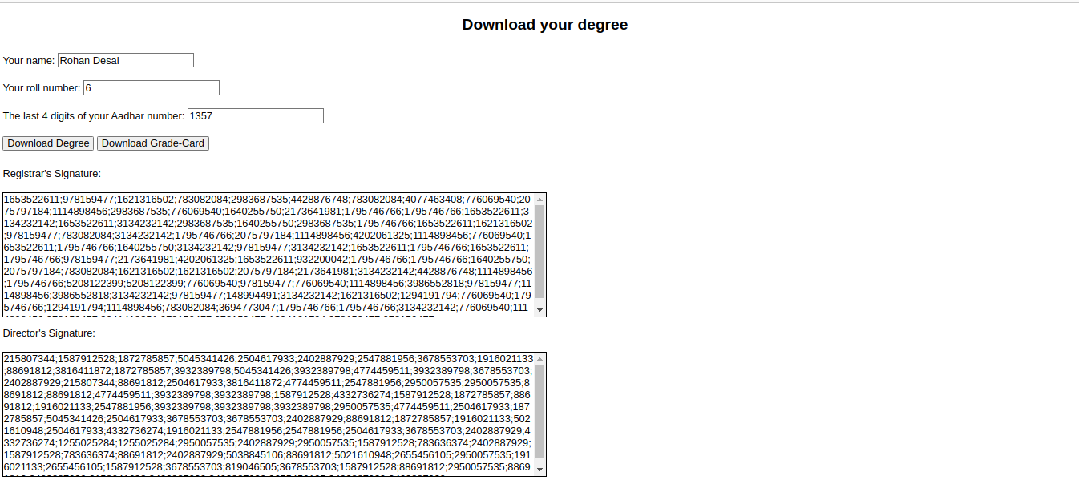
Screenshot of UI

