Slide 1
SEMINAR TOPIC
ON
GLOBAL WIRELESS E-VOTING
www.engineersportal.in

Slide 2

to make it secured and efficient in the vision of modern technology we are “Global Wireless E-Voting”.
User can easily voting no special skill and technology required .
to present the various Electronic voting Method like voting by kiosk, Internet, telephone, punch card, and optical scan ballot, Proms and Cons of all voting types.
it’s very useful for today election .
www.engineersportal.in

Slide 3
Daily use wireless E-voting like that using smart phone /cell phone
If damage e-voting machine then use main database where insert all voter
entry .
Machine properly check user biometric symbol which is register in machine
if it’s not register then machine Show fake person .
One user can use only one time in one election .
Every where in world to easily voting any register user .
Machine check biometric symbol like that eye retina , thumb etc.
www.engineersportal.in

Slide 4

It’s more sequrefull.
It’s very fast .
It’s break on illegal voting .
It’s provide fast and correct election result.
www.engineersportal.in

Slide 5

Voting is one of the most critical features in our democratic process.
Electronic voting includes voting by kiosk, Internet, telephone, punch card, and optical scan ballot
One hopes that in this way the voting process becomes faster, cheaper.
www.engineersportal.in

Slide 6

Eligibility and authentication – only registered voters must be admitted.
Uniqueness – no voter may cast his vote more than once.
. Accuracy – voting systems should record the votes correctly.
. Minimum skill requirement for voter
www.engineersportal.in

Slide 7

In our system we trying to keep counting of votes in to a remote secured system.
Here we need not to go for the re election even if the machine is damaged.
In Global Wireless E-Voting system we are using a electronic circuit which enable the voter to vote and transfer this vote to the remote system by converting it to radio wave through the mobile towers.
www.engineersportal.in

Slide 8

• Each voter could only have one token to vote with.
• The token could be marked in private.
• Machine check user biometric symbol before
voting process .
• one user give one time vote in one election.
• The box could only be accessible to voters.
• At the end of the election the box would be opened in the presence of observers of all the parties standing for election.
www.engineersportal.in

Slide 9

Whenever voters enter to voting booth then he will be instructed to directly look at retina scanning machine at this time the machine scans the retina.
once retina scanning properly confirmed then it sent signal to the voting machine as to accept the vote it will be powered on .
then voter is made to vote.
www.engineersportal.in

Slide 10

One method to any error with voting machines is parallel testing, which are conducted on the Election Day with randomly picked machines.
Benefits can include reduced tabulation times and an increase of participation (voter turnout), particularly through the use of Internet voting.
It is not yet clear whether the total cost of ownership with electronic voting is lower than other systems.
www.engineersportal.in

Slide 11

Since now days voting system is replaced by electronic machine to carry out voting.
Now in a present system each and every section is given a electronic machine which stores the votes of the people who have voted for the particular candidate.
Control of present system is given to the in charge officer. He only check for the eligibility of the candidates and allow for the voting.
Finally we collect all the voting machine at a place and go for counting.
www.engineersportal.in

Slide 12
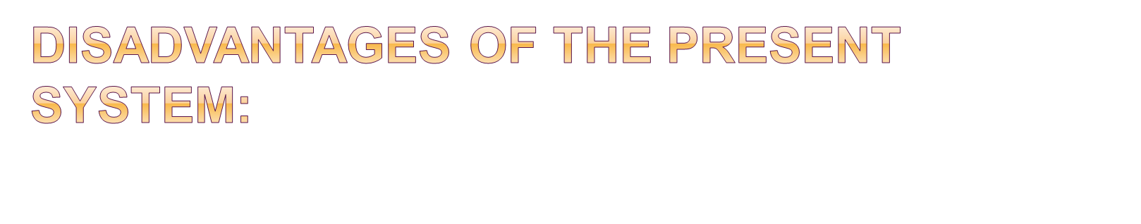
The machine is not able to recognize the eligibility of a candidate, so the corrupted officers may misguide the people.
Required fast speed internet .
During transportation of the machines the in charge person can change the status of machines and even may destroy.
www.engineersportal.in

Slide 13

This project can be enhanced to work over the mobiles that is voting is made possible through the mobile through SMS.
This machine can be made vote through the INTERNET.
Multiple election with voting can possible.
Online voting possible with website.
www.engineersportal.in

Slide 14

Thus this machine can be used for any level voting purpose. The machine provides high level of security, authentication, reliability, and corruption -free mechanism.
By this we can get result with in minute after a completion of voting. Minimum manpower Utilization, hence mechanism is error free.
www.engineersportal.in

Slide 15

www.engineersportal.in

Slide 16

www.engineersportal.in

