Slide 1

Seminar
On
Semantic Web
Presented by: Guided by:
Abhimanyu kumar G . P Das
Branch-IT
Regd no- 1501211049

Slide 2
Overview
Introduction
History
Expressing Meaning
Components
URI
XML
RDF
Ontologies
Incremental Ontology Creation
Evolution of Semantic Web
Advantage
Challenges
Conclusion

Slide 3
Introduction
The Semantic Web is an extension of the World Wide Web
It was standarded by the World Wide Web Consortium (W3C).
It standards was to promote common data formats and exchange protocols on the Web, and the most fundamentally key was the Resource Description Framework (RDF).
According to the W3C, "The Semantic Web provides a common framework that allows data to be shared and reused across application, enterprise, and community boundaries".
The Semantic Web is therefore regarded as an integrator across different content, information applications and systems.
.

Slide 4
The term was coined by “Tim Berners-Lee” for a web of data (or data web) that can be processed by machines
—that is, one in which much of the meaning is machine-readable. While its critics have questioned its feasibility, proponents argue that applications in industry, biology and human sciences research have already proven the validity of the original concept.
He originally expressed his vision of the Semantic Web as follows:
“I have a dream for the Web [in which computers] become capable of analyzing all the data on the Web – the content, links, and transactions between people and computers”.
A "Semantic Web", which makes this possible, has yet to emerge, but when it does, the day-to-day mechanisms of trade, bureaucracy and our daily lives will be handled by machines talking to machines.

Slide 5
History
In 2001, Scientific American article by Berners-Lee, Hendler, and Lassila described an expected evolution of the existing Web to a Semantic Web.
In 2006,Berners-Lee and colleagues stated that: "This simple idea…remains largely unrealized".
In 2013, more than four million Web domains contained Semantic Web markup.
Tim Berners-Lee has described the semantic web as a component of "Web 3.0"

Slide 6
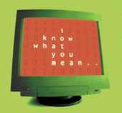
Expressing Meaning
Most of the web’s content today is designed for humans to read , and not for
computer programs to process meaningfully.
Computers can
- parse the web pages.
- perform routine processing (here a header, there a link, etc.)
In general, they have no reliable way to understand and process the semantics.
The Semantic Web will bring structure to the
meaningful content of the web of web pages,
creating an environment where software agents
roaming from page to page carry out sophisticated
tasks for users.
The Semantic Web is not a separate web.

Slide 7
components
Several formats and languages form the building blocks of the semantic web.
Some of these include
Identifiers: Uniform Resource Identifier(URI),
Documents :Extensible Markup Language(XML),
Statements : Resource Description Framework (RDF)

Slide 8
URI: Uniform Resource Identifier
To identify items on the Web, we use identifiers. Because we use a uniform system of identifiers, and because each item identified is considered a "resource," we call these identifiers "Uniform Resource Identifiers" or URIs for short.
We can give a URI to anything, and anything that has a URI can be said to be "on the Web":
The URI is the foundation of the Web. While nearly every other part of the Web can be replaced, the URI cannot: it holds the rest of the Web together. One familiar form of URI is the URL or Uniform Resource Locater.
A URL is an address that lets you visit a web page, such as: http://www.w3.org/Addressing/. If you break it down, you can see that a URL tells your computer where to find a specific resource (in this case, the W3C's Addressing web site)

Slide 9
XML:(eXtensible Markup Language)
XML was designed to be a simple way to send documents across the Web.
It allows anyone to design their own document format and then write a document in that format.
These document formats can include markup to enhance the meaning of the document's content.
This markup is "machine-readable," that is, programs can read and understand it.
By including machine-readable meaning in our documents, we make them much more powerful.

Slide 10
RDF
It Stands for “Resource Description Framework”
The most fundamental building block is Resource Description Framework(RDF), a format for defining information on the web.
RDF is a markup language for describing information and resources on the web. Putting information into RDF files, makes it possible for computer programs ("web spiders") to search, discover, pick up, collect, analyze and process information from the web.
The Semantic Web uses RDF to describe web resources.
RDF provides a model for data, and a syntax so that independent parties can exchange and use it.
It is designed to be read and understood by computers. It is not designed for being displayed to people.

Slide 12
Ontologies
Ontologies are collections of statements written in a language such as RDF
that define relations between concepts and specifies logical rules for
reasoning about them.
Computers/agents/services will understand the meaning of semantic data on
a web page by following links to specified ontologies.
It can express a large number of relationships among entities
(objects) by assigning properties to classes and allowing subclasses to inherit
such properties.
An Ontology may express the rule,
If City Code State Code
and Address City Code then Address State Code
Enhances the functioning of semantic web: Improves accuracy of web
searches, Easy development of programs that can tackle complicated queries.

Slide 13
Incremental Ontology Creation
Your Web Page
www.petshop.com
o1
Feline of type f2
Your own ontology page
We sell animals
Animals of type feline
o2
Oa
Animals of type canine
F1 is popular
Feline of type f1
F1 is exotic
Pages from a web ontology repository
http://www.daml.org/ontologies
The meaning of the terms or XML codes used on a web page can be defined
by pointers (markup not displayed by a typical browser) from the page to an
ontology page.
Problem: Same concept different definitions.
E.g. One ontology defines : Address contains Zip Code.
Other ontology defines : Address contains Postal Code.
Resolved: If ontologies provide equivalence relations, i.e one or both
may contain the information that “Zip Code is Equivalent to Postal Code”

Slide 14
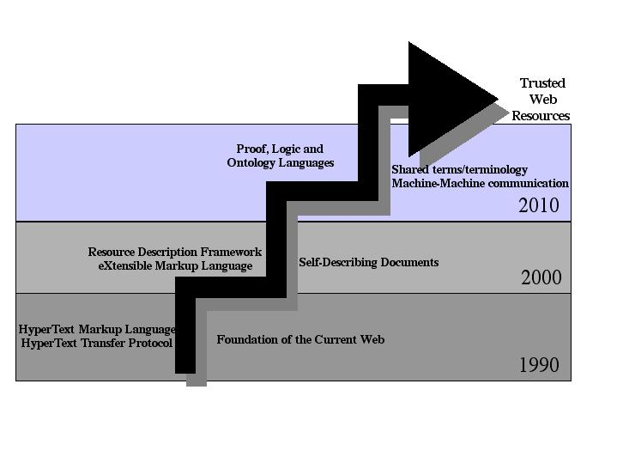
Evolution of Semantic Web

Slide 15
Advantages
Automated Tools
Enhanced Web Services
Effective Searching
Quality issues
Trust Issues

Slide 16
Challeges
Some of the challenges for the Semantic Web include
vastness
vagueness
Uncertainty
Inconsistency
Deceit
This list of challenges is illustrative rather than exhaustive, and it focuses on the challenges to the "unifying logic" and "proof" layers of the Semantic Web.

Slide 17
Reference
www.google.com
www.wikipedia.com
www.projectsreports.org

Slide 18
Conclusion
The semantic web in naming every concept simply by a URI, lets everyone express new concepts that they invent with minimal effort.
Its unifying modeling language will enable these concepts to be progressively linked into a universal web.
The structure of semantic web will open up the knowledge and workings of human kind to meaningful analysis by software agents, providing a new class of tools by which we can live, work and learn together.

Slide 19
THANK YOU

