Slide 1
Use Case Diagrams

Slide 2
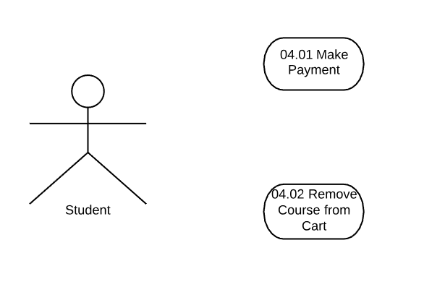
04. Cart
System

Slide 3
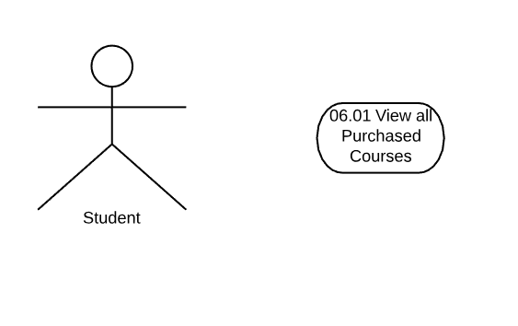
06. My Courses(Student)
System

Slide 4
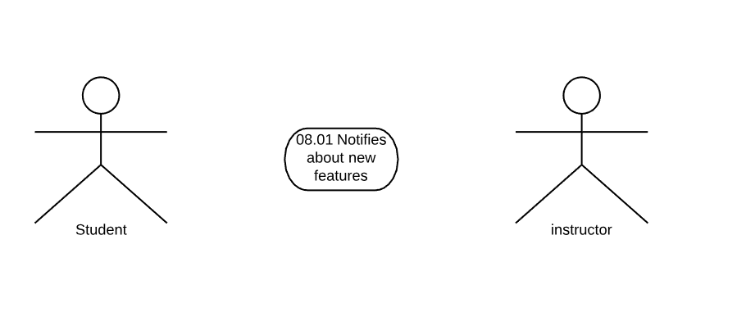
08. Notification
System

