Slide 1


End-to-End Machine Learning Workflow Using Julia

Slide 2

Development Steps
Load Data
Preprocessing
Model Training
Deployment
Project code:
https://github.com/JuliaComputing/ScoringEngineDemo.jl
Data from the AI Crowd Insurance Pricing Game challenge
https://www.aicrowd.com/challenges/insurance-pricing-game

Slide 3

Load Data
JuliaIO
Data source | Package
CSV | https://github.com/JuliaData/CSV.jl
JSON | https://github.com/quinnj/JSON3.jl
Arrow / Feather | https://github.com/apache/arrow-julia
Parquet | https://github.com/JuliaIO/Parquet.jl
HDF5 | https://github.com/JuliaIO/HDF5.jl
SQLite | https://github.com/JuliaDatabases/SQLite.jl
Postgres | https://github.com/invenia/LibPQ.jl
MySQL | https://github.com/JuliaDatabases/MySQL.jl
Excel (xlsx) | https://github.com/felipenoris/XLSX.jl
SAS (sas7bdat) | https://github.com/tk3369/SASLib.jl
Matlab | https://github.com/JuliaIO/MAT.jl

Slide 4
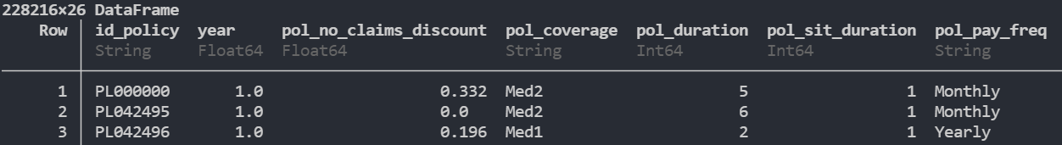
Load Data
JuliaIO
load_data(path) = CSV.File(path) |> DataFrame

Slide 5

Preprocessing
DataFrames.jl
groupby(df, "grouping_var")
combine(df, "in_var" => fun => "out_var")
select(df, "keep_vars") | select(df, "in_var" => fun => "keep_var")
transform!(df, "in_var" => fun => "out_var")

Slide 6
Preprocessing
DataFrames.jl
transform!(df, "in_var" => fun => "out_var")
density(pop, area) = pop ./ area
["population", "town_surface_area"] => density => "density"

Slide 7
Preprocessing
DataFrames.jl
pol_cov_dict = Dict{String,Float64}(
"Min" => 1,
"Med1" => 2,
"Med2" => 3,
"Max" => 4)
pol_cov_map(x) = get(pol_cov_dict, x, 4)
"pol_coverage" => ByRow(pol_cov_map) => "pol_coverage"

Slide 8
Preprocessing
DataFrames.jl
struct Normalizer{T} <: Function
μ::T
σ::T
end
Normalizer(x::AbstractVector) = Normalizer(mean(x), std(x))
function (m::Normalizer)(x)
return (x - m.μ) / m.σ
end

Slide 9
Preprocessing
DataFrames.jl
struct Preproc <: Function
layers::Vector
end
function (p::Preproc)(df::DataFrame)
for layer in p.layers
transform!(df, layer)
end
return df
end

Slide 10

Model Training
Data
Dense
(feat, 64)
Dropout
(p = 0.5)
m = Chain(
Dense(num_feats, 64, relu),
Dropout(0.5),
Dense(64, 32, relu),
SkipConnection(Dense(32, 32, relu), +),
Dense(32, 1),
x -> reshape(x, :))
Dense
(64, 32)
SkipConnection
Dense
(32, 1)
Reshape

Slide 11
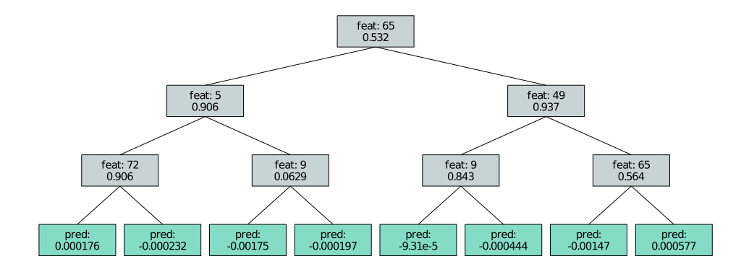
Model Training
EvoTrees.jl | Gradient Boosted Trees
config = EvoTreeRegressor(
loss = :logistic,
metric = :logloss,
nrounds = 2000,
nbins = 100,
λ = 0.5,
γ = 0.1,
η = 0.05,
max_depth = 6,
min_weight = 1.0,
rowsample = 0.5,
colsample = 0.8)

Slide 12
Model Training
Single Instance:
442.27 seconds
Hyper 1
…
Hyper N
Results
Distributed (8 workers):
95.58 seconds
Hyper 1
…
Results
Hyper N

Slide 13
Deployment
const preproc_flux = BSON.load("preproc-flux.bson"), ScoringEngineDemo)[:preproc]
const adapter_flux = BSON.load("adapter-flux.bson"), ScoringEngineDemo)[:adapter]
const model_flux = BSON.load("model-flux.bson"), ScoringEngineDemo)[:model]
function score_flux(req::HTTP.Request)
df = JSON3.read(IOBuffer(HTTP.payload(req))) |> jsontable |> DataFrame
score = df |> preproc_flux |> preproc_adapt_flux |> model_flux |> logit
res = Dict(:score => score)
return HTTP.Response(200, JSON3.write(res))
end

Slide 14
Deployment
const SCORING_ROUTER = HTTP.Router()
HTTP.@register(SCORING_ROUTER, "GET", "/", welcome)
HTTP.@register(SCORING_ROUTER, "POST", "/api/v1/flux", score_flux)
HTTP.@register(SCORING_ROUTER, "POST", "/api/v1/gbt", score_gbt)
df = df_tot[1:5, :]
body = JSON3.write(arraytable(df))
req = HTTP.request("GET", "http://localhost:8008")
req = HTTP.request("POST", "http://localhost:8008/api/v1/flux", [], body)
req = HTTP.request("POST", "http://localhost:8008/api/v1/gbt", [], body)

Slide 15

Next Steps
Interactive Visualizations &
Model Interpretability
Dash.jl
Stipple.jl

