Slide 1
SCALA

Slide 2
Reference
Programming in Scala By Martin Odersky
Scala Cookbook by Alvin Alexander
Scala Doc - https://docs.scala-lang.org/

Slide 3
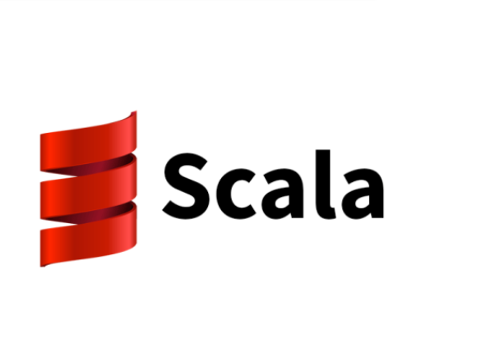
What is Scala
Scala is a general-purpose, high-level, statically-typed programming language that incorporates object-oriented and functional programming..
The name Scala is Scalable Language.
We are going to learn Spark Version 2.12
Created by Martin Odersky in 2003 to provide a high performance & concurrent-ready environment.
Scala is a statically typed language that is based on Java
Scala runs on Java Platform.
It is purely Object Oriented and functional programming.

Slide 4
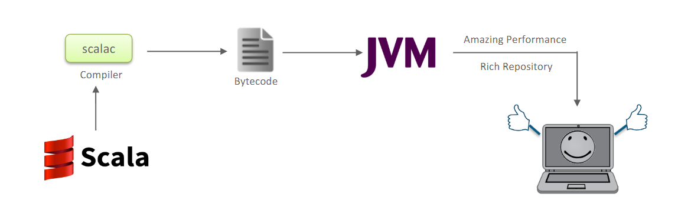
Scala runs on Jvm
The optimizations performed by today’s JVM are extraordinary, allowing byte code to outperform natively compiled code in many cases.
Both Scala and Java run on JVM. So their code must be compiled into bytecode before running on JVM. But Scala compiler supports an optimization technique called tail call recursion. The optimization makes the Scala code compile faster than Java code

Slide 5
Why Scala?
Conciseness:- Programs written in scala require less code than similar programs written in Java. Thus, Scala coding takes up less time, and the obtained results turn out to be easier to read and edit. At the same time, Java is well known for the “heaviness” of code structures, and the presence of a large number of bugs in such code is a typical situation.
High performance: Scala has an exact syntax, eliminating boilerplate code. Scala is considered a very fast language and according to comparative Scala vs Java performance tests, projects based on Scala run, on average, 20% faster than their Java-based analogs.
Flexibility: It is both an object-oriented language and a functional language. This combination makes Scala the right choice for web development
Full compatibility with Java - You can use Scala to execute Java code, can use and import java libraries
Advanced frameworks: It’s ideal for data analytics when supported by tools like Apache Spark

Slide 6

Moreover …….

Slide 7
Features Of Scala
Object - Oriented
Every value is an object
Extensible
Easy to add new language constructs without domain specific language extensions
Statically Typed
Binds the type to a variable for its entire scope
Functional
Every function is value, every value is an object, thus functions are object
Interoperates
Compiled into java byte code and executes on the JVM

Slide 8
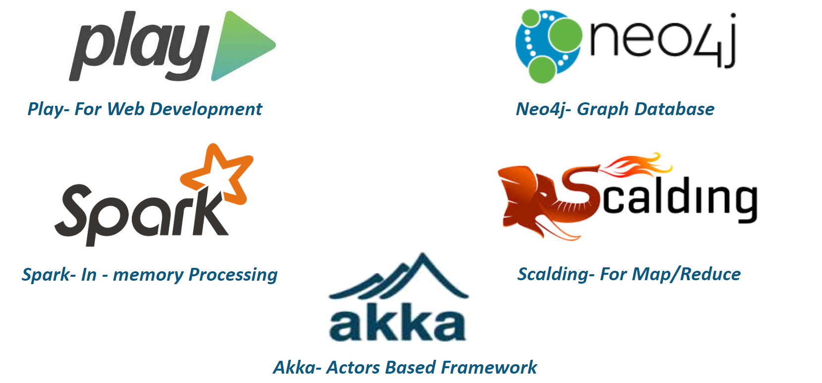
Scala In different framework

Slide 9
Scala REPL
: All Scala basic Operations in REPL

Slide 10
Basic operation in Scala

Slide 11
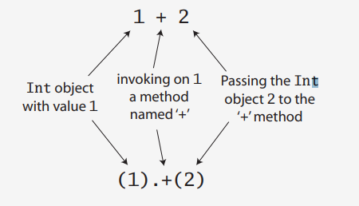
Literals- A literal is a way to write a constant value directly in code
Integer Literal
Floating Point Literals
Character literals
String Literals
Boolean Literals
Operators- operators are methods in Scala
Arithmetic Operations
Relational and logical operations

Slide 12
Variable Types
Variables are reserved memory locations for storing values
Immutable:- “val” (Read Only)
Similar to java final variables
Once Initialized, values can’t be reassigned
Mutable:- “var” (Read-Write)
Similar to non-final variables in Java
It allows to change the value after declaration of variable

Slide 13
Type Inference
Even if we do not declare the variable type, Scala infers it. This is called Type Inference.
Once a type is assigned to a variable, it remains same for entire scope.
Thus, Scala is Statically Typed language
Block Expression: {} Block is a list of expression, and result is also a expression. The value of a block is the value of the last expression of it.
In lazy Evaluation, the expression is not evaluated immediately, but once on first access.

Slide 14
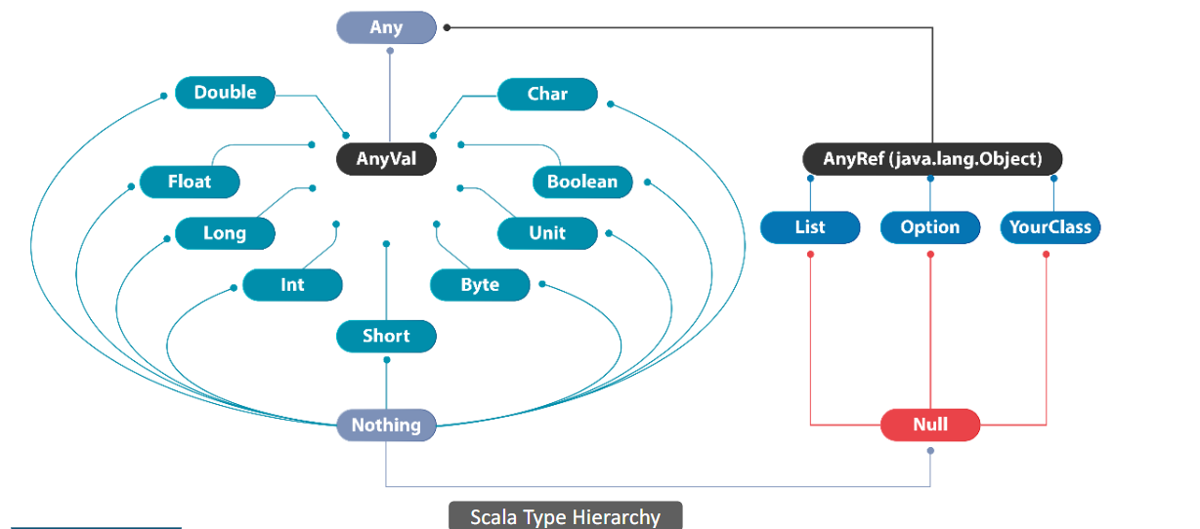
DATA TYPES IN SCALA
In Scala all values have a type, including numerical values and functions

Slide 15
Data Types (Contd.)
SNo | Data Type | Description
1 | Any | Super type of all types, also known as top type
2 | AnyVal | Represents value types
3 | AnyRef | The super type of any reference type.
4 | Double | 64 bit IEEE 754 double-precision float
5 | Float | 34 bit IEEE 754 single-precision float
6 | Long | 64 bit signed value. -9223372036854775808 to 9223372036854775808
7 | Int | 32 bit signed value, range -2147483648 to 2147483647

Slide 16
Data Types (Contd.)
SNo | Data Type | Description
8 | short | 16 bit signed value, range -32768 to 32767
9 | Byte | 8 bit signed value, range from -128 to 127
10 | Unit | Corresponds to no value
11 | Boolean | true/false
12 | Char | 16 bit unsigned Unicode character, range from U+0000 to U+FFFF
13 | Null | Null or empty reference
14 | Nothing | The subtype of every other type; includes no values.

Slide 17
Lazy evaluation
In lazy Evaluation, the expression is not evaluated immediately, but once on first access.

Slide 18
Control Structures In Scala

Slide 19
Control Structures (Contd.)
if/then/else
for loops
while loops
for expressions (also known as for comprehensions)
try/catch/finally
match expressions

Slide 20
COLLECTIONS In Scala

Slide 21
Collections in Scala
Scala Collections are the containers that hold sequenced linear set of items.
Collections can be mutable and immutable
Arrays & Arraybuffers
Lists
Sets
Maps
Tuples

Slide 22
Collections In Scala
Scala Collections are the containers that hold sequenced linear set of items
All collections belongs to the package scala.collection and can be either mutable or immutable.
Immutable
Mutable
Package – scala.collection.immutable
By default Scala Picks Immutable collection.
Package - scala.collection.mutable
Array is by default mutable

Slide 23
Collections in Scala
Array is by default mutable . For using Immutable array – import scala.collection . Array Buffer

Slide 24
Singleton object

Slide 25
Functions In Scala

Slide 26
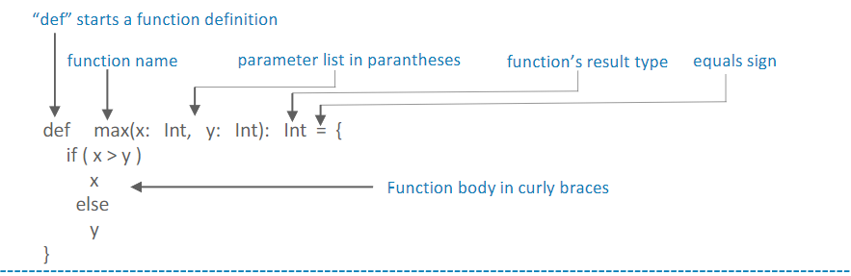
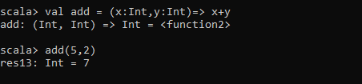
Functions
Declaring a function
Recursive Function
Tail Recursive Function
Anonymous Function/Function literal
Higher Order Function
Built in Functions –
foreach,
map,
filter
flatMap
FoldLeft
FoldRight
Input parameter (x,y) and type (Int)
Return expression
The => designates that this function converts the thing on the left (any integer x and y) to the thing on the right (x + y). So, this is a function mapping any integer x,y to x + y

Slide 27
Strings Operations

Slide 29
Summary

