Slide 1
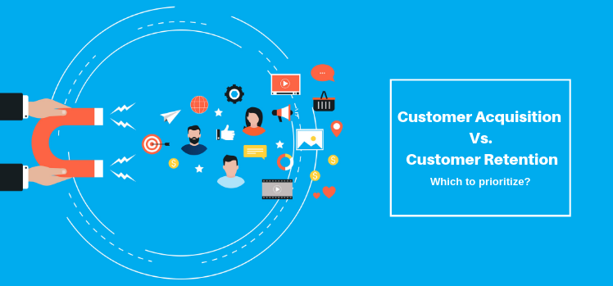
FLIP ROBO
Customer Retention Case Study Report
(E-retail factors for customer activation and retention: A case study from Indian e-commerce customers)
Prepared by :
Abhimanyu Varpe.

Slide 2

AGENDA
Introduction
Problem Statement
Problem Understanding
What is Customer Retention?
Benefits of Customer Retention
Details of Dataset
Data Analysis Steps
Actual data visualization
Assumptions
Conclusion

Slide 3

Problem Statement
Customer retention refers to the activities and actions companies and organizations take to reduce the number of customer defections .The goal of customer retention study is to help companies retain as many customers as possible, often through customer loyalty and brand loyalty initiatives.
Customer retention is the collection of activities a business uses to increase the number of repeat customers and to increase the profitability of each existing customer.
Customer retention strategies enable you to both provide and extract more value from your existing customer base. You want to ensure the customers you worked so hard to acquire stay with you, have a great customer experience, and continue to get value from your products.
In short, acquisition creates a foundation of customers while your retention strategy is how you build customer relationships and maximize revenue for each one. But how much time and resources should you devote to your retention program.

Slide 4
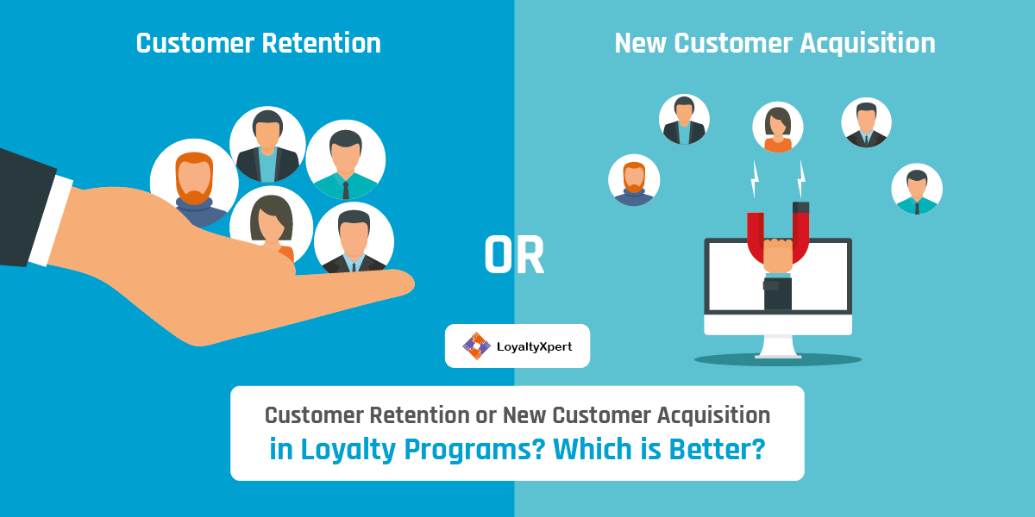

Slide 5


Customer Retention Benefits
Retaining customers is less expensive than attracting new customers, and to retain customers retailers must give them reasons to be loyal.
A study from Harvard Business School showed that an increase in customer retention rates of 5% can increase profits by 25–95%.
Customer Retention in e-commerce -
91 Percent of the customers are likely to purchase from the brands that recognize them and send them personalized & contextual offers.
On average, 65 percent of the e-commerce revenue comes from repeat customers.
New customer acquisitions can cost five times more than that of retaining the existing customer base.
86 Percent of the customers prefers to purchase from a brand that offers a great customer experience.

Slide 6


Customer retention dataset
The dataset contains information about survey conducted on online retail customers, several questions were asked and data was collected for total 269 customers.
Dataset is non-null dataset with only one numerical column
Dataset is consists of 269 rows and 71 different columns.
Detailed analysis was carried out on dataset containing information gathered from 269 customers in anaconda Jupiter notebook with Python, various libraries used for analysis are –
NumPy
Pandas
Seaborn
Matplotlib
Plotyl.express

Slide 7

DETAILS OF DATA SET
Dataset contains 71 different columns, few of them are tells personal information about customer:
Gender,
Age ,
Shopping city,
Internet used,
Medium Used,
Operating system used,
Mode used to reach online store,
Time Spent on store website,
Browser used to reach website,
Frequency of items purchased / abandone,…

Slide 8

DETAILS OF DATA SET
Some columns tells information about app/website features they are:
Payment modes available,
Countian of website understandable,
Product comparison offered,
Complete information about seller listed on website,
Ease of navigation of website,
Loading speed,
Guarantee of keeping privacy of customers,
Visual appearance of website,
Delivery speed,
Fast loading of webpage,
Wide verity of products offered,…

Slide 9

DETAILS OF DATA SET
Some columns tells information about User experience hedonic values they are:
User friendly website,
Enjoyment derived from the online shopping,
Value for money,
Trust developed for the retail store,
Satisfaction derived from online shopping,
Gratification derived from online shopping,
Enhancement of social status,
Adventure derived from shopping online,…

Slide 10

Data Analysis Steps
Import Libraries
Import Dataset
Data Preprocessing
Finding null values
Data visualization
Label Encoding & Correlation

Slide 11
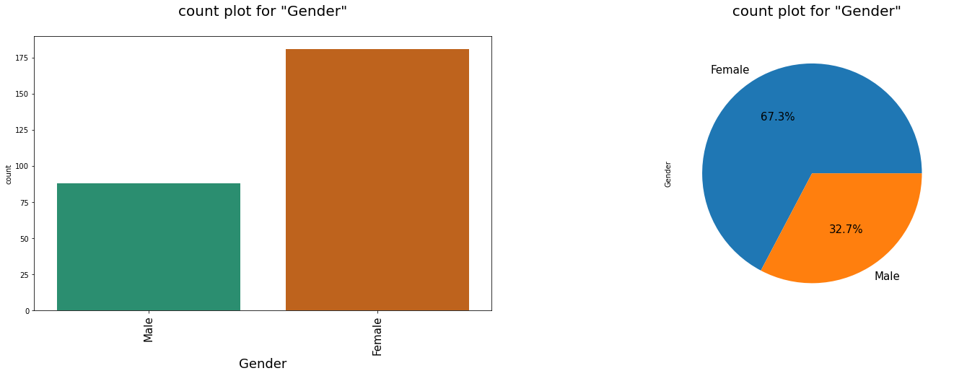

Analysis of gender of customer
Analysis shows that 68 % of the customers are females and only 33 % are the males.
Which means Females are more likely to shopping online than Males.

Slide 12
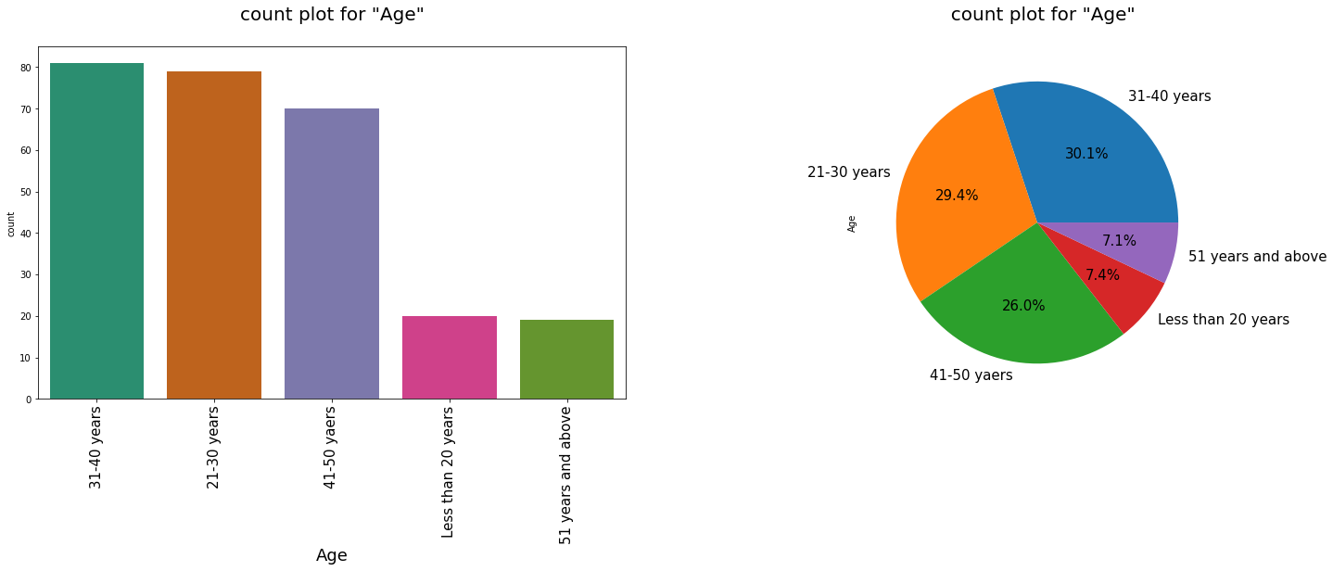

Analysis of Customer Age
The population which does the online shopping regularly belongs in 20 to 50 age-group.

Slide 13
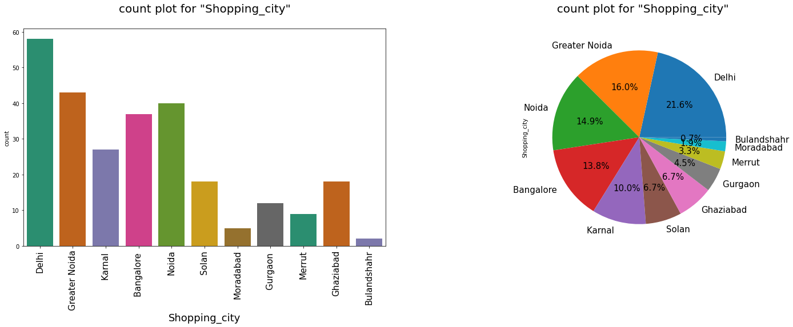

Analysis of Customers Cities:
We can see a greater number of customers are from Delhi followed by Noida, Greater Noida and Bangalore and then karnal.
It would be beneficial, if companies consider to develop a business strategies for small cities also.

Slide 14
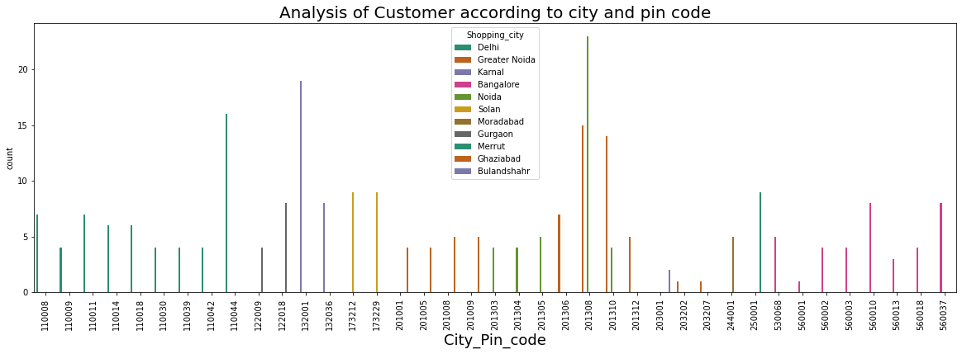
Analysis of Customers City pin code
IN above analysis it can be predicted that in metro cities there are certain regions where a company can have more delivery focus
Above plot shows that our data has very large number of Peoples who are doing inline shopping from past 2 to 1 years.

Slide 15
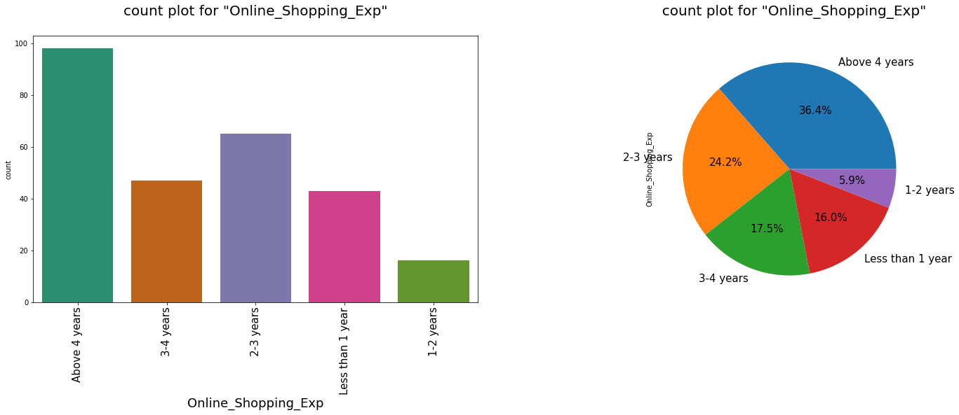

Analysis of online shopping experience of customers:
Above plot shows that 37 % of customers are using online shopping for more than 4 years whereas 25 % of customers says that they have been doing online shopping since 2 to 3 years and then the percentage keep on decreasing with years. This confirms our earlier fact thar 95 % customers are likely to shop again after there first purchase.

Slide 16
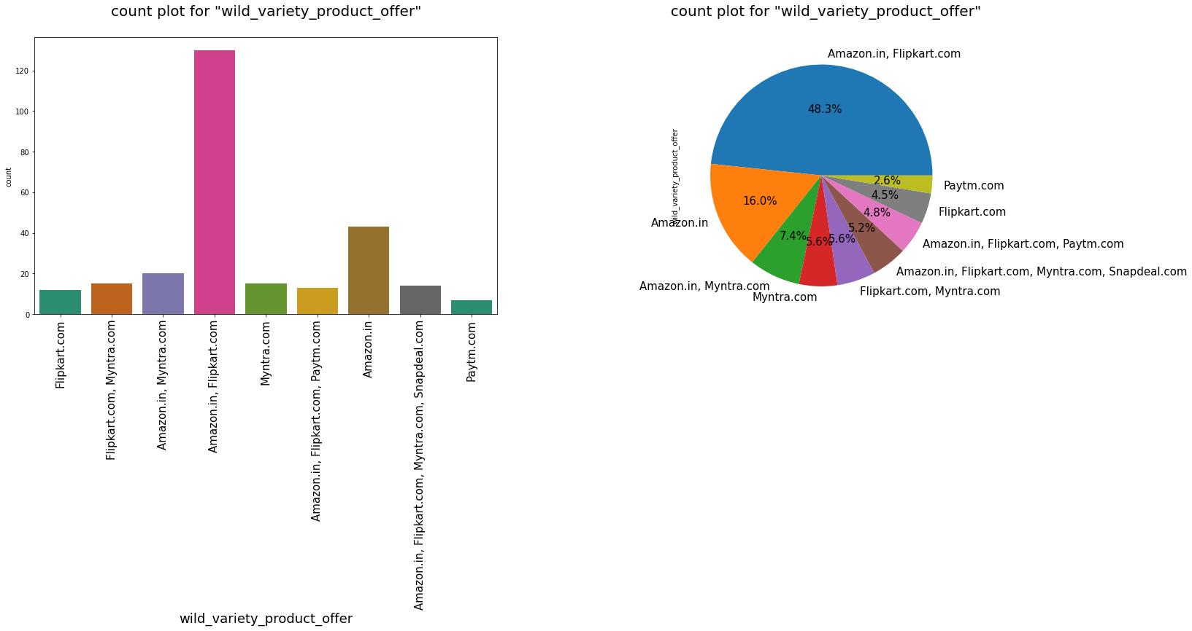
Analysis of Verity of products offered
It is found that 48 % of customers thinks that Amazon and Flip Cart offers a wide range of products. Also, Myntra is third rated in case of product verity and flowed by Paytm. Snapdeal has limited verity of products.

Slide 17
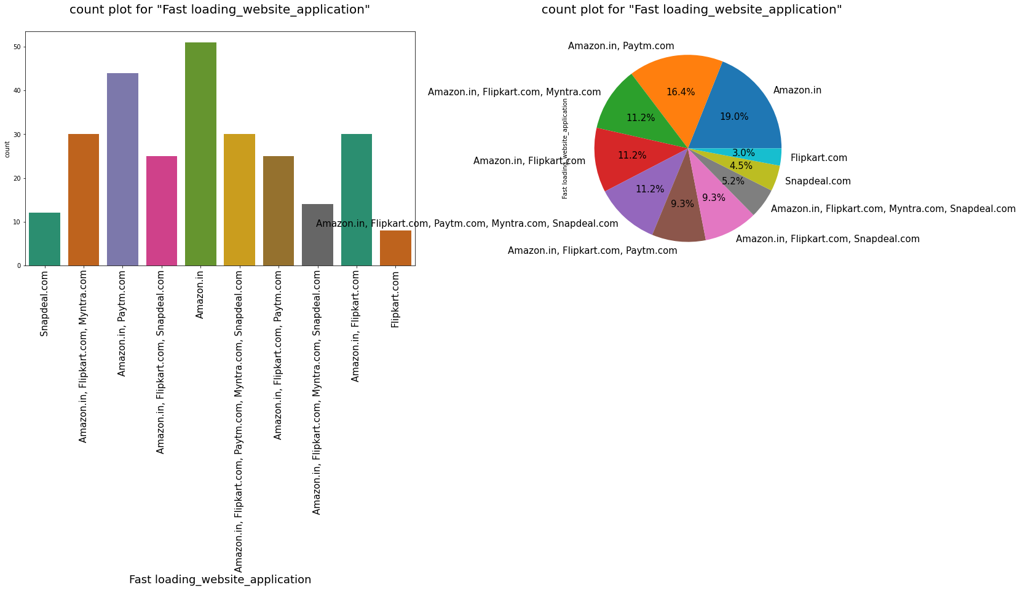
Analysis of Loading Speed of the website
Most People voted for the Amazon for the fastest loading website.
We have listed the website name according to their loading speed:-
1.Amazon.in
2.Paytm.com
3.Flipkart.com
4.Myntra.com
5.Snapdeal.com

Slide 18
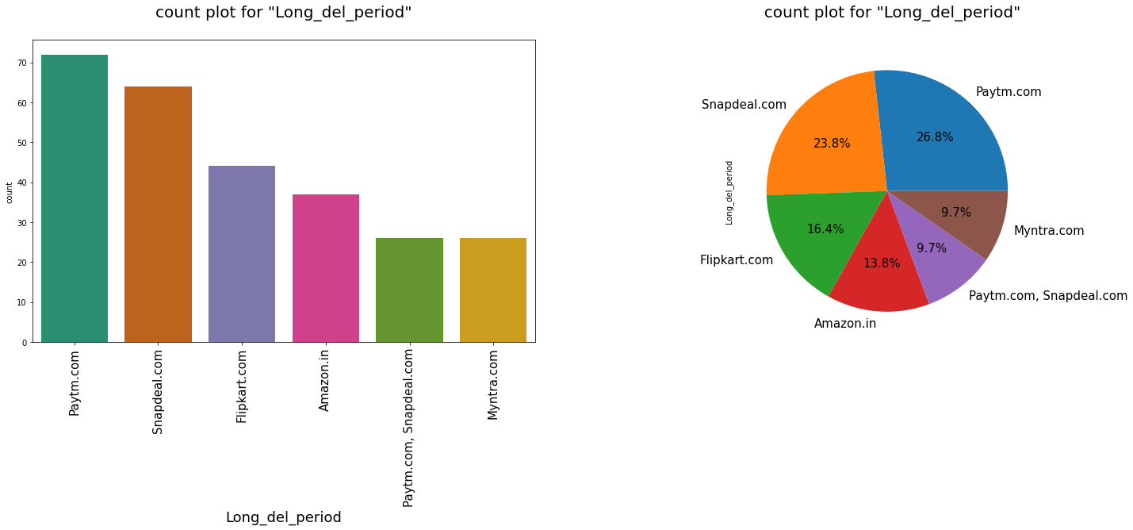

Analysis of Longer Delivery Periods
Most lately delivering online retail store is “Paytm.com”.
We are giving the list of the online retail store according to their longer delivery periods:-
1.Paytm.com 2.Snapdeal.com
3.Flipkart.com 4.Amazon.in

Slide 19
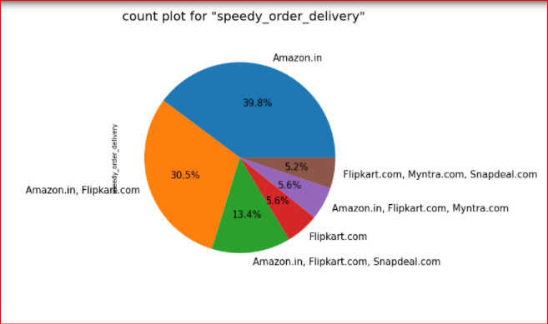

Analysis of Fastest Order Delivering Store
Fastest order delivering website is the “Amazon.in” followed by the “Flipkart.com”.
Slowest order delivering website is the “Snapdeal.com” followed by the “Myntra.com”.

Slide 20
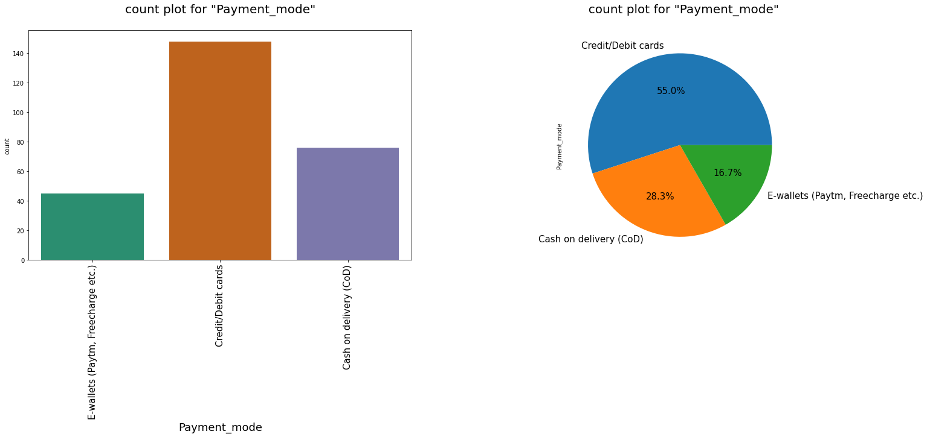

Analysis of Payment modes used
Above plot shows that more than 72 % of times online payments were used by the customers. Also 28 % of the users use cash on delivery as their Payment option.

Slide 21
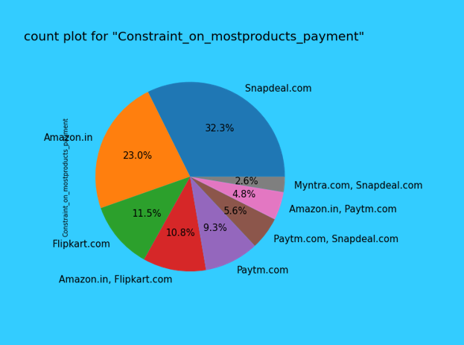

Analysis of Restricted Payment method Options
Website which offers many payment method restrictions on most of the products are in the following order.
1.Snapdeal.com
2.Amazon.in
3.Flipkart.com
4.Paytm.com
5.Myntra.com

Slide 22
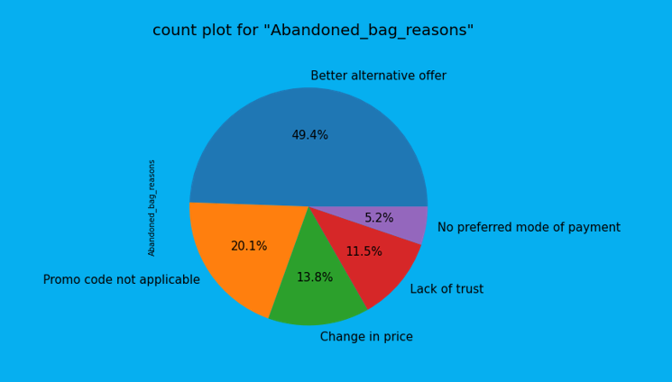

Analysis of Reasons of Product abandoned by customer
It was found that more than 50 % of users abalone the product because they get a better alternative offer on the other store or with the different seller. Also 21 % of users says that they don’t found promocode applicable that is they didn’t get offer od their choice for the selected product nearly 14 % of peoples say that price was changed

Slide 23
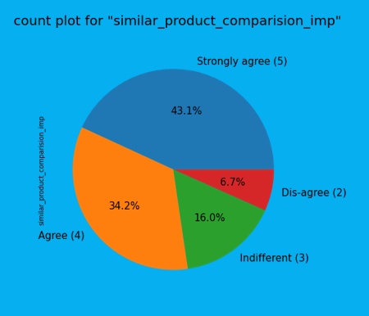
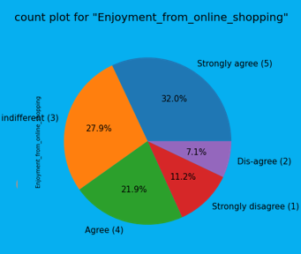
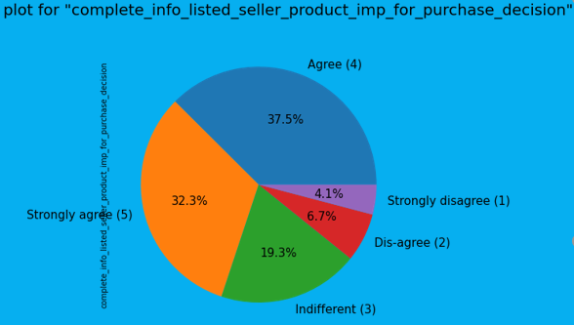

Analysis of Hedonic/Utilitarian values for the Customer
Similar information displayed for comparison helps to buy
Almost 90% customers thinks that loading speed affects the purchase
Almost 80% of customers found that they find shopping more exiting , enjoyable .
more ever 70 % of users thinks that shopping online increases their social status and finds adventure in it.

Slide 24
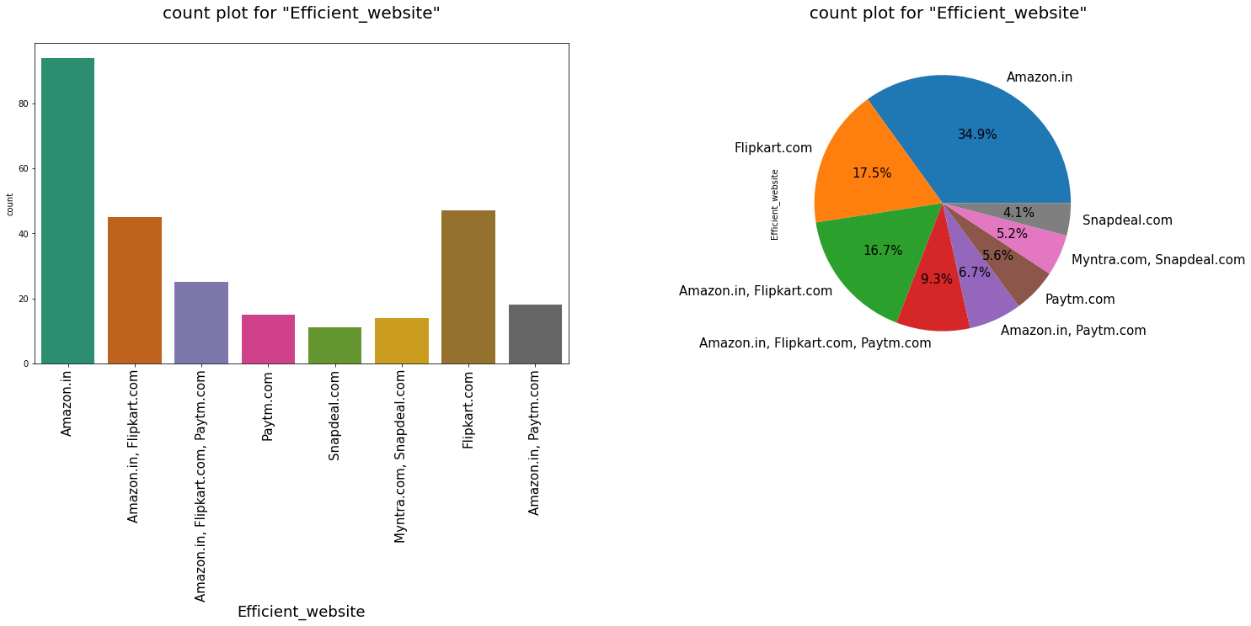
Analysis of Efficient Website
Data says most Efficient Website is “Amazon.in”
After Amazon its “Flipkart.com”
Least efficient website is “Snapdeal.com”.

Slide 25
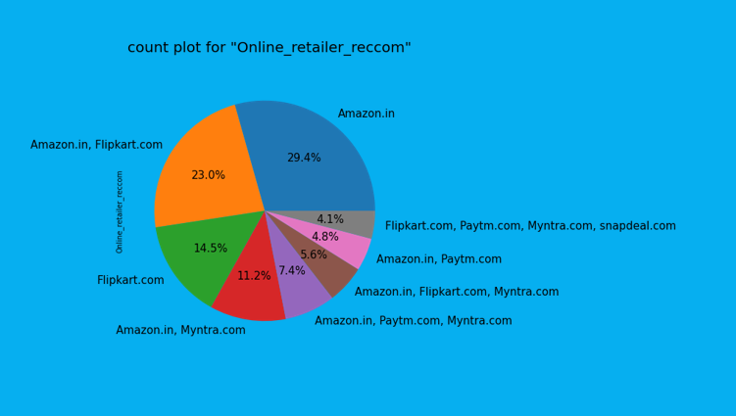

Analysis of Online Retailer Recommendation.
Most people are recommending the “AMAZON.IN” to others.
After Amazon people’s favorite is “FLIPKART.COM”.
Least recommended website is “SNAPDEAL.COM”.

Slide 26

CONCLUSION
Study shows that Amazon is most popular brand among the customers due to following reasons
Faster loading speed of website
Better design and visual appearance of the website
Verity of product categories offered
Relevant information about the product is displayed
Faster checkouts / more payment options available
Faster speed of delivery/less delivery period.
Amazon maintains customer privacy
Flip Kart is second favorite brand after Amazon for the customers as it is being following Amazon in almost every above listed quality.
Myntra is third favorite brand for the customers as it is lagging behind in delivery speed, website loading speed and verity of products.
Paytm is has been being fourth preferred brand due to slower delivery speeds and least verity of product Paytm even outperforms Myntra in serval aspects like availability of several payment options but it has father scope to improve.
Snapdeal is lagging behind in almost all of the aspect among all other brands.

Slide 27

What is to be improved in a company
Amazon.com
During promotions, try to give a disturbance free shopping experience to customers.
Give more payment options to customers.
Try to show price early during promotion.
Reduce the delivery time of the products.
Flipkart.com
During promotions, try to give a disturbance free shopping experience to customers.
Give more payment options to customers.
Try to give the price early during promotion.
Reduce the delivery time of the products.
Flipkart and Amazon almost share the same feedbacks with varying percentages as the only difference.

Slide 28

During promotions, try to give a disturbance free shopping experience to customers.
Try to give the price early during promotions.
Reduce the delivery time of the products during promotions.
Myntra.com
Reduce the delivery time of the products during promotions.
Try to give the price early during promotion.
During promotions, try to give a disturbance free shopping experience to customers.
Late declaration of price and discounts.
Paytm.com
Reduce the delivery time of the products during promotions.
Try to give the price early during promotion.
During promotions, try to give a disturbance free shopping experience to customers.
Late declaration of price and discounts.
No one has expressed to recommend Snapdeal to a contact as it has the most negative feedbacks among all other websites.
Snapdeal.com

Slide 29







